Slide 1
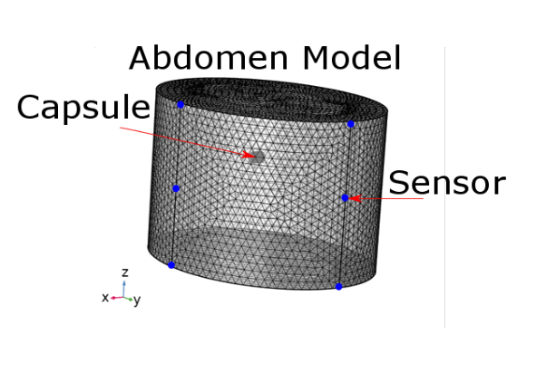
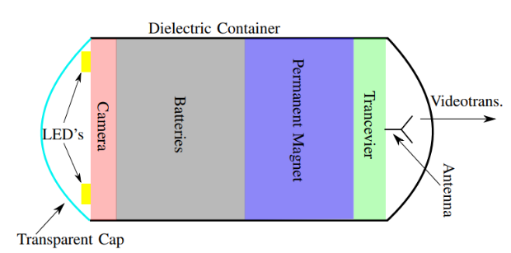
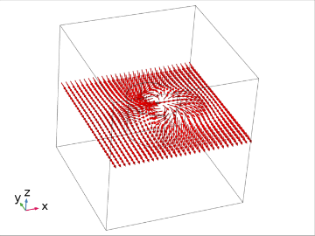
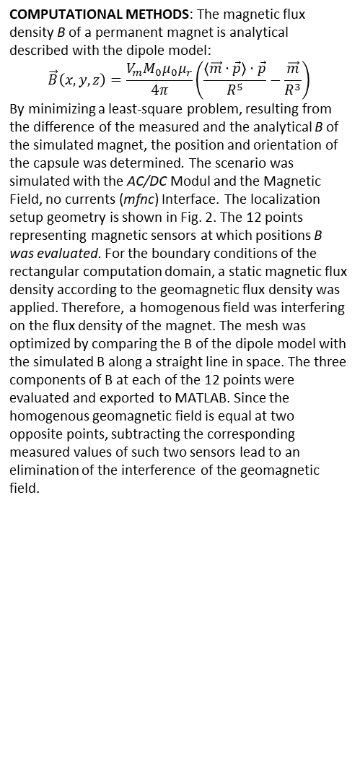
Static Magnetic Localization of Capsule Endoscopes: A Differential Method
S. Zeising, K. Ararat , A. Thalmayer, G. Fischer and J. Kirchner
Institute for Electronics Engineering, Friedrich-Alexander-Universität Erlangen-Nürnberg (FAU), Erlangen, Germany
INTRODUCTION: Static magnetic localization of capsule endoscopes is a promising technique for enhancing the diagnosis of the gastrointestinal tract by using wireless capsule endoscopy (WCE). Therefore, a cylindric permanent magnet is embedded in a WCE capsule (Fig. 1). The magnetic flux density B generated by the magnet is measured by a magnetic sensor array on the body surface of a subject. From the measured B, the position and orientation of the capsule can be reconstructed. However, since the method is static, the geomagnetic flux density is interfering. Therefore, in this work a differential method was proposed.
Figure 2. Abdomen model with the capsule and the
12 Sensors (blue dots)
RESULTS: By applying a differential localization algorithm proposed in [1], the impact of the geomagnetic field on the measured data (Fig. 3) was eliminated under the assumed conditions. The mean value and STD of the position and orientation errors were significantly below 0.1 mm and 0.1 °, respectively.
Figure 1.Endoscopy capsule with embedded permanent magnet.
COMPUTATIONAL METHODS: The magnetic flux density B of a permanent magnet is analytical described with the dipole model:
$$\vec{B}\left(x,y,z\right)=\frac{V_{m}M_{0}μ_{0}μ_{r}}{4π}\left(\frac{\left\langle \vec{m}⋅\vec{p}\right\rangle ⋅\vec{p}}{R^{5}}−\frac{\vec{m}}{R^{3}}\right)$$
By minimizing a least-square problem, resulting from the difference of the measured and the analytical B of the simulated magnet, the position and orientation of the capsule was determined. The scenario was simulated with the AC/DC Modul and the Magnetic Field, no currents (mfnc) Interface. The localization setup geometry is shown in Fig. 2. The 12 points representing magnetic sensors at which positions B was evaluated. For the boundary conditions of the rectangular computation domain, a static magnetic flux density according to the geomagnetic flux density was applied. Therefore, a homogenous field was interfering on the flux density of the magnet. The mesh was optimized by comparing the B of the dipole model with the simulated B along a straight line in space. The three components of B at each of the 12 points were evaluated and exported to MATLAB. Since the homogenous geomagnetic field is equal at two opposite points, subtracting the corresponding measured values of such two sensors lead to an elimination of the interference of the geomagnetic field.
Figure 3. Normalized arrow plot of B.
Interference of homogenous geomagnetic
field is visible.
CONCLUSIONS: By using COMSOL Multiphysics simulations, a novel differential algorithm for eliminating interference of the geomagnetic field was evaluated. The simulation-based results reveal that the algorithm is feasible for the localization of capsule endoscopes and robust towards interference of the geomagnetic field. In the future measurements will be conducted to validate the simulation-based results.
REFERENCES:
S. Zeising et al., Evaluation of the impact of static interference on an empirical data based static magnetic localization setup for capsule endoscopy,” to be published in Current Directions in Biomedical Engineering, vol. 6, 2020.
Excerpt from the Proceedings of the 2020 COMSOL Conference

