Slide 1
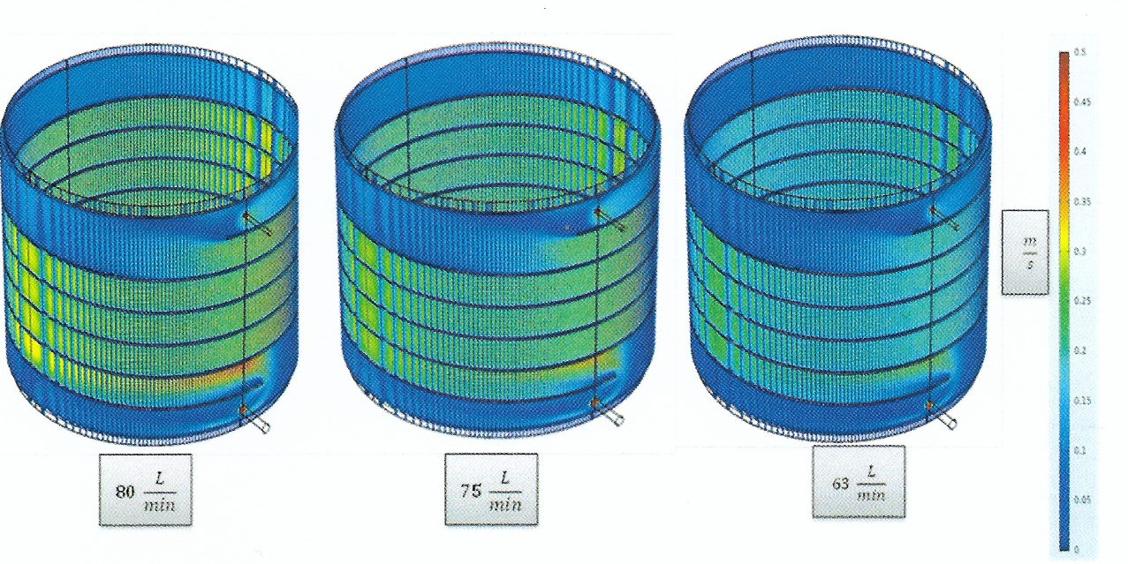
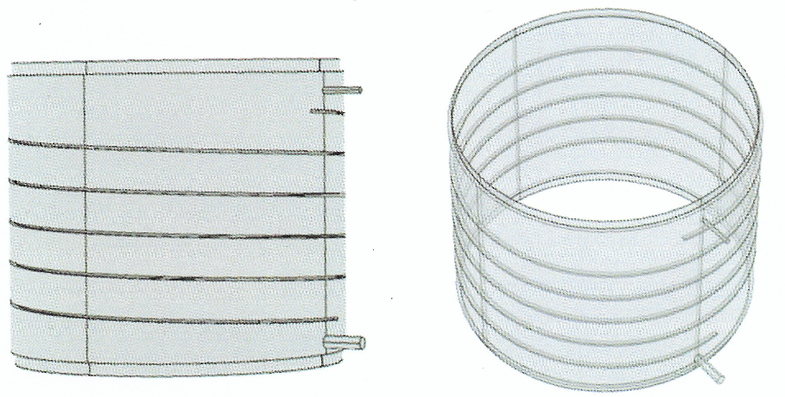
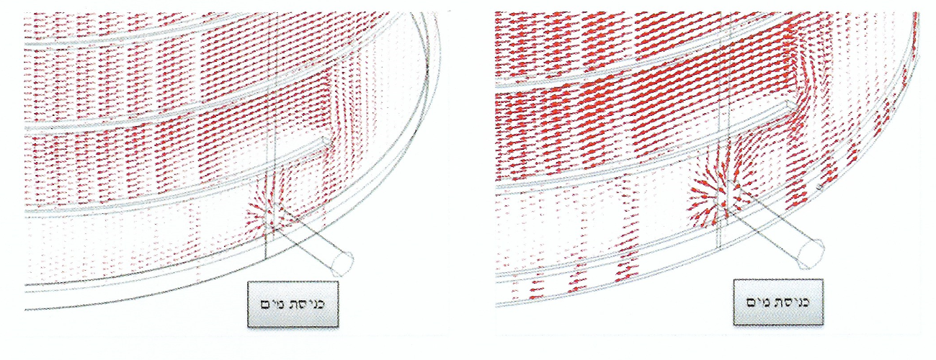

3D model of the Flow Inside a Cooling Jacket in order to Prevent Corrosion Marks Problem
Ori Eini¹, Amir Kaplan², Yael Yasur³, Sharona Atlas²
1. Israel Atomic Energy Commission (IAEC), P.O box 7061, Tel Aviv 61070, Israel
2. Nuclear Research Center Negev (NRCN), Department of Chemical Engineering, P.O. Box 9001, Beer-Sheva, 84190, ISRAEL
3. Engineering and computational mechanics center, Rotem industries ltd, Mishor Yamin D.N ARAVA 86800, Israel
INTRODUCTION: Corrosion marks were found in specific areas on the outer wall of a process container. The container is cooled by a spiral cooling jacket. The corrosion marks were found in the lower and upper circumference of the container and in the areas adjacent to the water inlet and outlet.
Some engineering solutions were tested in the simulation in order to encourage flow in the above stagnant areas [1], including:
(a) Increasing the cooling water flow rate.
(b) Expanding the distance between the container and the jacket.
RESULTS: The first solution tested in the simulation was examining whether increasing the cooling water flow rate encourages the flow in the stagnant areas. The regular flow rate is 63L/hr and the test was done for 75 and 80L/hr.
Figure 3. The water velocity[m/sec] in the colling jacket in different
water flow rate (right: 63L/hr, middle: 75L/hr, left: 80L/hr)
The second solution tested in the simulation was examining whether expanding the distance between the container and the jacket will effect the stagnant areas. This distance (which expresses the space for water flow between the two walls) in the current geometry is 3mm, and the test was done for 4 and 5mm.
Figure 1. Model geometry (upper view)
COMPUTATIONAL METHODS: We have used the CFD module (laminar flow) in order to simulate the system, using the 3D Navier-Stokes equations:
Water enters from the lower open of the jacket in Q_{in} flow rate and exits from its upper open to atmospheric pressure. There is no flow on the wall of the jacket
$$\begin{matrix}ρ\left(\frac{∂u}{∂t}+u⋅∇u\right)=−∇p+μ∇^{2}u+f \\ ∇⋅u=0\end{matrix}$$
3mm
5mm
Figure 4. The velocity arrows in 5mm space (right) and 3mm space (left)
CONCLUSIONS: As shown in the results, so far, we introduced two different engineering solutions for encouraging flow in stagnant areas in cooling jacket. The first one (increasing water flow rate) doesn’t show any improvement in the flow in the stagnant areas and only increasing the water velocity, while the second solution shows clearly that thickening the narrow areas in the lower and upper circumference of the container encouraging water flow in these areas.
Outlet
Inlet
Figure 2. Model geometry (side view)
REFERENCES:
Marjan S., Robert C., Borut B., “The impact of stagnant water on the corrosion processes in pipeline”, Materials ans technology 44 (2010) 6, 379-383.
Excerpt from the Proceedings of the 2020 COMSOL Conference

