Slide 1
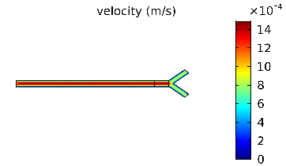
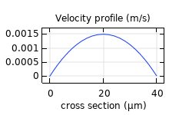
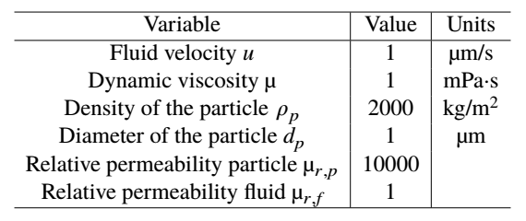
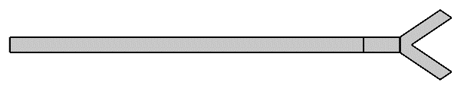


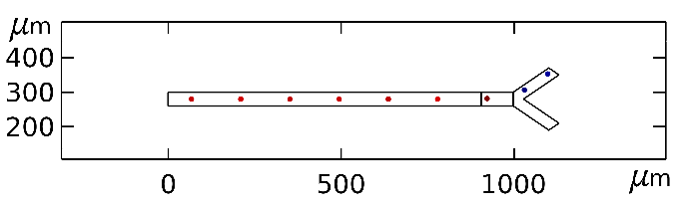


Particle Steering In Magnetic Drug Targeting: A Simple Comsol Model
A. Thalmayer, S. Zeising, D. Ahmed, G. Fischer, J. Kirchner
Friedrich-Alexander-Universität Erlangen-Nürnberg (FAU), Germany
INTRODUCTION: Magnetic nanoparticles offer numerous applications in medical diagnosis and therapy. One example of a possible application is the so-called magnetic drug targeting (MDT), which is a therapeutic approach in cancer therapy. Thereby, the cancer drug is bounded to magnetic nanoparticles, which are injected in the aorta in the vicinity of the tumor and pulled into the tumorous tissue by an external magnetic field. However, the steering of the particles into the tumor depends on several forces and, therefore, on several parameters, like the magnitude or susceptibility of the magnetic nanoparticles, the velocity or the density of the volume flow, or the gradient of the external applied magnetic field.
The steering of the particles is still an open research topic. To consider all the mentioned parameters, a simulation setup was implemented in COMSOL Multiphysics®.
Figure 2. Velocity profile for the observed geometry. The fluid streams from the left to the right side.
Figure 3. Parabolic shape of the velocity profile in the cross-section before the intersection.
Moreover, the mesh size was optimized, until the velocity profile got parabolic (Fig. 3). Subsequently, the particles were included. As aforementioned, the movement of the particles was implemented by using a time-dependent study considering the parabolic velocity profile. At every time step, one particle was released and its trajectory was studied via an animation video.
Inlet
Gravitational Force F_{g}
Outlet 1
Magnetophoresis Force F_{m}
Outlet 2
Table 1. Overview of the chosen parameters.
RESULTS: Firstly, the particle movement without any external force was observed. As expected, the particles divided into the branches. Next, F_{g} was applied. For the presented setup F_{g} pulled the particles to the bottom branch. Additionally, a F_{m} was considered short before the intersection. Since F_{m} depends on the gradient of the magnetic field, the external magnetic field H was chosen to Hy = H0*(y*c[1/m]). The constant c was observed in a parameter sweep. The F_{m} was able to pull the particles in the upper branch (Fig. 4).
Figure 1. Geometry of the proposed vessel-model.
COMPUTATIONAL METHODS: In the presented work, three different forces on the nanoparticles are taken into account, namely the gravitational force (F_{g}), the hydrodynamic drag force (F_{D}) and the magnetophoresis force (F_{m}). The hydrodynamic drag force F_{D} is defined as
and the magnetophoresis force F_{m} via
The chosen parameters can be found in Tab. 1. Since the flow within an aorta can be assumed as laminar, the Laminar Flow (spf) interface from the Subsurface Flow Module with a stationary study was applied. Furthermore, to include the magnetic particles in the flow, the Particle Tracing for Fluid Flow (fpt) interface from the Particle Tracing Module with a time-dependent study was set up. To accomplish the movement of the particles, the velocity profile from the stationary study, had to be used as F_{D}. Therefore, the whole simulation consists of two studies. A 2D geometry was chosen, keeping the computational effort low. To examine the laminar flow at a branch, a symmetrical Y-shaped geometry was accomplished in which the fluid moved from the left to the right side (Fig. 1). As expected, the velocity in the split paths was nearly halved and no turbulence was observed (Fig. 2).
with
with
.
Figure 4. Particle trajectory: The particles are pulled in the upper branch by F_{m}.
CONCLUSIONS: By using COMSOL Multiphysics®
simulations, the influence of different forces on magnetic nanoparticles in a volume flow was in MDT evaluated. The results reveal, that the magnetophoresis force is able to guide the particles in a defined direction. In future research, the observed simulation results will be used to design a magnet for steering magnetic particles through the cardiovascular system in the tumor.
REFERENCES:
R. Tietze, S. Lyer, et al., Efficient drug-delivery using magnetic nanoparticles – biodistribution and therapeutic effects in tumour bearing rabbits, Nanomedicine: nanotechnology, biology, and medicine, 9, 961 – 971 (2013)
F. Alnaimat, S. Dagher, et al., Microfluidics Based Magnetophoresis: A Review, Chemical Record, 18, 1596 – 1612 (2018)
COMSOL, Particle Tracing Module User’s Guide (2012)
Excerpt from the Proceedings of the 2020 COMSOL Conference

