Slide 1
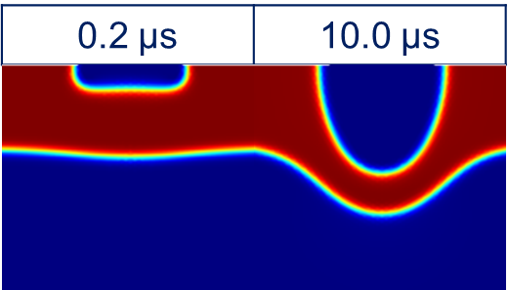
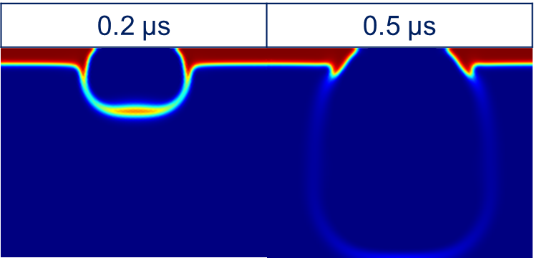
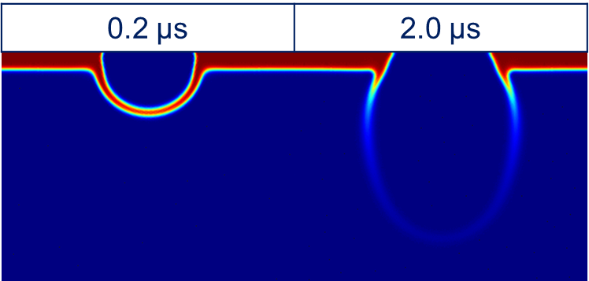
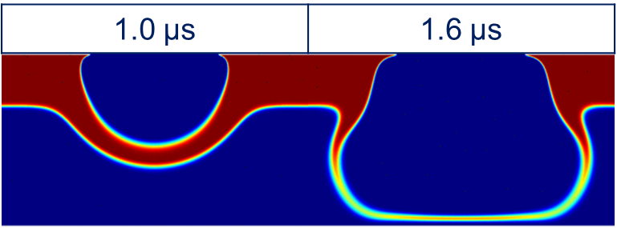
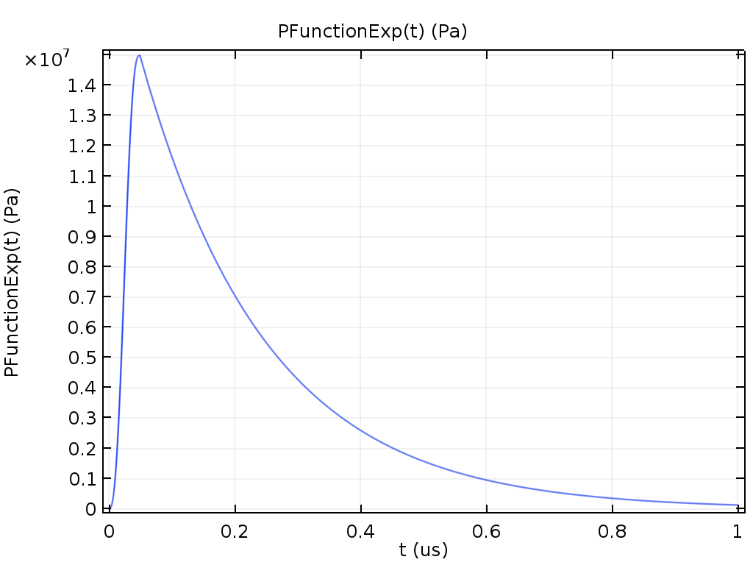
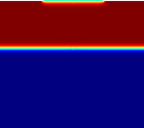

Simulation of laser-induced forward transfer for high-viscosity pastes
J. Moreno-Labella, M. Morales, D. Munoz-Martin, C. Molpeceres
Centro Láser, Universidad Politécnica de Madrid, Alan Turing 1, 28038, Madrid, Spain
INTRODUCTION: Laser-induced forward transfer (LIFT) is a non-contact direct-write technique for high-resolution patterns usable for transferring high-viscosity metallic pastes [1, 2].
RESULTS: The results has been compared to former works [1] in which silver paste LIFT images were taken. The different regimes have been replicated using this model: non-transference, dot-transference, explosive regime, and columnar structures [3].
LIFT set-up
Donor
Material
Figure 3. Non- transference regime
Acceptor
Figure 1. Title of the figure
Figure 1. LIFT setup
COMPUTATIONAL METHODS: The model is implemented as a 2D-axisymmetrical Two-Phase Flow, Phase Field interface. The movement of the fluid is induced by including a flow inlet that follows a predefined pressure function. The acceptor may be also included to study their influence.
$ρ{∂u}/{∂t}+ρ\left(u·∇\right)u=∇·\left[−pI+μ\left(∇u+{∇u}^{T}\right)\right]+$ $F_{st}$
$$ρ∇·u=0$$
$${∂ϕ}/{∂t}+\left(u·∇\right)ϕ=∇·{γλ}/{ε^{2}}∇ψ$$
$$ψ=−∇·ε^{2}∇ϕ+\left(ϕ^{2}−1\right)ϕ$$
$$σ={2\sqrt{2}}/3·λ/ε$$
$$γ=χε^{2}$$
Figure 4. Dot transference
Figure 5. Explosive regime
Inlet
Figure 6. Columnar structure
Paste
CONCLUSIONS: The morphology and dynamics of the process is more understandable after its analysis through the numerical simulation of the process, under lower uncertainties for certain parameters that may fluctuate in the experiments, such as the paste layer thickness.
ACKNOWLEDGMENTS: This research has been funded by Spanish MINECO projects CONTACTOS SELECTIVOS Y CAPAS ACTIVOS PARA DISPOSITIVOS DE ENERGIA (SCALED) (PID2019-109215RB-C44) and CHENOC (ENE2016-78933-C4-4-R) and Comunidad de Madrid Projects ADITIMAT-CM (S2018/NMT-4411) and BIOPIELTEC-CM (P2018/BAA4480)
Acceptor
Figure 2. Pressure function (left) and initial geometry (right)
REFERENCES:
Munoz-Martin, D., Laser-induced forward transfer of high-viscosity silver pastes, Applied Surface Science, 366, 389-396 (2016)
Chen, Y., Laser Induced Forward Transfer of High Viscosity Silver Paste for New Metallization Methods in Photovoltaic and Flexible Electronics Industry, Physics Procedia, 83, 204-210 (2016)
Shan, Y., Laser direct printing of solder paste, AIP Advances, 9, 125306 (2019)
Excerpt from the Proceedings of the 2020 COMSOL Conference

