Slide 1


FEM modeling of highly strained monocrystalline ZnTe/CdTe core-shell hetero-nanowires
Serhii Kryvyi, Slawomir Kret, Dorota Janaszko, Jakub Plachta, Piotr Wojnar
Institute of Physics, Polish Academy of Sciences, al. Lotnikow 32/46, 02-668 Warsaw, Poland
COMSOL Conference 2020 Europe
October 14–15

Slide 2
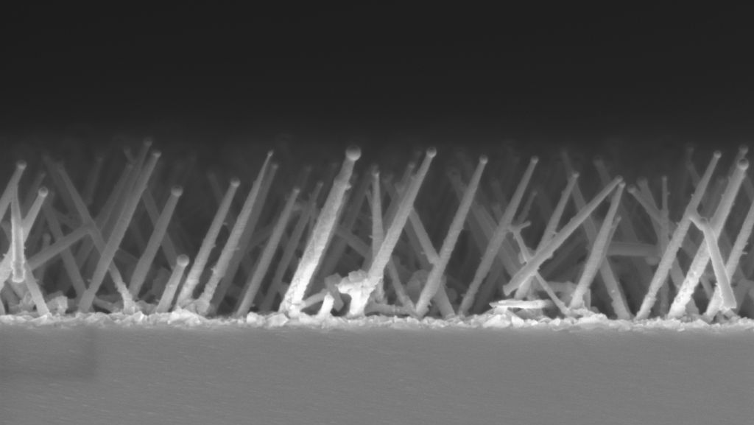
Motivation
Two types of hetero-nanowires:
10 - 100nm
Extremely high surface to volume ratio
Ability to obtain defect-free structures even on highly mismatched and “exotic” substrates
Material 1
Material 1
Applications:
Various sensing applications
Nanoscale optoelectronics and photonics
Micro- and Nano-Electro-Mechanical Systems
Transistors ...
Material 2
Material 2
SEM image of ZnTe nanowires on Si substrate
Axial hetero-NW
Radial hetero-NW
The core-shell configuration introduce complex anisotropic 3D lattice distortion comparing to 2D tetragonal distortion of epilayers on thick substrate.

Slide 3
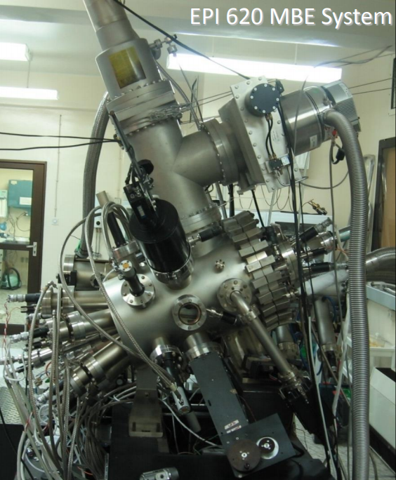
Hetero-nanowires fabrication
MBE
Molecular Beam Epitaxy:
Vapor-Liquid-Solid mechanism
Te
Zn
Effusion cells
1
ZnTe
Diameter: 20 - 100nm
Alloy
Te
Zn
T ~ 380°C
Te
Zn
1 - 4μm
Alloy
Au
Alloy
Si (111)
Sample
Te
Cd
Cd
2
Te
Core-shell nanowires
CdTe shell
ZnTe core
T ~ 340°C
Si (111)
Si (111)

Slide 4
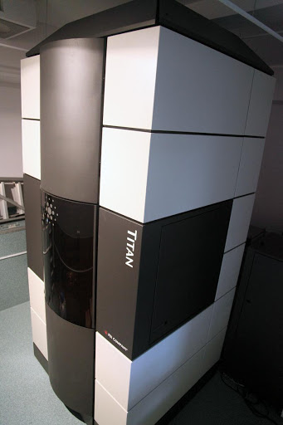
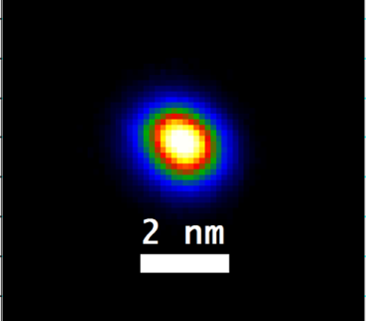
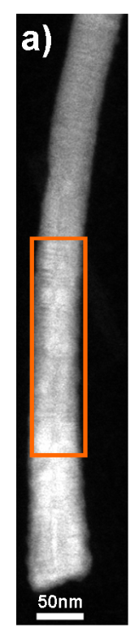
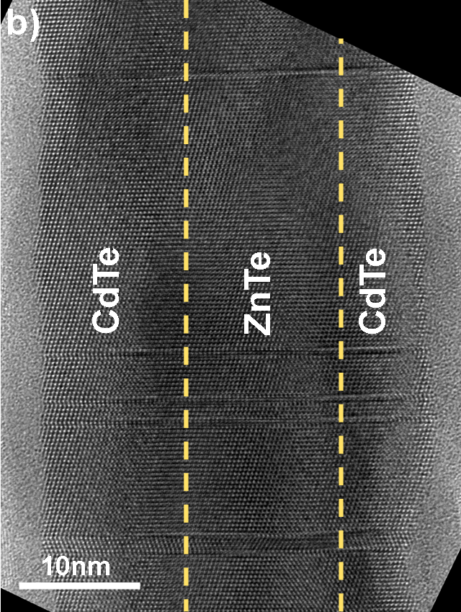

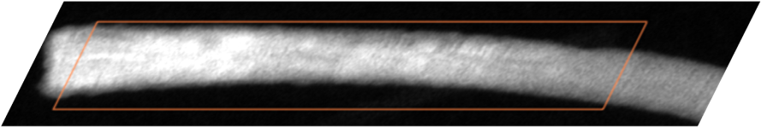
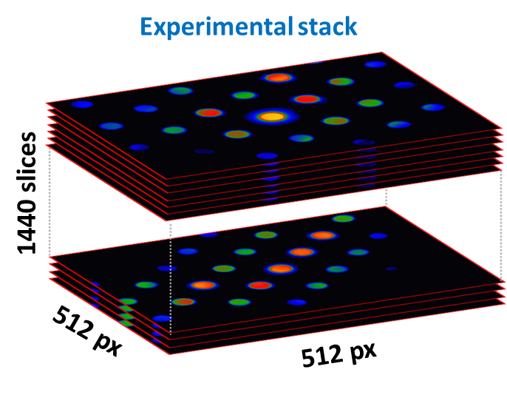
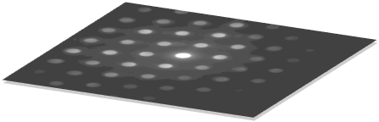
Receiving TEM data
Scanning Nanobeam Electron Diffraction
FEI Titan Cubed 80-300
Lattice constant:
a_{ZnTe} = 6.103Å
a_{CdTe} = 6.483Å
zinc blende structure
High Angle Annular Dark Field image of NW
a)
b)
e-beam
Probe size
60 px
24 px
50nm
Diffraction pattern
High resolution TEM image part of NW

Slide 5
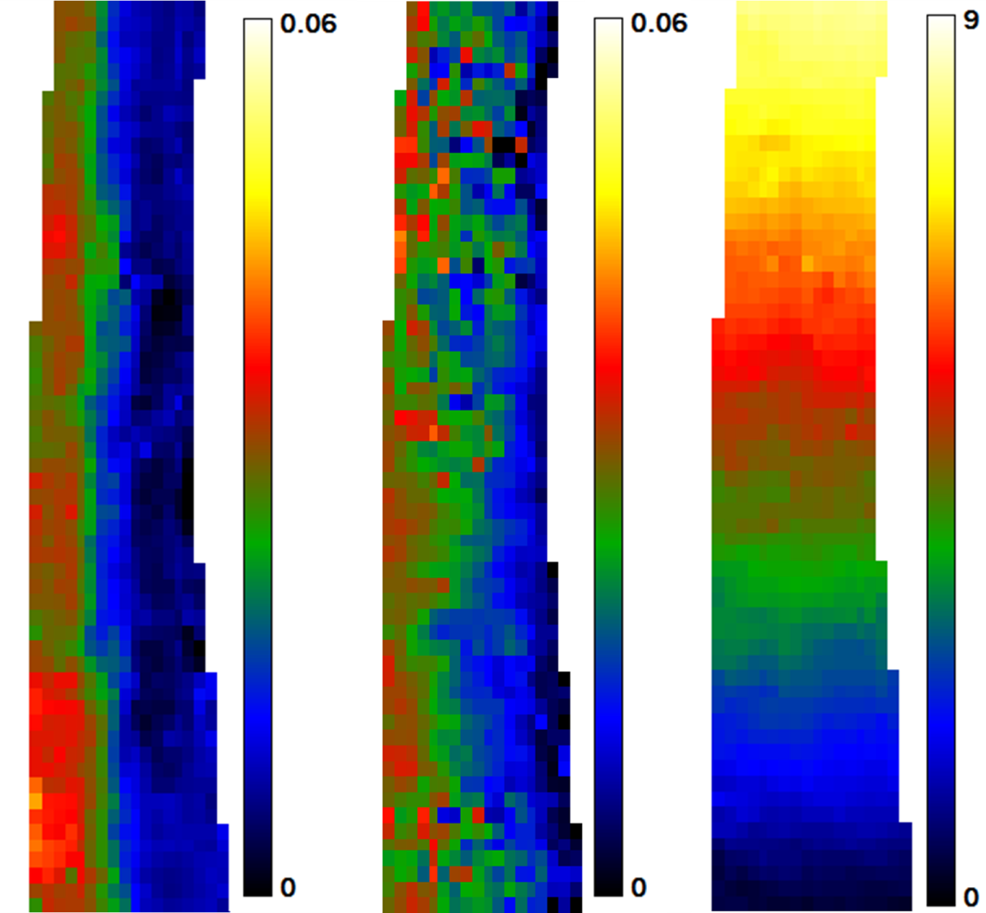

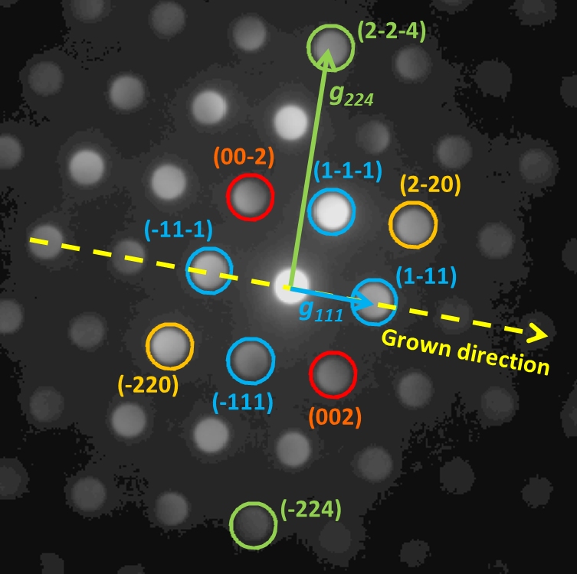

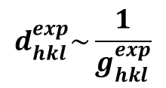
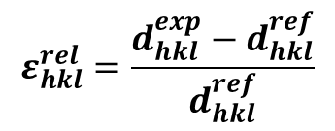
Strain mapping
Experimental diffraction pattern
Relative strain:
$$ε_{hkl}^{rel}=\frac{d_{hkl}^{exp}−d_{hkl}^{ref}}{d_{hkl}^{ref}}$$
$d_{}^{ref}$=$d_{ZnTe}^{exp}$
$$d_{hkl}^{exp}\sim \frac{1}{g_{hkl}^{exp}}$$
d – interplanar spacing
g - reciprocal lattice vector
Strain in axial (grown) direction - ε_{zz}
Strain in radial direction - ε_{xx}
In-plane tilt
(deg)

Slide 6
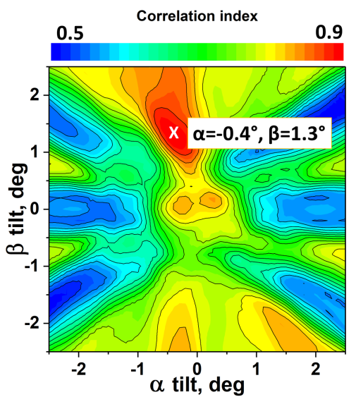
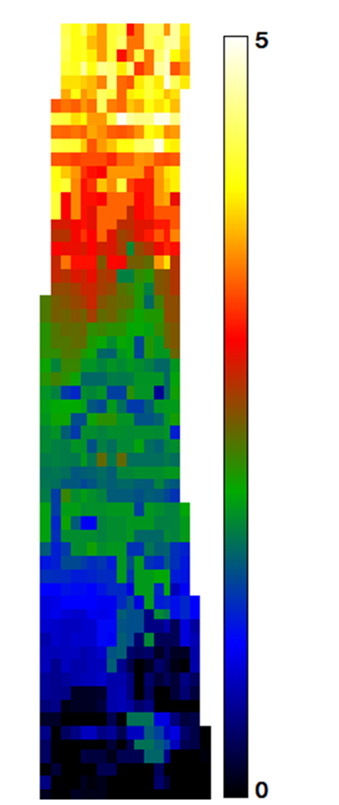
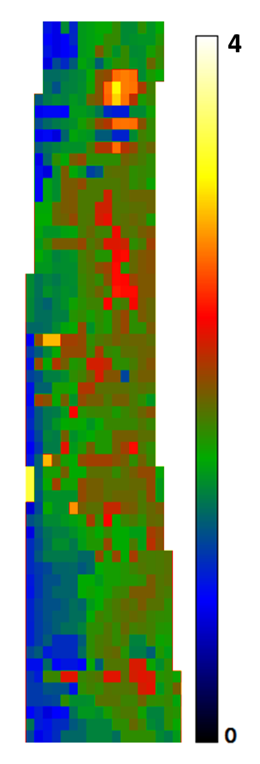
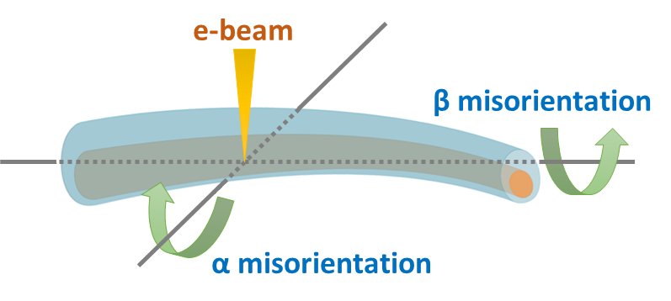
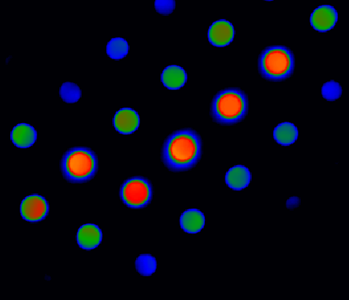
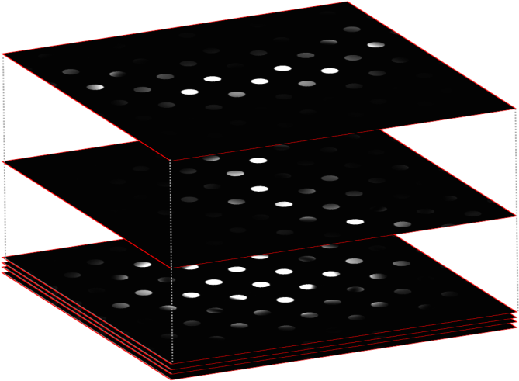
Local orientation mapping
6
Local orientation maps
Nanowire
α=0°, β=1.2°
⊗
Cross-
correlation
α=1.2°, β=0°
α=0°, β=0°
Experimental diffraction pattern
Simulated stack
α - tilt
β - tilt

Slide 7
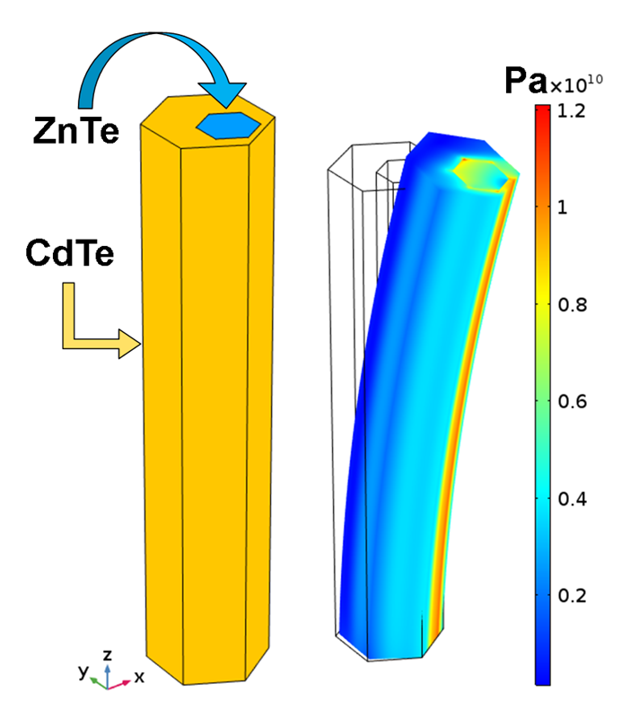
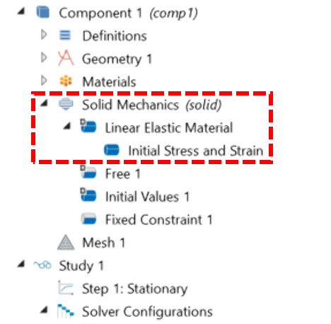
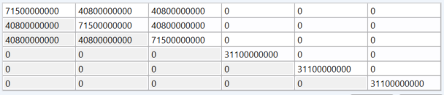
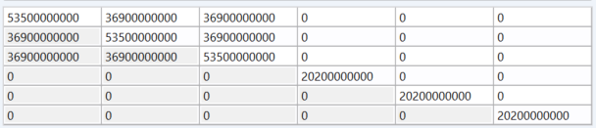
FEM modeling of core-shell hetero-nanowires
7
Model
Simulation
Solid Mechanics
Linear Elastic
Initial Stress and Strain
von Mises stress
240 nm
Anisotropic elastic material
ZnTe:
[111]
[11-2]
CdTe:
[1-10]
Crystallographic directions

Slide 8
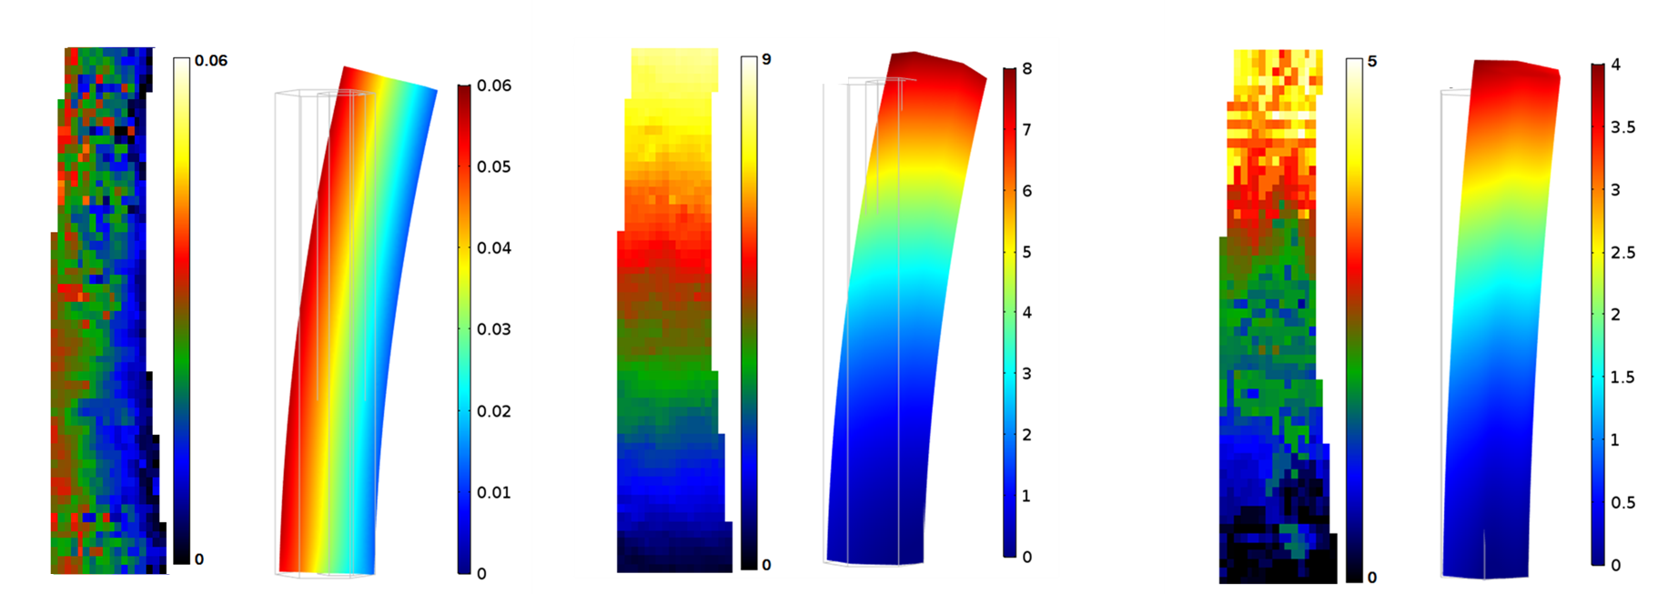
Comparison FEM simulation and experiment results
Experiment
Simulation
Experiment
Simulation
Experiment
Simulation
Relative strain in axial direction - ε_{zz}
In-plane tilt
(deg)
α – misorientation
(deg)

Slide 9

Conclusions
Proposed approach for strain and orientation mapping for single nanoobject with nanometer resolution which is not achieved even for a synchrotron!
Obtained good agreement FEM simulation and experimental data
Further works:
Taking into account Nonlinear Elastic Strain in model
Expand the model for simulation piezoelectric and magnetostriction effects
The research was supported by National Science Centre (Poland) by grant: UMO-2016/21/B/ST5/03411

Slide 10
Thank You for attention

