Slide 1




Electro-Thermal analysis of a microheater for aerosol generation application
Mohammadreza Saberi Laboratory for the Design of Microsystems Department of Microsystems Engineering - IMTEK University of Freiburg, Germany

Slide 2
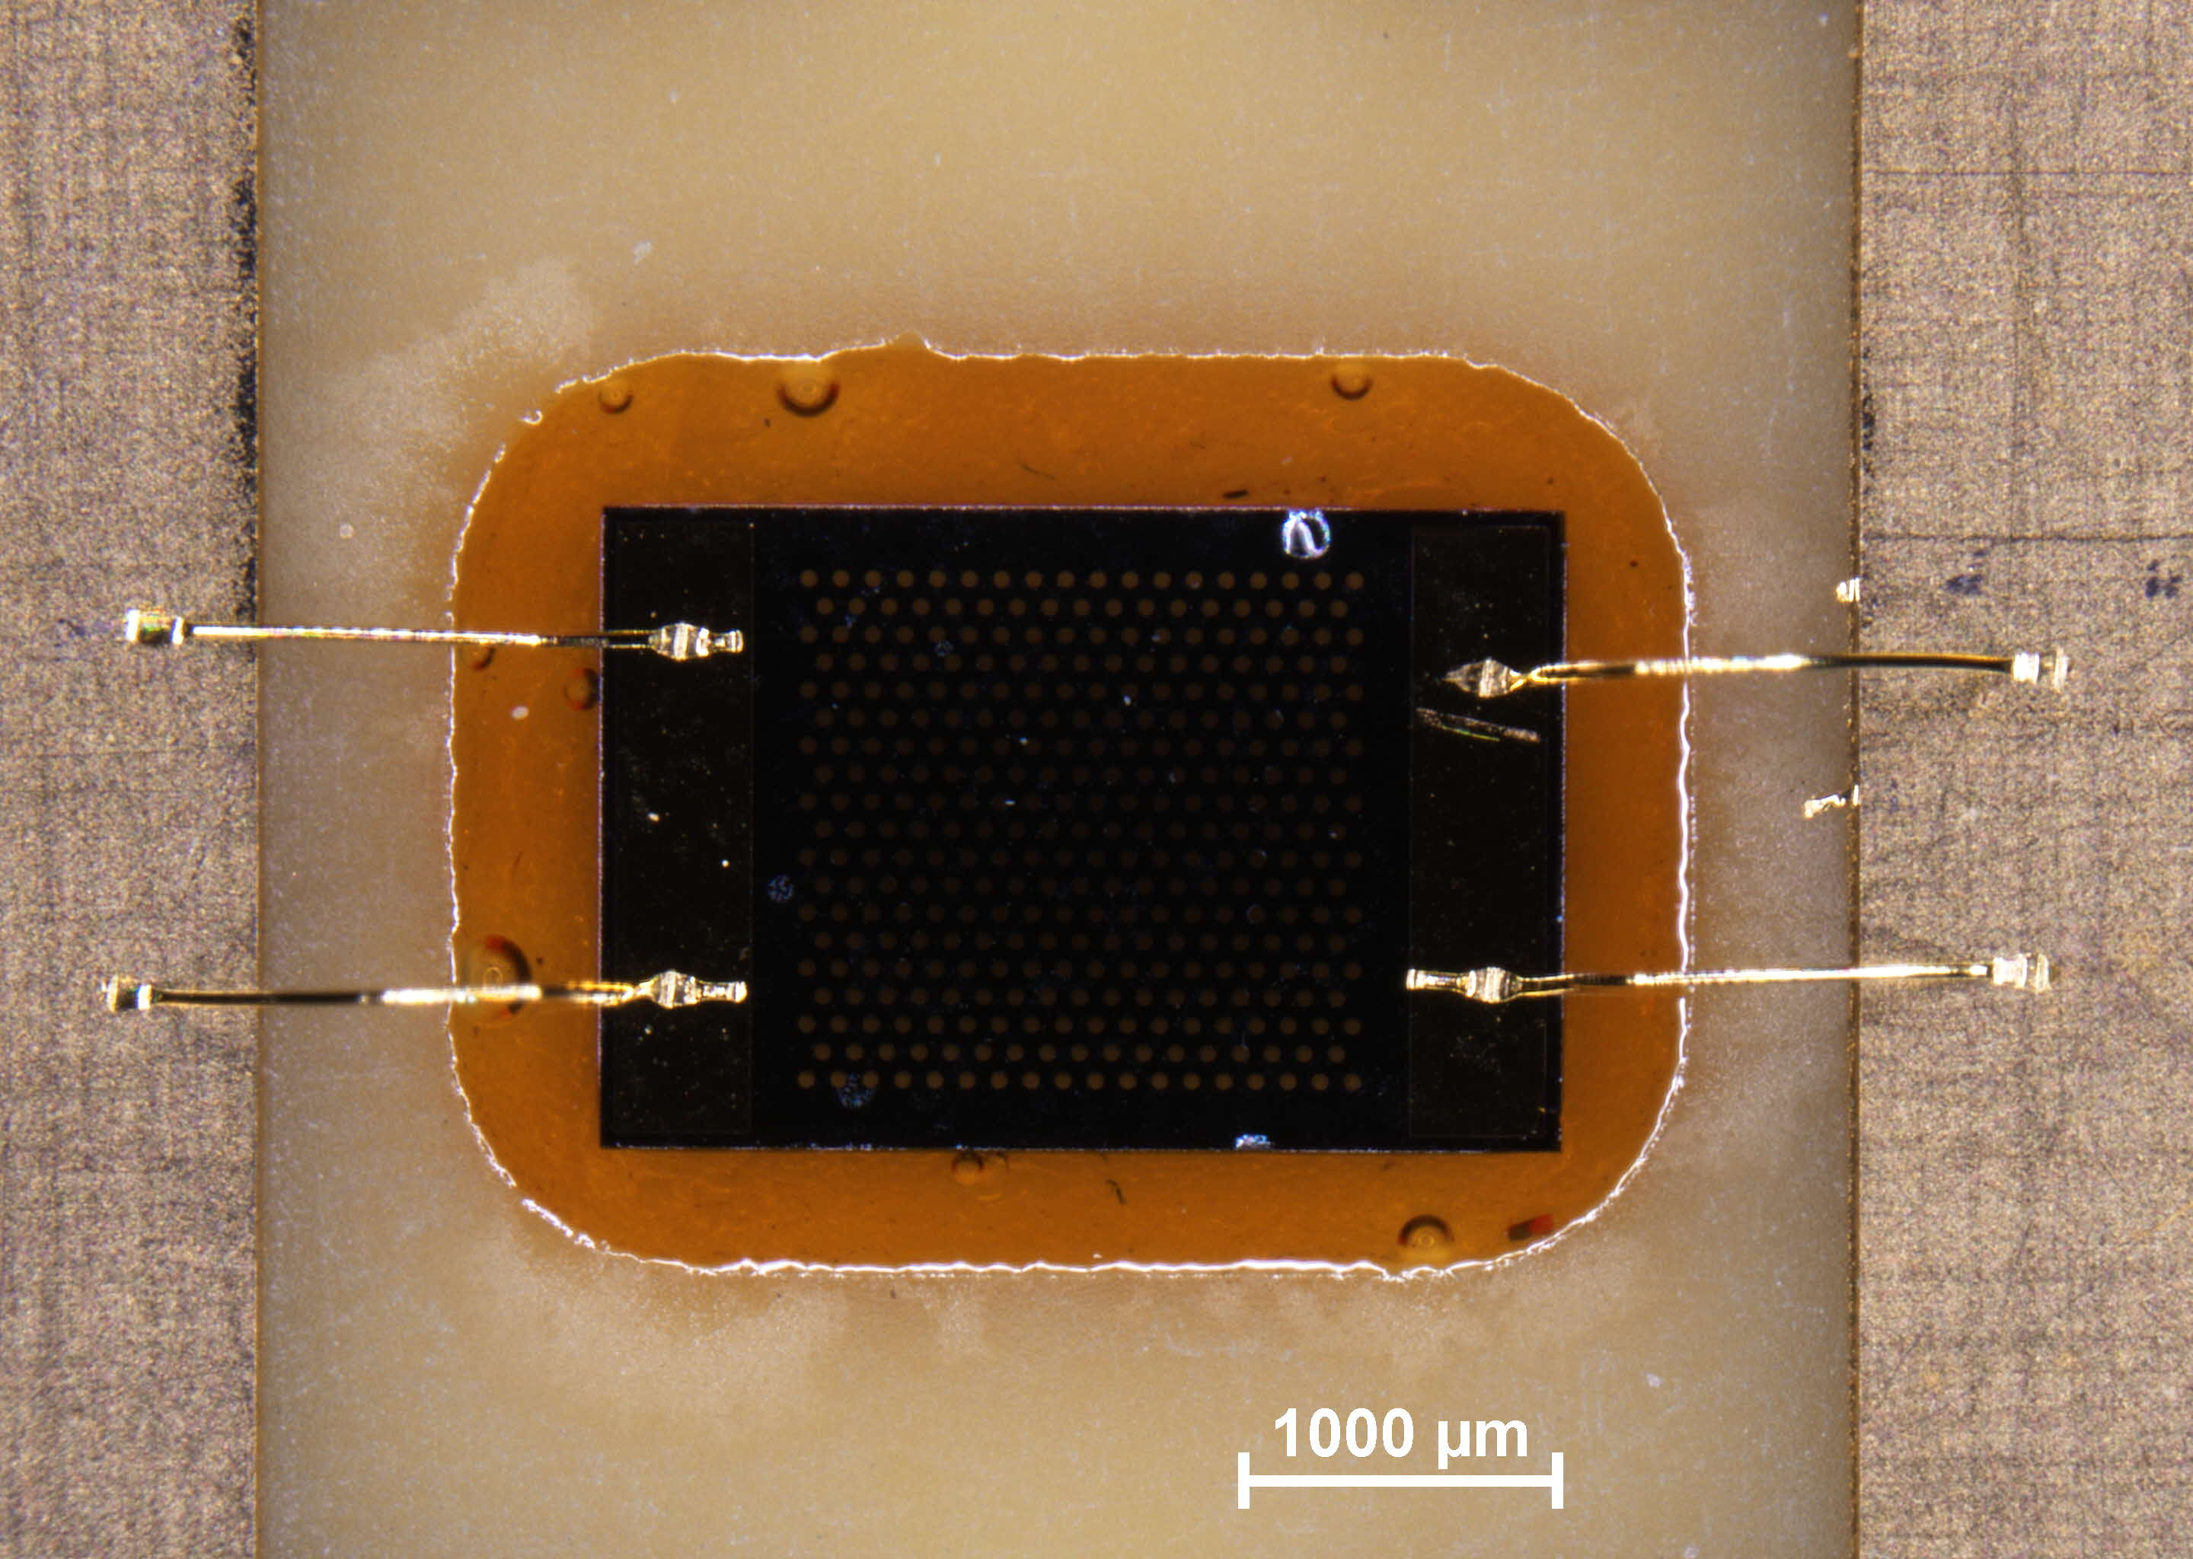
Introduction
Microheater to generate arousal [1,2]
E-cigarettes [3]
Drug delivery devices with precise dosage
Goals
Temperature distribution
Amount of vapor production
Heat loss calculation
[1] J. Pourchez, et al, Assessment of new-generation high-power electronic nicotine delivery system as thermal aerosol generation device for inhaled bronchodilators,(2017)
[2] A.R. Bhashyam, et al., Aerosol delivery through nasal cannulas: an in vitro study
[3] F. Goldschmidtboeing, et al, Heater for Controlled Evaporation of Liquids for Personalized Drug Delivery to the Lungs

Slide 3
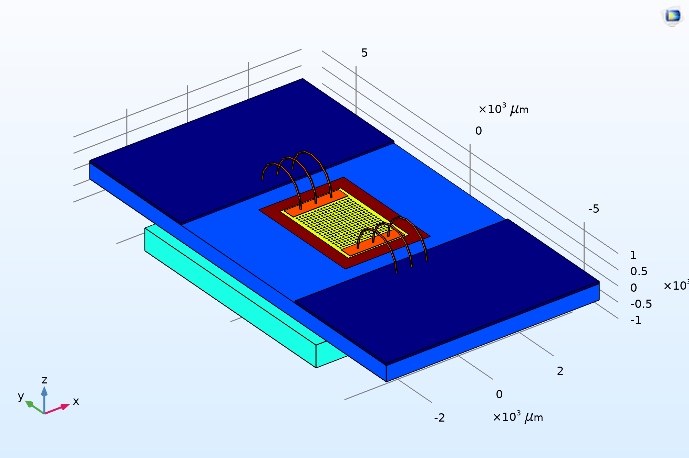
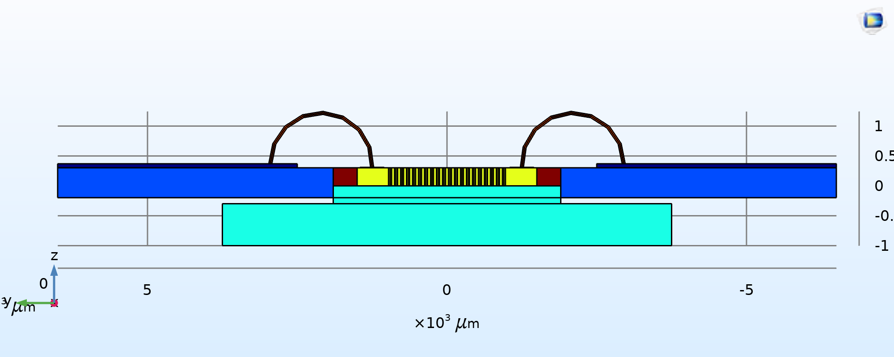
Numerical model
Modules
Heat Transfer (HT)
Laminar Flow (LF)
Electrical Current (EC)
Events (EV) [4]
Multiphysics
Electromagnetic Heating (Joule heating)
Nonisothermal Flow
PCB
Epoxy glue
Heater
Wicking material
[4] Solving Models with Pulsed Loads in Time - Knowledge Base,, https://www.comsol.com/support/knowledgebase/1245.

Slide 4
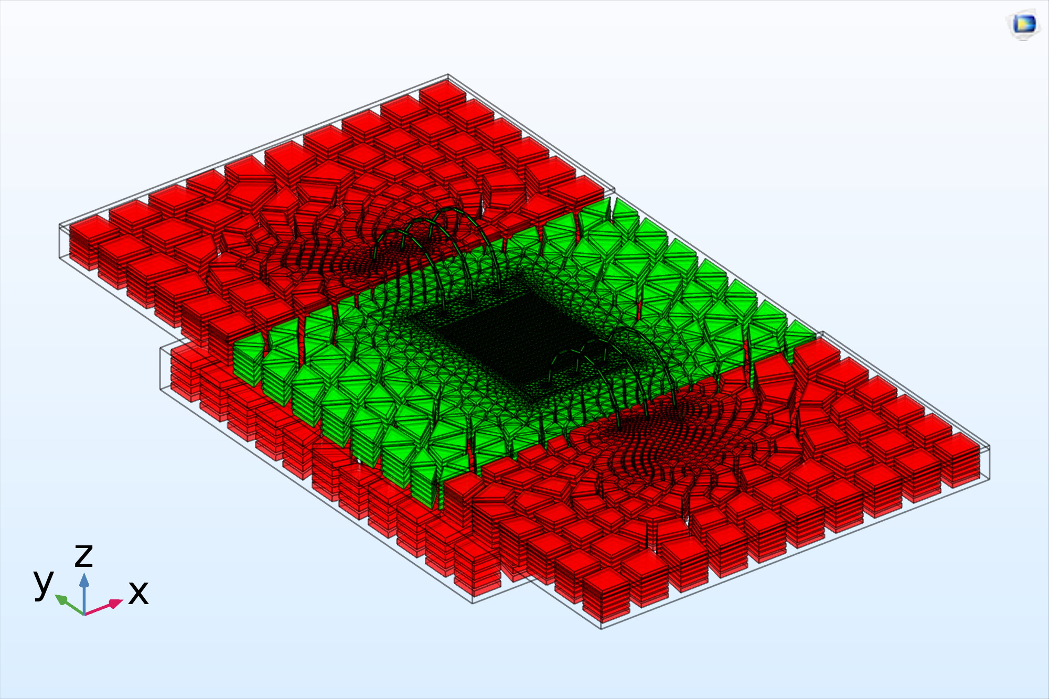
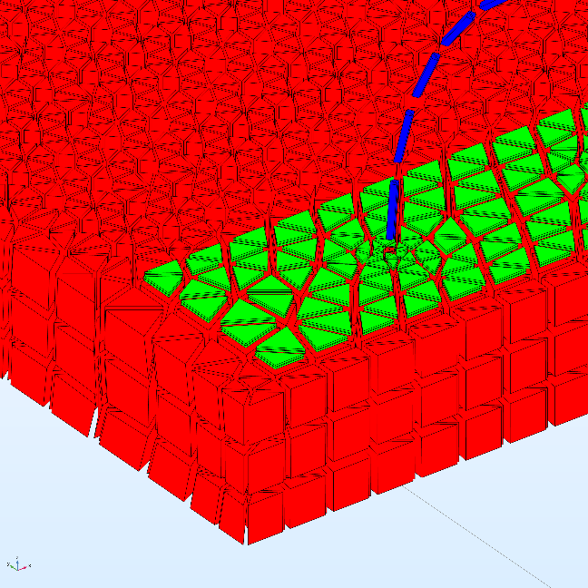
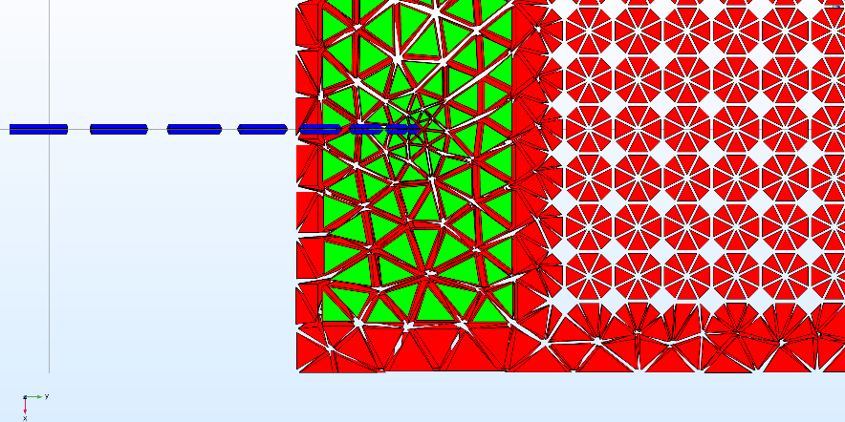
Mesh and governing equations
Mesh
Custom mesh
Prism and hexahedrons
Created with mesh sweep feature
Equations
Time transient 3D Cartesian heat transfer
Phase change
Electrical current
Laminar flow in porous media
All equations from software documentation
COMSOL discretizes them over them geometry.

Slide 5
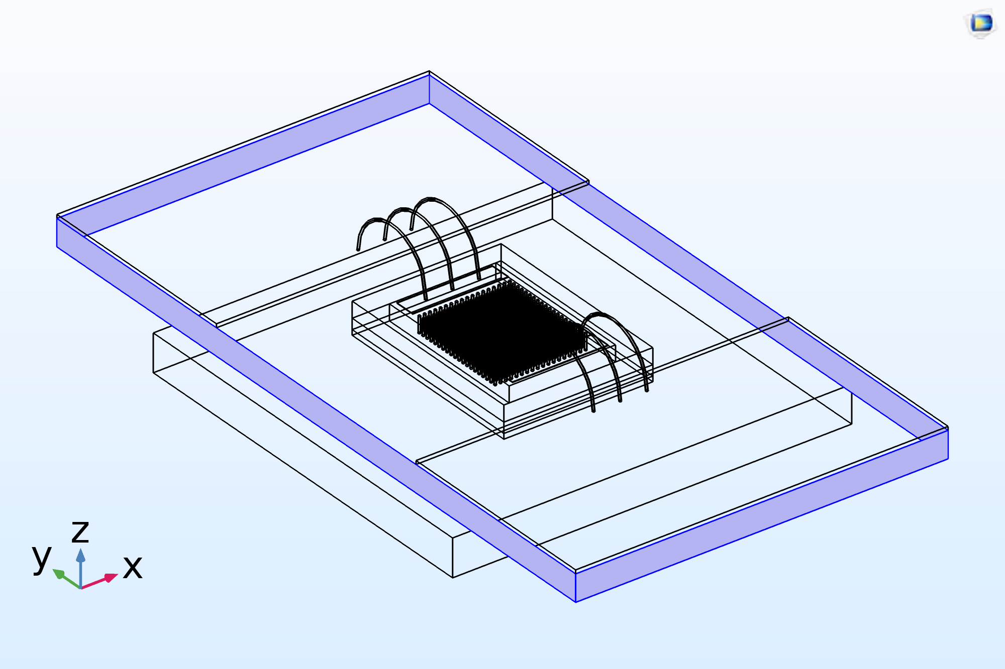
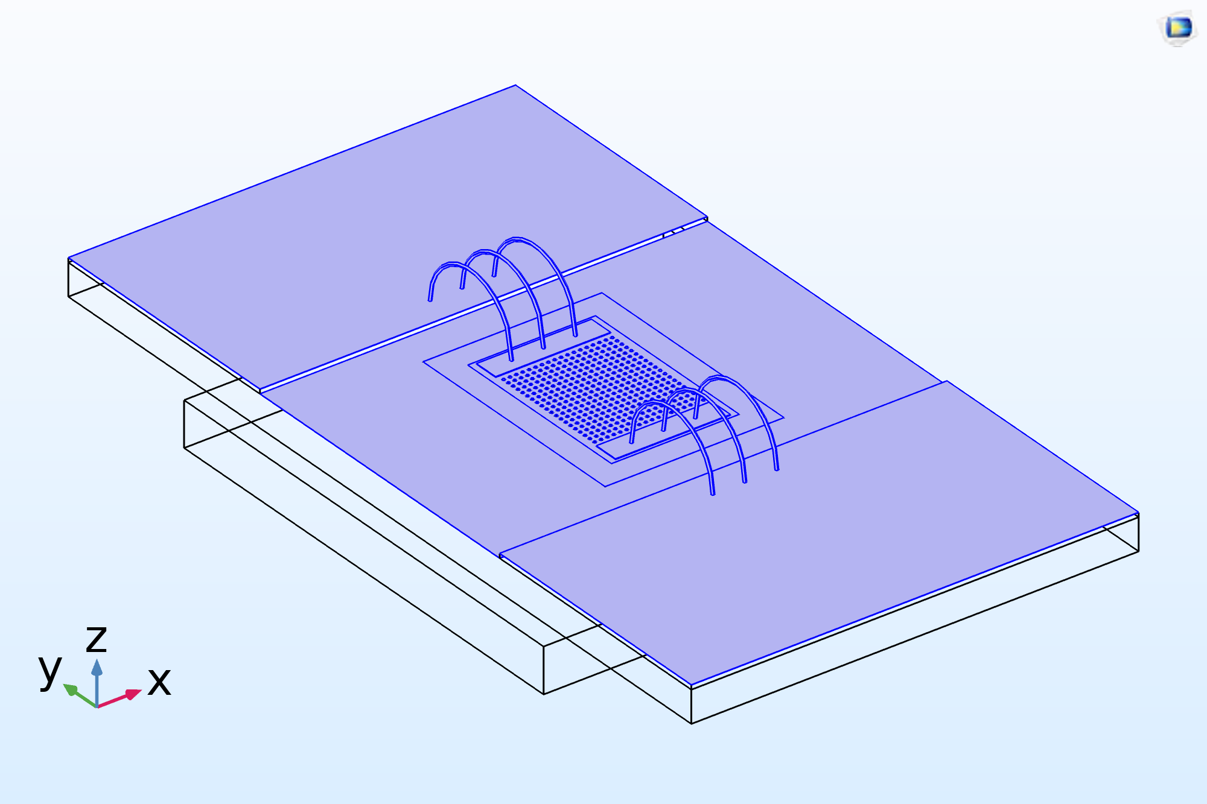
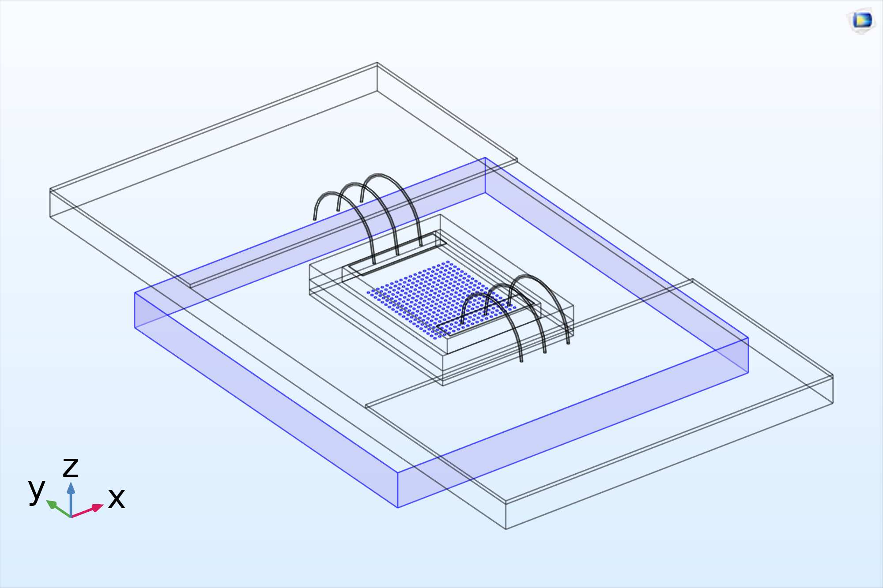
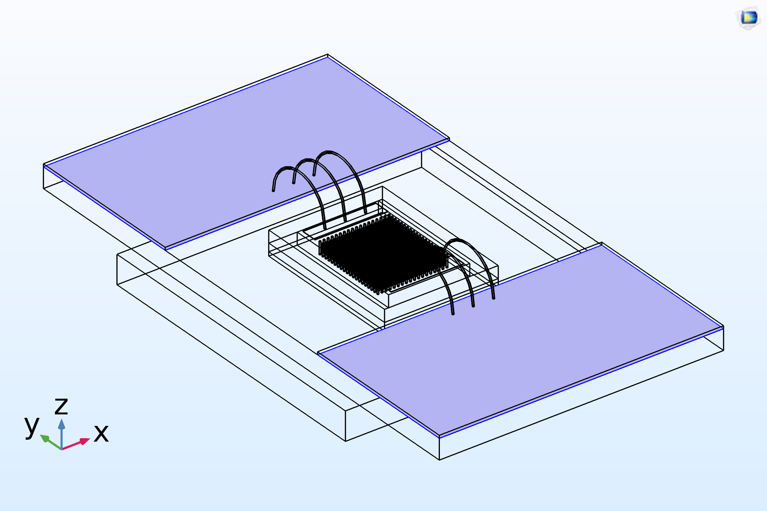
Boundary conditions and initial values
Boundary condition
PCB temperature, convection to air
Controlled voltage terminals
Liquid inlet and outlet with hydraulic pressure
Initial values
Zero velocity on fluid domain
Ambient temperature all over the domain
Steady step study before transient step
Ambient temperature on PCB edges
Convection to air on top surfaces
Liquid inlet and outlet
Electrical terminals

Slide 6
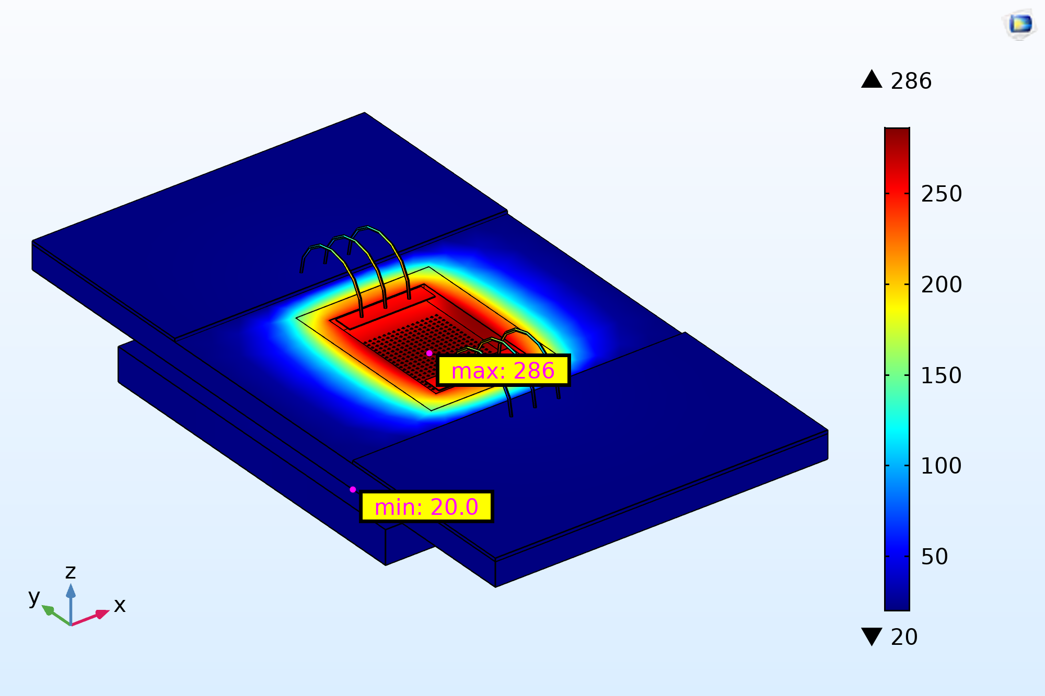
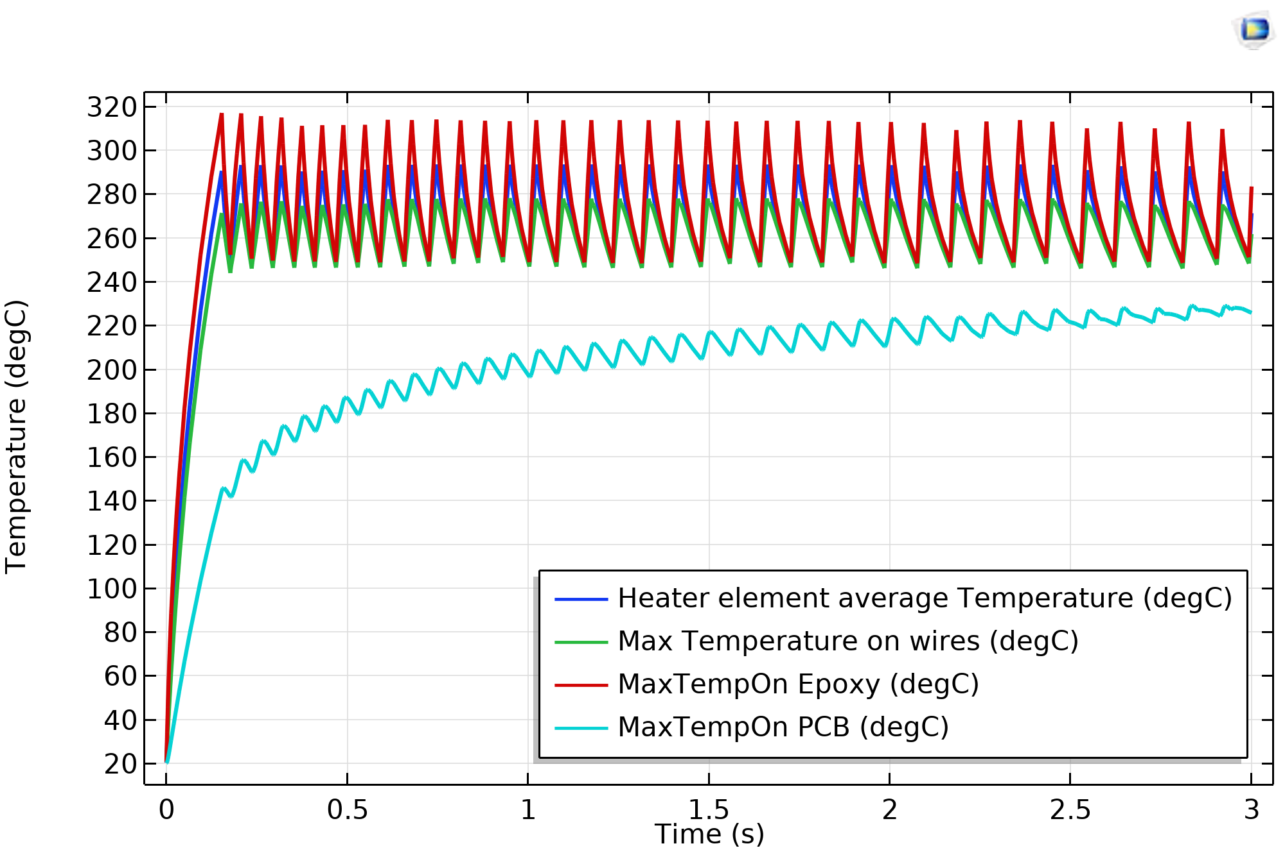
Simulation results and discussion
temperature distribution
amount of vapor production
heat loss calculation
notes
temperature on silicon and gold wire bonds
below the melting point
FR4 composite of PCB and epoxy glue
temperature above their limits
Temperature at t=3s.
Maximum temperature on components

Slide 7
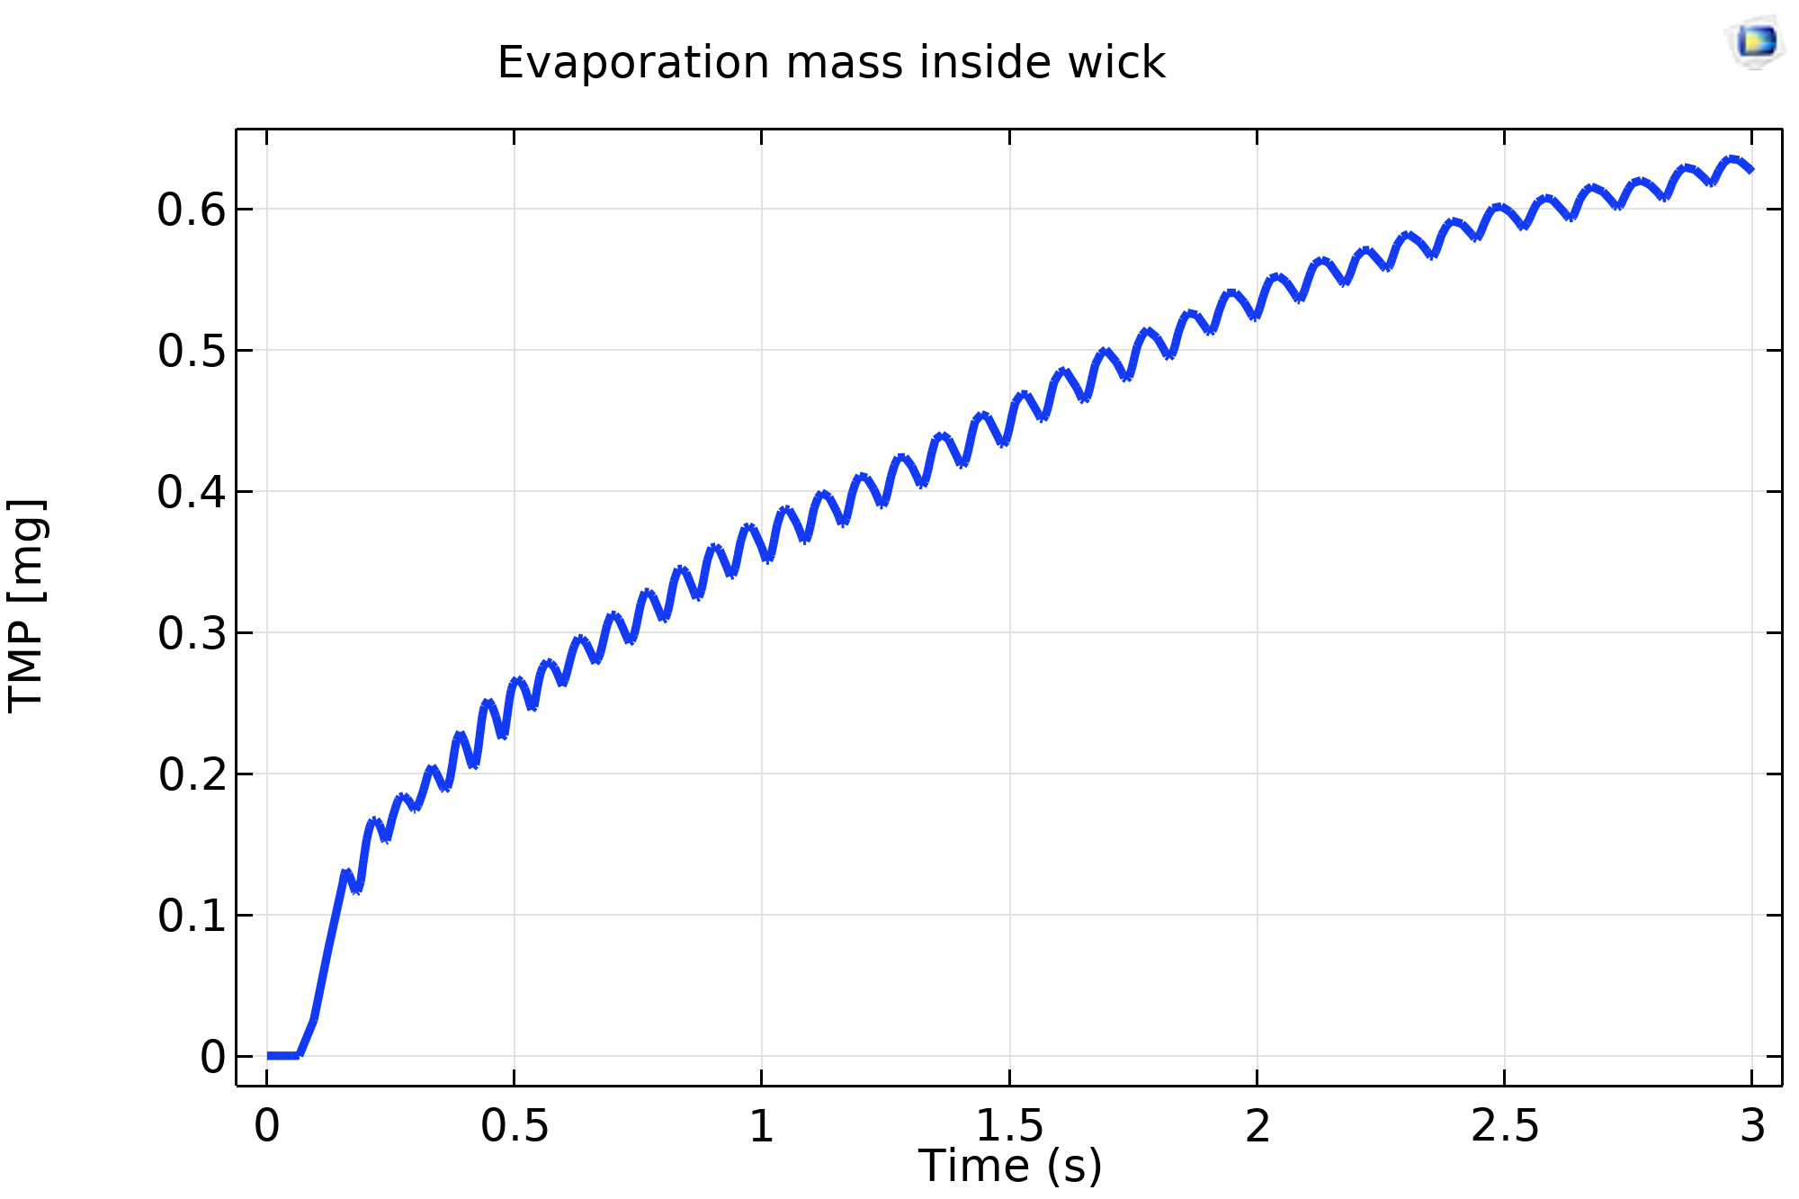
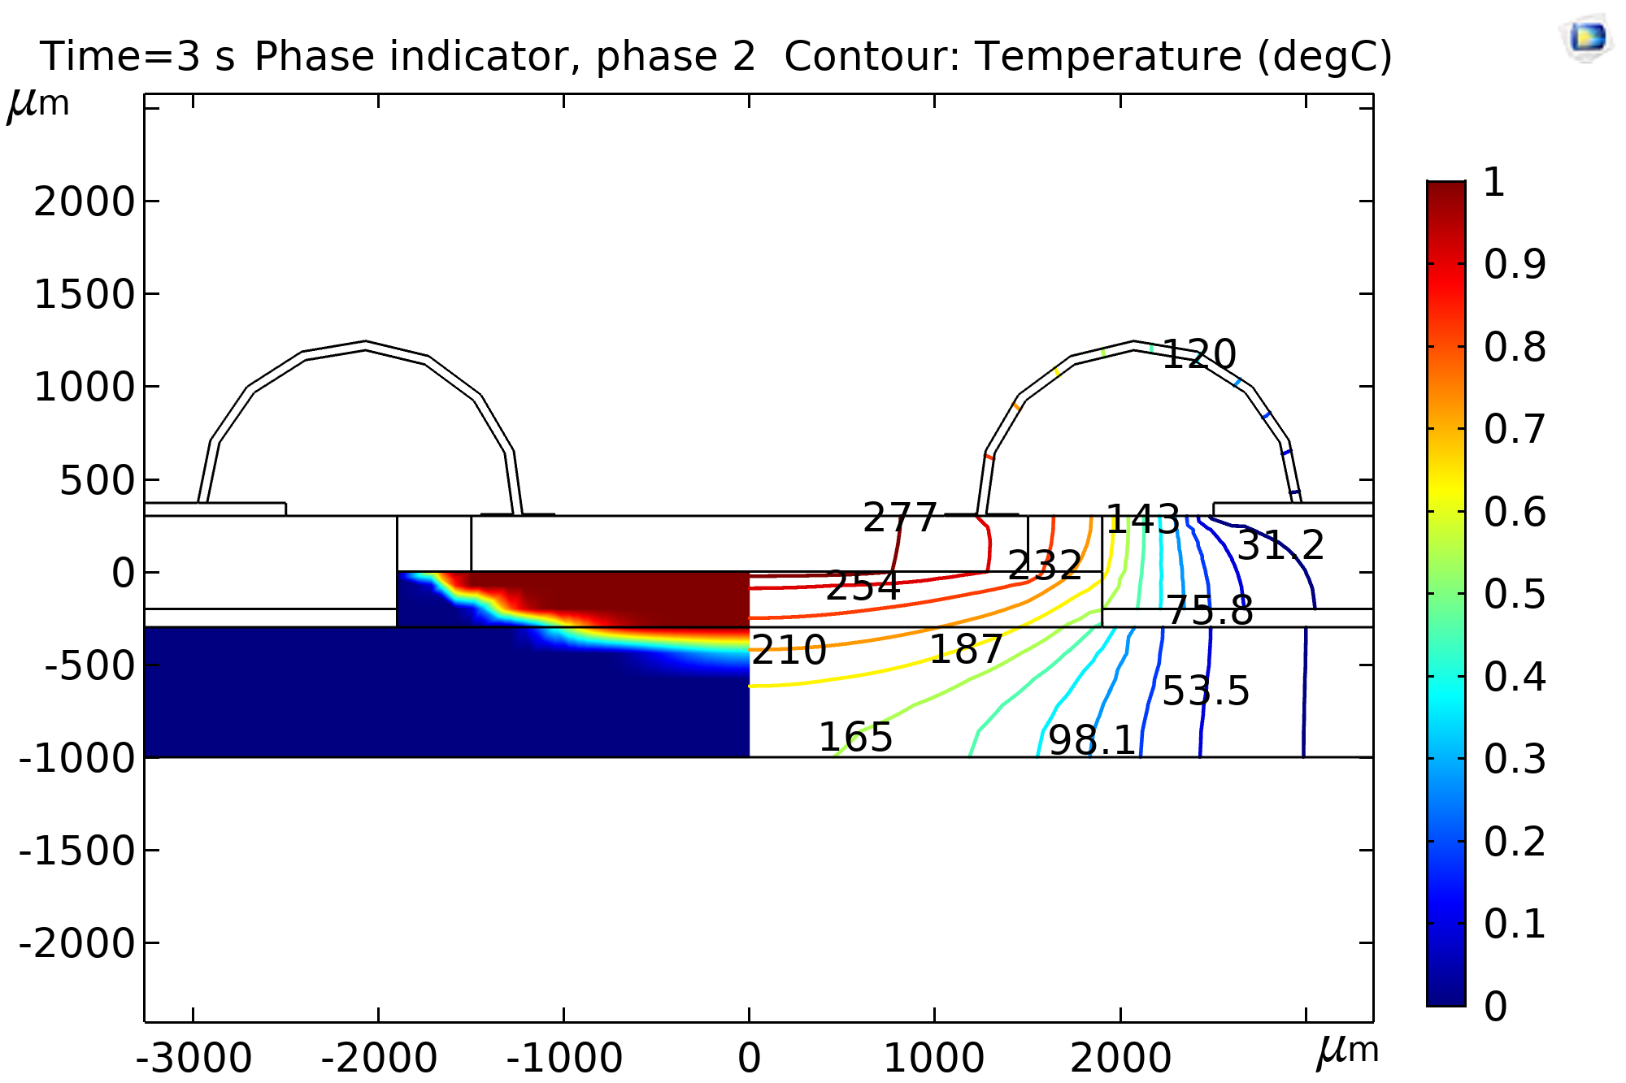
Simulation results and discussion
temperature distribution
amount of vapor production
heat loss calculation
notes
0.65 mg vapor at the end of 3 seconds
at switching temperature of 270°C

Slide 8
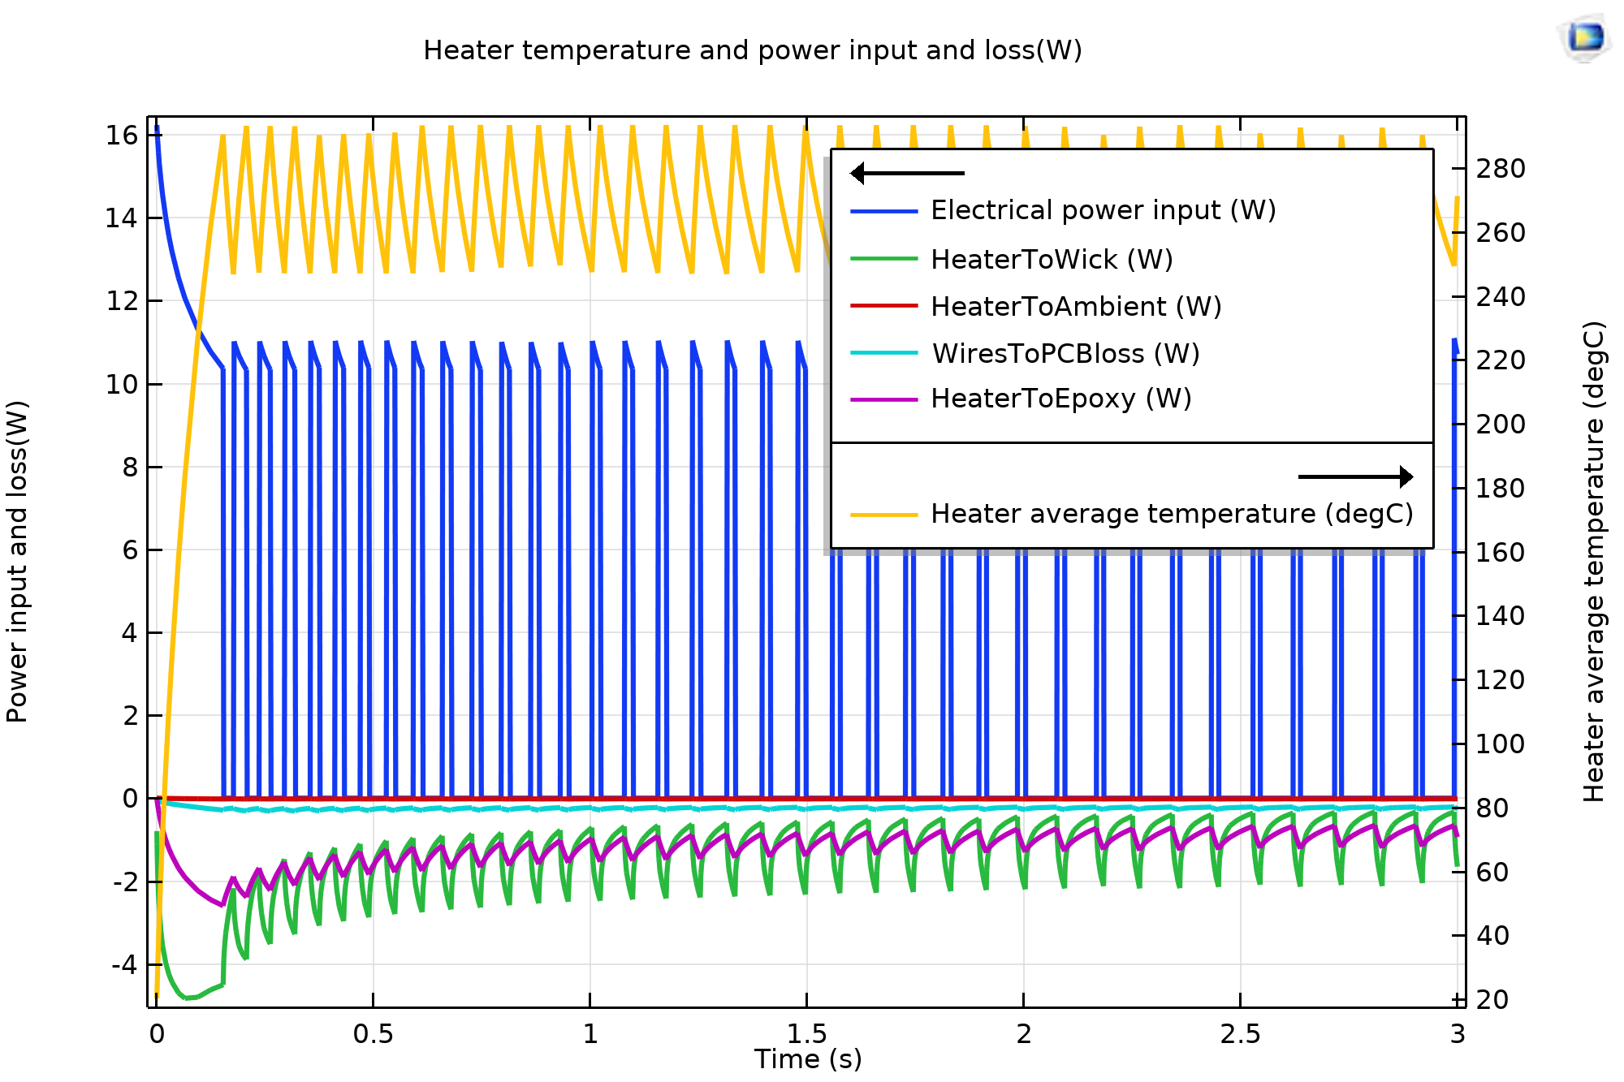
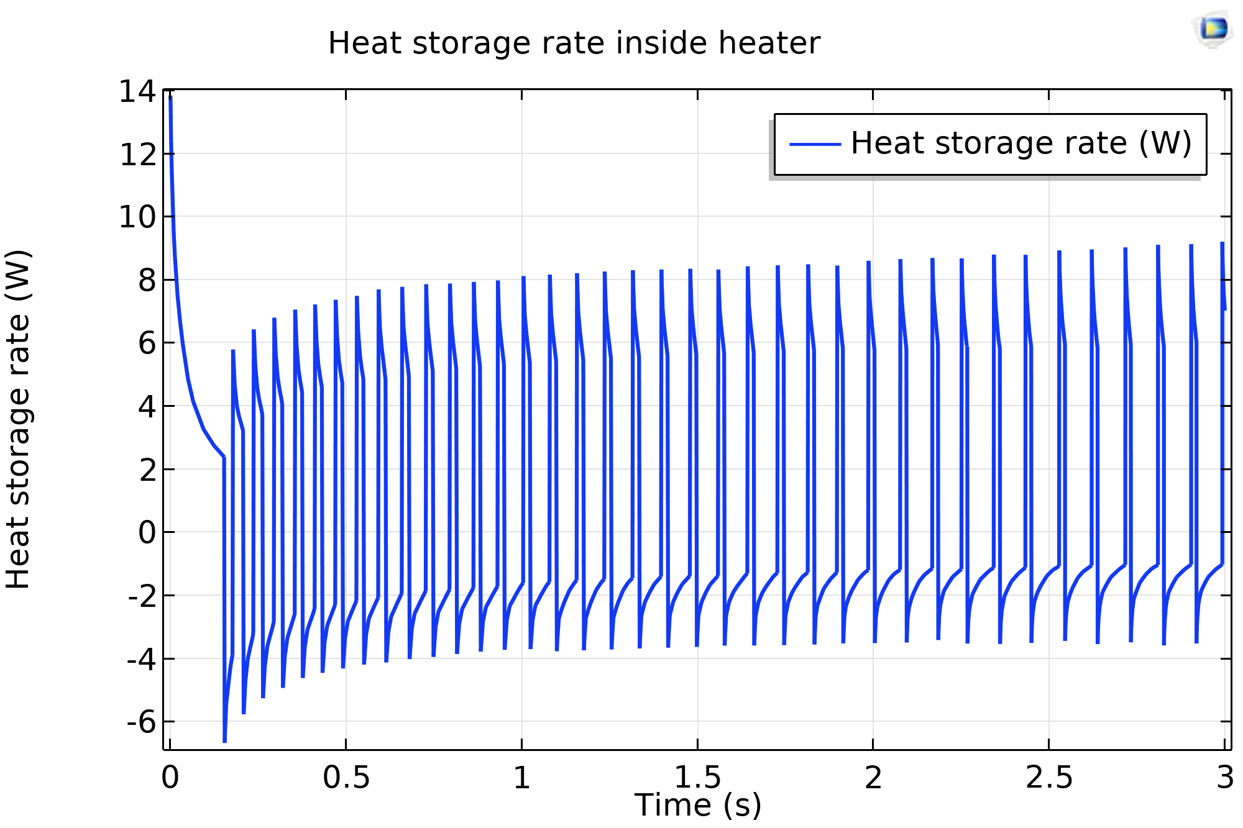
Simulation results and discussion
temperature distribution
amount of vapor production
heat loss calculation
notes
Biggest power losses
wick material and epoxy glue
Negligible power loss through
wire bonds and convection to air
Energy conservation

Slide 9
Thank you for your attention
References
[1] J. Pourchez, F. de Oliveira, S. Perinel-Ragey, T. Basset, J.-M. Vergnon, N. Prévôt, Assessment of new-generation high-power electronic nicotine delivery system as thermal aerosol generation device for inhaled bronchodilators, International journal of pharmaceutics 518 (2017) 264–269.
[2] A.R. Bhashyam, M.T. Wolf, A.L. Marcinkowski, A. Saville, K. Thomas, J.A. Carcillo et al., Aerosol delivery through nasal cannulas: an in vitro study, Journal of aerosol medicine and pulmonary drug delivery 21 (2008) 181–188.
[3] F. Goldschmidtboeing, U. Pelz, M. Ghanam, T. Bilger, A. Jamali, M. Saberi et al., Heater for Controlled Evaporation of Liquids for Personalized Drug Delivery to the Lungs, J. Microelectromech. Syst. (2020) 1–6.
[4] Solving Models with Pulsed Loads in Time - Knowledge Base, [October 10, 2019], https://www.comsol.com/support/knowledgebase/1245.

