Slide 1

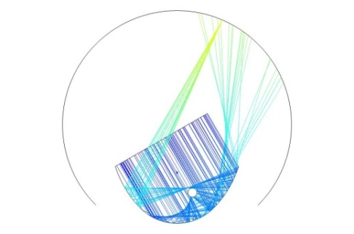
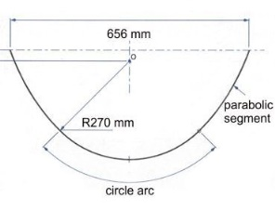
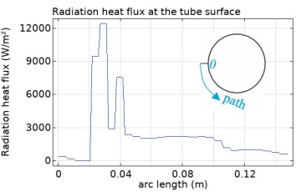
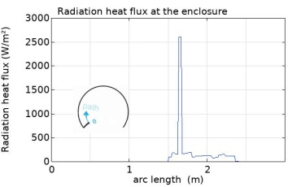
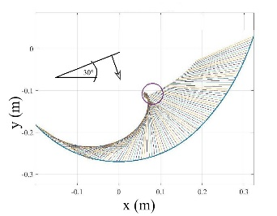
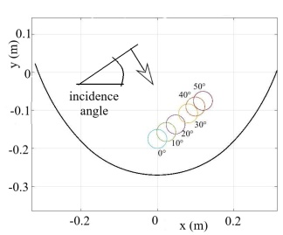
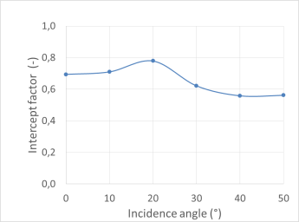
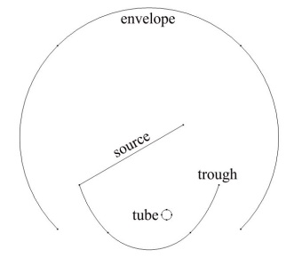

Optimal Performance Assessment of a Solar Collector
with a Static Concentrator
J. Goettsche ¹, S.Alexopoulos ¹, A.Duemmler¹ , G.Breitbach²
Solar-Institut Jülich, FH Aachen, Juelich, Germany
2. FH Aachen, Juelich, Germany
INTRODUCTION: The object under consideration is a trough (static solar concentrator) based on investigations in [1].
GEOMETRY OF THE TROUGH: Figure 1. shows the geometric configuration of the trough.
Figure 1. Trough made of a
circular part and two
parabolic segments
Figure 5. Ray pattern for 30° incidence angle
PREANALYSIS OF TUBE POSITIONS: Regions of high ray concentrations inside the trough are identified for different incidence angles. Computations are done with MATLAB. The Figure 2 shows reflected ray bundles for 30°incidence angle. The circle marks an optimal position of the tube. Optimal positions for different incident angles are shown in Figure 3.
Figure 6. Tube surface heat flux,
30° incidence
(tube diameter Φ= 47mm)
Figure 7. Enclosure heat flux,
30°incidence (radiation loss)
INTERCEPT FACTOR CONSIDERATIONS: The following table contains integral radiation heat balances for the tube and the loss through the enclosure. Figure 8 gives the intercept factor.
Figure 2. Reflected rays for 30° incidence angle
Figure 3. Optimal tube positions for different incidence angles
COMSOL MODELING (GEOMETRIC OPTICS MODULE):
2D-models are used. The components are represented by lines. The medium between the lines is transparent. The system is shown and described in Figure 4. There are four different parts (here for 30°incidence angle): Trough - tube - source line - absorption envelope
Table 1. Radiation input for
different incidence angles
Figure 8. Intercept factor
CONCLUSIONS: Optimum absorber positions of a solar collector with static concentrator as proposed by [1] were found. The intercept factor was found to be between 56% and 78 % for incidence angles between 0° and 50°. An absorber motion along a straight line brings reasonable results. The geometric optics module of COMSOL is a suitable tool for systematic investigations for the application treated here.
Figure 4. 2D-model,
Trough → specular reflecting line
Tube → perfectly absorbing line
Source → source of rays perpendicular to the line normed to a heat flux of 1000 W/m²
Envelope → perfectly absorbing line.
Shown is the situation at 30°incidence
Acknowledgements
This project was co-funded by the German Federal Ministry of Education and Research (BMBF) and the Hellenic Secretariat for Research and Technology (SCOSCO project) in the framework of the Greek-German co-operation.
RESULTS OF ANALYSIS: Results for the different con-figurations are presented by three diagrams:
Ray pattern, radiation flux at the tube surface, radiation flux at the envelope. In the figures it is given for the 30°incidence angle.
REFERENCES:
[1] Tripanagnostopoulos Y., Yianoulis P., “CPC solar collectors with multi-channel absorber”. Solar Energy 58 (1-3), pp. 49-61, 1996
Excerpt from the Proceedings of the 2020 COMSOL Conference

