Slide 1
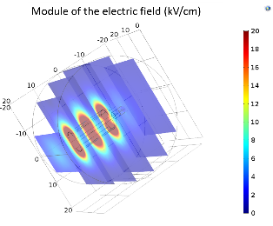
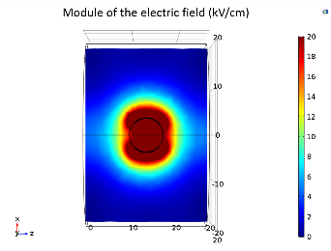
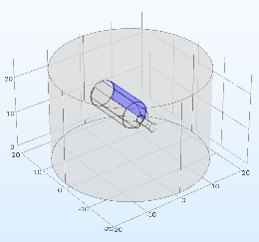
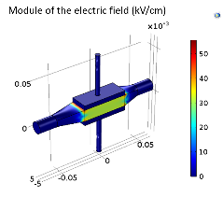
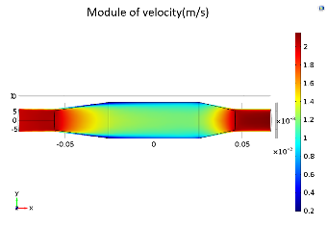
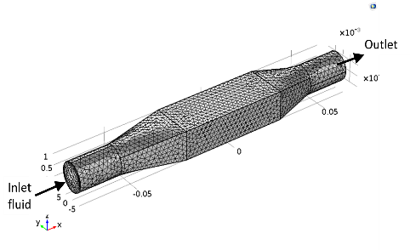
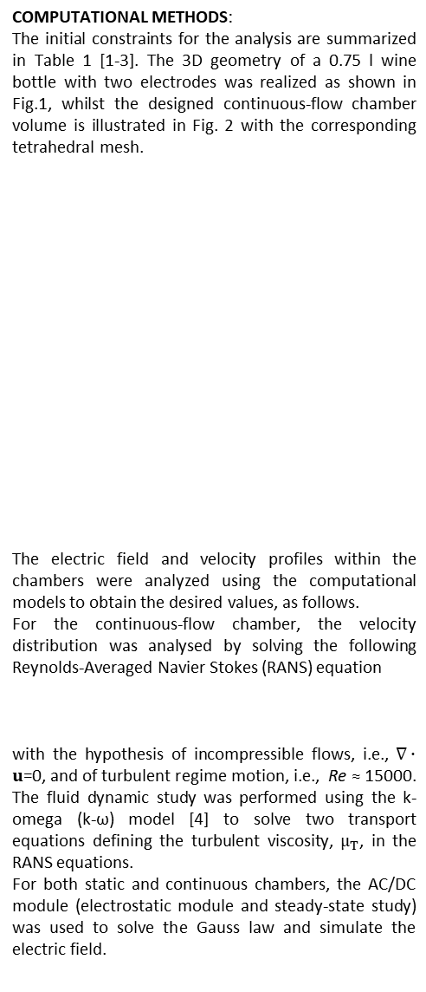
Pulsed Electric Field Analysis for Wine Treatment in Static and Continuous-flow Chambers with COMSOL Multiphysics®
P. Casti¹, M. Salmeri¹, I. Bertini², F. Bonfà²
1. Department of Electronics Engineering, University of Rome Tor Vergata, Rome, RM, Italy
2. ENEA, Casaccia, Rome, RM, Italy
INTRODUCTION: Pulsed Electric Field (PEF) technology is a non-thermal procedure to preserve safety, organoleptic and nutrients properties of food [1]. The scope of the present study is to model, with COMSOL Multiphysics®, PEF treatment of wine in static and continuous-flow chambers in order to optimize the process parameters and ensure microbial inactivation of bacteria and yeasts, pre- and post-bottling.
The stationary electrostatic module was chosen as the system time constant is less than the duration of the PEF application pulses by several orders of magnitude.
RESULTS: For the case of the glass-bottle (see Fig. 3 and 4), values of the electric field not less than 20 kV/cm within the chamber are unattainable via external electrodes for safety and energy consumption reasons. Other configurations are practicable with at least one electrode positioned within the bottle.
COMPUTATIONAL METHODS:
The initial constraints for the analysis are summarized in Table 1 [1-3]. The 3D geometry of a 0.75 l wine bottle with two electrodes was realized as shown in Fig.1, whilst the designed continuous-flow chamber volume is illustrated in Fig. 2 with the corresponding tetrahedral mesh.
The electric field and velocity profiles within the chambers were analyzed using the computational models to obtain the desired values, as follows.
For the continuous-flow chamber, the velocity distribution was analysed by solving the following Reynolds-Averaged Navier Stokes (RANS) equation
with the hypothesis of incompressible flows, i.e., $∇∙u$=0, and of turbulent regime motion, i.e., Re ≈ 15000. The fluid dynamic study was performed using the k-omega (k-ω) model [4] to solve two transport equations defining the turbulent viscosity, $μ_{T}$, in the RANS equations.
For both static and continuous chambers, the AC/DC module (electrostatic module and steady-state study) was used to solve the Gauss law and simulate the electric field.
Variable | Value | Units
Pulse duration | 2 | µs
Treatment time | 0.05 | s
Electric field | >20 | kV/cm
Inlet/outlet diameter UNI EN 10255 | 1,27 | cm
Figure 3. Distribution of the electric field in different x-z planes for the static chamber
Figure 4. Distribution of the electric field with constant y value for the static chamber
Table 1. Initial constraints defining the problem [1-3].
Figure 1. Geometry of the wine bottle and electrodes
Figure 3. Distribution of the electric field in the continuous-flow chamber
Figure 4. Velocity distribution in the x-y plane for the continuous-flow chamber
The designed continuous-flow chambers (see Fig. 5 and 6) are efficient from the point of view of uniformity of the electric field and of the velocity profiles in relation to the treatment time of the wine volume.
CONCLUSIONS: We computationally analysed different chamber solutions for PEF treatment in the winemaking process. The proposed PEF-based inactivation solutions are expected to reduce the quantity of added sulfites and improve the quality of wines. PEF experimentations in real case scenarios will help, in the future, optimizing the treatment delivery.
Figure 2. Tetrahedral mesh for the continuous-flow chamber
$$ρ\frac{∂u}{∂t}+∇∙μ_{T}\left(∇u+{\left(∇u\right)}^{T}\right)+ρ\left(u∙∇\right)u+∇P=∇∙μ\left(∇u+{\left(∇u\right)}^{T}\right)$$
REFERENCES:
U.S. Food and Drug Administration, “Kinetics of microbial inactivation for alternative food processing technologies,” Institute of Food Technologists, Silver Spring, 2000.
C. Delsart et al. “Comparison of the effect of pulsed electric field or high voltage electrical discharge for the control of sweet white must fermentation process,” Journal of Applied Microbiology, vol. 120, n. 1, pp. 152-164., 2016
J. R. Beveridge et al. “Pulsed electric field inactivation of spoilage microorganisms in alcoholic beverages and the influence of pulse profile,” in IEEE Int. Pulsed Power Conference, 2003
D. C. Wilcox, “Formulation of the kw turbulence model revisited,” AIAA journal, vol. 46, n. 11, pp. 2823-2838, 2008
Excerpt from the Proceedings of the 2020 COMSOL Conference

