Slide 1

Estimation of Temperature, Microstructure and Deformations in Strip Hardening Industrial Process
Yalçın Kaymak¹, Andreas Heßler², Roman Kuziak³
1. VDEh-Betriebsforschungsinstitut, Düsseldorf, Germany
2. HUGO VOGELSANG GmbH & Co. KG, Hagen, Germany
3. Instytut Metalurgii Zelaza, Gliwice, Poland

Slide 2
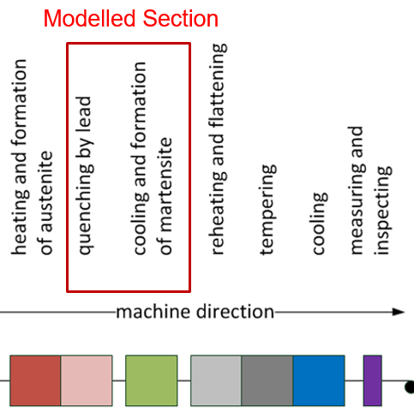
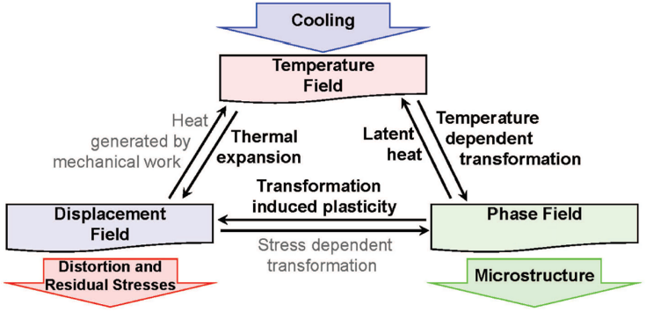
Introduction
Quenching of the advanced steel grades is a challenging process since the residual stress and deformation are pronounced and the quality requirements of the customers are tighter.
The strongly coupled temperature, microstructure and displacement fields must be modeled in order to better control the strip hardening industrial process thus lowering the rejection rates.
A comprehensive modelling of the complex phenomena to estimate the residual stress and deformation is essential for developing an optimal process control.

Slide 3
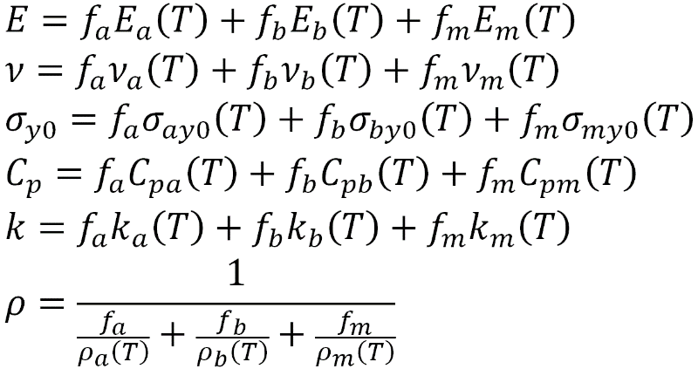
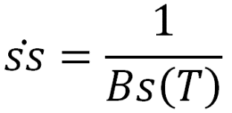

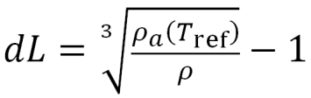

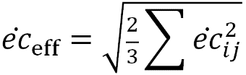
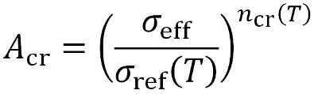
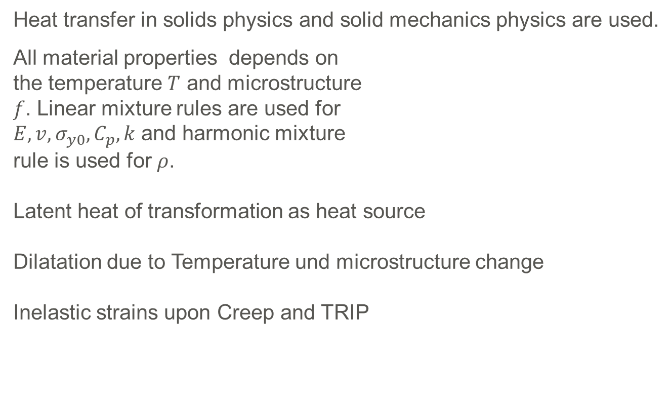
Computational Methods: Temperature, Microstructure and Displacement Fields
Heat transfer in solids physics and solid mechanics physics are used.
All material properties depends on the temperature $T$ and microstructure $f$. Linear mixture rules are used for $E,v, σ_{y0}, C_{p}, k$ and harmonic mixture rule is used for $ρ$. Latent heat of transformation as heat source Dilatation due to Temperature und microstructure change Inelastic strains upon Creep and TRIP
Two types of transformations are modelled:
Austenite → Bainite
Scheil’s rule
JMAK-equation
Austenite → Martensite
KM-equation

Slide 4
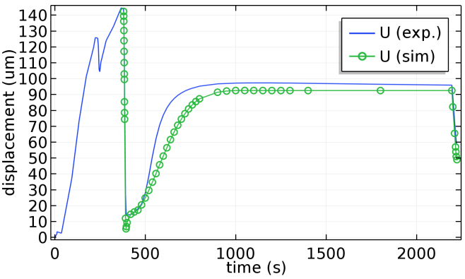
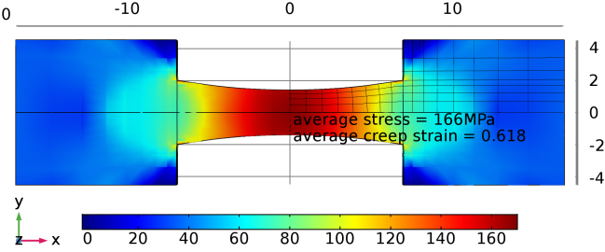
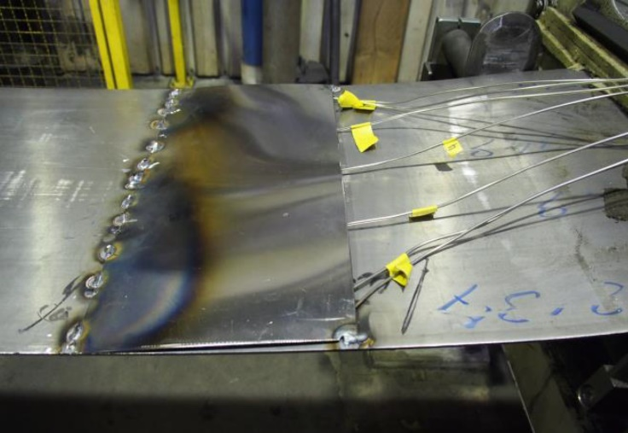
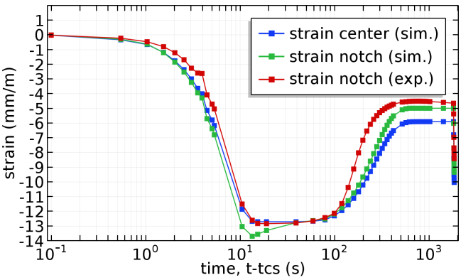
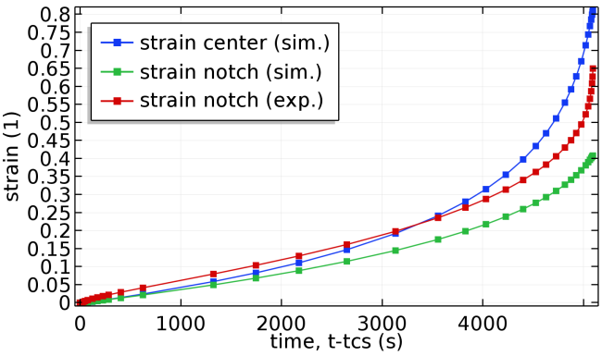
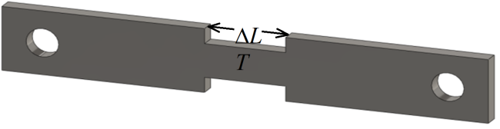
Model Calibration by Measurements
In-situ temperature measurement TRIP model Creep model at industrial process line
Determination of material properties via Laboratory measurements

Slide 5
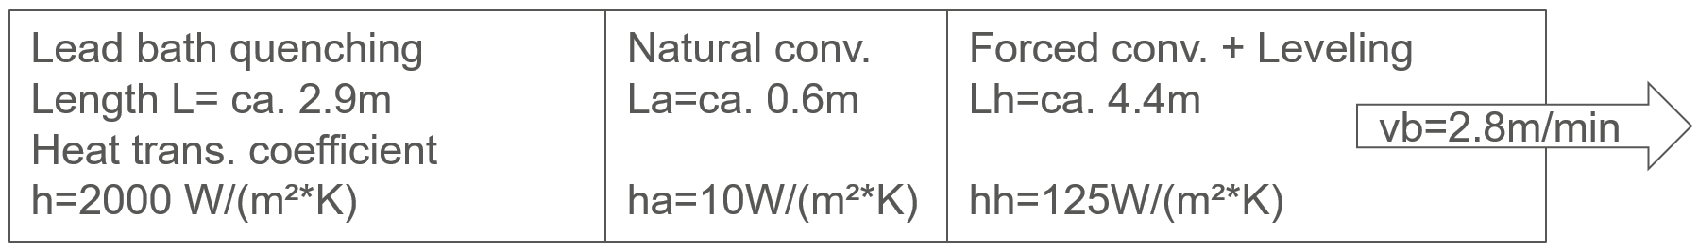
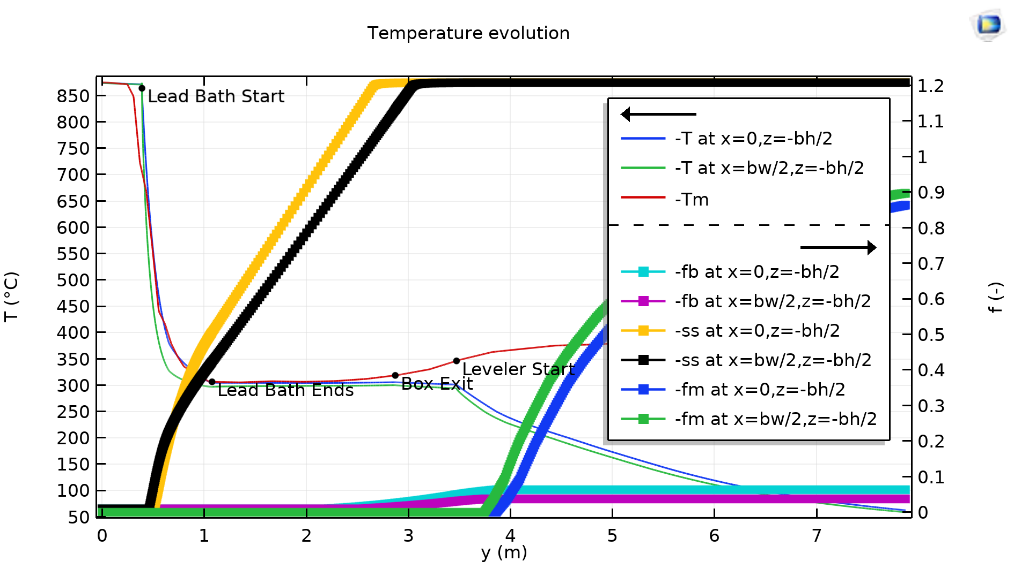
Simulation Methods and Discussion of the Results
The sequence of the complex processes is modeled geometry & BC of the strip using a series of components and study steps in Comsol Multiphysics®: 1) Compute temperature and microstructure of the moving strip (3d comp., stationary). results of step 1 2) Compute bending configuration of the strip in level- rollers (2d comp., parametric & stationary contact). 3) So-called 2.5d deformation analysis by a generalized plane strain (2d comp., transient). 4) 3d nonlinear post-buckling analysis using the stress state from step 3 (3d comp., stationary).

Slide 6

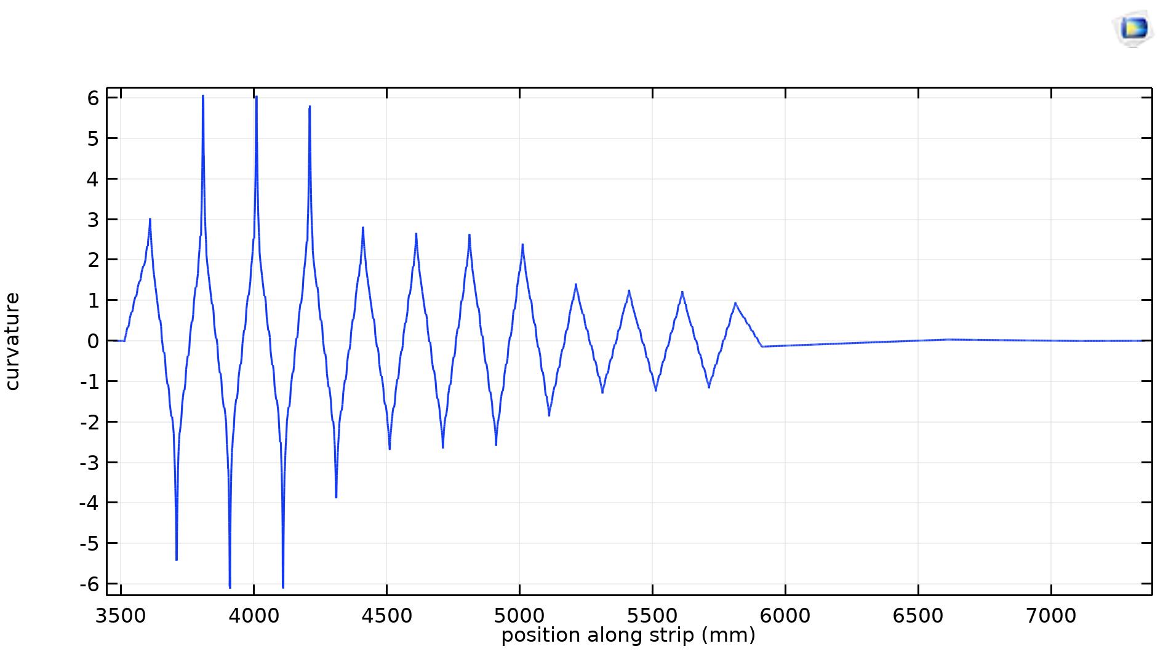
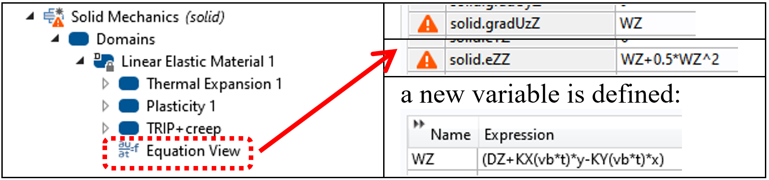
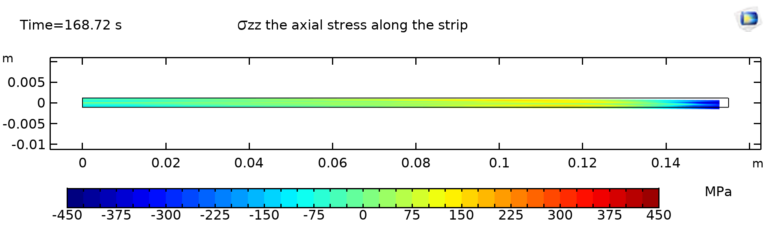
… continued …
step2: 2d comp., parametric & stationary contact
geometry & BC of the strip for the contact model
curvature of strip as it goes through leveling rollers
step3: 2d comp., transient
global eq. defined for the strip axial strain
modification of domain equations
typical computed stress field

Slide 7
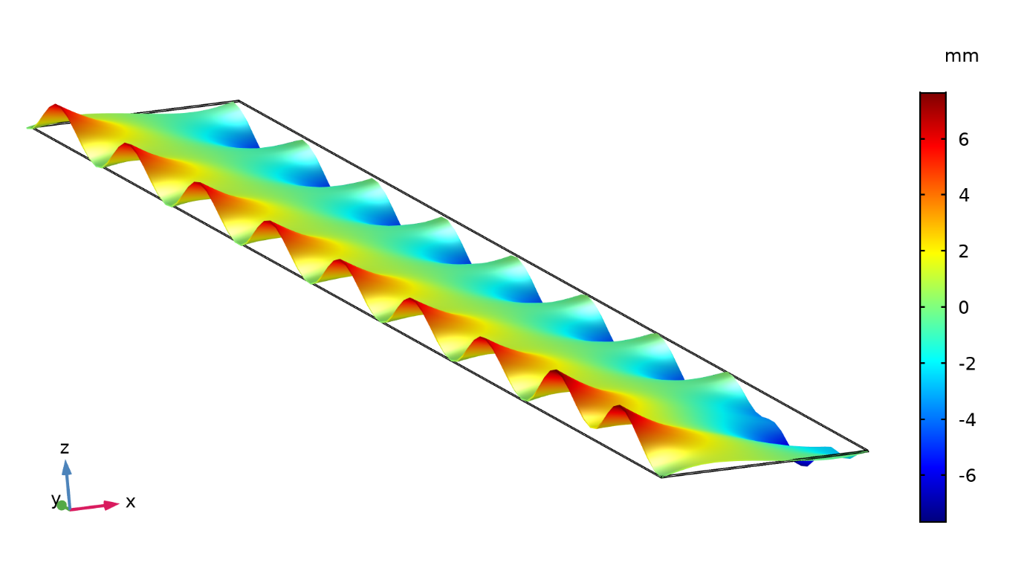
… continued …
step4: 3d comp., stationary, geo. nonlinear
computed stress SY re-mapped to 3d geo.
(via parametric extrusion solution set)
leveling rollers RR1 plastically bending the strip
post-buckling analysis
computed deformed 3d geo.
scale factor:10

Slide 8
Conclusions and Summary
mathematical model for the modeling of metal heat treatment process is introduced
model is calibrated and validated by the measurements at the industrial plant and laboratory
model is applied to estimate the temperature, microstructure and deformation in a typical strip hardening industrial process using a series of study steps in Comsol Multiphysics®

Slide 9


Contact
Yalçın Kaymak, : yalcin.kaymak@bfi.de, : +49 211 6707 299
VDEh Betriebsforschungsinstitute GmbH, Düsseldorf, Germany
Andreas Heßler, : andreas.hessler@vogelsang-bandstahl.de
HUGO VOGELSANG GmbH & Co. KG, Hagen, Germany
Roman Kuziak, : rkuziak@imz.pl
Instytut Metalurgii Zelaza, Gliwice, Poland

