Slide 1
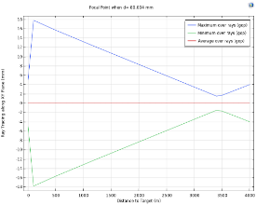
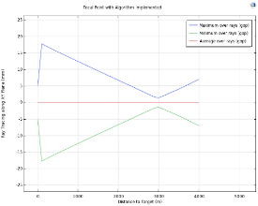
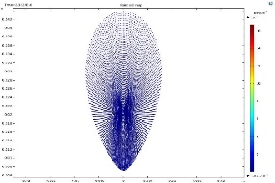
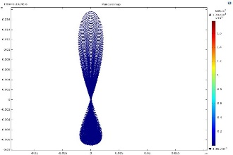
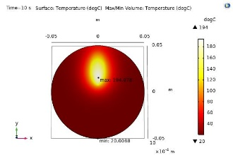
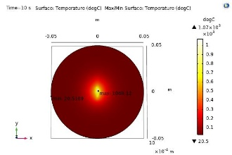
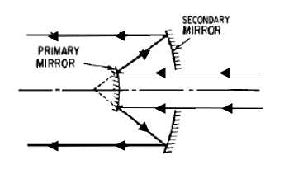
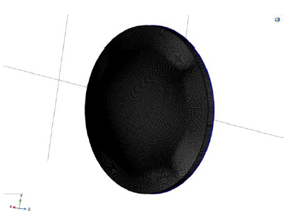
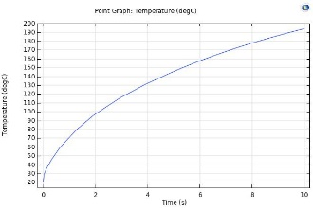
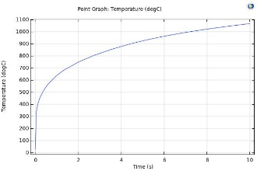


Optimizing and Improving the Flux Intensity in a Reflective type
Laser Focusing System
Rufus Patrick, Ashok Sharma
PTDC, Larsen & Toubro, Powai, India
INTRODUCTION: A Laser Focusing system (LFS) focuses continuous or pulsed laser beam onto a surface of a Specimen. This Beam of light is absorbed by the specimen and heats up its surface. In a Reflective type LFS, there is a small focal shift from the geometric focus point when the Laser Source feed is placed at an offset from the Optical Axis of the Mirrors^{[1]}. This poster investigates to Optimize and improve the Directivity of the Reflective based LFS by shifting the high - tapered feed axially away from the Reflector, so that the Specimen can be heated up expeditiously.
Figure 4 Ray Trajectory w/o and with Algorithm
COMPUTATIONAL METHODS: A 3D model of the LFS was modelled, meshed and analyzed using the Geometric Optics Module in COMSOL Multiphysics 5.5. A schematic layout of the LFS is shown in Figure 1.
Figure 5 Poincare Map w/o and with Algorithm
Figure 6 Hot Spot w/o and with Algorithm
Figure 1. Schematic Model of LFCS
Figure 2. Mesh of the Primary Mirror
Figure 3 shows the Governing equation for a ray tracing simulation.
The Mirror’s reflecting Boundary were meshed using a mapped mesh and the same was swept over their respective domains. The fine mapped mesh on the Primary Mirror is shown in Figure 2. The Reflecting Surfaces and the Laser beam were modelled using the mirror function and release from grid under Geometric Optics respectively.
Figure 7 Temperature Plot w/o and with Algorithm
Table 1. Spot Analysis w/o and with Algorithm
Parameters | Without Algorithm | With Algorithm | Unit | Δ Change
Max Width | 15.5 | 4.4 | mm | ↓ 71.6%
Max Height | 36.8 | 26.85 | mm | ↓ 9.9%
Max Flux | 16.7 | 1.78e⁺³ | kW/cm² | ↑ 106.6x
Figure 3. Governing Equations for Ray Tracing
CONCLUSIONS: The Simulation yields a reduction in the size of the heat spot on the Specimen after implementing an Algorithm. This Algorithm is yet to be implemented and validated in Realtime.
REFERENCES:
Hao Ling, Shung-Wu Lee, P. Lam and W. Rusch, "Focal shifts in parabolic reflectors," in IEEE Transactions on Antennas and Propagation, vol. 33, no. 7, pp. 744-748, July 1985.Author, Article Title, Journal, Volume, Page numbers (year)
Perram, Glen & Marciniak, Michael & Goda, Matthew. (2004). High energy laser weapons: Technology overview. Proc SPIE. 5414. 10.1117/12.544529.
Al-aish, Thair. (2015). Design and Analysis the Fiber Laser Weapon System FLWS. Advances in physics theories and applications. 47.
Roso, Nelson & Moreira, Romero & Oliveira, Jose. (2014). High Power Laser Weapons and Operational Implications. Jounal of Aerospace Technology and Management. Vol.6. 10.5028/jatm.v6i3.342.
Mizuyama, Y. (2017). How Does the Choice of Ray Tracing Algorithm Affect the Solution. [Blog] COMSOL Blog. Available at: https://www.comsol.co.in/blogs/how-does-the-choice-of-ray-tracing-algorithm-affect-the-solution/.
Warren J. Smith (2008). Modern Optical Engineering - Fourth Edition. SPIE Press. DOI: 10.1036/0071476873
[7] Rudolf Kingslake & R. Barry Johnson (2010). Lens Design Fundamentals - Second Edition. SPIE ISBN: 9780819479396.
RESULTS: A positive focal shift is observed and an Algorithm was implemented to reduce the effect of the Focal Shift Phenomenon. Figure 4 shows trajectory of the ray from the LFCS that is focused onto a Target at 3kms with and without the Algorithm
Excerpt from the Proceedings of the 2020 COMSOL Conference

