Slide 1


Optimizing and Improving the Flux Intensity in a Reflective type
Laser Focusing System
Rufus Patrick, Ashok Sharma
PTDC, Larsen & Toubro, Powai, India

Slide 2
CONTENTS
Introduction
Problem Statement
COMSOL Modelling
Result & Discussion
Conclusion & Future work
Reference

Slide 3

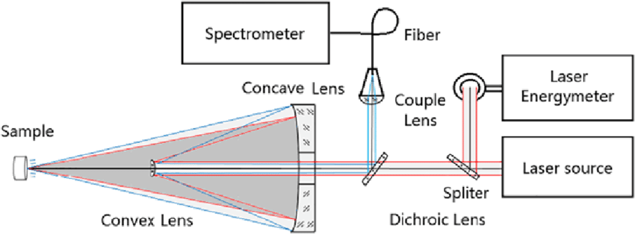

INTRODUCTION
A Laser Focusing system (LFS) focuses continuous or pulsed laser beam onto a surface of a Specimen.
This Beam of light is absorbed by the specimen and heats up its surface.

Slide 4
PROBLEM STATEMENT
In a Reflective type LFS, there is a small focal shift away from the geometric focus point when the high tapered Laser Source feed is focused onto the specimen^{[1]}. This Optical Phenomenon is termed as a “Positive Focal shift”
COMSOL was used to visualize this phenomenon and an algorithm developed to reduce the effect of the positive focal shift.
Notes:
The magnitude of this Positive Focal shift depends mainly on the Freshnel number of the Reflector

Slide 5
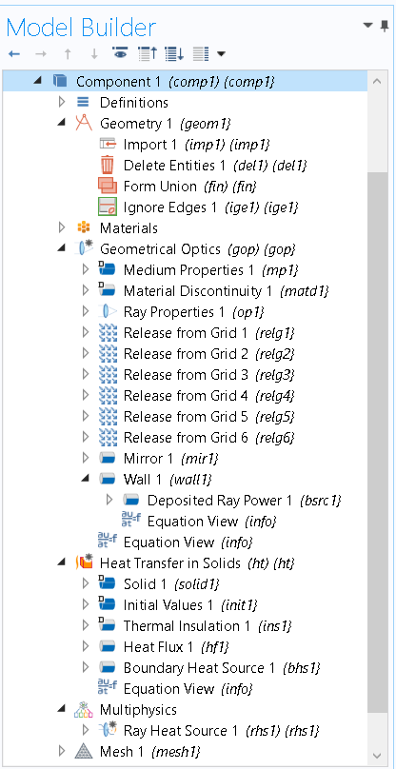
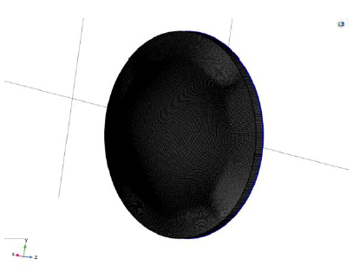
COMSOL MODELLING
COMSOL Multiphysics, Geometrical Optics Coupled with Heat Transfer Module (Ray Heating)
The Mesh refinement on the Optical elements affects the accuracy of the ray trajectories which in turn affects the accuracy of spot diagrams^{[5]}.
Swept Quad mesh of size 0.2mm on the Secondary mirror.

Slide 6
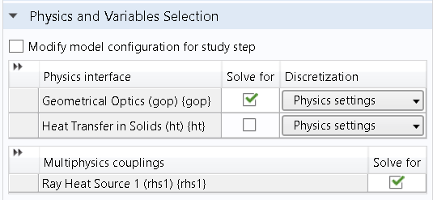
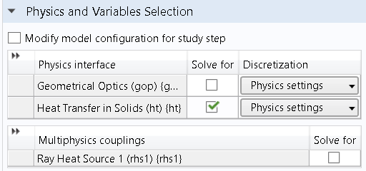
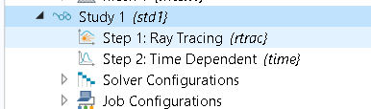
COMSOL MODELLING
Ray Tracing was solved first and the time dependent thermal Analysis was solved in the next step

Slide 7
RESULTS & DISCUSSION
Specimen is placed at 3000m from the LFS
Effect of the positive focal shift phenomenon is observed.

Slide 8
RESULTS & DISCUSSION
Implementation of the algorithm helped in reducing the effect of the positive focal shift

Slide 9
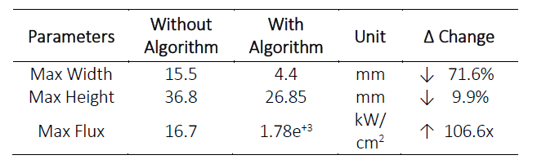
RESULTS & DISCUSSION
Change in Flux Intensity on Target

Slide 10
RESULTS & DISCUSSION
Hot Spot on Target

Slide 11
CONCLUSION & FUTURE WORK
COMSOL provides us good amount of information & visuals to understand the optical focus shift phenomenon.
The Effect of the positive focal shift was reduced by implementing an Algorithm.
The Simulation with the algorithm yields a huge improvement in increasing the flux density on the Target.
In the future, we plan to validate the effective of the developed Algorithm in real time.

Slide 12
THANK YOU

Slide 13
REFERENCES
[1] Hao Ling, Shung-Wu Lee, P. Lam and W. Rusch, "Focal shifts in parabolic reflectors," in IEEE Transactions on Antennas and Propagation, vol. 33, no. 7, pp. 744-748, July 1985.
[2] Perram, Glen & Marciniak, Michael & Goda, Matthew. (2004). High energy laser weapons: Technology overview. Proc SPIE. 5414. 10.1117/12.544529.
[3]Al-aish, Thair. (2015). Design and Analysis the Fiber Laser Weapon System FLWS. Advances in physics theories and applications. 47.
[4]Roso, Nelson & Moreira, Romero & Oliveira, Jose. (2014). High Power Laser Weapons and Operational Implications. Jounal of Aerospace Technology and Management. Vol.6. 10.5028/jatm.v6i3.342.
[5] Mizuyama, Y. (2017). How Does the Choice of Ray Tracing Algorithm Affect the Solution. [Blog] COMSOL Blog. Available at: https://www.comsol.co.in/blogs/how-does-the-choice-of-ray-tracing-algorithm-affect-the-solution/.
[6] Warren J. Smith (2008). Modern Optical Engineering - Fourth Edition. SPIE Press. DOI: 10.1036/0071476873
[7] Rudolf Kingslake & R. Barry Johnson (2010). Lens Design Fundamentals - Second Edition. SPIE ISBN: 9780819479396.

