Slide 1


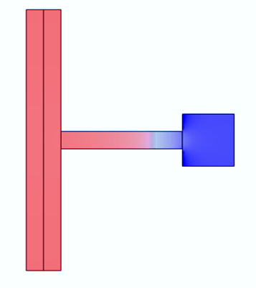
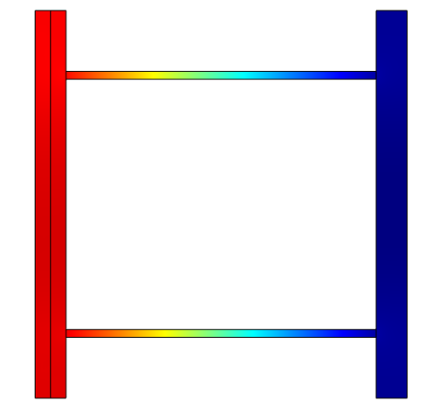
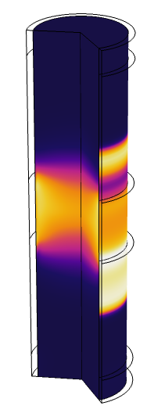
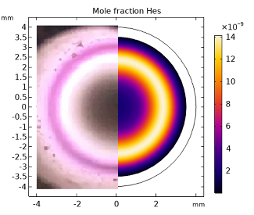
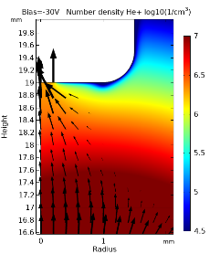
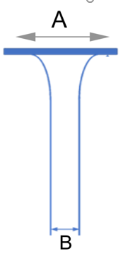
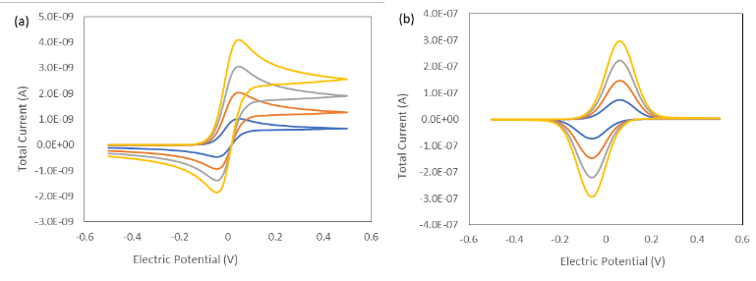

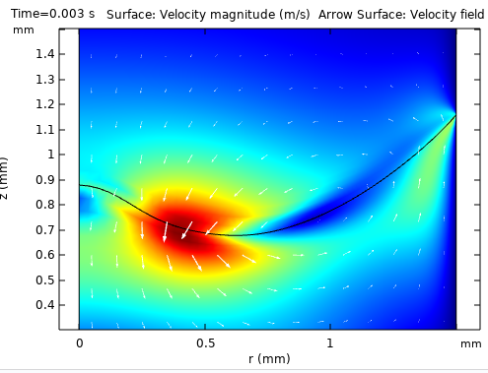
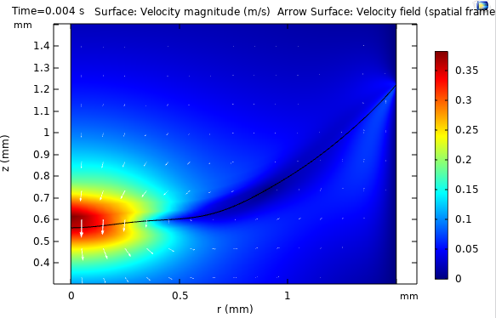
From the Laboratory to the Living Room: COMSOL as a Remote Teaching and Research Tool for Analytical Chemistry
R. Asprec¹, C. Gariboldi¹, S. Luan, Y. Wang¹, M. Parkes¹, D. J. Caruana¹, M. E Sener^{1*}
Chemistry, University College London, London, United Kingdom
* E-mail: m.sener.12@ucl.ac.uk
INTRODUCTION: For 4 months, COMSOL Multiphysics was used by four MSci Analytical Chemistry students at University College London to allow research projects to continue at a time when laboratory access was not possible. Short summaries of all projects are provided.
PROJECT DESCRIPTIONS: Four virtual projects were set-up as extensions of planned or ongoing research
Acoustic resonator design for photoacoustic spectroscopy,
Simulation of an atmospheric pressure plasma jet,
Electrochemistry in soap films,
Dynamic electrowetting.
We found that COMSOL based short term research projects were very successful in introducing modern computational simulation methods while providing insight into physical and chemical phenomena being studied. Thanks to the existing application libraries and documentation, students were able to rapidly adapt their research questions to the simulation environment and generate relevant results..
Photoacoustic spectroscopy (PAS) requires resonators with signal to noise ratios at acoustic resonant frequencies. Using the results from numerical simulations we can design better PAS cells for improved sensitivity. Resonator designs were parametrically optimized to afford the best signal to noise ratio and highest quality factors.
Figure 1. (Left to right) Simulated acoustic pressure in dumbbell, Helmholtz and differential resonator cells at the primary resonance frequency
Atmospheric pressure plasmas are difficult to characterize using electrostatic probes. Via COMSOL, plasma parameters for a cylindrical dielectric barrier helium discharge were estimated and compared to experimental probe data. Perturbation of plasma due to probes was also modelled and found to be significant.
Figure 2. Electron temperature within the discharge volume (left) , photograph and simulated emission from the plasma (center), ion flux to a probe placed in plasma (right).
A>>B
Confined electrolytes in thin soap films show electrochemical behavior that is different to bulk liquids. Modelling an electrode in contact with a soap film meniscus made it possible to see the effect of varying film dimensions on simulated electrochemical measurements.
A=B
C
Electrode
Meniscus
Figure 3. Diagram of an electrode piercing through a soap film (left), simulated cyclic voltammograms of films with (right) and without (center) meniscus at increasing probe concentrations.
Liquid-liquid interfaces can deform when in contact with a biased dielectric interface, showing electrowetting behavior. Based on the COMSOL electrowetting application example, the time evolution of the interface was tracked to visualize the electrowetting behavior of different solvent pairs.
Figure 3. Travelling deformation in dichloroethane-water interface upon application of a voltage on the right-hand side boundary.
Excerpt from the Proceedings of the 2020 COMSOL Conference

