Slide 1

Metamaterial design for ideal solar absorber using multiscale simulations on COMSOL Multi-physics.
Presenter :
    Dr. Mohamed El Hachemi.
Project Team:
    Ms Nikhar Khanna
    Dr. Gullaum Lamblin
    Dr. Emanuele Barborini

Slide 2

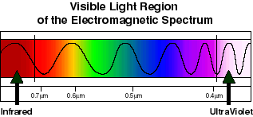

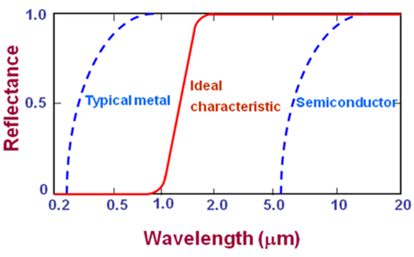
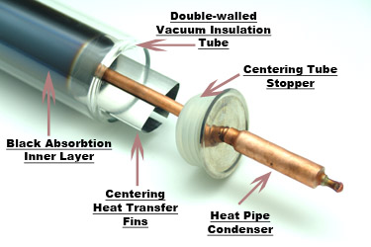
Introduction
What is about?
The absorber coating is the crucial
component in Concentrated Solar Power(CSP) units.
Absorber
Heat sink,
Thermoelectric Unit

Slide 3
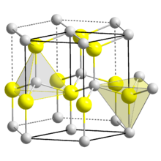
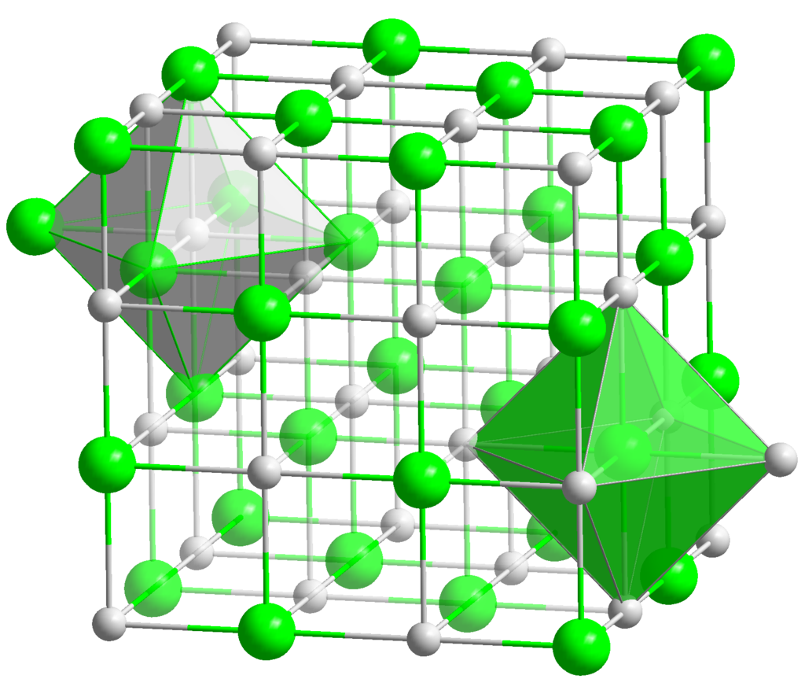
Material for dielectric
TiN-AlN Composite
Property | Aluminium Nitride | Titanium Nitride
Thermal conductivity | High (210-285 Wm⁻¹K⁻¹) | Very low (19.2 Wm⁻¹K⁻¹)
Electrical conductivity | Low | High
Absorption coefficient | Very low (k<10⁻³) | High
Melting point | 2200° C | 2950°C
Oxidation resistance | 750°C | 800°C
Structure | Hexagonal Wurtzite | Cubic NaCl type
TiN-AlN Composite
Due to their different crystal structures, it is expected that the mismatch in slip systems near the interface hinders dislocation activity and thus Aluminium Nitride and Titanium Nitride behave as individual components in the composite.
en.wikipedia.org/wiki/Titanium_nitride#/media/File:NaCl_polyhedra.png
en.wikipedia.org/wiki/Aluminium_nitride#/media/File:Wurtzite_polyhedra.png
N
Ti
N
Al

Slide 4
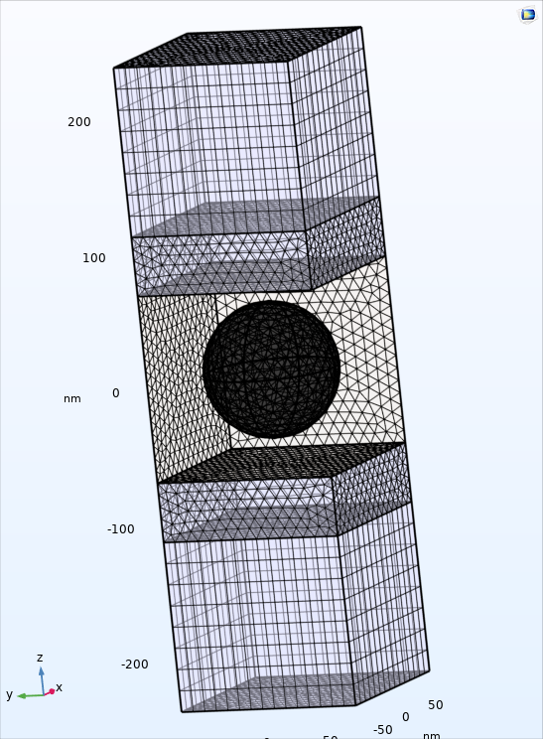

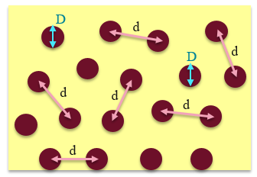
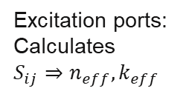


Dielectric Design using comsol
d: distance between consecutive TiN particles.
D: diameter of TiN particles.
PML
$$d=\frac{1}{4}{\left[\frac{6V\text{π}D3}{Vf }\right]}^{\frac{1}{3}}$$
Air
Excitation ports:
Calculates
$S_{ij}⇒n_{eff},k_{eff}$
$V_{f}$: volume fraction
AlN Matrix
TiN particle
Floquet PBC
Aluminium Nitride matrix
Titanium Nitride
inclusions
Dielectric

Slide 5
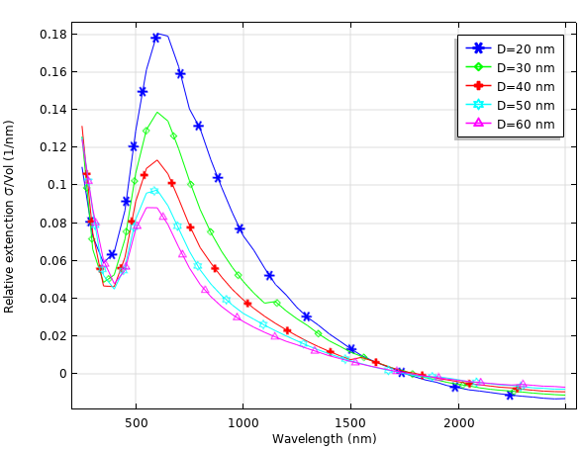
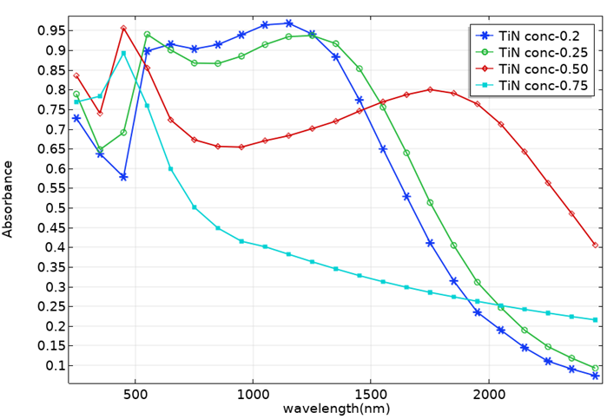
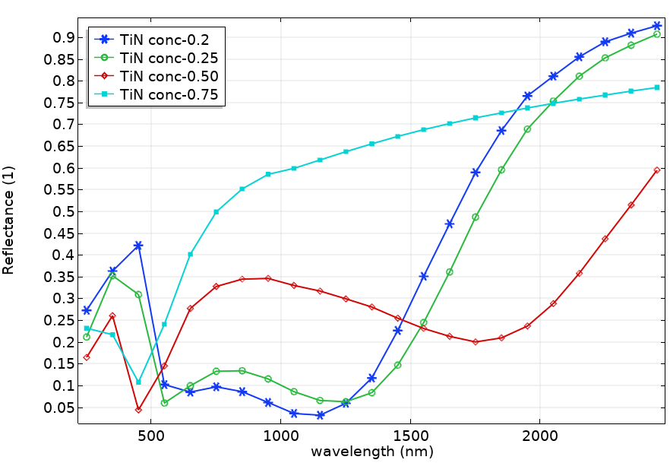
Dielectric Design using comsol
Fig-1. Variation of the extinction cross section relative to particle volume showing small particle diameter give better performance.
Fig-2. The absorbance of 1µm thick slab results showing that 20% of TiN content performs the best absorption over the Vis&IR spectrum.
Fig-3. The reflectance 1µm thick slab results showing that 20% of TiN content presents the best IR filter characteristics.

Slide 6
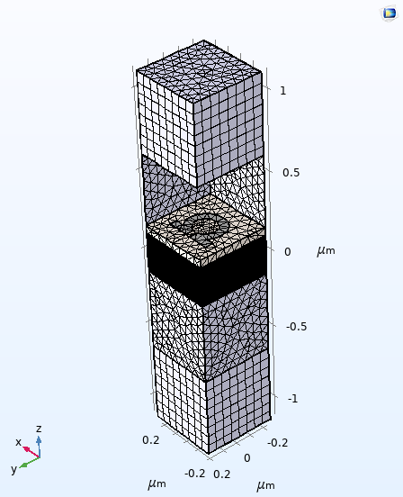
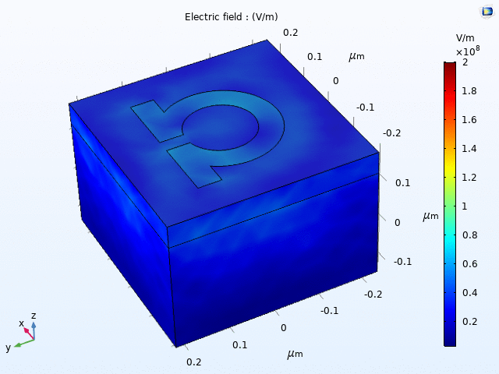
Metamaterial design for solar absorber
Ag Omega resonator
PML
AlN
AlN/TiN 20%
composite
Air
Floquet PBC

Slide 7
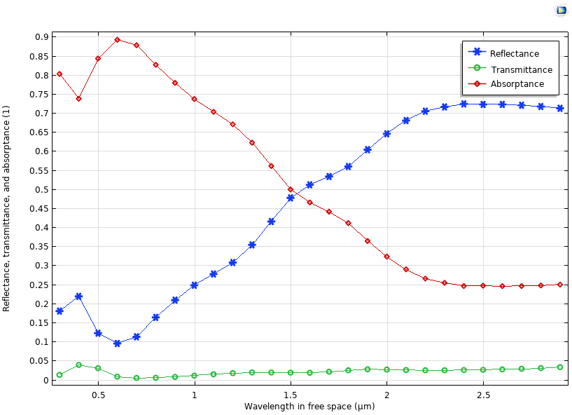
Metamaterial design for solar absorber
The reflectance 100nm thick metamaterial layer results showing good IR filter characteristics.

Slide 8
Conclusion
Multiscale simulations using CMSOL wave optics were successfully performed.
The nanoscale simulations allowed the investigation for best dielectric design
The microscale simulations allowed the prediction of reflectance/absorbance of the metamaterial
Future investigations will consist on using the predictive capability of COMSOL wave optics to optimise for best geometrical parameters of the resonant nanostructure that produce Ideal absorber filter.

Slide 9
Thanks for your attention
We acknowledge the Luxembourg National Research Fund for the FNR INTER-RCUK grant: Projet MADISSA INTER -RCUK/1611584556.

