Slide 1
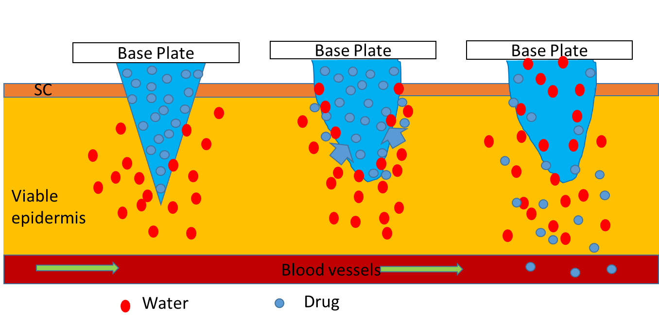
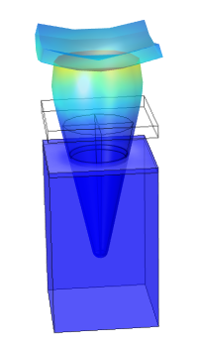
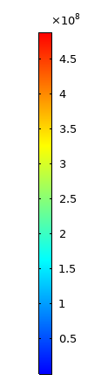
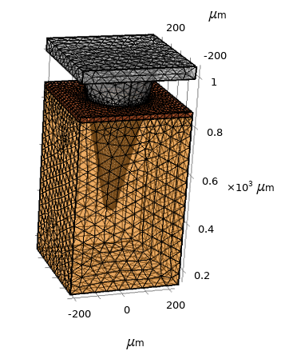

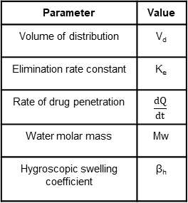
Modelling Swellable Microneedle based Transdermal Drug Delivery
P. R. Yadav^{1,2}, S. K. Pattanayek¹ D. B. Das²
1. Department of Chemical Engineering, Indian Institute of Technology, Delhi, Hauzkhas, New Delhi, India
2. Department of Chemical Engineering, Loughborough University, Loughborough, Leicestershire, United Kingdom
INTRODUCTION:
Swellable microneedles (MNs) have gained a lot of attention for drug transport through skin.
MNs swells by absorbing interstitial fluid, causing drug to transport into the skin
Aim: Linking physicochemical parameters of MN (e.g., Swelling kinetics) to controlled drug delivery
RESULTS:
115% increase in mass of MN within 15 min due to water uptake
Total drug released from microneedle domain within 3 hours
Skin elasticity forces swelled MN to rise upward
The model validated against the experimental data
Figure 1. Mechanism of drug transport from swellable microneedles
COMPUTATIONAL METHODS:
Transport of diluted species
$\frac{∂C_{i}}{∂t}=∇.\left(−D_{i,eff}∇C_{i}\right)$ i = water, drug
Concentration dependent insulin diffusion through polymer^{[2]}.
Global ODE and PDE for insulin absorption in bloodstream
$V_{d}\frac{dC_{d}}{dt}=\frac{dQ}{dt}−k_{e}C_{d}V_{d}$ (One compartment model)
Solid mechanics (hygroscopic swelling, contact modelling)
$$ε_{hs}=β_{h}×Mw\left(C_{w}−C_{initial}\right)$$
Figure 3. Microneedle mass change
Figure 4. Surface Von mises stress (N/m²)) (Time =40 min)
Figure 5. Microneedle mass change
Figure 6. Insulin conc. in blood
Parameter | Value
Volume of distribution | V_{d}
Elimination rate constant | K_{e}
Rate of drug penetration | $$\frac{dQ}{dt}$$
Water molar mass | Mw
Hygroscopic swelling coefficient | β_{h}
CONCLUSIONS:
Controlled drug delivery can be achieved by tuning the polymer swelling
Skin mechanical properties should be considered for MN based drug delivery
Force needs to be applied at needle base to hold it in place
Figure 2. 3D Model of single MN with meshing
Table 1. Model parameters
REFERENCES:
Donnelly, R. F. et al., Hydrogel-forming microneedles prepared from “super swelling” polymers combined with lyophilised wafers for transdermal drug delivery, PLoS One, 9(10), (2015).
Yang et al., Phase‐transition microneedle patches for efficient and accurate transdermal delivery of insulin, Advanced Functional Materials, 25(29), 4633-4641 (2015).
Caccavo, D. et al., Modeling the drug release from hydrogel-based matrices, Molecular Pharmaceutics, 12(2), 474-483 (2015).
Single MN is modeled, and results interpolated for MN array (5X5) due to uniformity
Model drug - insulin, Polymer - 15% Polyvinyl alcohol
Excerpt from the Proceedings of the 2020 COMSOL Conference

