Slide 1



An approach to verify the water transport model in organic coatings
E. Jalilian¹, M. Meeusen², B. Wouters², G. Van Assche¹, A. Hubin², H. Terryn²
¹Vrije Universiteit Brussel (VUB), Research Group Physical Chemistry and Polymer Science, Pleinlaan 2, B-1050 Brussels, Belgium
²Vrije Universiteit Brussel (VUB), Research Group Electrochemical and Surface Engineering, Pleinlaan 2, B-1050 Brussels, Belgium
Notes:
Kop
10/2/2020
Voet
1

Slide 2
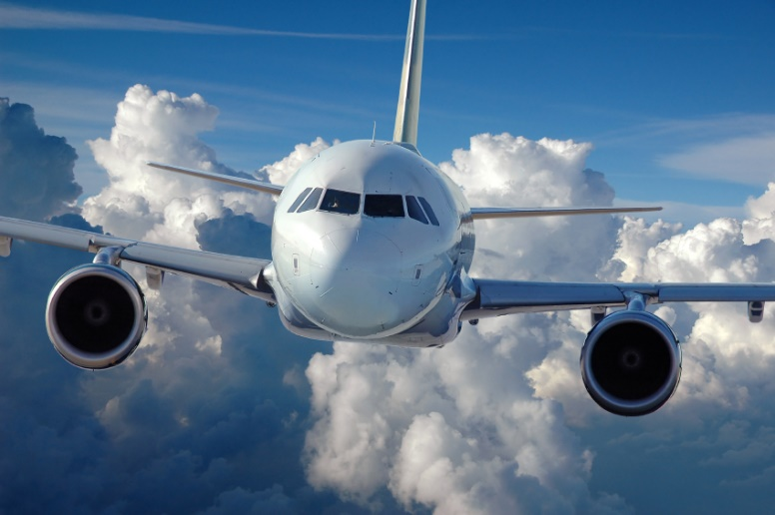

INTRODUCTION
GoalS
Advanced Materials industry
Extend service life
Sustainable material concepts
Higher performance (multifunctionality)
Lifetime and ageing testing of coatings
Formulation stage (initial product formulation + testing) months
Application stage (optimization application parameters) months
Internal testing months
Accelerated testing (standards ISO, NORSK,…) 6/9 months
Field testing (long-term testing) 3/5 years+
Total = 4-10 years (application)
CURRENT Approach (STATE OF THE ART)
M. Meeusen – An approach to verify the water transport model in organic coatings
10/2/2020 | 2

Slide 3

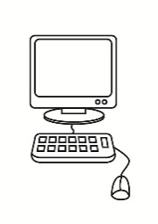
INTRODUCTION
APPROACH
AIM: Develop an integrated corrosion modelling tool that is reliable and predictive (20-30 years)
Integrated: subsystems (metal/coating/electrolyte) + phenomena (transport/interfacial (electro)chemistry/delamination) in 1 model
Combined experimental & modelling (FEM) approach
Experimental: mechanistic insight + input parameters model + validation model
PARAMETER OPTIMIZATION
2
1
3
INPUT
Model
OUTPUT & VALIDATION
FTIR
EIS
M. Meeusen – An approach to verify the water transport model in organic coatings
10/2/2020 | 3

Slide 4
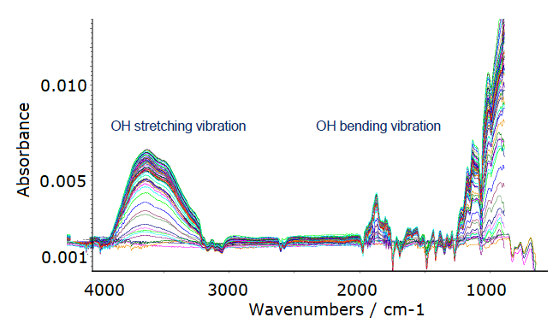
INTRODUCTION
APPROACH
AIM: Develop an integrated corrosion modelling tool that is reliable and predictive (20-30 years)
Integrated: subsystems (metal/coating/electrolyte) + phenomena (transport/interfacial (electro)chemistry/delamination) in 1 model
Combined experimental & modelling (FEM) approach
Experimental: mechanistic insight + input parameters model + validation model
PARAMETER OPTIMIZATION
2
1
3
INPUT
Model
OUTPUT & VALIDATION
FTIR
EIS
Rel Cf & Cb afo time (hours/days)
@ coating/substrate interface
M. Meeusen – An approach to verify the water transport model in organic coatings
10/2/2020 | 4

Slide 5

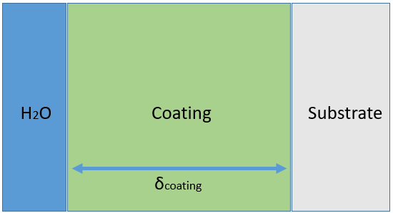

PARAMETER OPTIMIZATION
1
2
3
2. MODEL
INPUT
Model
OUTPUT & VALIDATION
1D model
Time-dependent water transport through coating
Diffusion
D diffusion constant
Adsorption/Desorption reaction
Cf concentration free water
Cb concentration bound water
kads adsorption rate
kdes desorption rate
Θf_max max fraction of sites for free water
Θb max max fraction of sites for bound water
EIS
Gravimetry
FTIR
INPUT
$${(H}_{2}{O)}_{f} ⇄ {}_{k_{des}}^{k_{ads}}{{ (H}_{2}{O)}_{b}}$$
1D
VARIABLES
MODEL PARAMETERS
[mol/m³] !!!
M. Meeusen – An approach to verify the water transport model in organic coatings
10/2/2020 | 5

Slide 6


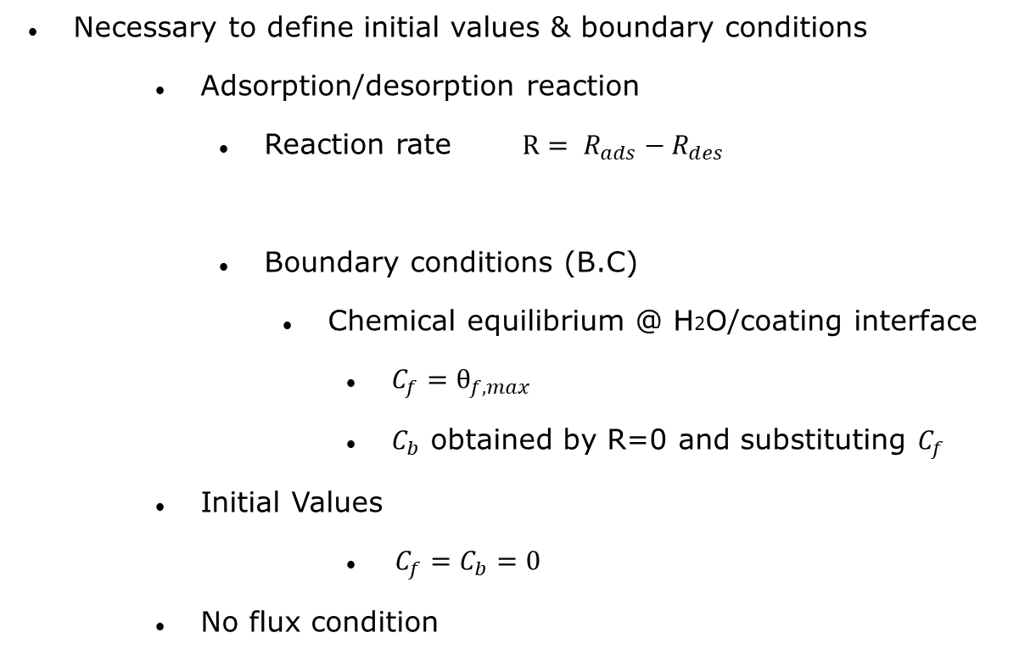
PARAMETER OPTIMIZATION
1
2
3
2. MODEL
INPUT
Model
OUTPUT & VALIDATION
Necessary to define initial values & boundary conditions
Adsorption/desorption reaction
Reaction rate $R= R_{ads}−R_{des}$
Boundary conditions (B.C)
Chemical equilibrium @ H2O/coating interface
$C_{f}=θ_{f,max}$
$C_{b}$ obtained by R=0 and substituting $C_{f}$
Initial Values
$C_{f}=C_{b}=0$
No flux condition
Gravimetry
FTIR
EIS
$${(H}_{2}{O)}_{f} ⇄ {}_{k_{des}}^{k_{ads}}{{ (H}_{2}{O)}_{b}}$$
$$=k_{ads}C_{f}\left(θ_{b,max}−C_{b}\right)−k_{des}C_{b}$$
1D
B.C.
No Flux
M. Meeusen – An approach to verify the water transport model in organic coatings
10/2/2020 | 6

Slide 7
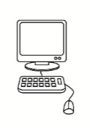
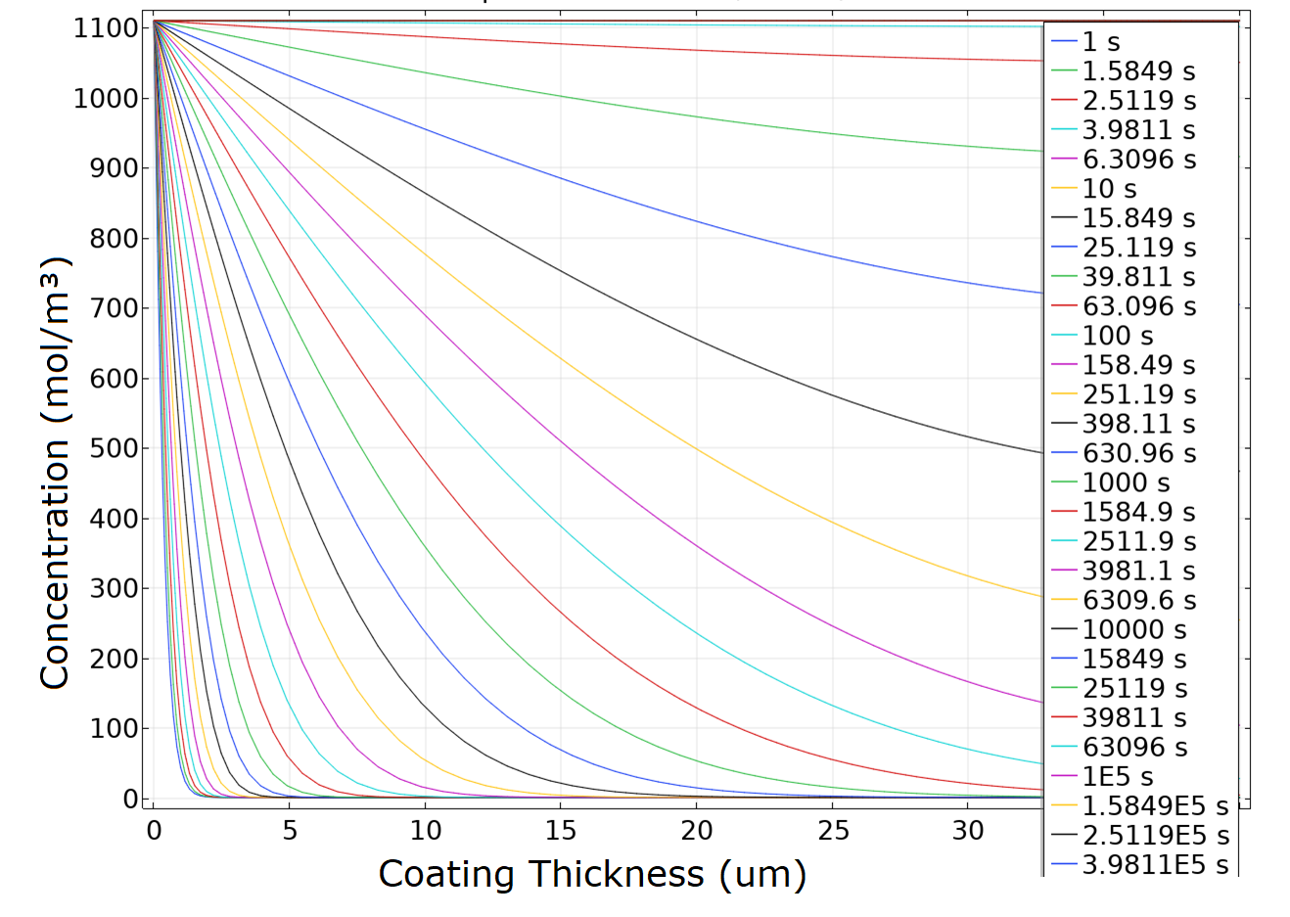
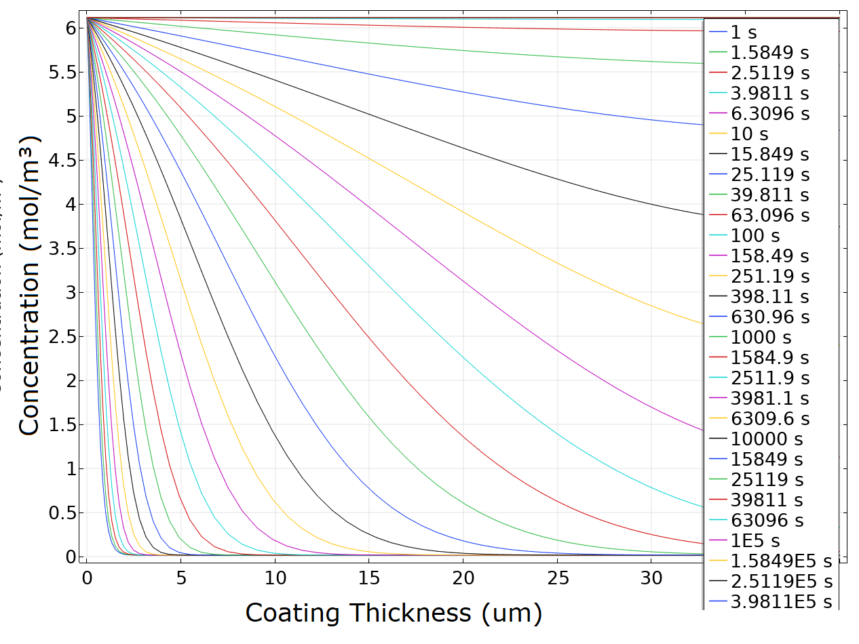
PARAMETER OPTIMIZATION
1
2
3
3. OUTPUT & VERIFICATION
INPUT
Model
OUTPUT & VALIDATION
OUTPUT
Gravimetry
FTIR
EIS
Cf vs d afo time
Cb vs d afo time
Time
Time
M. Meeusen – An approach to verify the water transport model in organic coatings
10/2/2020 | 7

Slide 8
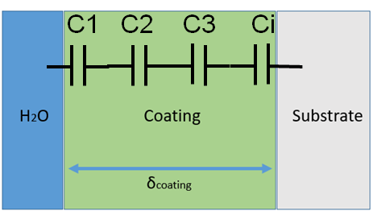
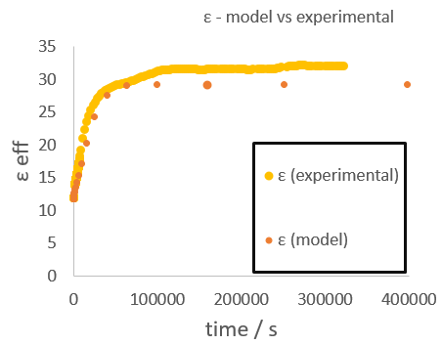
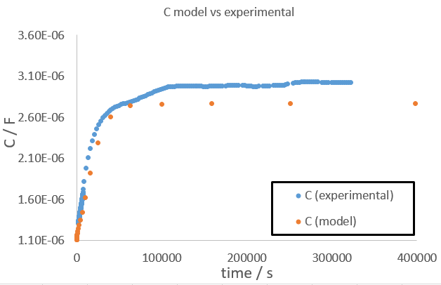
PARAMETER OPTIMIZATION
1
2
3
3. OUTPUT & VERIFICATION
INPUT
Model
OUTPUT & VALIDATION
OUTPUT - POSTPROCESSING
Gravimetry
FTIR
EIS
Concentrations c permittivities ε
capacitances C
virtual impedance plots Z
M. Meeusen – An approach to verify the water transport model in organic coatings
10/2/2020 | 8

Slide 9
Blue: modelling
Green: verification exp. parameters
Red: verification modelling results
Diffusion
Adsorption/Desorption
…
EC (Corrosion)
Delamination
SUMMARY & CONCLUSIONS
Now
FYSC:
Coating thickness (d)
Chemistry (MM, ρ)
Gravimetry:
D
Max water uptake
1
3
INPUT
Model
OUTPUT & VERIFICATION
Conc,free f(time, d)
& Conc,bound f(time, d)
Conc Ɛ
C
Bode plot
2
SURF:
ATR-FTIR Kretchmann
(coating/metal)
Rel. Conc free
Rel. Conc bound
SURF:
(ORP-)EIS Bode plot
C
Ɛ
D
Water uptake
PARAMETER OPTIMIZATION
kads – kdes – θsat – θbound_sat
M. Meeusen – An approach to verify the water transport model in organic coatings
10/2/2020 | 9

Slide 10
THANK YOU !!!
QUESTIONS ?
M. Meeusen – An approach to verify the water transport model in organic coatings
10/2/2020 | 10

