Slide 1



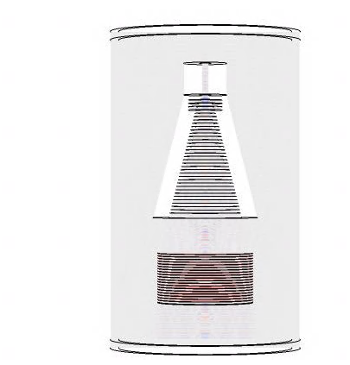



Enabling search for Dark Matter Axions with COMSOL Dr. Antonios Gardikiotis
Dark Matter Candidate
How to detect it
COMSOL to design an Axion detector
B
Notes:
The aim of this presentation is to introduce the work we did within the MADMAX collaboration to include Axion physics in COMSOL to be able to use this tool to optimize a detector for dark matter search

Slide 2
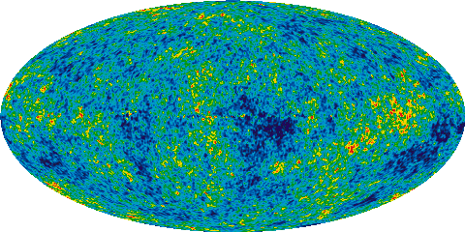
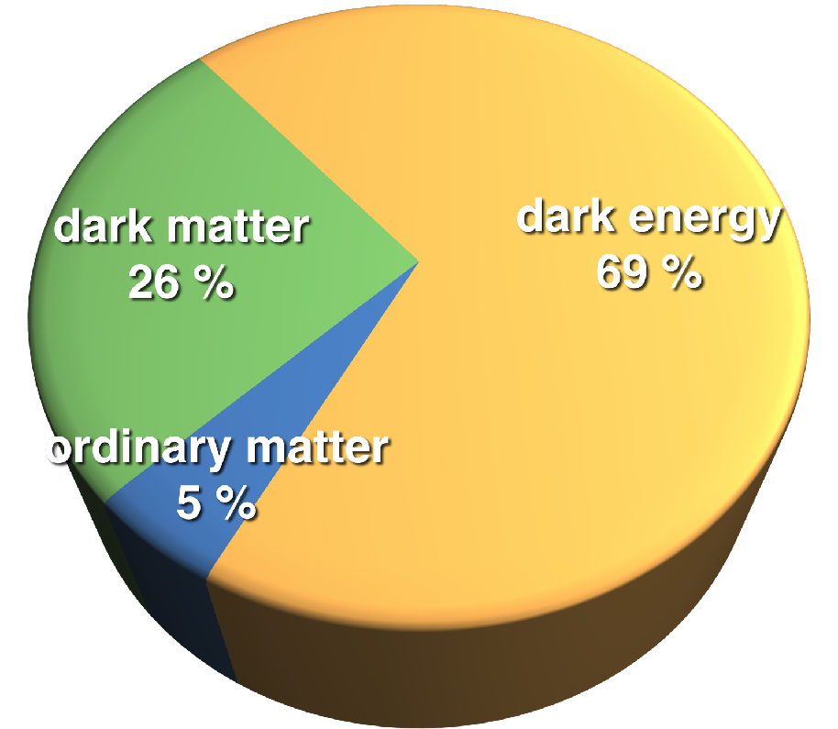
Dark matter
Cosmological indications hint to
We call it: Dark matter
It makes up 26% of the Universe
A form of matter with no electromagnetic interaction with normal matter
But we do not know what it is
Among many theoretical options a favourite candidate is the Axion
Very light particle (ma ∼ 10-100 μeV/c) or high frequency wave (νa ∼ 10-100 GHz)
Behaviour as a collision-less fluid at cosmological length scales

Slide 3
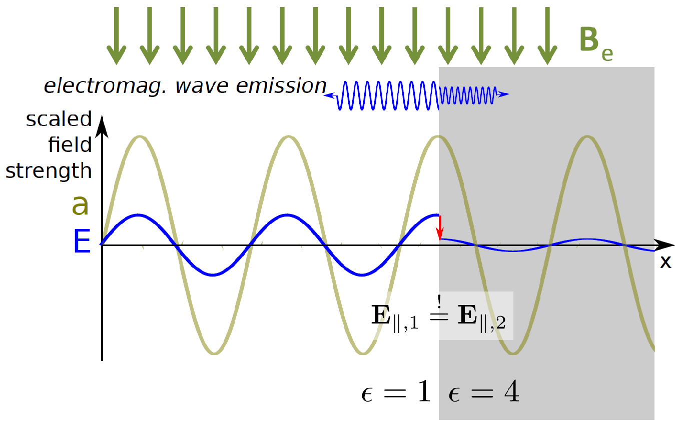
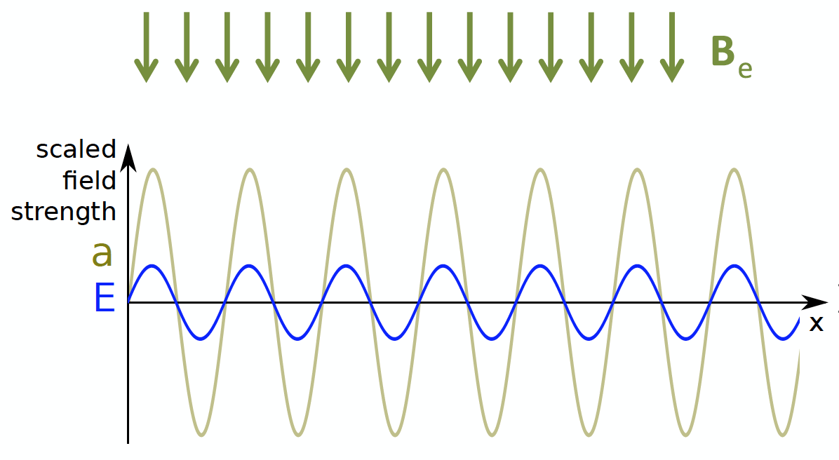
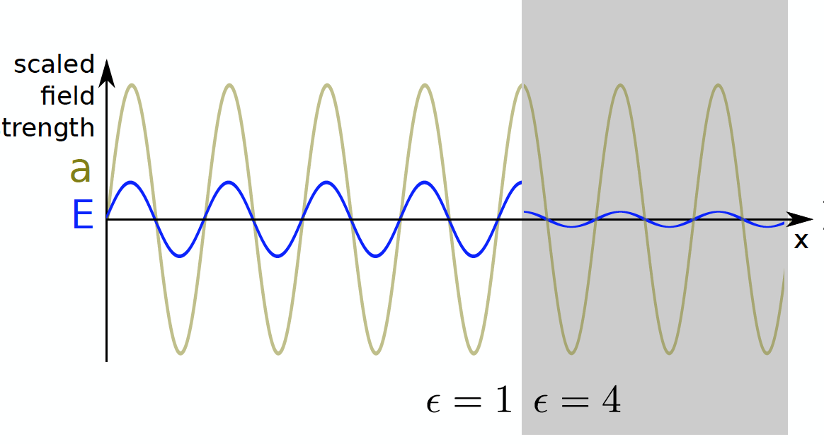
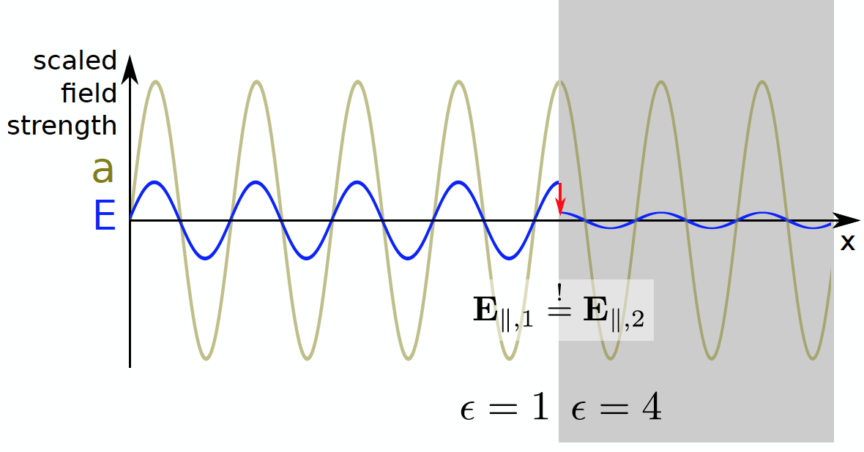
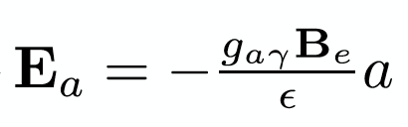
Axion detection
If the Axion exists, it can be converted to a photon in a strong B-field: In an external B-field the axion sources an oscillating E-field
B
B
D. Horns, J. Jaeckel, A. Lindner, A. Lobanov, J. Redondo and A. Ringwald JCAP 1304 (2013) 016 [arXiv:1212.2970].
At surfaces with transition of ϵ: Discontinuity of E-field
Emission of photons
The Axion detector is designed to measure
the photon power emitted

Slide 4
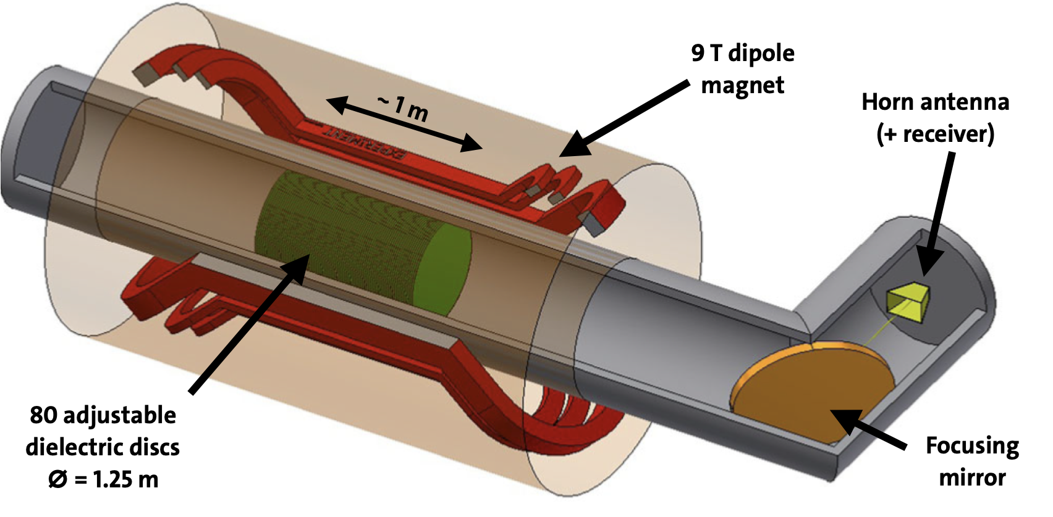
– Axion detection experiment
Complex system with many aspects to optimize
Use COMSOL to simulate axion generated EM wave
Investigate 3D effects of: - dielectric materials - mixing modes - near field effects - “wave guide” cryostat - antenna coupling - …
Very computationally demanding task
COMSOL simplified design
Dielectric discs
Receiver

Slide 5
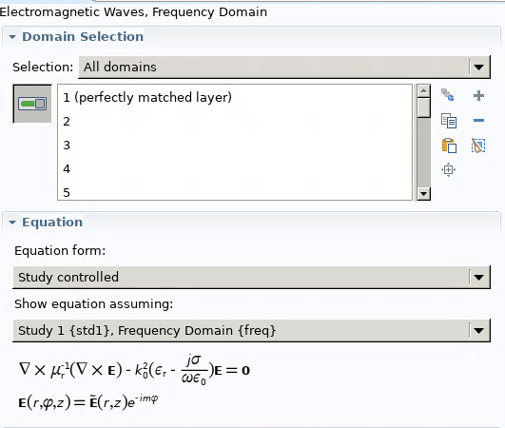
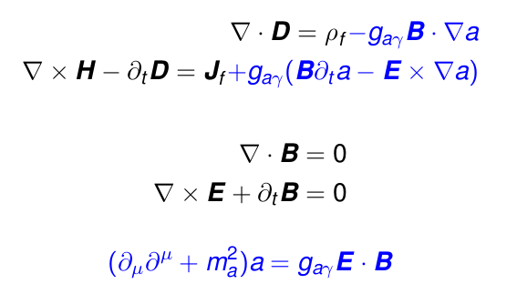
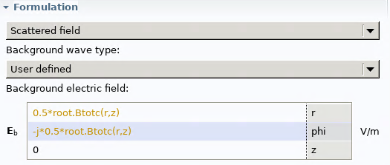


Axion implementation in COMSOL
Theoretical implementation as modification of Maxwell's equations
COMSOL implementation in frequency domain
a = Axion field
Axion induced field:
A First Look on 3D Effects in Open Axion Haloscopes
Stefan Knirck, Jan Schütte-Engel, Alexander J. Millar, Javier Redondo, Olaf Reimann, Andreas Ringwald, Frank D. Steffen
https://iopscience.iop.org/article/10.1088/1475-7516/2019/08/026

Slide 6
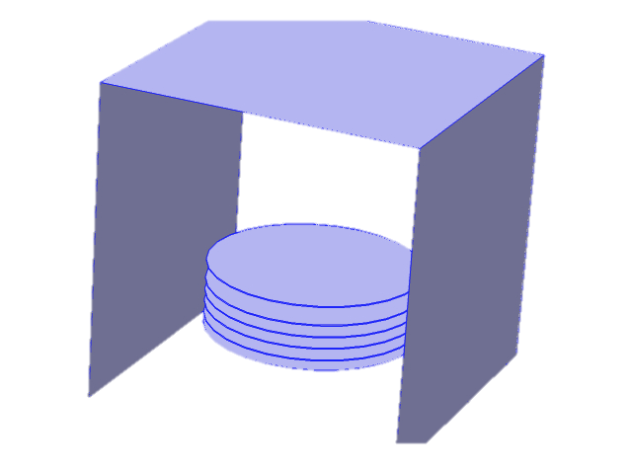
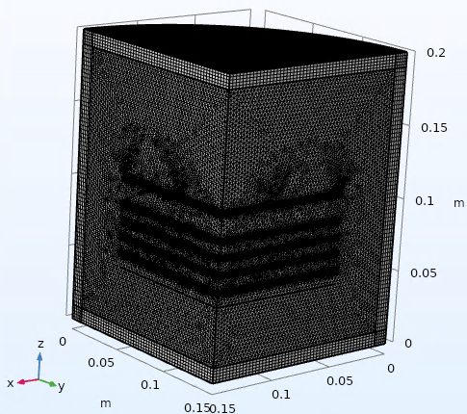

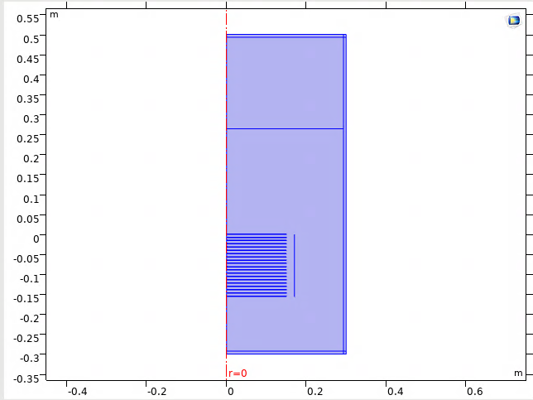
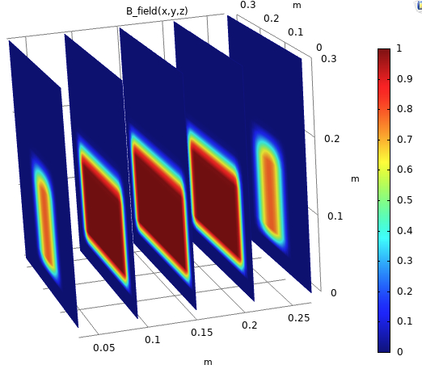
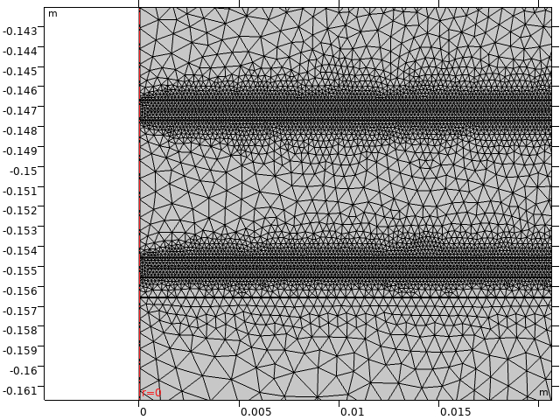
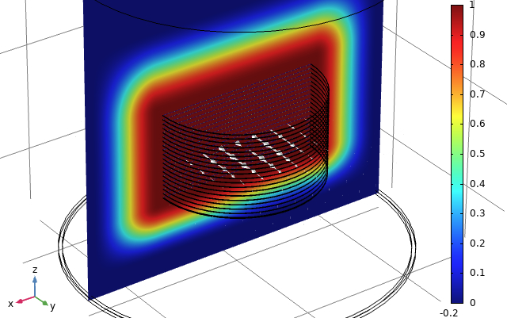
Reduce 3D problem to 2D
Symmetry broken by B-field, but reduce problem to two 2D circular modes:
B
d
m
PML= λ /2
λ=1.33 cm
B
PEC
5 dielectric disks (⌀ 20 cm, d=15 cm, ε=24, tanδ=5^{x}10⁻⁵)
Mesh size = λ/10 (νa ∼ 10-100 GHz ➔ λ ∼ 1-30 mm )
3D problem is computational demanding > 10 GHz

Slide 7
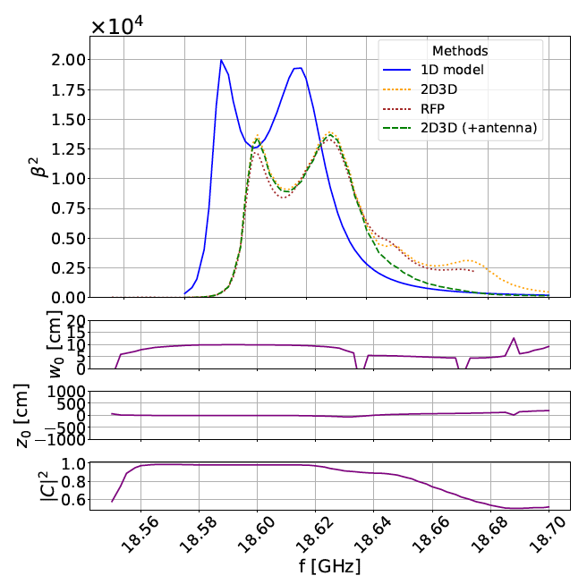
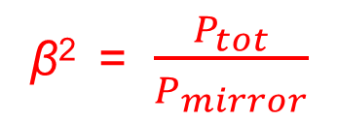
Validation and comparison to 1D
COMSOL implementation validated against a recursive Fourier propagation (RFP code)
Significant effect of 3D w.r.t. 1D model ➔ crucial for detector design
Emitted power through many disks:
– coherent emission from multiple interfaces
– resonance effects
Power boost factor

Slide 8
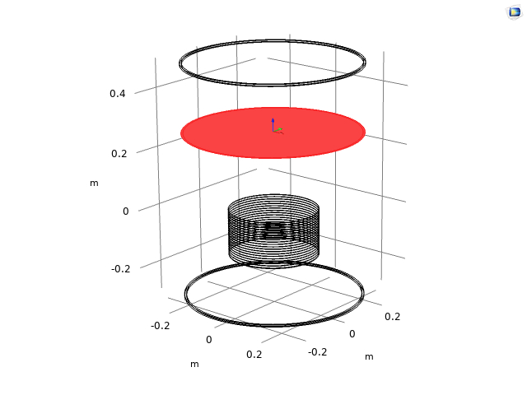
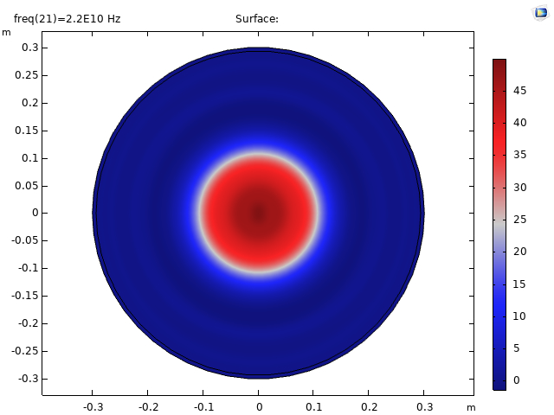
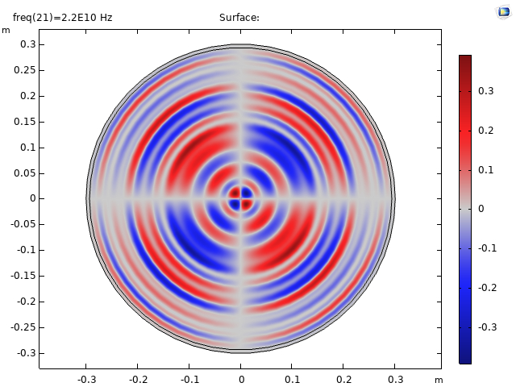
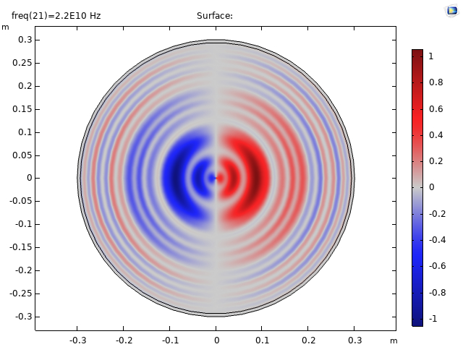
Signal matching to antenna
10
Axion induced field by 20 dielectric disks in a B_{x}-field
Most of the signal has Gaussian shape
Small y, z components
E_{x}
10⁻¹¹
d = 20 cm
Next: study the matching effect
10⁻¹¹
E_{z}
10⁻¹¹
E_{y}

Slide 9
Conclusions
We have implemented Axion physics in COMSOL
We use two circular mode 2D simulations to simplify the 3D simulation
3D effects are significant compared to 1D analytical models
COMSOL is used to optimize the detector design of the future MADMAX experiment:
An experiment to enable the detection of Dark Matter Axions

Slide 10
BACKUP

Slide 11
MADMAX sensitivity projection
Unique chance to discover axions in the theoretically favoured region

