Slide 1
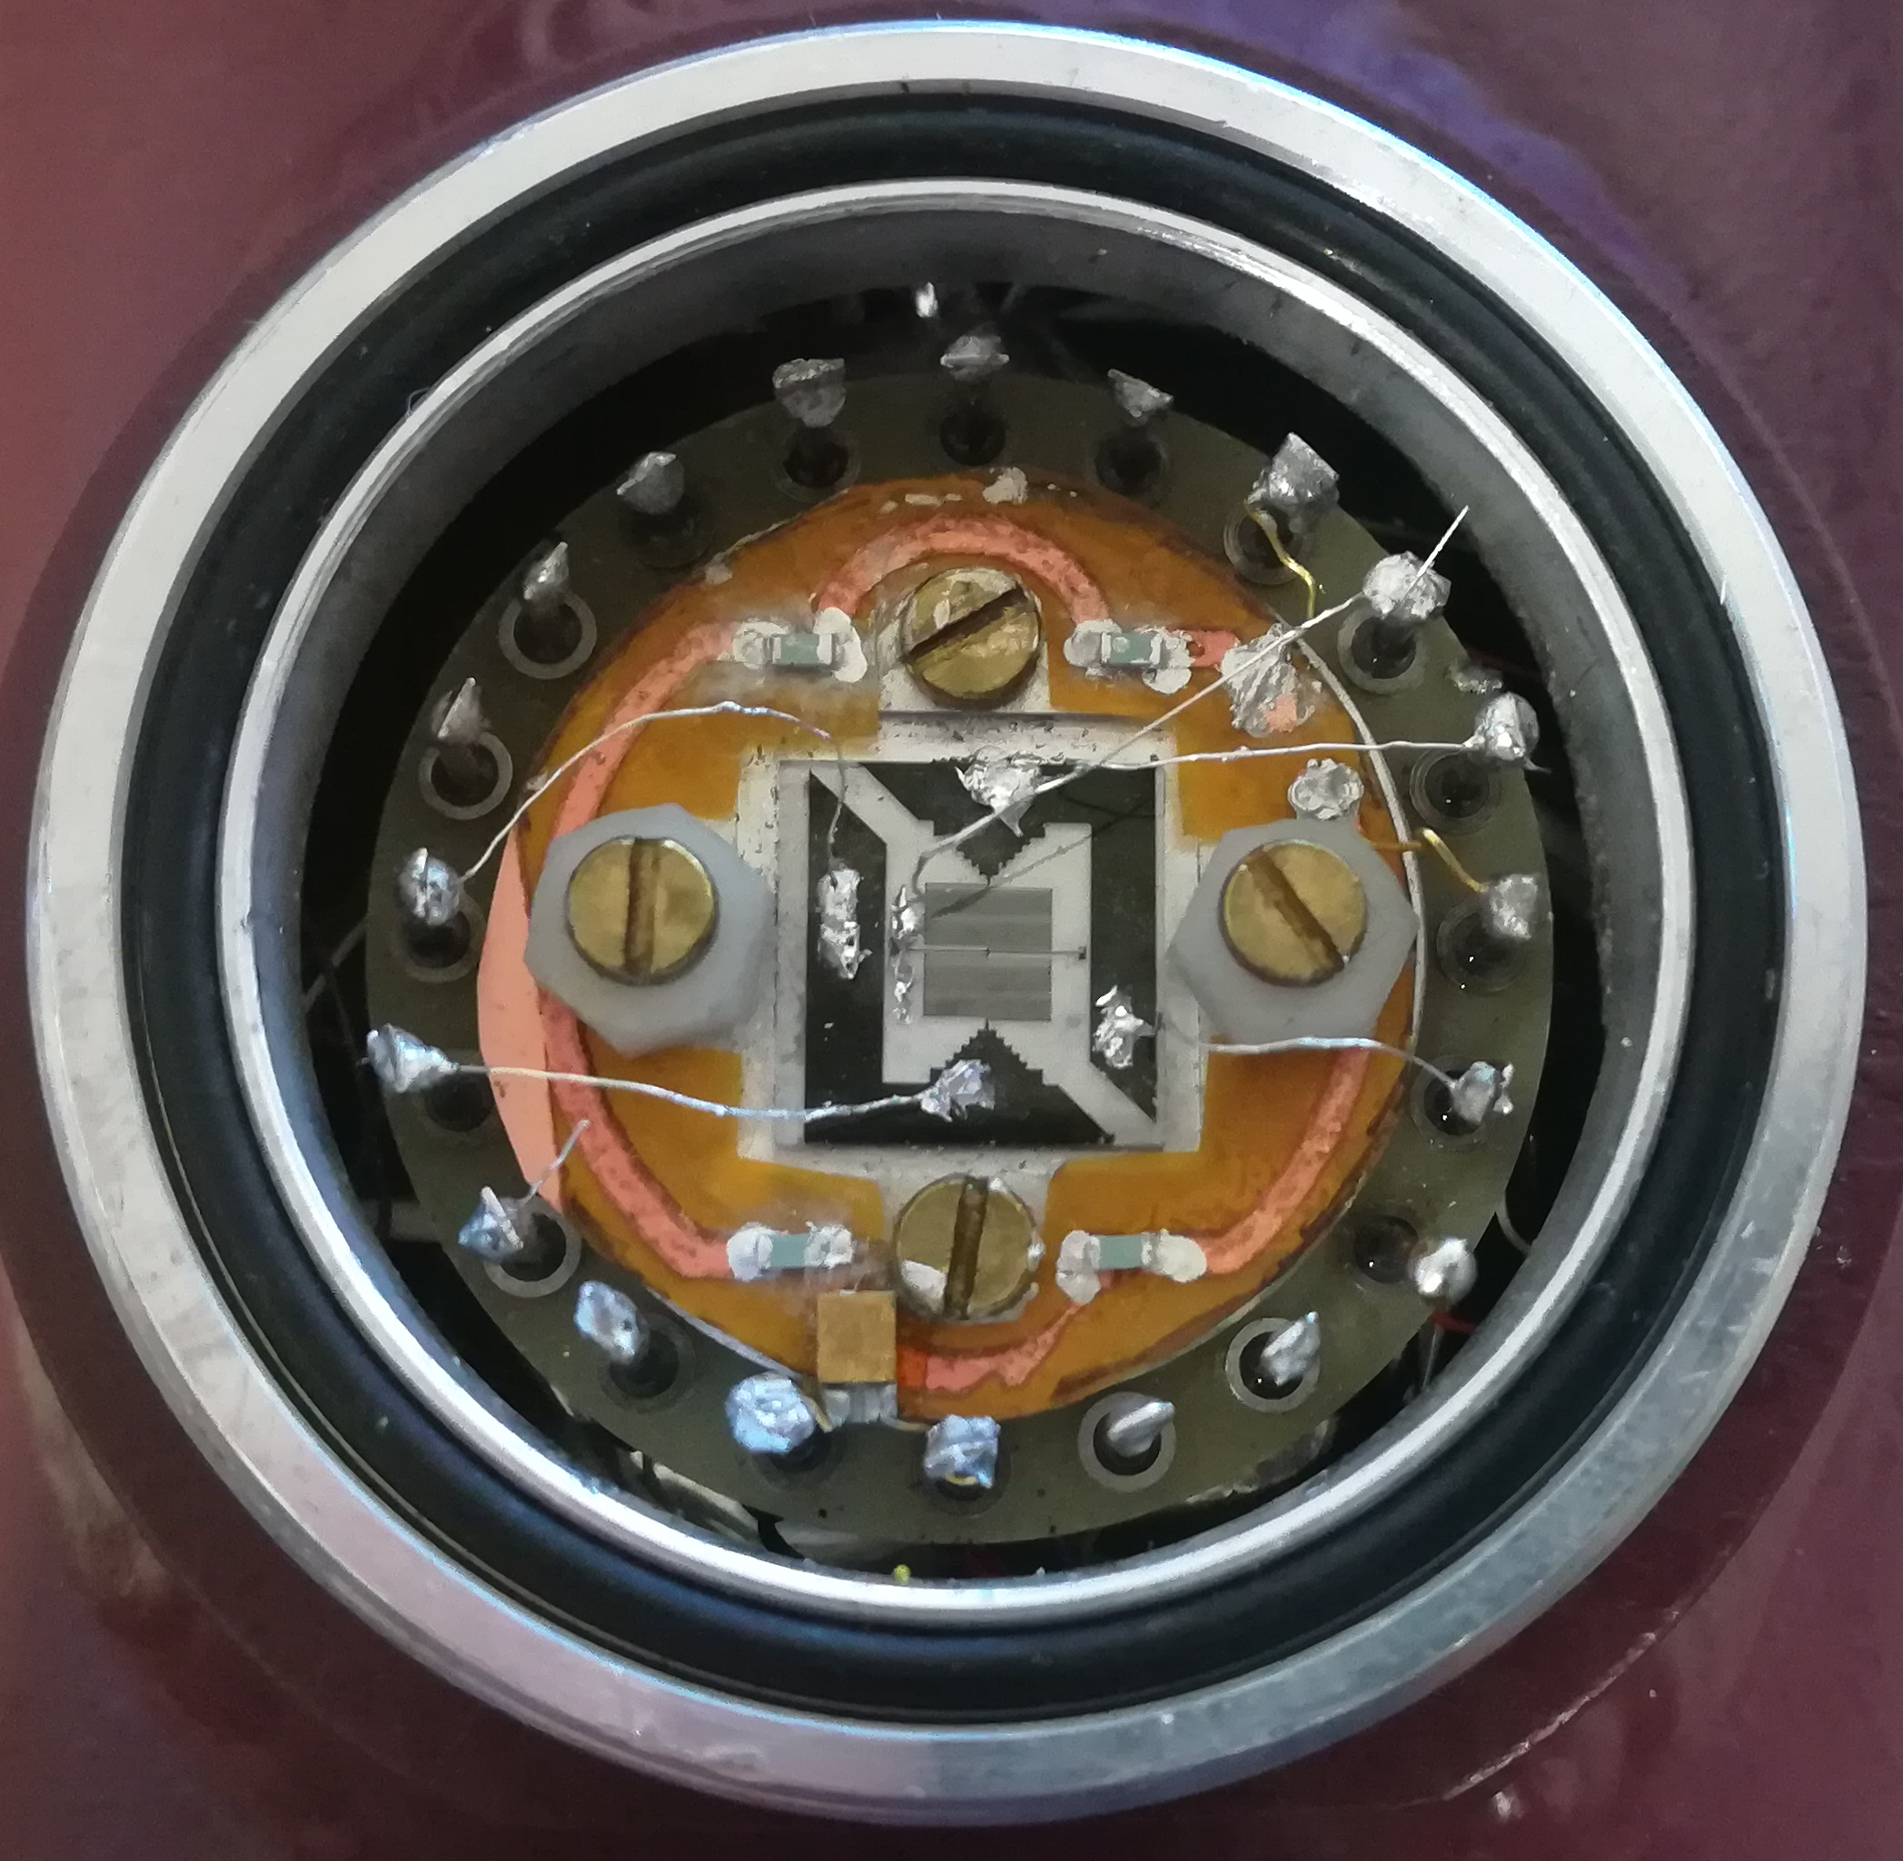
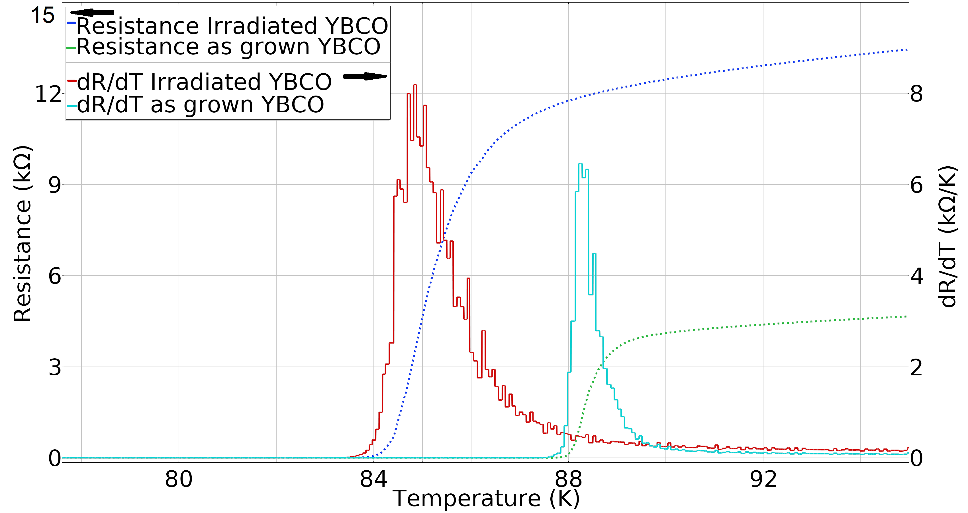
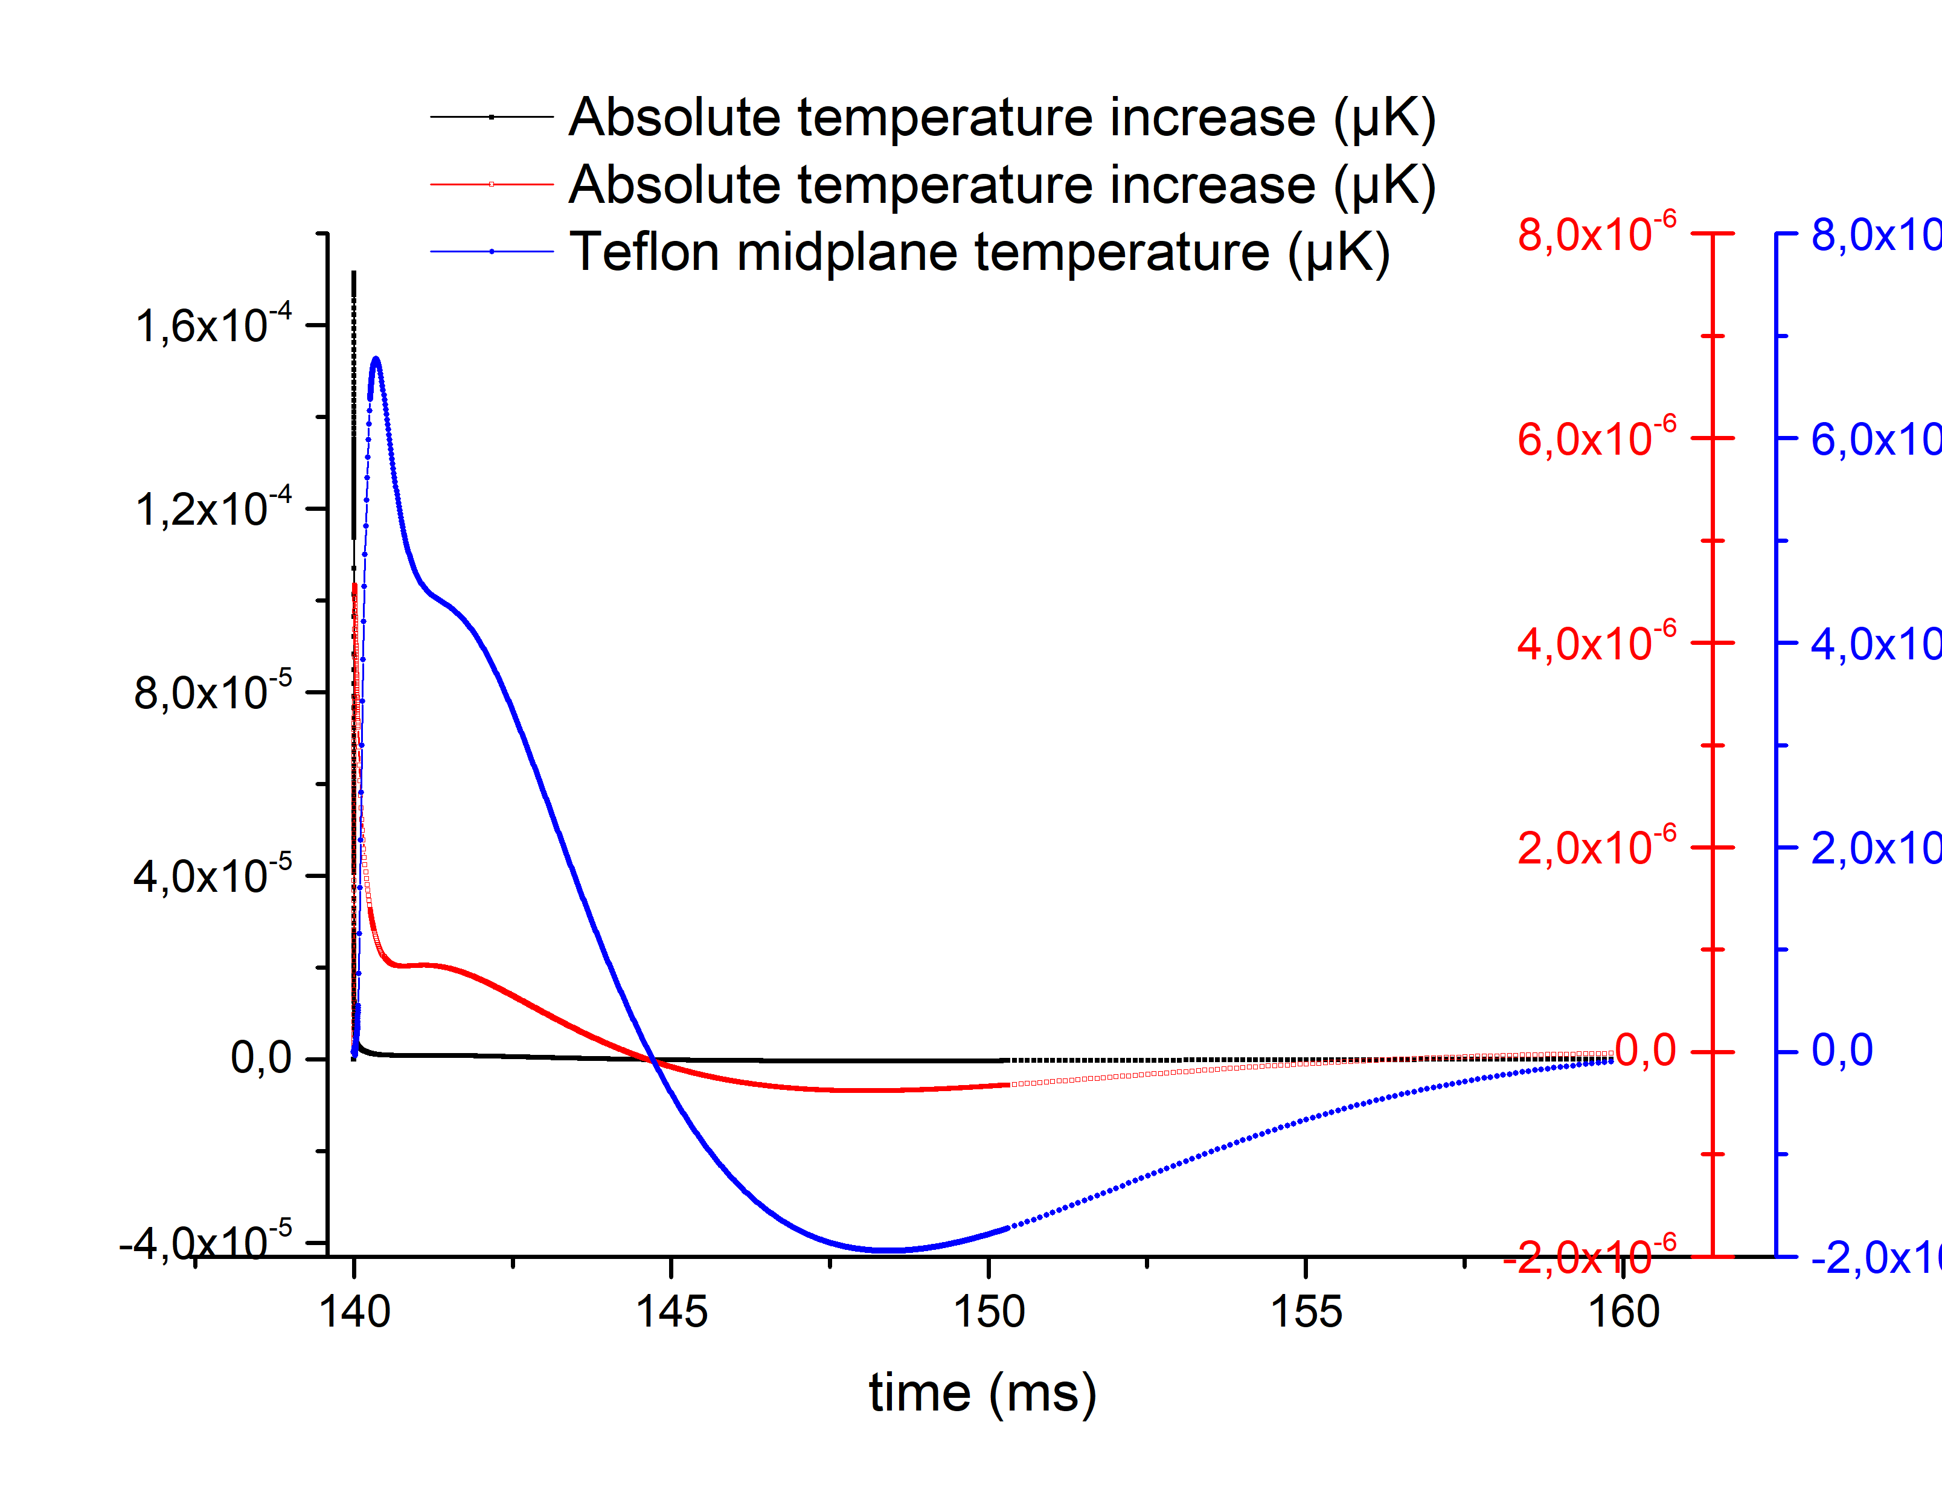
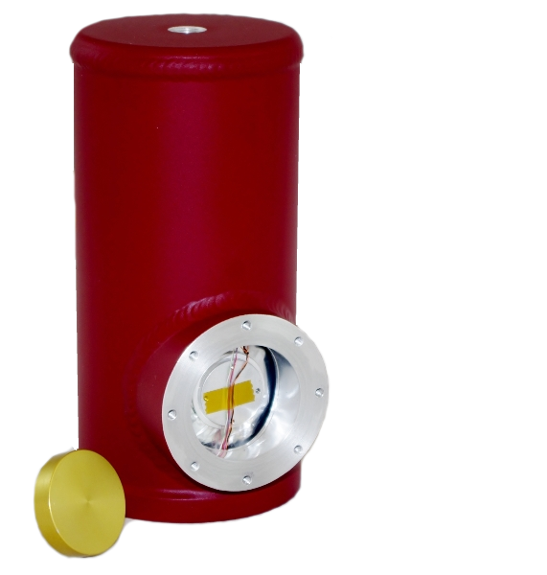
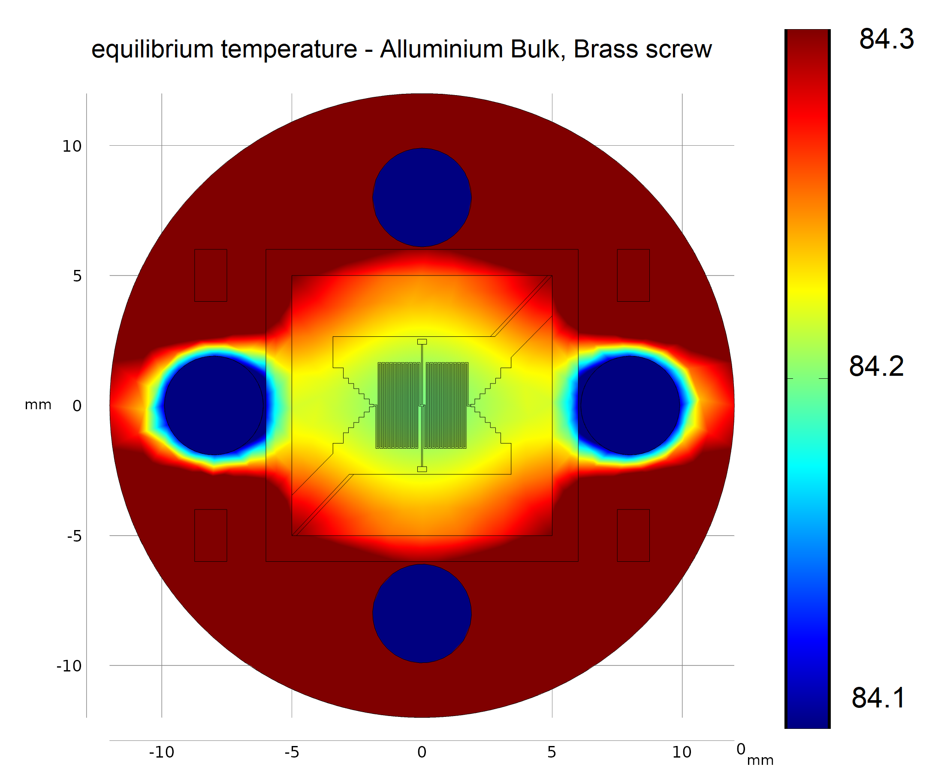
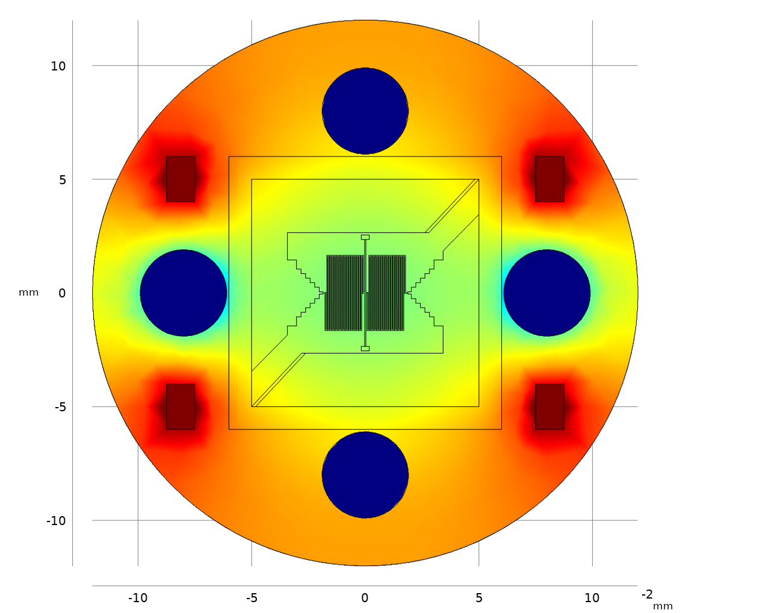
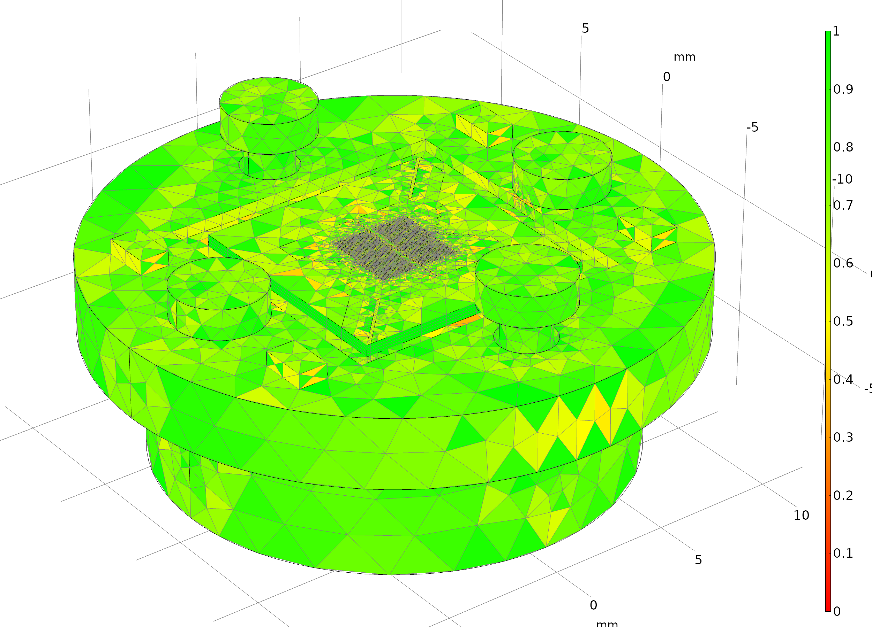
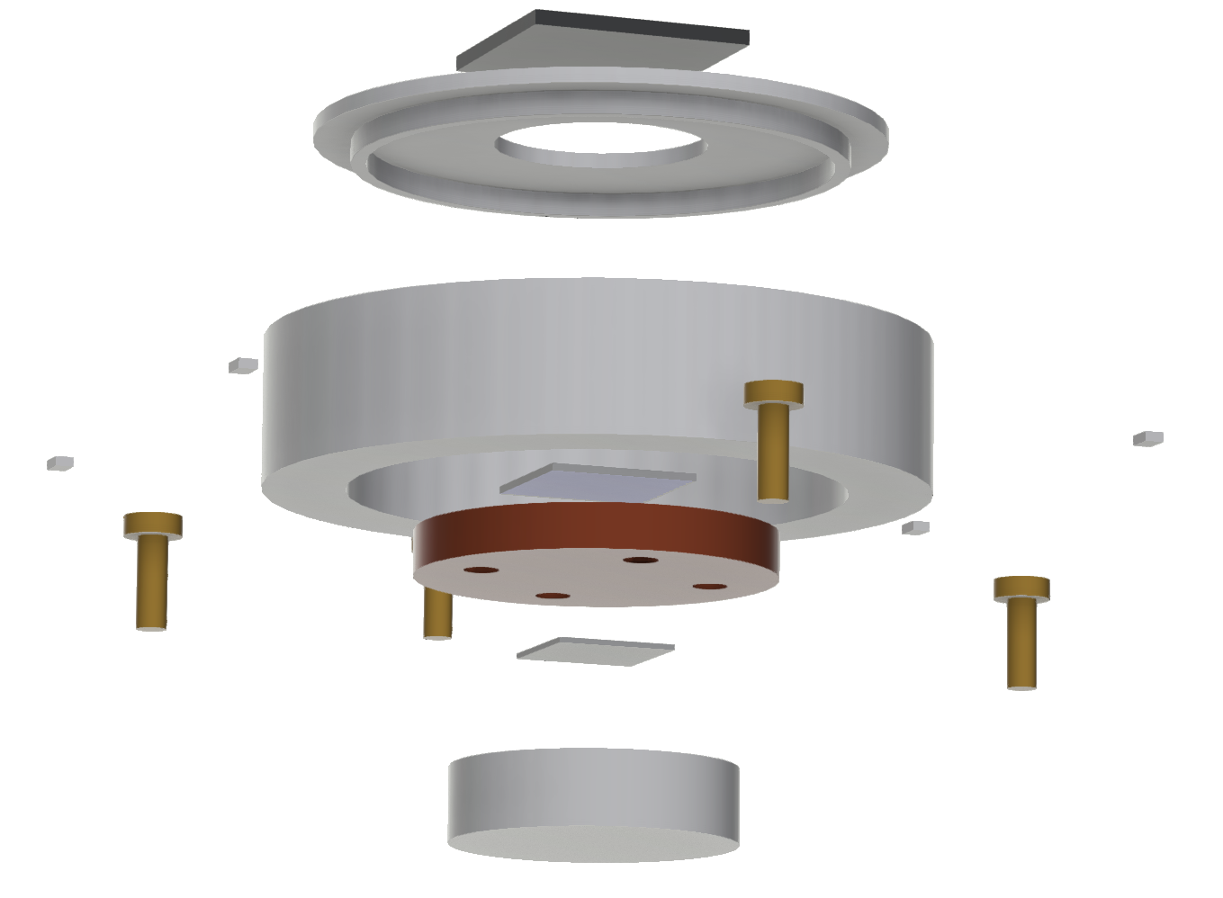
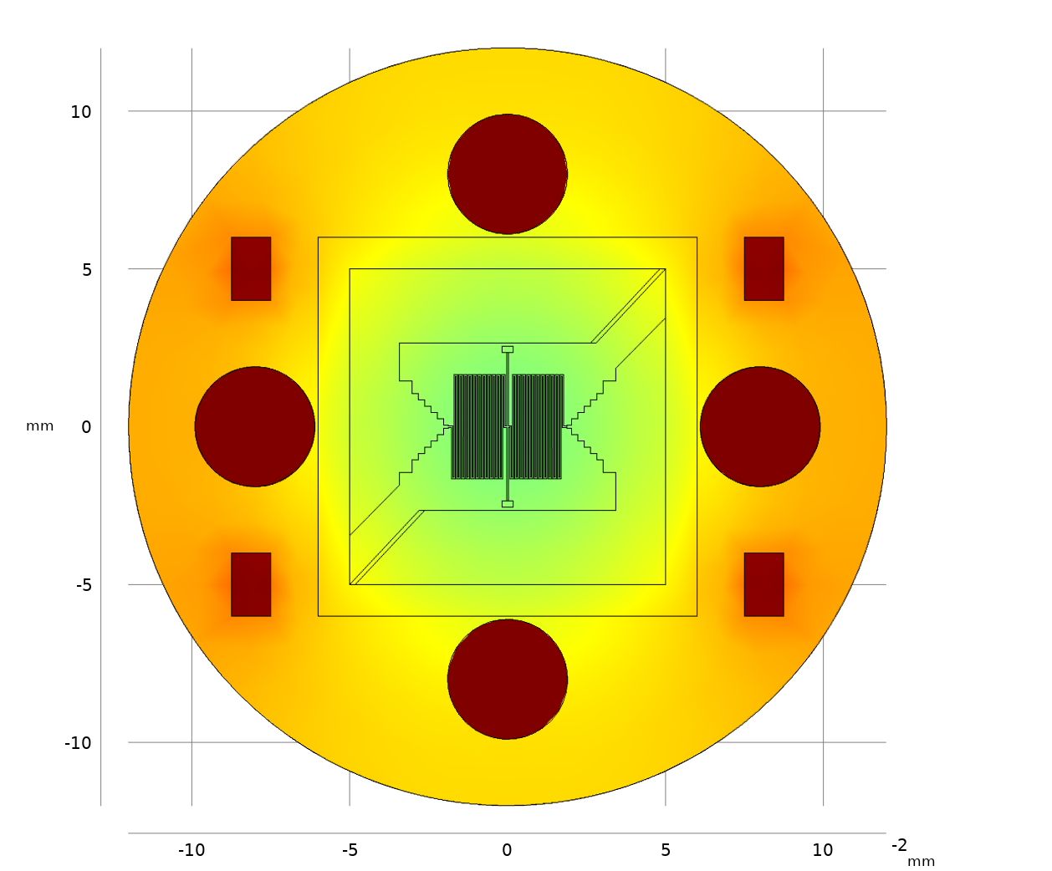
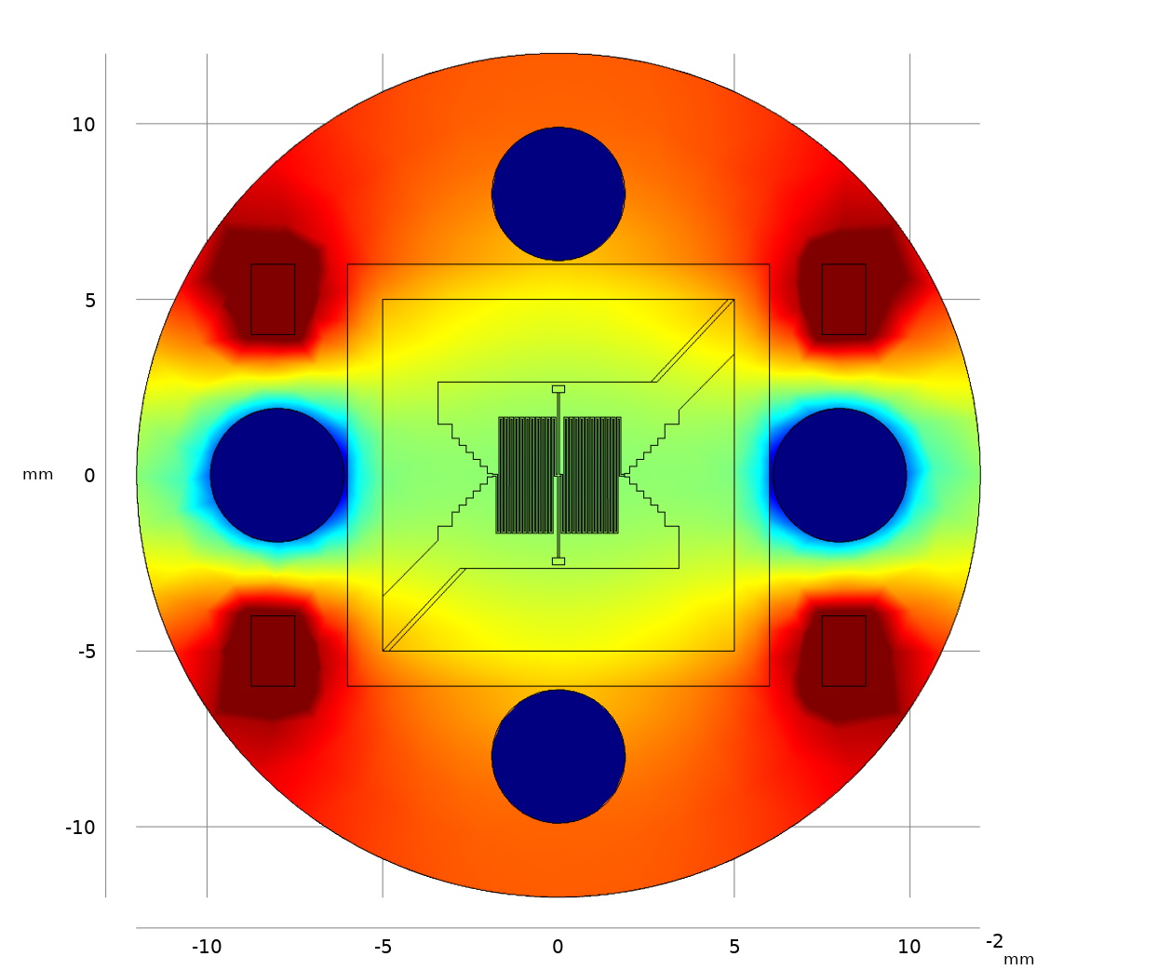
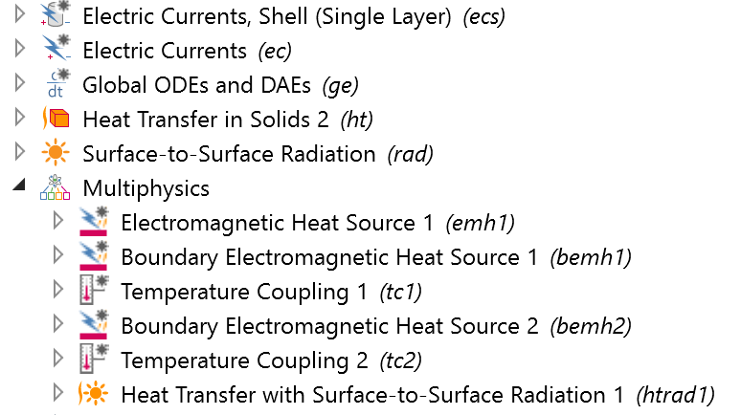
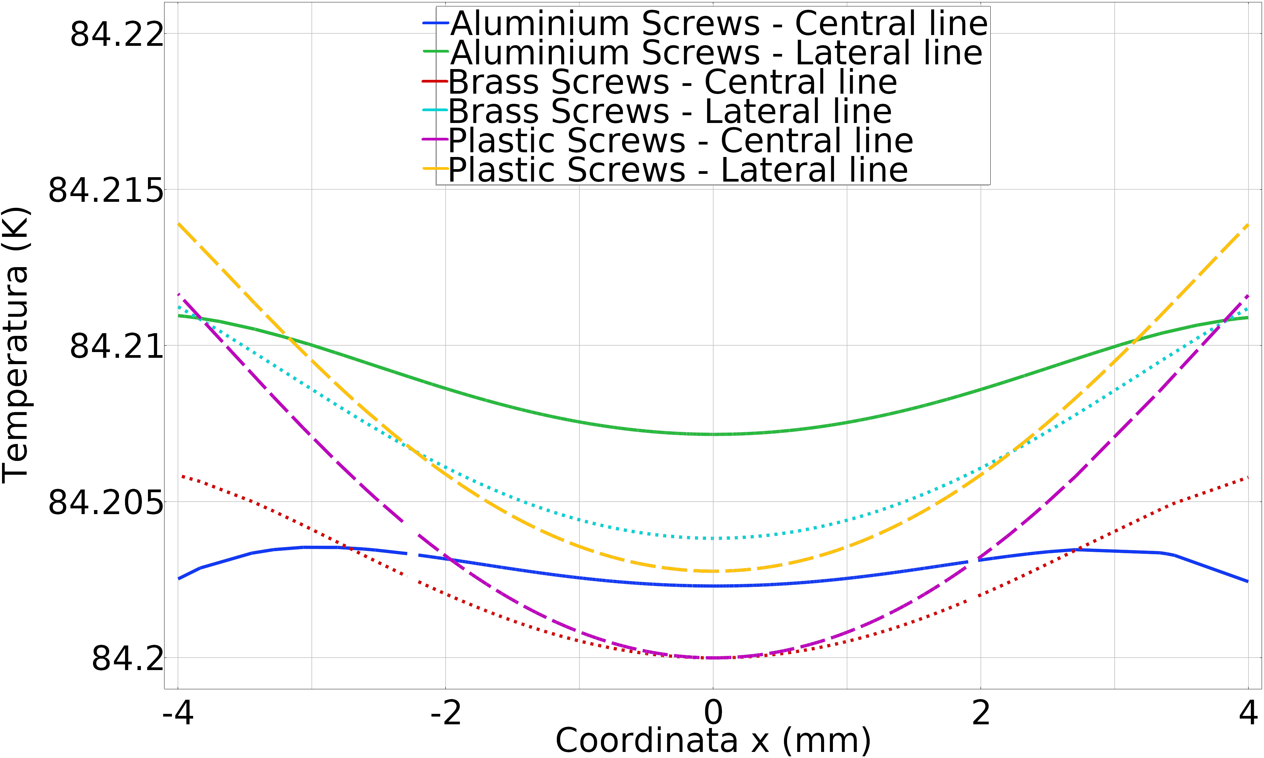
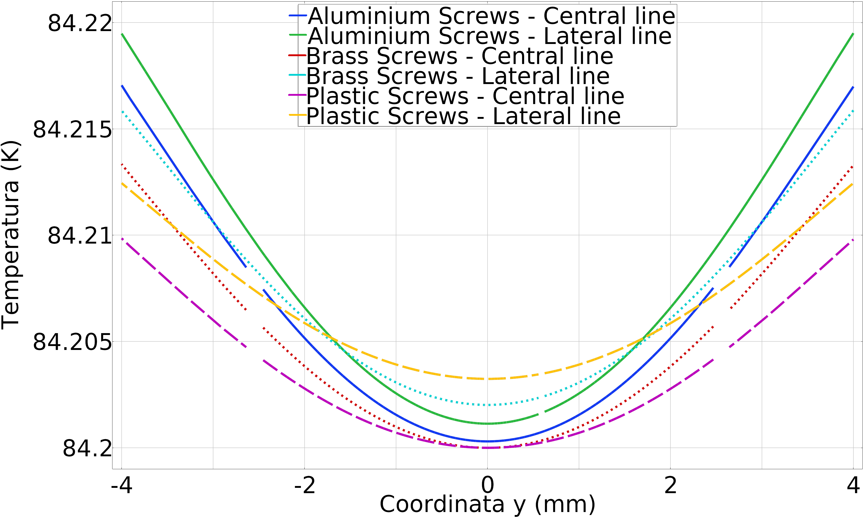
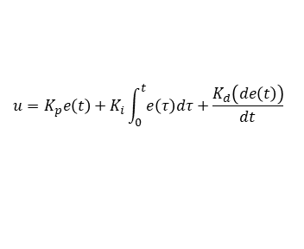

Optimization of superconducting bolometer working above LN2 temperature
A. Napolitano^{1,2}, S. Ferracin¹, M. Fracasso^{1,2}, R. Gerbaldo^{1,2}, G. Ghigo^{1,2}, L. Gozzelino^{1,2}, D. Torsello^{1,2} and F. Laviano^{1,2}
¹ DISAT, Dipartimento di Scienza Applicata e Tecnologia, Politecnico di Torino, corso Duca degli Abruzzi 24, 10129 Torino , Italy
² INFN Istituto Nazionale di Fisica Nucleare, Sezione di Torino, Via P. Giuria 1, 10125 Torino, Italy
INTRODUCTION:
The software COMSOL Multiphysics was used to simulate and optimize a YBCO based portable bolometer working at a temperature above 77K.
The optimization process was used to find the best materials for the cold finger and the screws.
RESULTS:
The first simulation intended to replicate the real bolometer, the temperature reproduced the obtained one and the study of the thermal evolution in response to the incoming electromagnetic signal was coherent with theoretical estimations.
Material | Theoretical | Simulated
MgO | 91.9e-5 (s) | 89.0e-5 (s)
Aluminum | 0.11 (s) | 0.13 (s)
Teflon | 0.42 (s) | 0.38 (s)
Figure 1. Detailed view of the superconducting sensor, Dewar containing the bolometer and experimental R vs T curves for both as grown and functionalized meander irradiated with heavy ions together with its derivative
Figure 4. Temperature evolution over time and theoretical and extrapolated time constant of the most important layer of the bolometer
The optimization process, performed after the validation of the model, considered two different materials for the bulk (aluminum and copper) and 4 for the screws (brass, plastic, aluminum and copper)
COMPUTATIONAL METHODS:
The CAD of the bolometer was imported in COMSOL for maintaining the best resolution and the experimental result of the YBCO’S resistance were imported and interpolate. The resistivity was then calculated considering the geometry of the sensor.
a)
b)
Figure 5. Temperature profile for a) aluminum bulk and brass screws, b,c,d) copper bulk and brass, plastic and aluminum screw respectively
Figure 2. exploded view of the components simulated in COMSOL and surface mesh quality of the internal part of the bolometer
$$u=K_{p}e\left(t\right)+K_{i}\int_{0}^{t}{e\left(τ\right)dτ}+\frac{K_{d}\left(de\left(t\right)\right)}{dt}$$
c)
d)
$$ρc_{p}V \frac{∂T}{∂t}=−kA^{∗} ∇T$$
$$τ=\frac{ρc_{p}V δx}{kA^{∗}}$$
Equation 1. PID equation for temperature control and time constant expression for model validation
Figure 3. Physics used for the simulation
Figure 5. Temperatures along x (left) and y-direction (right) in central position at 2 mm to the centre of the sensor for copper bulk and different screws
The external temperature boundary was set at 293 K, while the cold finger at 77.6 K, with no perturbation.
The superconducting film was approximate with the physics “Electric Currents, Shell” and “Thin Layer” for the thermal part. Coupling was set for electromagnetic and thermal physics. A global equation was implemented to simulate an active PID control of the temperature
CONCLUSIONS:
This study allows us to find the best combination of material for a homogeneous thermal profile which are copper bulk and aluminum screws.
The future detector will be assembled considering this results for enhancing performances and robustness.
ACKNOWLEDGEMENTS:
This work was done in the framework of the INFN-TERA project
Staff of INFN-LNL is gratefully acknowledged for support during irradiation experiments
REFERENCES:
F. Laviano, Thz Detection Above 77 K In YBCO Films Patterned By Heavy-ion Lithography, IEEE Sensors Journal 10, 863 (2010)
A. Napolitano, Multiphysics simulation of a superconducting bolometer working in a portable cryostat, J. Phys.: Conf. Ser. 1559 012019 (2020)
Excerpt from the Proceedings of the 2020 COMSOL Conference

