Slide 1



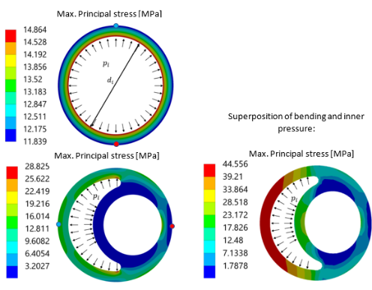
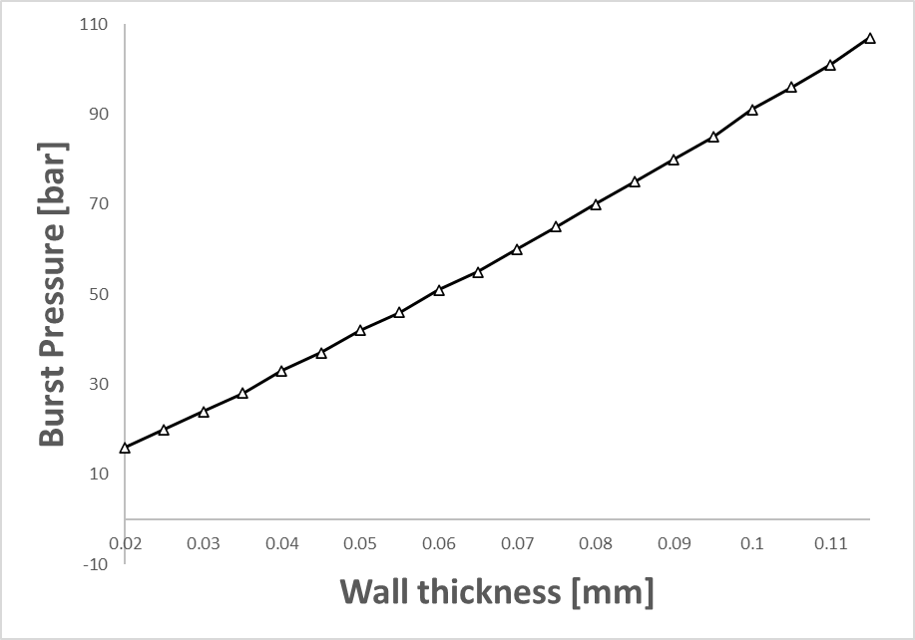
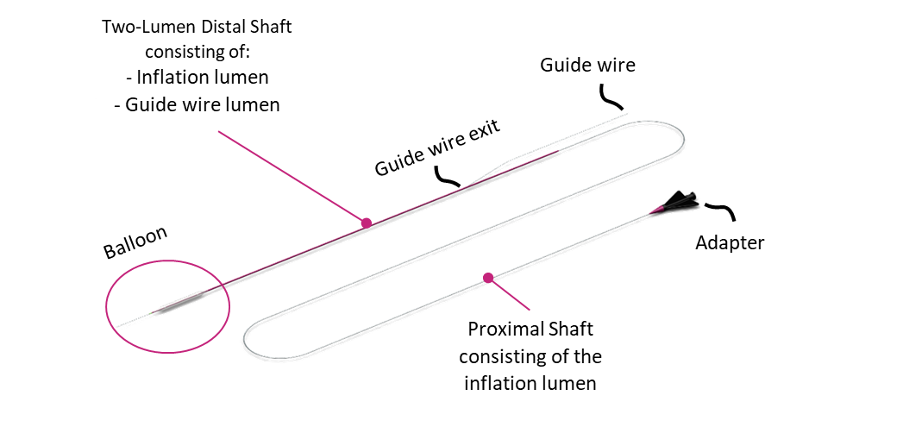
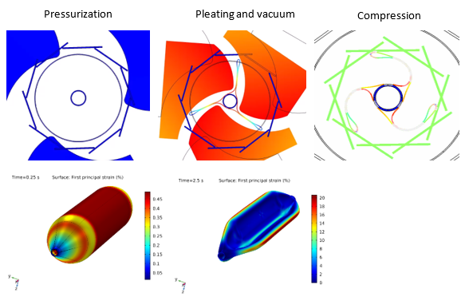



FE-Simulation of PTCA Balloon Catheters
C. Amstutz¹, R. Buehler¹, J.M. Behr², M. Stöver², A. Haeberlin¹, R. Vogel³, A. Zurbuchen¹, J. Burger¹
1. University of Bern, sitem Center for Translational Medicine and Biomedical Entrepreneurship, Bern, Switzerland
2. SIS Medical AG, Frauenfeld, Switzerland
3. Department of Cardiology, Bürgerspital Solothurn, Solothurn, Switzerland
INTRODUCTION: Since 40 years [1], percutaneous transluminal coronary angioplasty (PTCA) catheters are the tool-of-choice for treating coronary stenoses. However, navigation through the vessel and cracking highly calcified lesions remains challenging. Due to high safety requirements and the design complexity, the development and optimization of catheters is a demanding and costly procedure. To assist the development process in reducing prototyping costs and increasing device safety, Finite Element (FE) simulations have been introduced.
SHAFT SIMULATION:
Increasing the pressure resistance by optimizing the lumen geometry.
Observation of cross-sectional changes of the Lumen during inflation and/or bending.
Simulation of complex loading cases.
a)
b)
c)
d)
Figure 3. a) Single Lumen, b) Burst Pressure over Wall-thickness, c) Dual-Lumen with Inner pressure, c) Superposition of bending and inner Pressure
Figure 1. Scheme of a PTCA balloon catheter
BALLOON FOLDING:
Visible stress state inside the balloon during folding.
Realistic residual stresses at the end of the folding.
Prediction of the pressure resistance after folding.
Realistic folded geometry for further analyses.
A realistic and folded balloon will assist the:
Observation of deformations during inflation.
Influence of the wrapping design [3] on the successful treatment of a stenosis.
MATERIAL MODEL: A large-strain elastoplastic material model, with von Mises yield function is used in the FE-Simulations [2] . For this model, a user-defined hardening curve ($σ_{h}$) with 7 parameters ($σ_{∞}, m, n, o, p, q, r$) has been identified for the material of the shaft and the balloon.
$$σ_{h}(ε_{pl})=σ_{y0}+\left(σ_{∞}−σ_{y0}\right)∙\left(1−e^{−m∙ε_{pl}^{n}}\right)+o∙ε_{pl}^{p}+q∙ε_{pl}^{r}$$
Plastic flow rule (Von-Mises yield criteria):
$f:=\sqrt{3∙J_{2}}−σ_{y0}+σ_{h}(ε_{pl})=0$
$ε_{tot}=\underset{ε_{el}}{\underbrace{\frac{\sqrt{3∙J_{2}}}{E}}}+ε_{pl}$
$J_{2}:$2. invariant of the deviatoric stress tensor $σ_{y0}:$ Initial yield stress
$ε_{pl}:$Plastic strain[-]
$E:$Youngs Modulus [MPa]
Yield surface after plastic flow$: f\left(σ\left(t_{2}\right)\right)$
Original yield surface: $f\left(σ\left(t_{1}\right)\right)$
Figure 4. Balloon folding procedure
CONCLUSIONS: The design of a suitable and innovative shaft geometry can be aided using FE-Simulations and unnecessary costs for trial and error prototypes are being avoided. Stent expansion simulations performed with realistic balloon unfolding improve the prediction of stent expansion or help to predict the interaction between the balloon and the artery during treatment.
REFERENCES:
Barton, Balloon angioplasty – the legacy of Andreas Grüntzig, Frontiers in Cardiovascular Medicine, 2015
Kwon, On the application of FEM to deformation of high-density polyethylene, Int. J. of Solids Struct., 45 3521-3543, 2008
Geith, On the importance of modeling balloon folding, pleating, and stent crimping: a FE study comparing experimental inflation tests, Int. J. for Numer. Meth. in Biomedical Enigneering, 2019
Figure 2. Comparison between a linear and an elasto-plastic simulation
Excerpt from the Proceedings of the 2020 COMSOL Conference

