Slide 1




Slide 2
Concept Level Automotive Structural Analysis using COMSOL®
14-10-2020
Authors : Mihir Bhalerao, T K Hareesh, Alok Thanapati, Chandrakant Deshmukh

Slide 3
Content
Company Overview
Problem Statement : Frontloading Performance Targets
Why Structural Simulations?
Beam Modelling & Simulation Process
Equations
Global Stiffness Analysis
Eigenfrequencies
Application Builder & COMSOL Server
Analysis Process Flow
Conclusions
Way Forward

Slide 4


Company Overview : Mahindra & Mahindra Ltd

Slide 5


Automotive Sector Overview

Slide 6
Problem Statement : Frontloading Performance Targets
During concept phase of program, robust concept 3D CAD data will not be available. To create CAD data, structural concepts need to be generated & evaluated
To generate a concept, the critical parameters of the system and sensitivity of each parameter in response to the performance target need to be understood.
Performing DOE or Optimization through multiple CAD proposals is time and resource consuming.
A Robust Structural Concept which leads to matured CAD proposal will help reduce iteration at detail engineering phase.

Slide 7
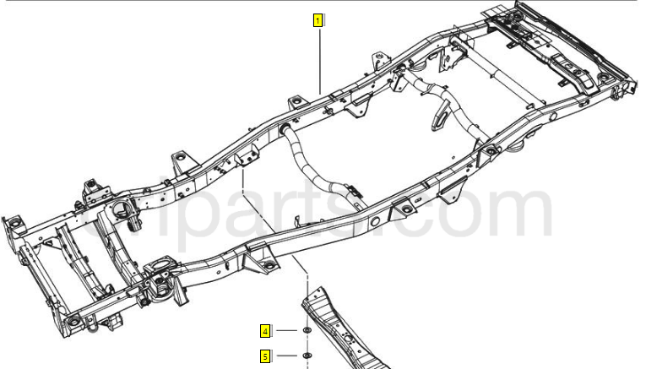

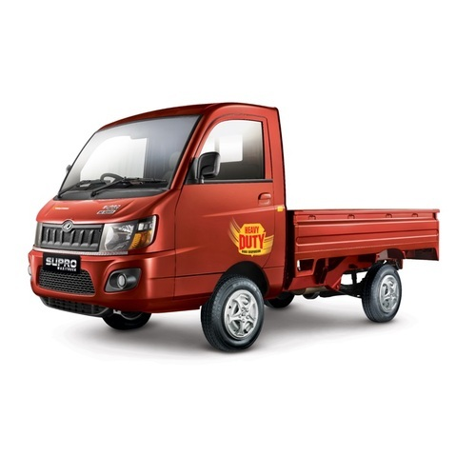
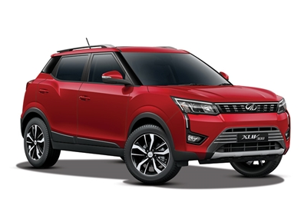
Why Structural Simulation?
Vital cog in vehicle architecture development process
First time Right design essential for timely product development
Have a long lead time in terms of design & validation
Multiple vehicle level targets such as Durability, NVH, Ride & Handling, Safety etc. are affected by structural systems and are critical to customer satisfaction
Different Body Constructions have different structural requirements

Slide 8
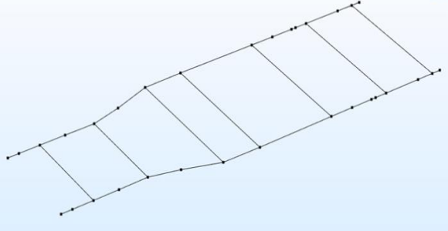
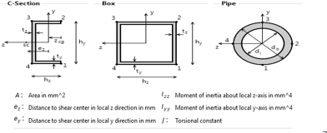
Beam Modelling & Simulation Process
Parameterization of the structural system
Parametric Wireframe generation in COMSOL
Section Details Input
Loads & Constraints as per Standards
Model Validation with Existing Vehicles
Beam Modelling Advantages :
Light, Flexible, Quick and fairly accurate
Easy to make parameterized models
Can run multiple iterations for DOE/Optimization
No requirement for 3D CAD

Slide 9

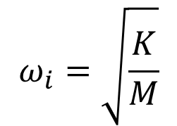
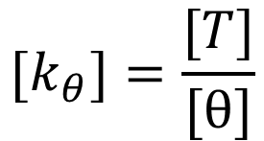
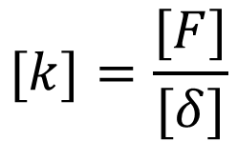
Calculations for stiffness & eigenfrequencies
Equations For Eigen frequency
Equations for Bending Stiffness
Equation of Motion
$$[k]=\frac{[F]}{[δ]}$$
Equation of Motion without Damping
Equations for Torsional Stiffness
Equation for Frequency
$${[k}_{θ}]=\frac{[T]}{[θ]}$$
$$ω_{i}=\sqrt{\frac{K}{M}}$$

Slide 10
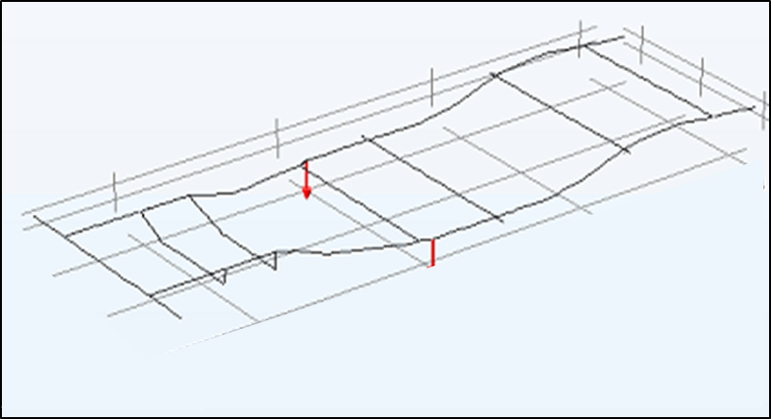
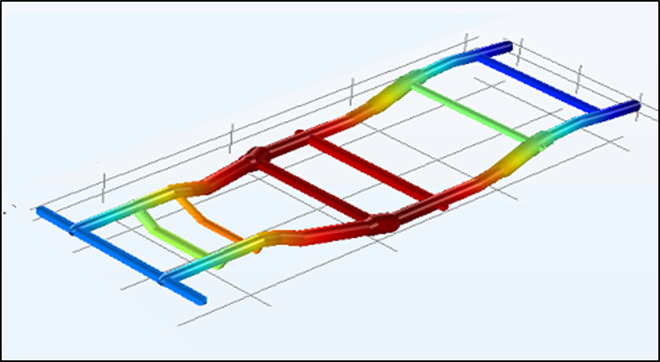
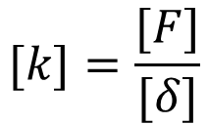
Global Stiffness Analysis
Bending Stiffness
Loading & Constraints
Results
Point Force
Constraint
Point Force
Z Displacement Plot
Force is applied at the centre and the
Z-displacement is measured
$$[k]=\frac{[F]}{[δ]}$$

Slide 11
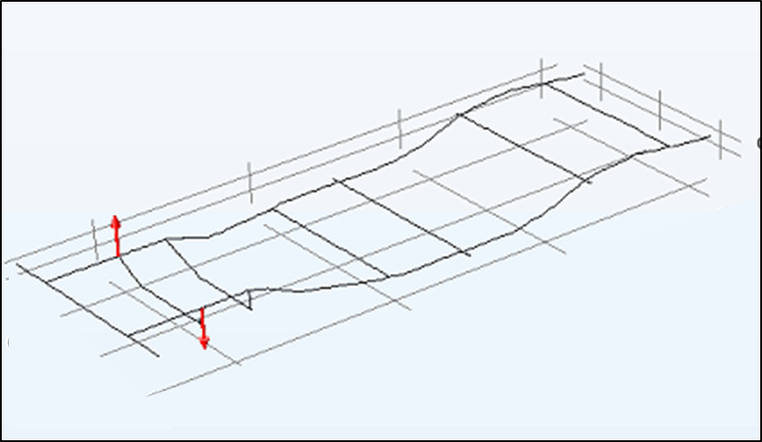
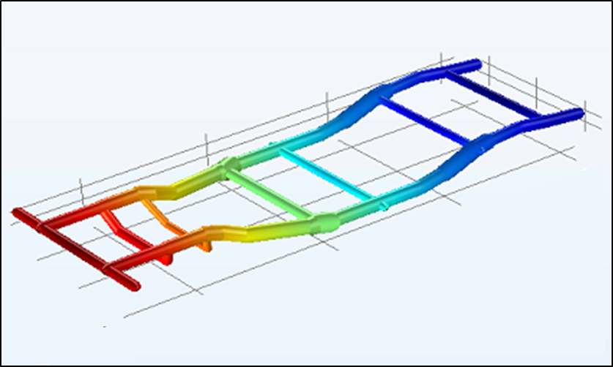
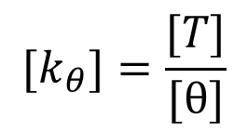
Global Stiffness Analysis
Torsional Stiffness
Loading & Constraints
Results
Constraint
Moment
Constraint
X Rotational Displacement Plot
Moment is applied and the rotational displacement is measured at the load application points
$${[k}_{θ}]=\frac{[T]}{[θ]}$$

Slide 12
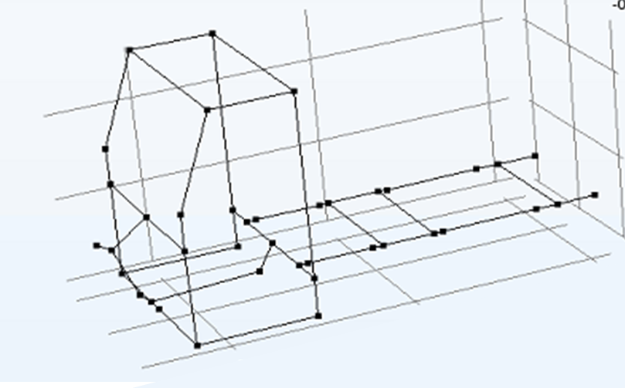
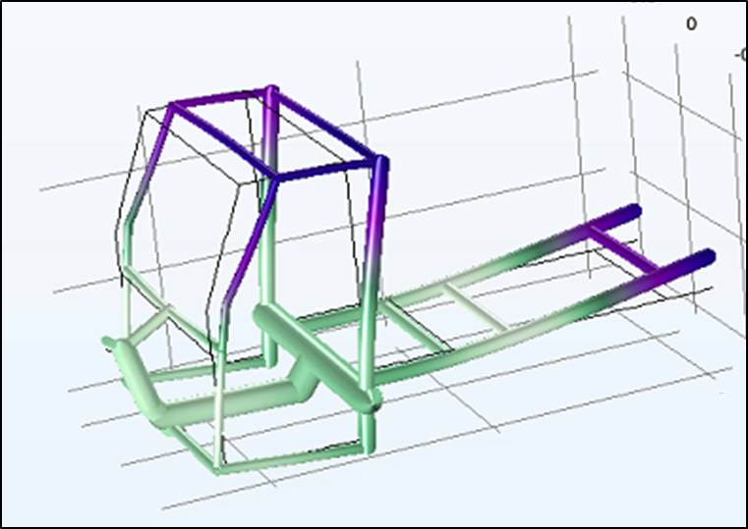
Modal Analysis : Eigenfrequencies
Loading & Constraints
Results
Free – Free Condition
1st 12 Eigenfrequencies & Mode Shapes

Slide 13
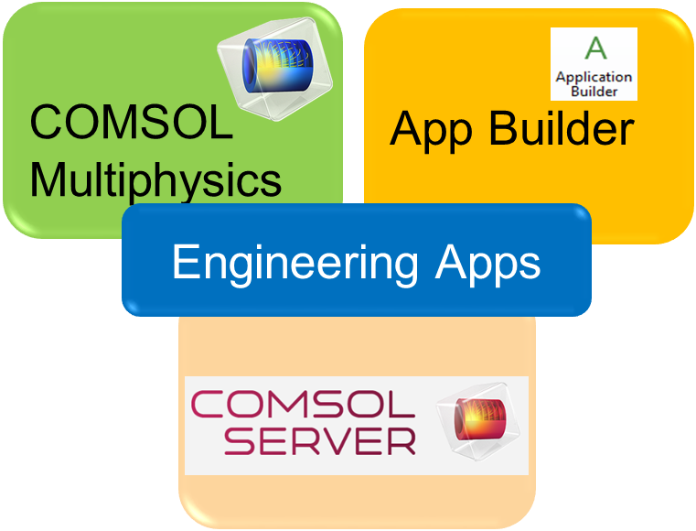

Application Builder & COMSOL Server
Application Builder in COMSOL enables Democratization of Models for Engineers
Parametric Model gives flexibility of Design Iteration
Quick Analysis at concept level gives more scope at CAE analysis level.

Slide 14
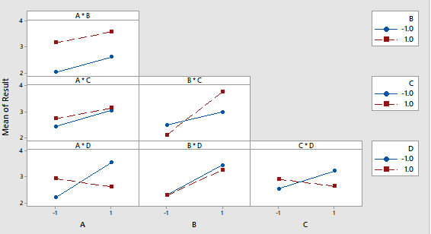
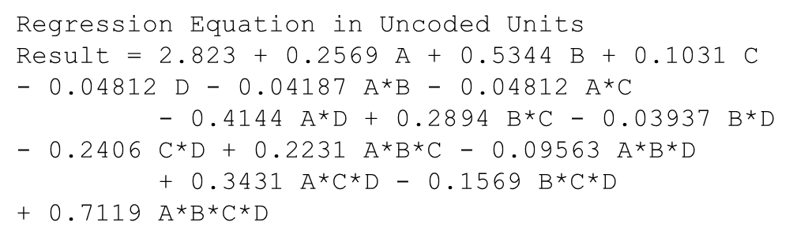
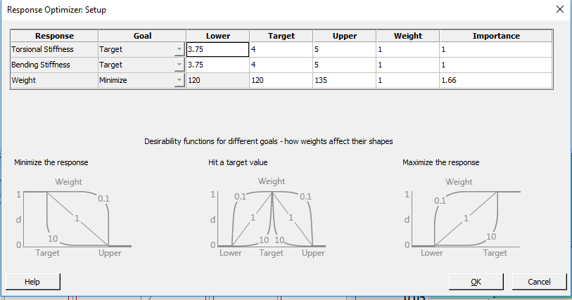
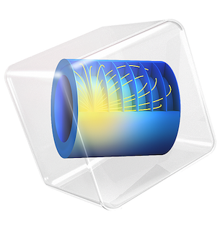
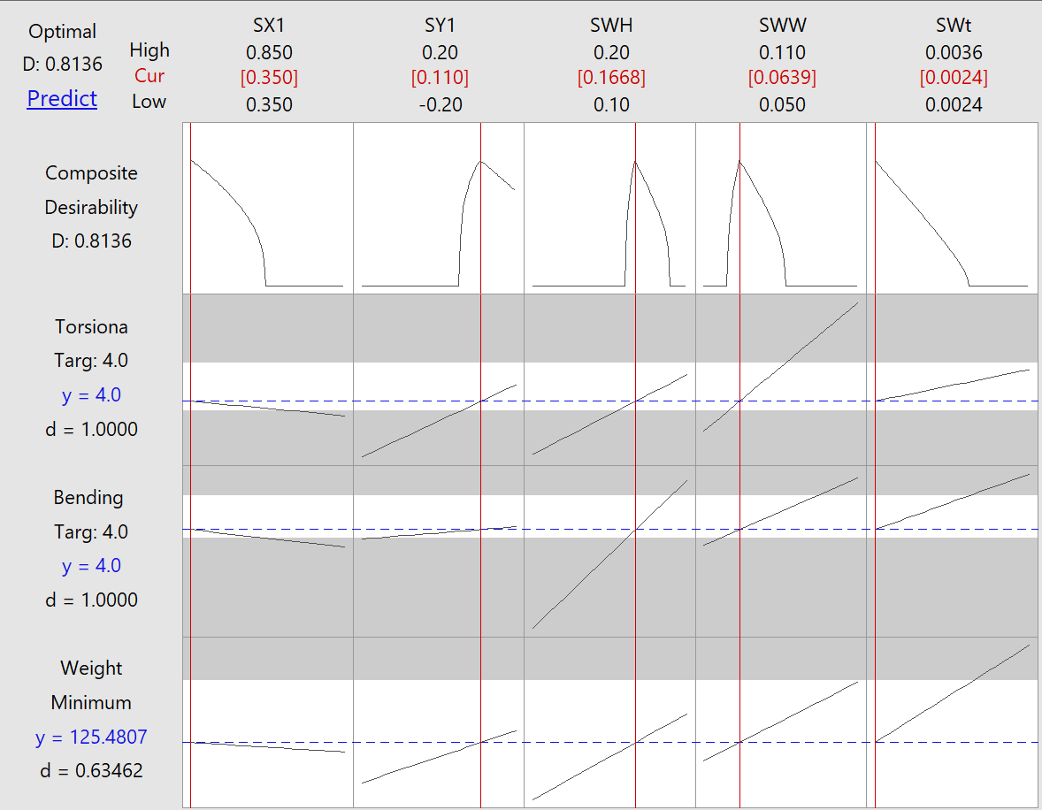
Analysis Process Flow
Design of Experiments
Regression Equation
Optimization Targets
Optimization
Proposals Generated from the Optimization
Sr no. | A | B | C | D | Weight | TS | BS
Proposal no 1
Proposal no 2
Proposal no 3
Reference Vehicles
Reference 1
Reference 2
*Minitab Software used for statistical analysis

Slide 15
Conclusions
Using the integration of COMSOL® tools (Multiphysics, App Builder & COMSOL server) for beam modelling , structural concepts can be generated quickly
Fast runtime (each iteration takes less than 2 minutes) and closely accurate simulation results (>80% correlation for all performance attributes) makes it possible to run multiple DOEs & optimizations
Performing multiple DOEs & Optimizations with the studied methodology for global stiffness and modal frequencies evaluation using beam modelling aids to a robust structural concept without 3D CAD.

Slide 16
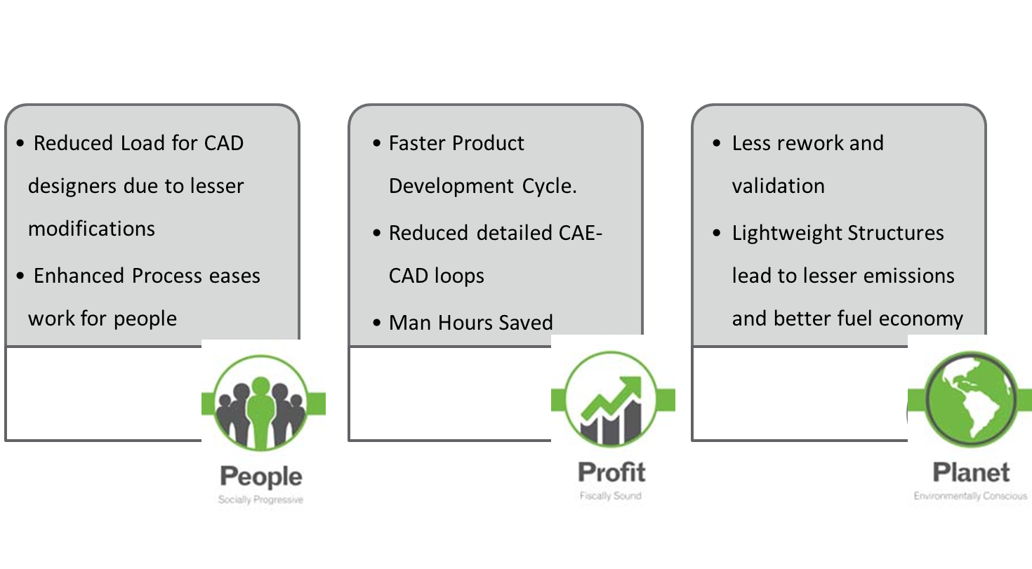
Benefits

Slide 17


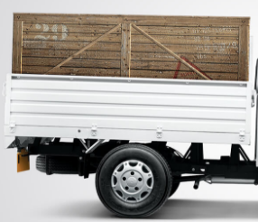
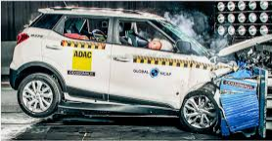
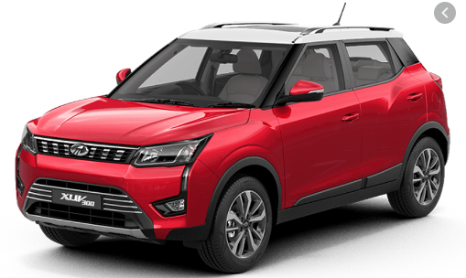
Way Forward
Structures
Further Analysis
  Expansion of current methodology for robust concept generation of other automotive structures such as the cargo, different body structures
  Enhancement of analysis scope for inclusion of other structural contributors such as durability and crash during concept phase
Cabin
Cargo
Body
Crash Analysis
Durability Analysis

Slide 18
Acknowledgement
We would like to thank our teammates at the advanced engineering dept. and methods dept. at Mahindra & Mahindra.
We would like acknowledge the timely support & guidance by our HoDs : Mr. Samir Rawte, Mr. Sridhar Lingan
We also thank the COMSOL support team for modelling support and smooth query resolution

Slide 19
Thank you
Visit us at www.mahindra.com

