Slide 1


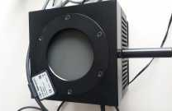
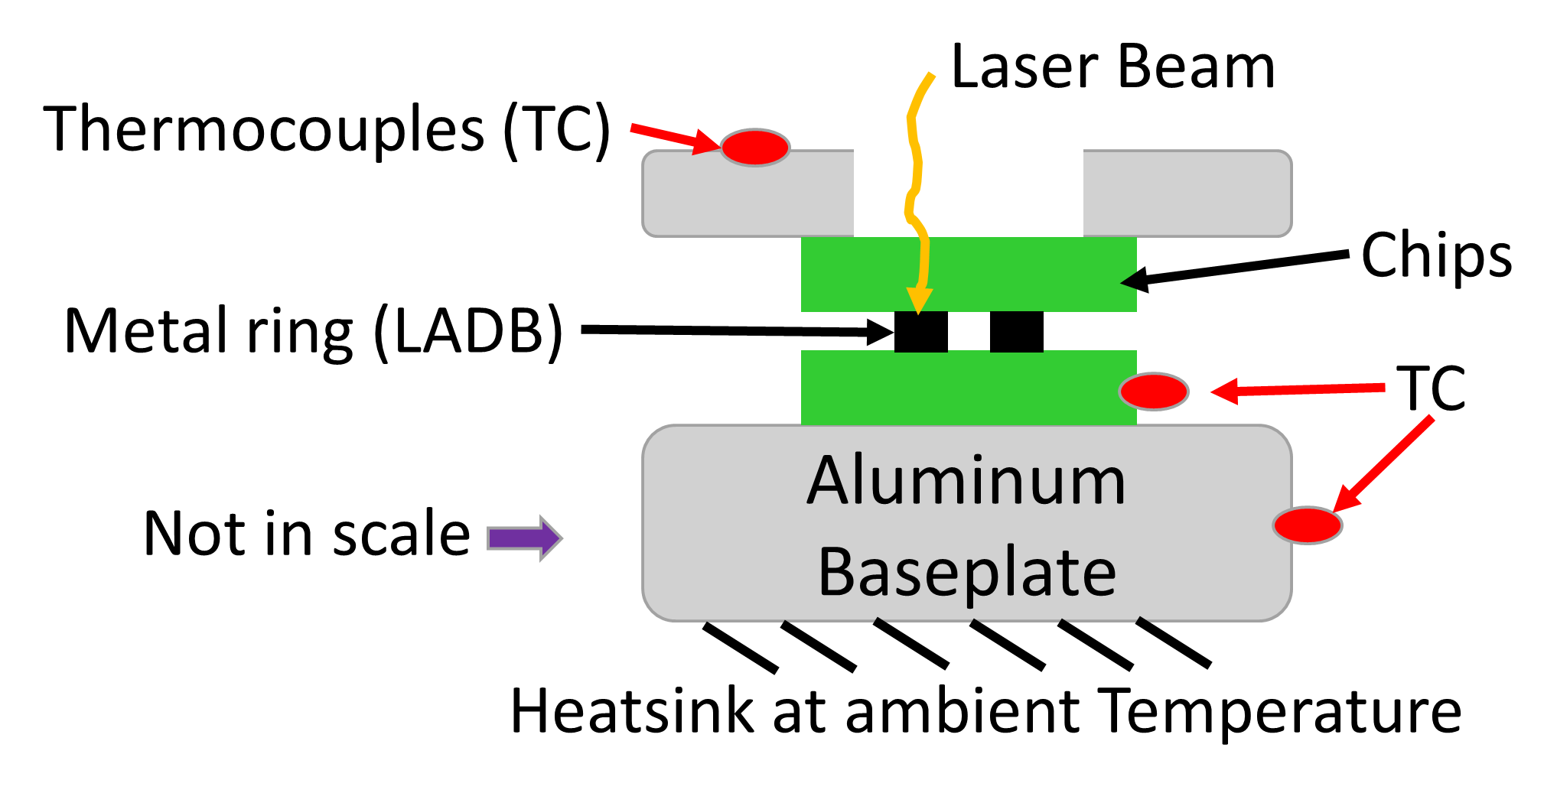
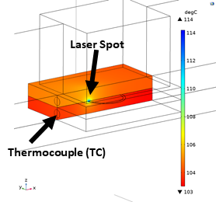
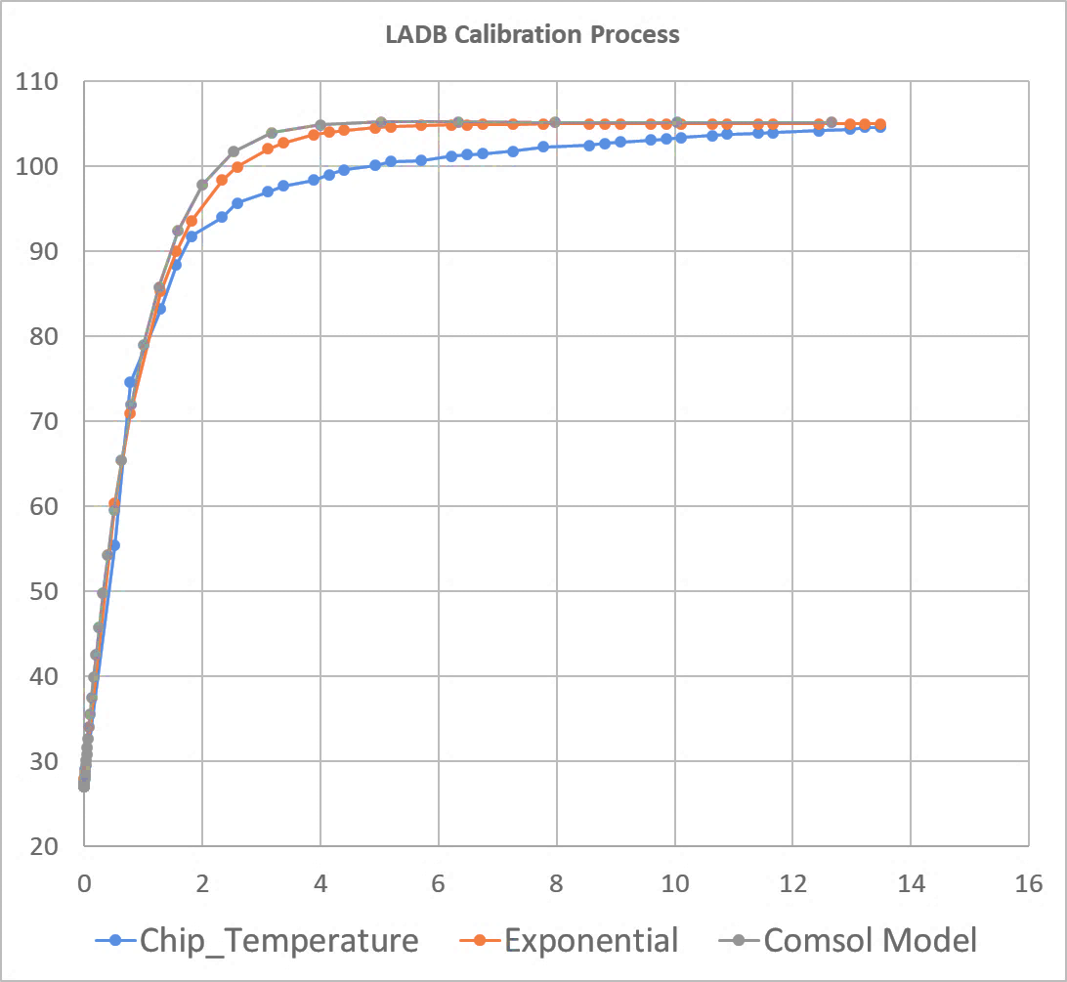
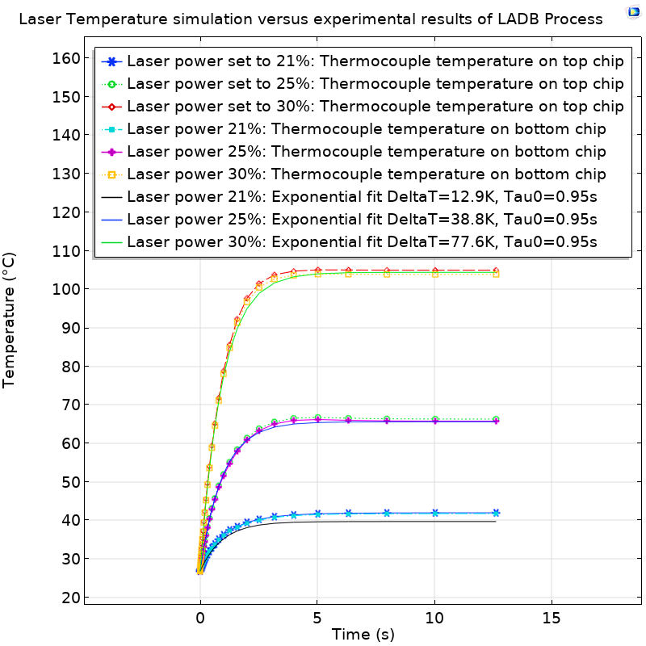
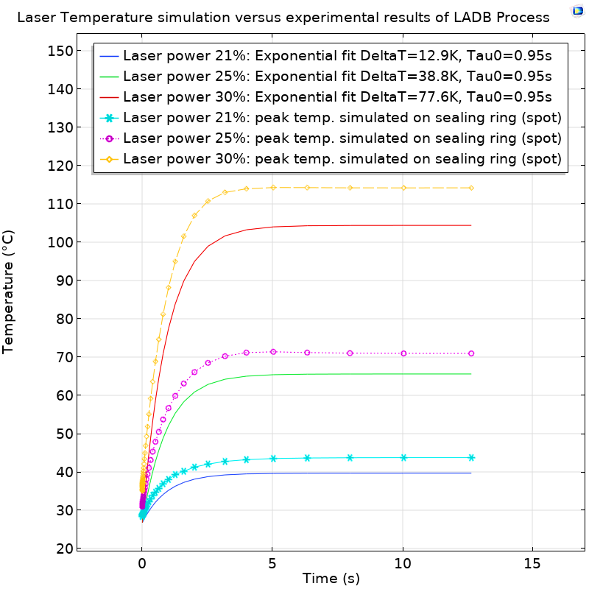
Calibration of Thermal Model To Simulate Laser Assisted Bonding Process
G. Spinola Durante¹, R. Jose James¹, E. Rutz-Innerhofer¹, K. Krasnopolski¹
1. CSEM SA, Alpnach Dorf (OW), Switzerland
Corresponding author: gsd@csem.ch – CSEM Website: www.csem.ch
INTRODUCTION: new emerging electronic and optoelectronic components require packaging technologies compatible to miniaturization trends and improved thermal management[1]. In this respect, CSEM has been developing packaging solutions performed with very localized heat, to achieve low-stress, hermetic and reliable laser assisted bonding (LADB) processes. Simulations are needed to realistically estimate temperatures on the bonding metal and avoid overheating the chips, especially if the chips are close to solder joints that could remelt. The simulation results will be applied within the Heatpack EU-Project to optimize laser process parameter to bond a heat spreader onto a GaN chip .
Figure 1. Thermopile detector for high power laser
Figure 2. Sketch of the fixture to press chips
implemented in a COMSOL model
Figure 3. Chip on chip cross-section showing peak
temperature with laser power setting of 30%
METHODOLOGY: the first step of this work is to measure and characterize the laser power by use of a thermopile (Fig. 1). The power measured by the thermopile is applied to the COMSOL model sketched in Figure 2 onto the laser spot on the metal ring. The fixture (Fig. 2) has thermocouples used to measure fixture and chip side temperature.
Model assumptions:
Thermal linear model not including radiative effects
Laser heating converted to heat only on the spot (Beer-lambert law not implemented)
Air convection to ambient temperature with 5W/m²K heat exchange coefficient
The calibration of the laser model follows this simplified procedure:
Selection of laser pulsed process parameters with an educated guess to perform bonding
Apply different laser powers with the same process timing settings and perform experiments
Measure the temperature build-up on the chip side (TC) and on the fixture during experiments
Run COMSOL parametric sweep: 1) laser power absorption (%) and 2) fixture thermal resistance to the chips
Find parameters to match experimental data (Fig. 4) and find chip max. temperature (Fig. 3 and 6)
Laser Power setting: 30%
Fitting exponential:
Asymptotic value is y0 = 104.5[degC]
Time constant T0 = 0.95[s]
Comsol optimal parameters:
Laser absorption: 0.22
Thermal contact: 7E-4 [K*m^2/W]
Figure 4. Simulated versus experimental
data & exponential fitting curves
Figure 5. simulated top/bottom chip temp.
versus exponential curve fit (measured data)
Figure 6 simulated max. chip temperature versus exponential curve fit (measured data)
RESULTS:
1. Comsol Model chip temperature is matching experimental data within <8% (Figure 5) during the time-transient 0-14[s].
2. Deviation from exponential behavior of chip temperature in experiments could be linked to a drift of the thermocouples.
3. Unexpected behavior in the power absorption with ~10% deviation of the temperature asymptote at low laser power setting of 21% (Fig. 6) is observed when keeping Comsol model parameters constant (Fig. 5).
CONCLUSIONS:
1. Model matches the experimental data and can be used to predict chip peak temperature (Fig. 7) which is critical in some assembly steps. E.g. we estimate to reach 200ºC peak while chip bulk is at ~180ºC
2. The Model can still be improved to better match experimental data. It provides a good basis for performing laser process development at CSEM also with different substrate/coating combinations.
3. Time-transient (0-14s) solves in less than 30s and therefore the model can also be extended to include the moving laser beam [2].
REFERENCES:
G. Spinola Durante, et al., "Thermal Management Modeling of High-power Chips and Calibration with Experimental Data", CSEM Scientific and Technical Report (2019) p. 30
G. Spinola Durante, et al., "Laser assisted bonding (LADB) thermal modeling with COMSOL Multiphysics®”, Comsol Conference Proceedings, Cambridge (2019) https://www.comsol.com/paper/laser-assisted-bonding-ladb-thermal-modeling-with-comsol-multiphysics-83001
Excerpt from the Proceedings of the 2020 COMSOL Conference

