Slide 1
Optimization of Loudspeakers
COMSOL Conference 2020 Europe
By A.J. Svobodnik, T. Nizzoli, F.L. Redl

Slide 2
Introduction
Electrodynamic transducer almost 100 years old
Challenge for product improvement/innovations
Mostly evolutionary progress
Idea: mathematical optimization models to improve the performance of electrodynamic transducers
Probably a revolutionary approach for loudspeaker design
Application of optimization procedures to various types of loudspeakers to optimize specific performance targets
Including cost optimizations as well

Slide 3
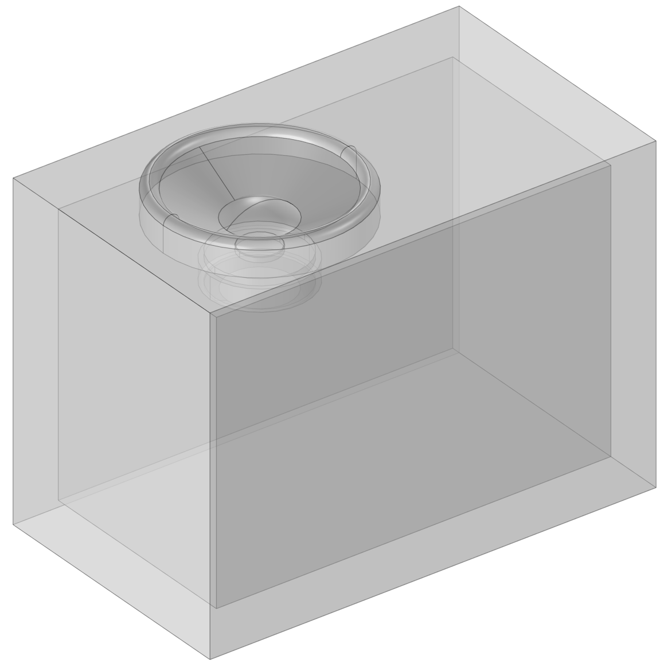
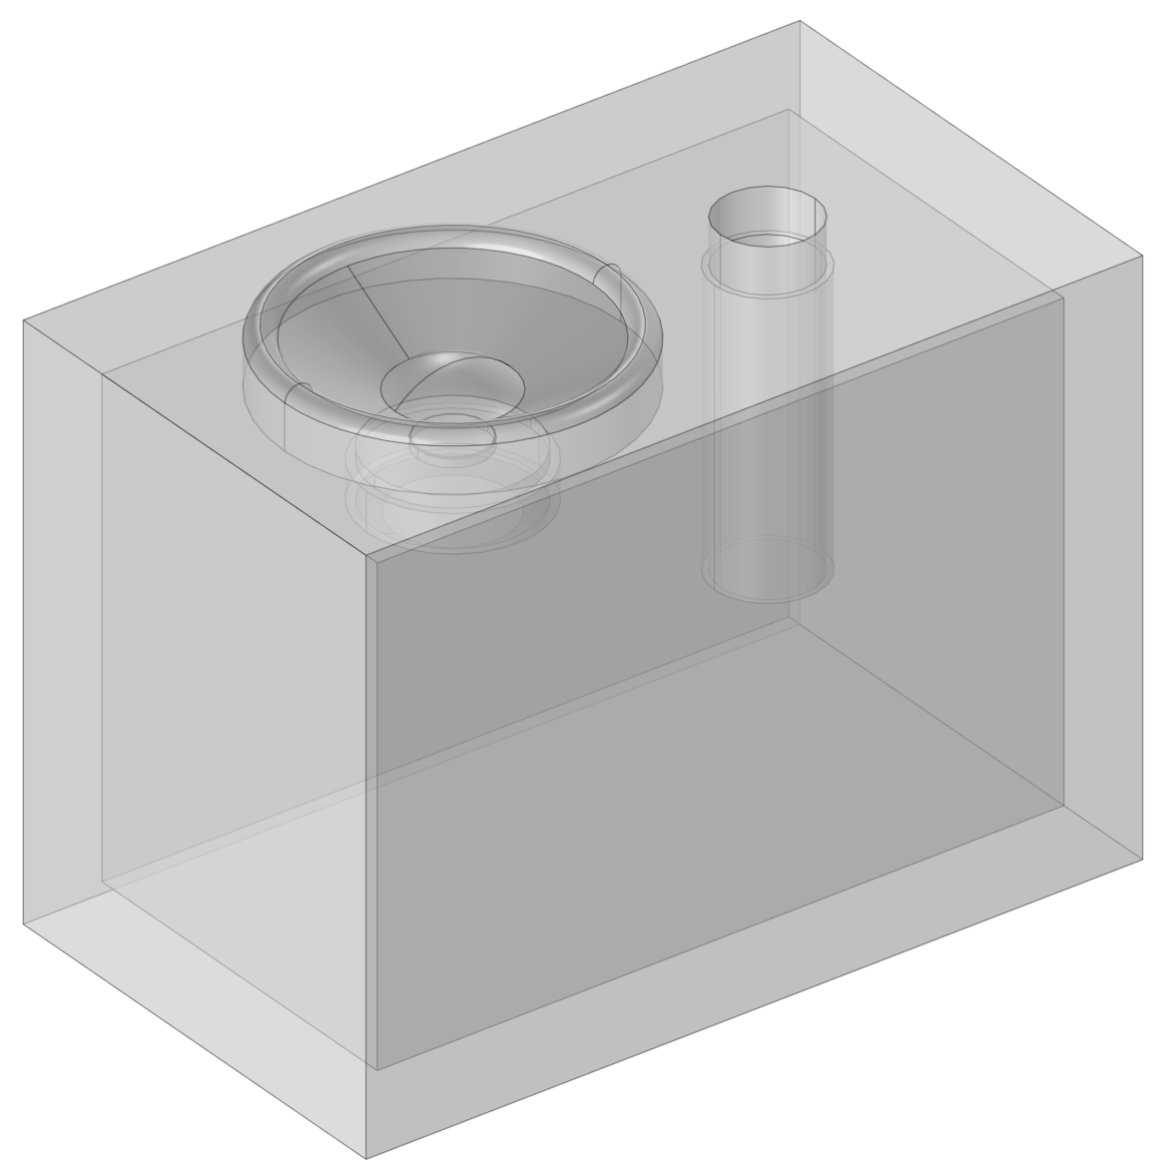
Devices Under Test
Sealed cabinet with woofer
Ported cabinet with subwoofer

Slide 4
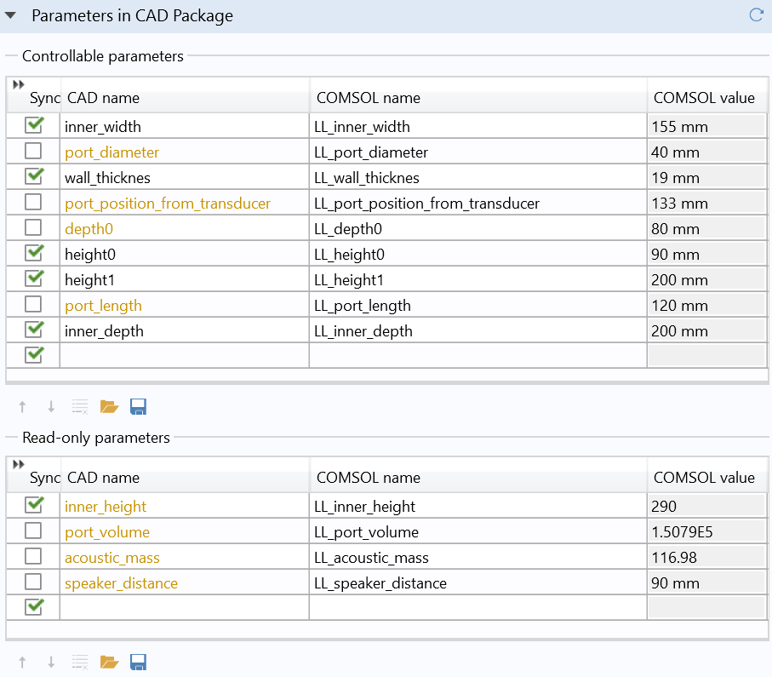
Devices Under Test
Geometry is based on a SOLIDWORKS®
Connected to the simulation model (including also the optimization) by means of LiveLink™ for SOLIDWORKS®

Slide 5
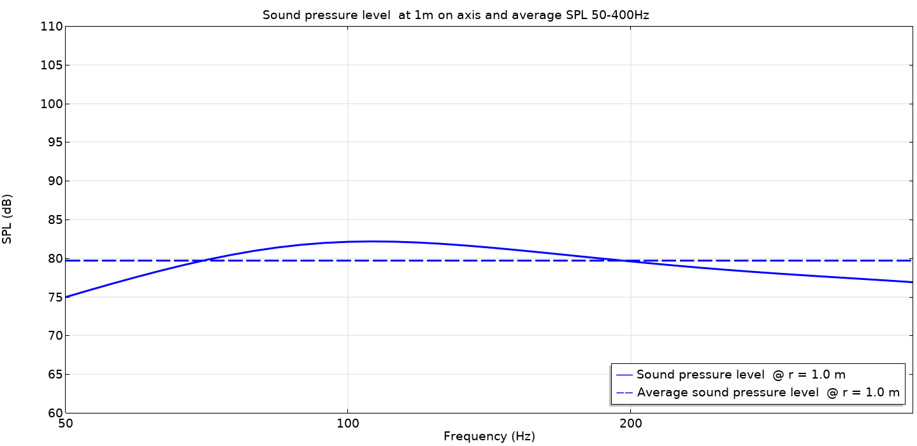
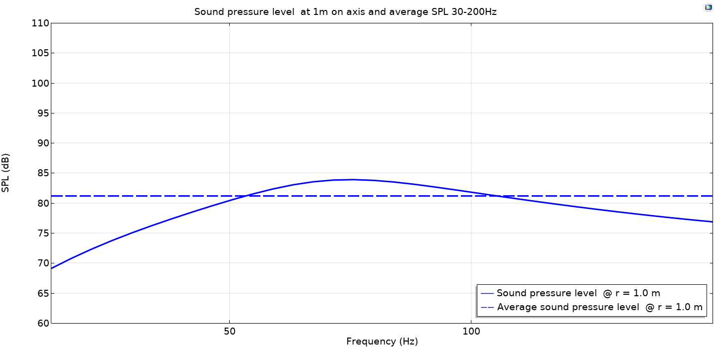
Devices Under Test
Sealed cabinet with woofer
Frequency response of initial configuration
Ported cabinet with subwoofer
Frequency response of initial configuration

Slide 6
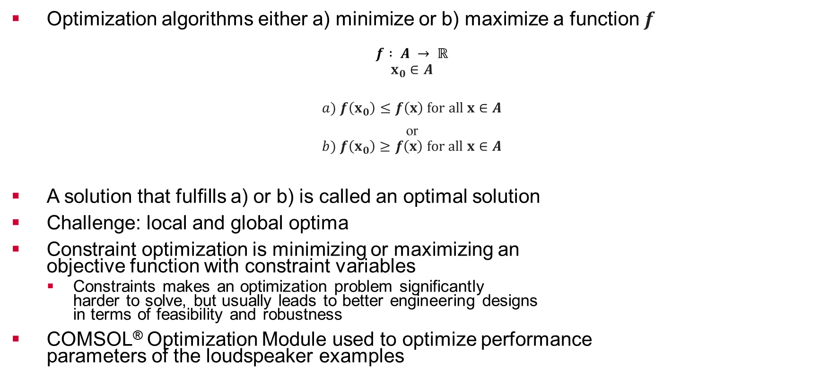
Mathematical Optimization
Optimization algorithms either a) minimize or b) maximize a function $f$
$$f : A → ℝ$$
$$x_{0}∈A$$
$$a) f\left(x_{0}\right)≤f\left(x\right) for all x∈A$$
or
$$b) f\left(x_{0}\right)≥f\left(x\right) for all x∈A$$
A solution that fulfills a) or b) is called an optimal solution
Challenge: local and global optima
Constraint optimization is minimizing or maximizing an objective function with constraint variables
Constraints makes an optimization problem significantly harder to solve, but usually leads to better engineering designs in terms of feasibility and robustness
COMSOL® Optimization Module used to optimize performance parameters of the loudspeaker examples
Constraint 1
Constraint 3
OBJECTIVE
Constraint 2
Constraint 4

Slide 7
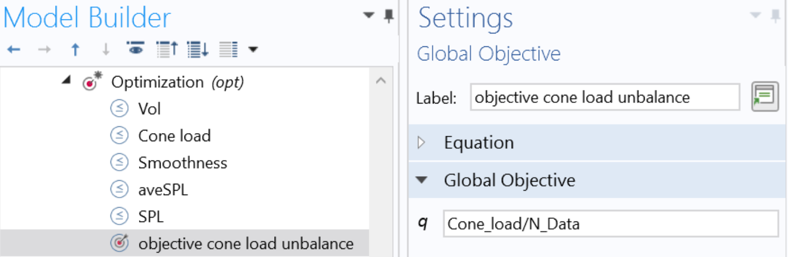
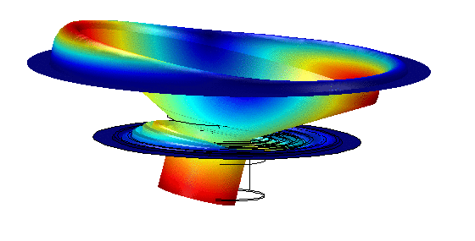
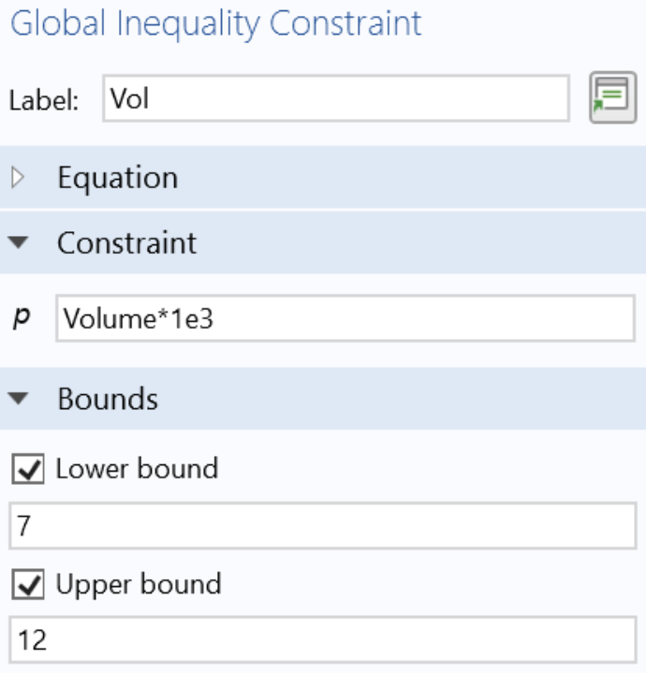
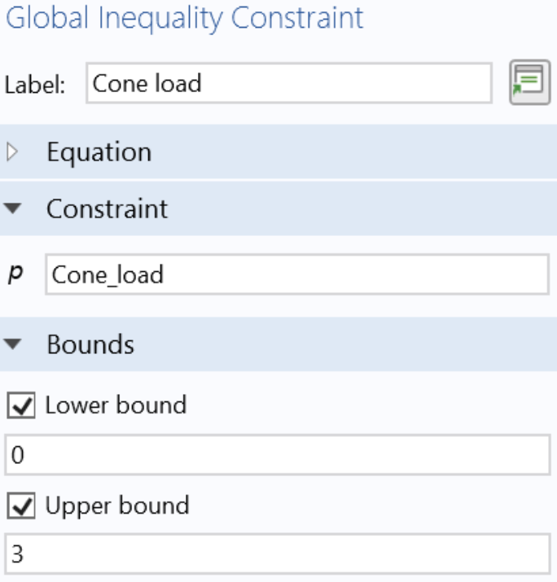
Constraint Optimizations Applied to Loudspeakers
Optimization of “rocking” of a woofer in a sealed cabinet
Rocking is a very critical effect and can lead to extremely unpleasant rub & buzz effects and is highly audible as well
Optimization target: minimize load variations on the membrane

Slide 8
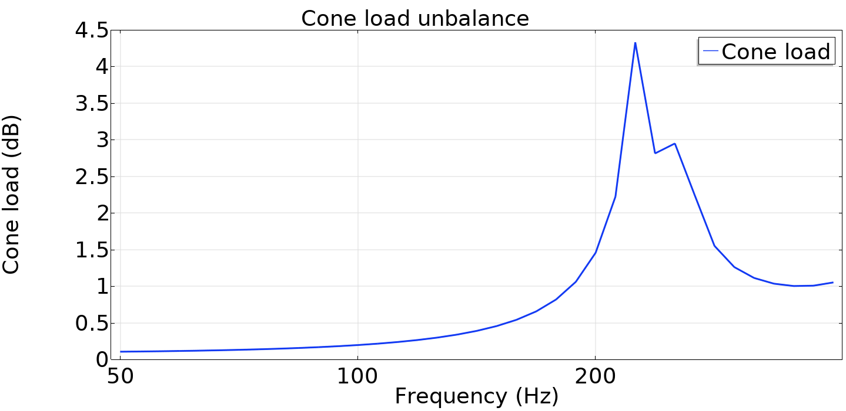
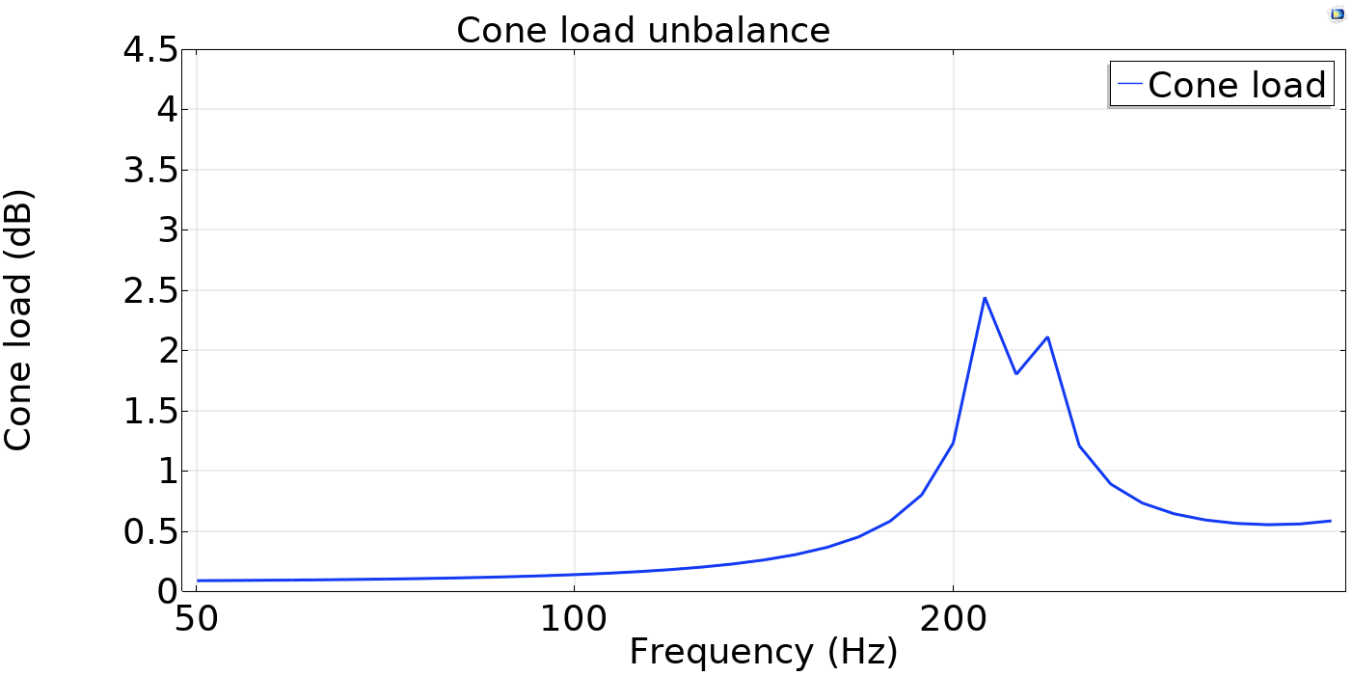
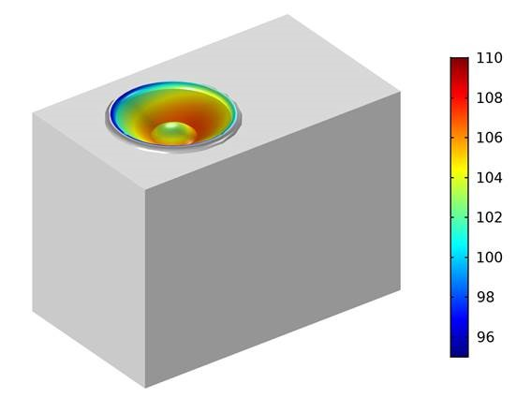
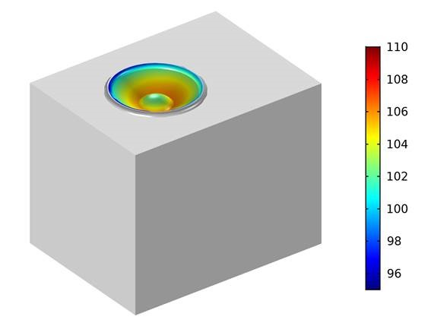
Woofer in a Sealed Cabinet
Target: cone average (frequency) load unbalance should be minimized
In the images it is shown the comparison at 250Hz
Constrains
Enclosure volume
Cone load maximum value
Smoothness max and min values
Average SPL
Reduction of 50 % in load unbalance!

Slide 9
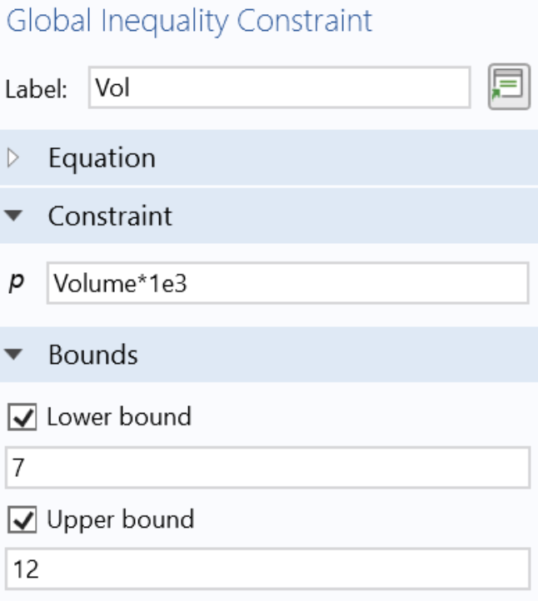
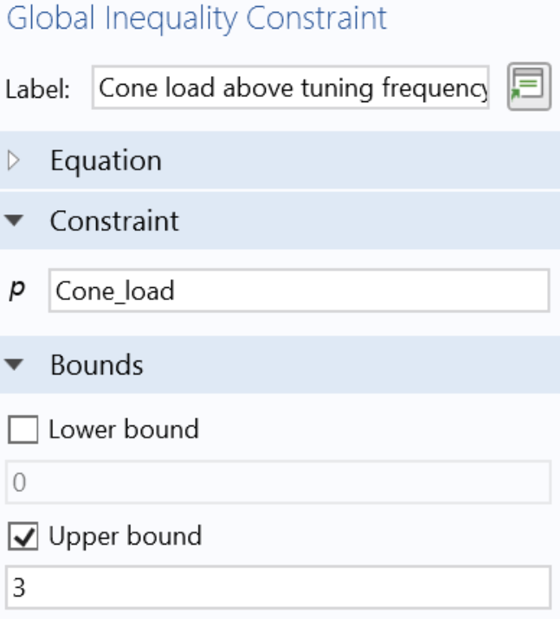
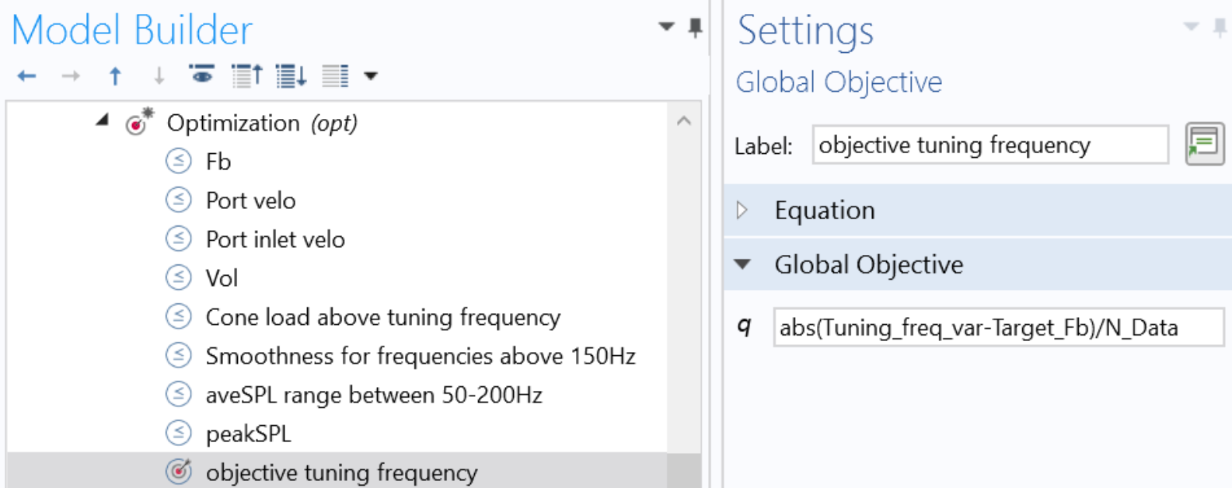
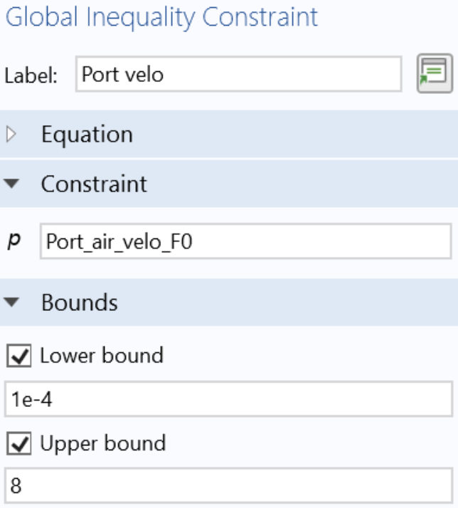
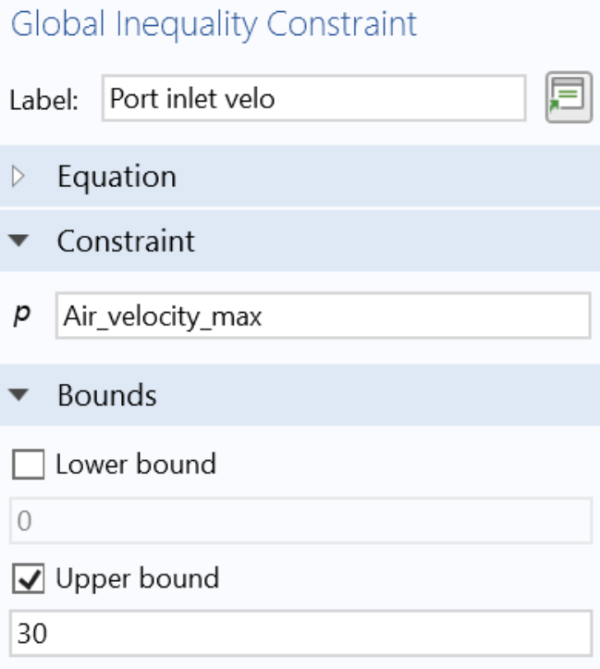
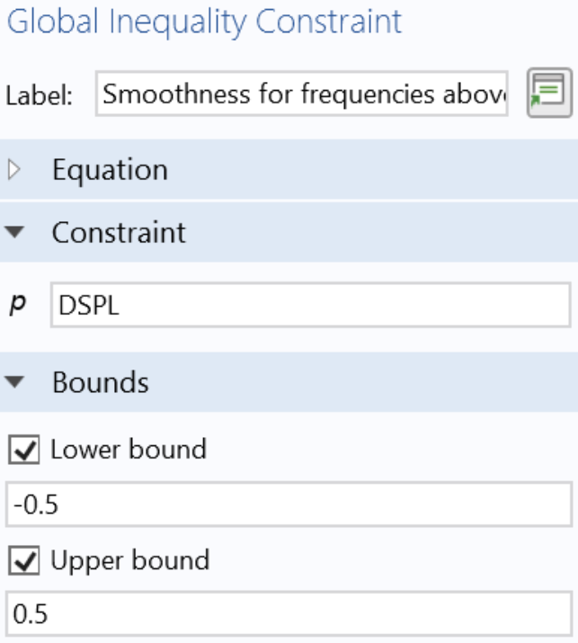
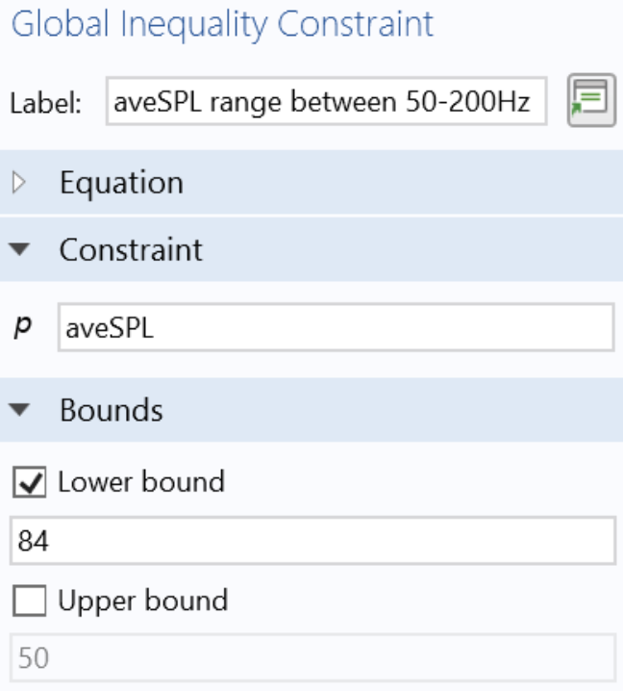
Constraint Optimizations Applied to Loudspeakers
Optimization of “tuning frequency” of a subwoofer in a ported cabinet
Tuning frequency is resonance frequency of the air in the port
Typical performance parameter specified by system engineer
Acoustic resonance is significantly boosting the output of the loudspeaker and hence improves the sensitivity

Slide 10
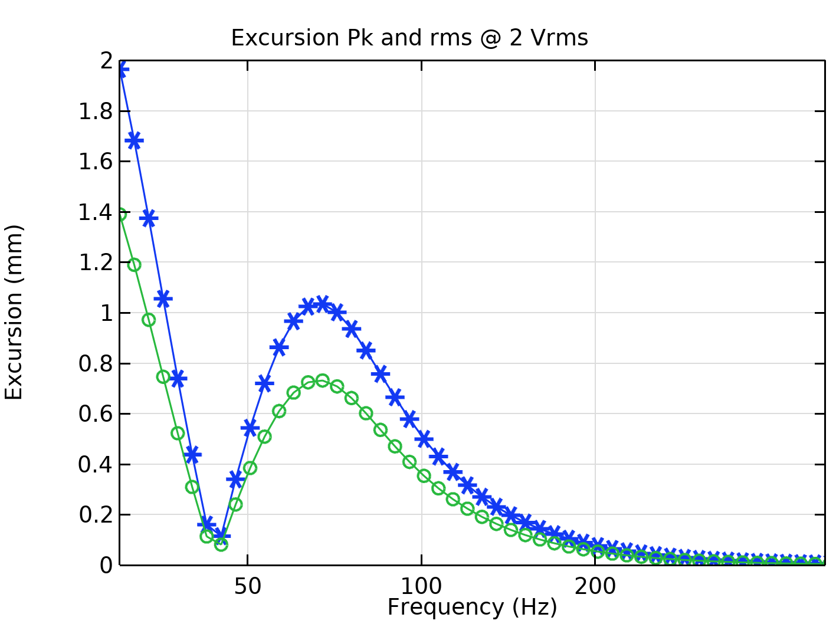
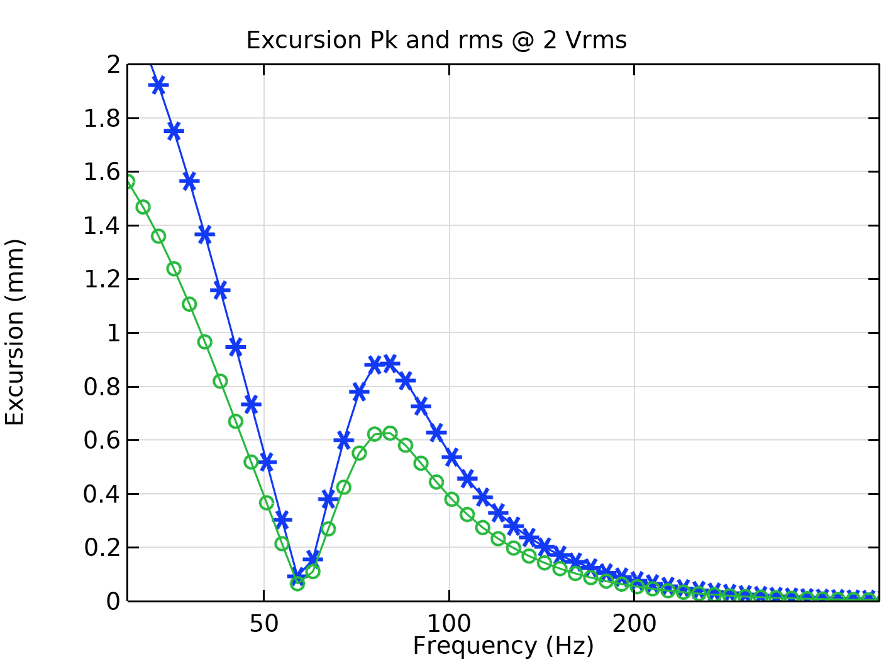
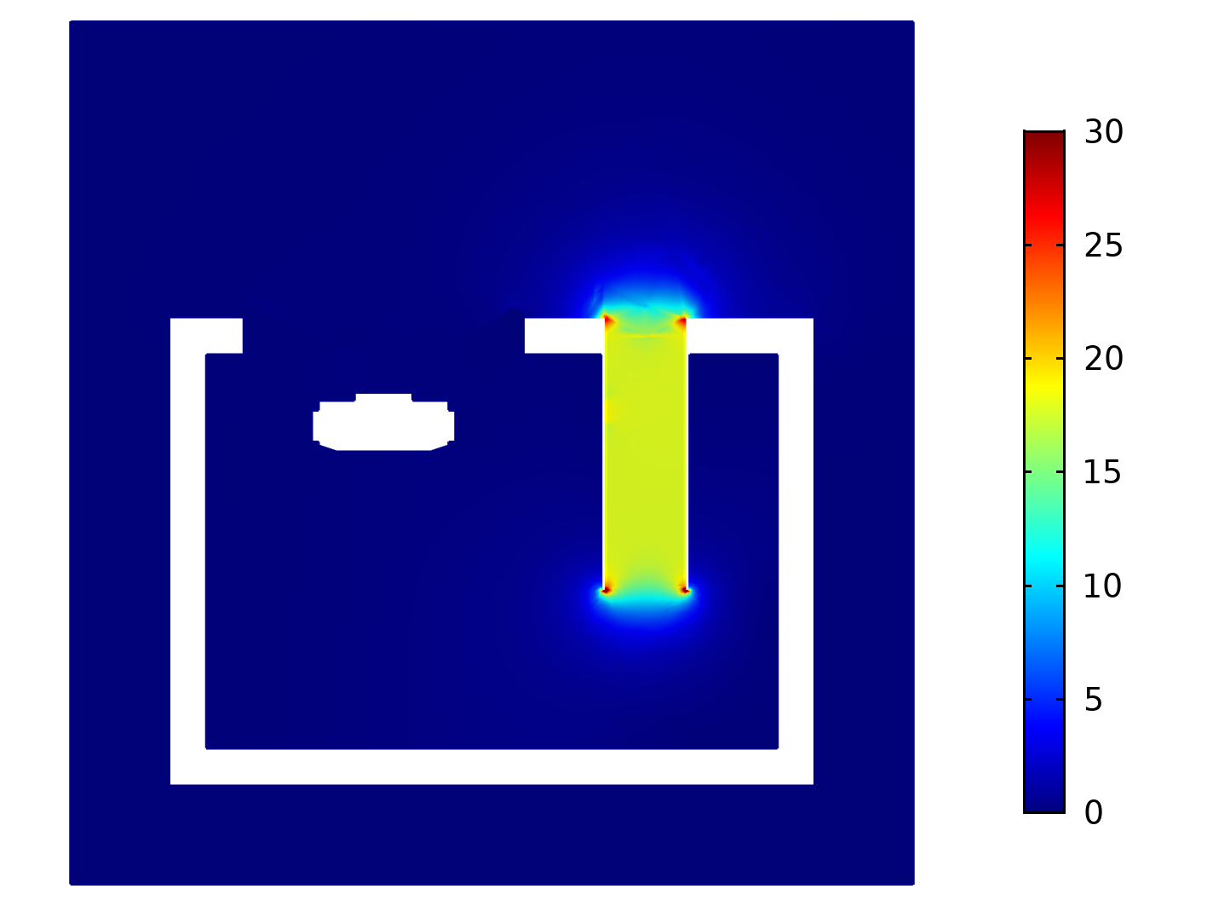
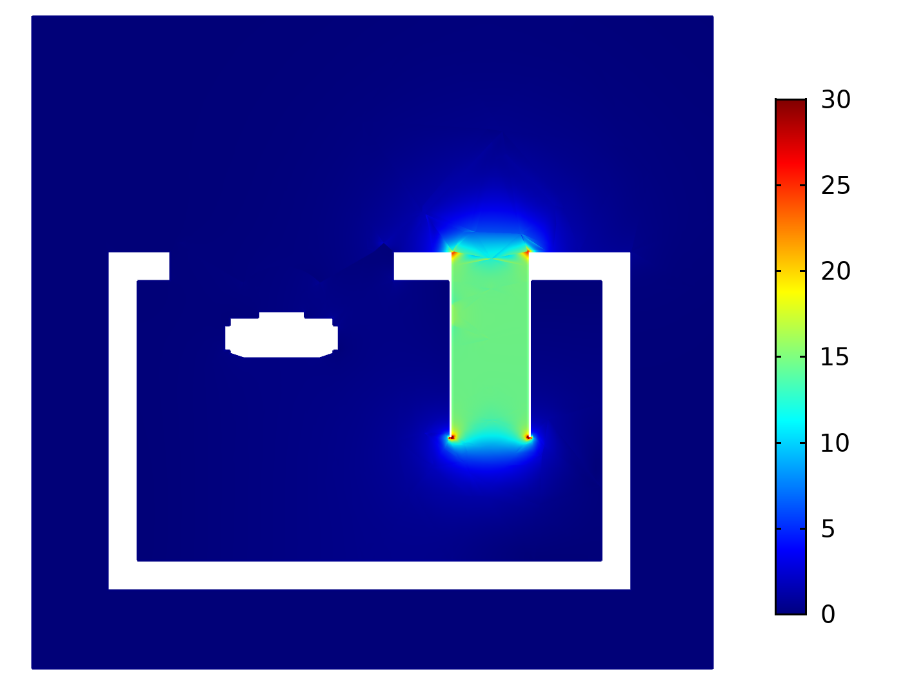
Subwoofer in a ported cabinet
Target: tuning frequency from 45 to 55 Hz
In the images it is shown the comparison of section view of (port) air velocity at the tuning frequency (at maximum voltage)
Constrains
Enclosure volume
Port air velocity at tuning frequency max value
Cone load maximum value
Smoothness max and min values
Average SPL

Slide 11
Conclusions
Application of mathematical optimization with constraints to some typical engineering tasks in loudspeaker engineering
Specific performance parameters can be significantly improved, while the general performance of the system is still given
These improvements can be done without additional product costs

Slide 12
Optimization of Loudspeakers
COMSOL Conference 2020 Europe
By A.J. Svobodnik, T. Nizzoli, F.L. Redl

