Slide 1



An interaction between electromagnetic field and materials:
Characterization of mechanical stress in ferromagnetic materials using Eddy current non-destructive techniques
Safae Bouterfas, PhD student, EOBE, Univ. Paris-Saclay
Laurent Daniel, University Professor, CentraleSupélec
Yann Le Bihan, University Professor, Univ. Paris-Saclay
Laurent Santandréa, Engineer, CNRS

Slide 2
Plan
Context
Eddy Currents Non-Destructive Testing
Model definition
Finite Element Method: COMSOL
External Function
Results
COMSOL CONFERENCE 2020 EUROPE

Slide 3
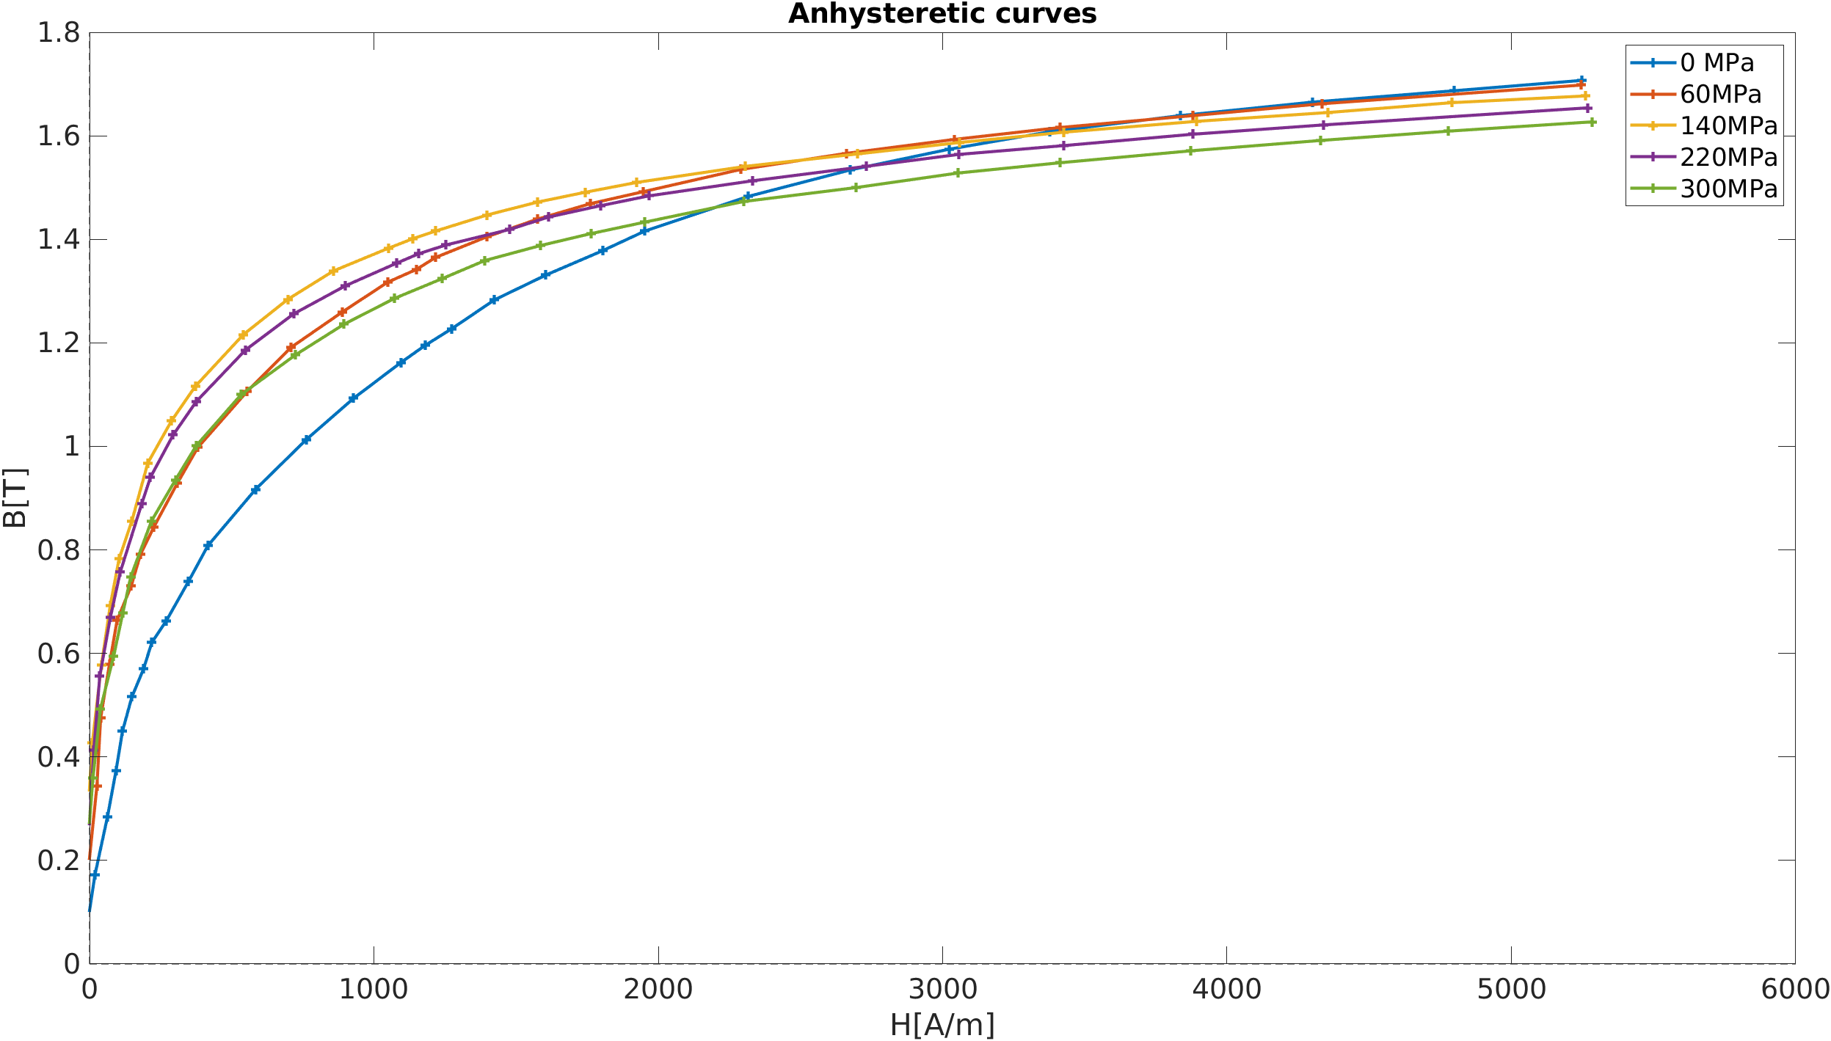
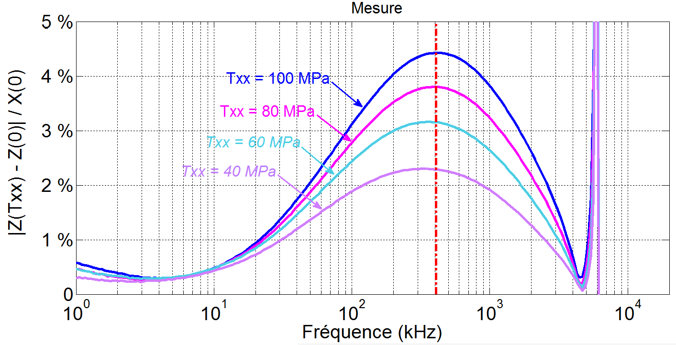
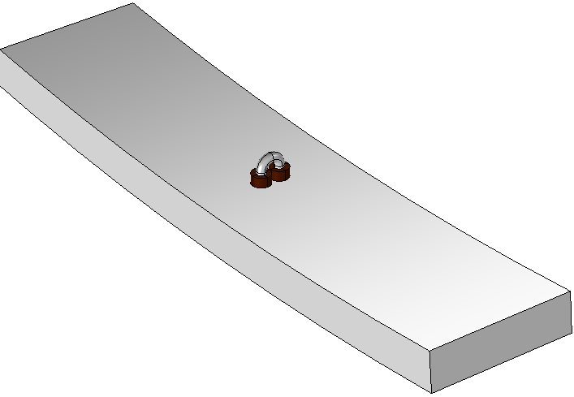
Context
3D stress in gas pipelines
e_{Θ}
e_{L}
e_{R}
Villari effect
Ferromagnetic material
T_{yy}
T_{xx}
T_{xx}
T_{yy}
[Dahia et al. 2015]
Local 2D stress
COMSOL CONFERENCE 2020 EUROPE

Slide 4
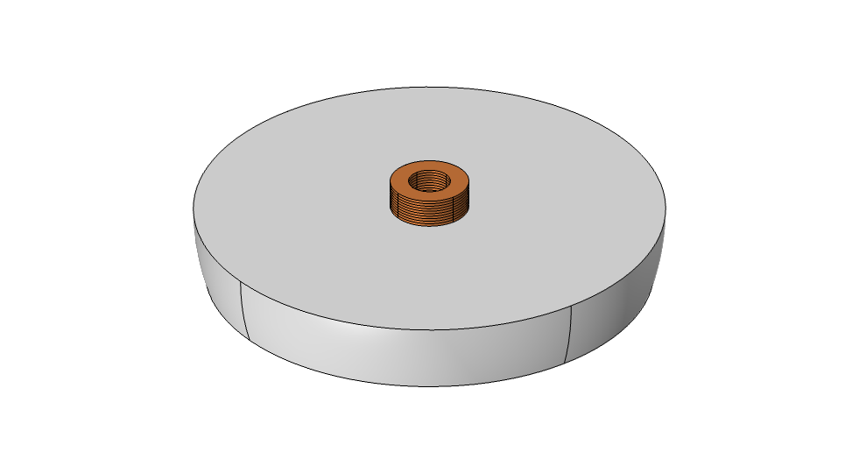
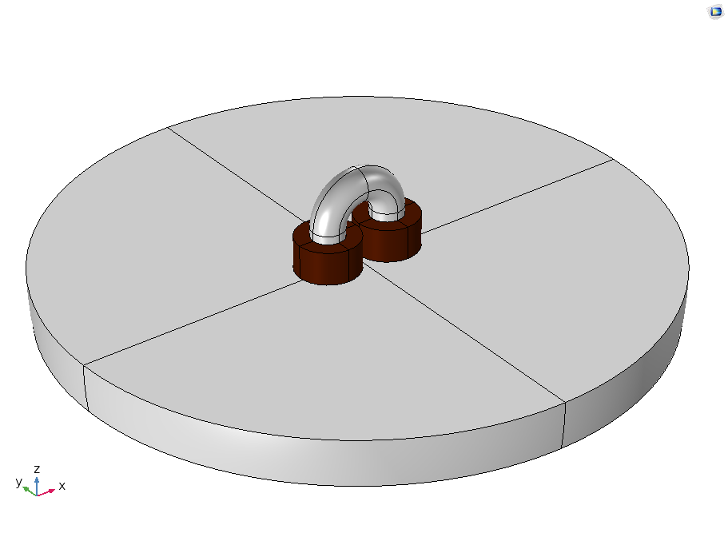
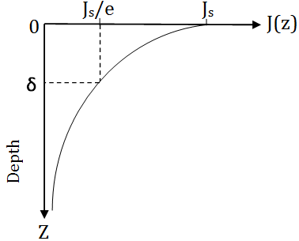


Eddy Currents Non-Destructive Testing
Excitation coil
Skin depth
$$J_{EC}\left(Z\right)=J_{s}e^{\frac{−Z}{δ}}$$
$$δ=\frac{1}{\sqrt{πfµσ}}$$
H_{p}
I
H_{s}
J_{EC}
µ(T)
Ferromagnetic specimen
Evolution of Eddy Currents in depth of a conductor material
H_{s}(µ(T)) → EC sensor: Z(T)
COMSOL CONFERENCE 2020 EUROPE
Notes:
Eddy currents are created in the extreme surface of the conductor plate when its subjected to a dynamic magnetic field excitation.

Slide 5
Model definition
Magnetic field direction U_{H}
AMSM: Magnetic permeability µ(U_{H},T)
Stress tensor T
EC sensor impedance Z(T)
COMSOL: Magnetic fields H and B
Finite element method
COMSOL CONFERENCE 2020 EUROPE

Slide 6
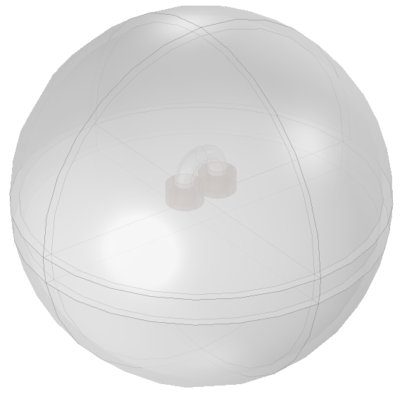
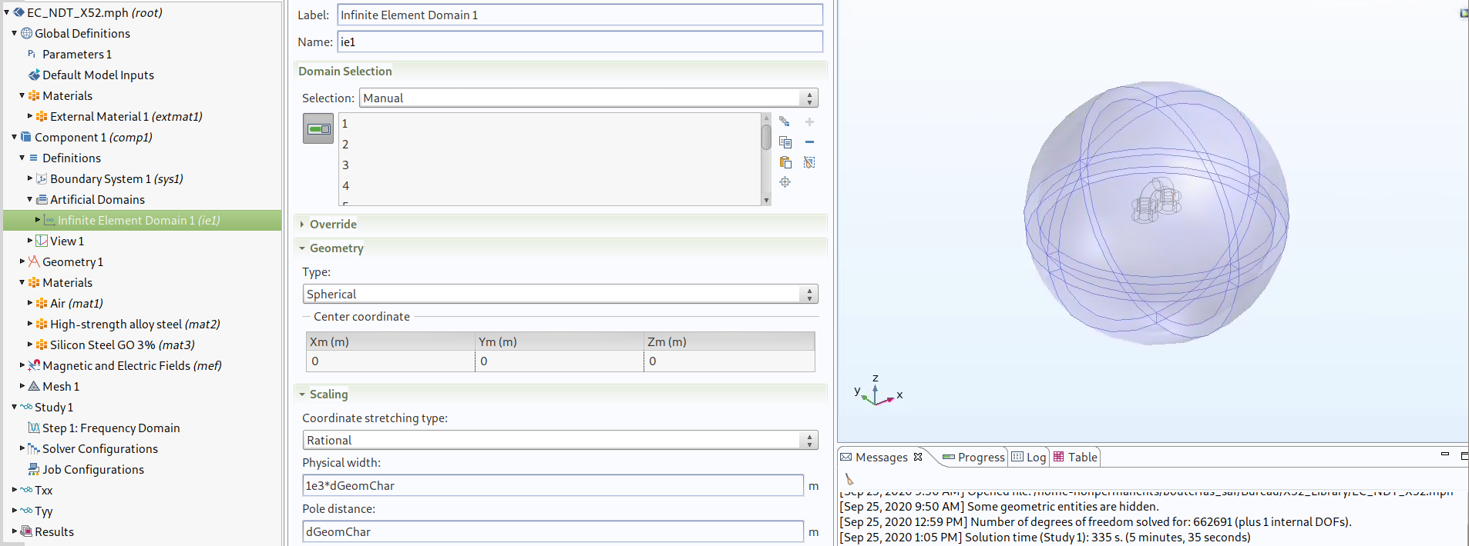
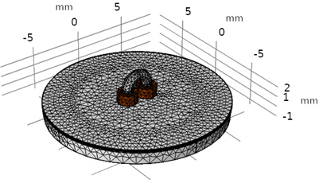
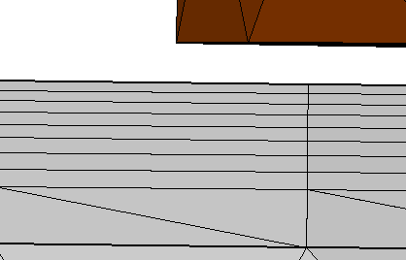
Finite Element Method: COMSOL Geometry definition
Infinite element domain
Mesh
NDT using EC
EC sensor
Study domain
Pipeline
Boundary Layers
COMSOL CONFERENCE 2020 EUROPE

Slide 7
Finite Element Method: COMSOL EC sensor impedance
AC/DC Module: Magnetic and Electrical Fields
Frequency study: from 1 kHz to 1MHz
Specimen
Study domain
P_{J} = R I²_{eff}
W_{mag}= ½ L I²_{eff}
Z = R + j Lω
COMSOL CONFERENCE 2020 -EUROPE- October 2020

Slide 8
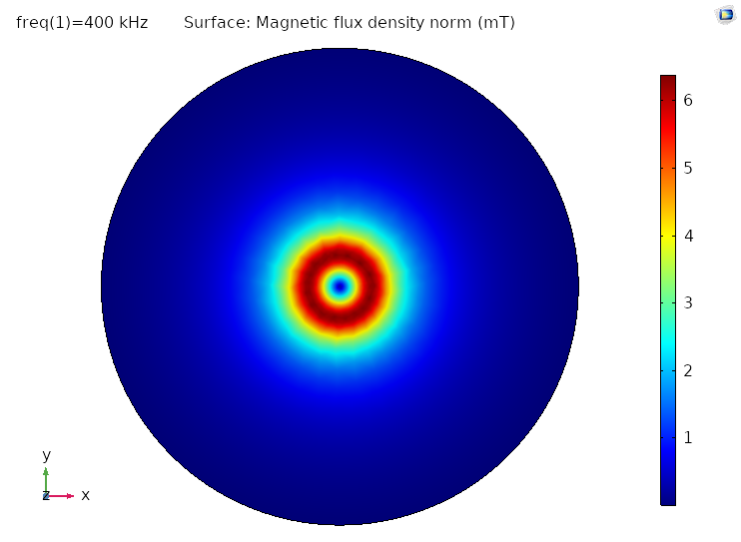
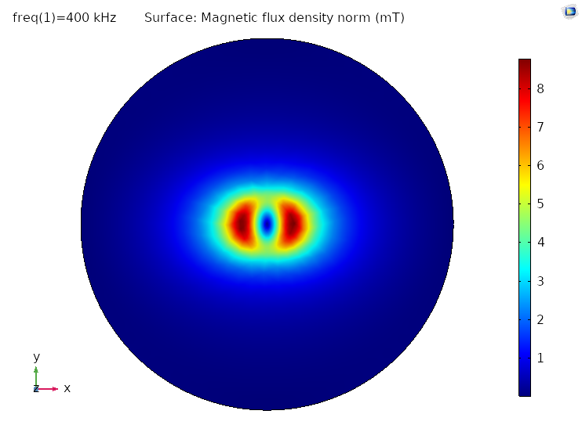
Results Magnetic flux density: induced stress anisotropy
Without stress
Under stress: T_{xx}=150MPa
COMSOL CONFERENCE 2020 EUROPE

Slide 9
Model definition
External function
Magnetic field direction U_{H}
AMSM: Magnetic permeability µ(U_{H},T)
Stress tensor T
C code
EC sensor impedance Z(T)
COMSOL: Magnetic fields H and B
COMSOL CONFERENCE 2020 EUROPE

Slide 10
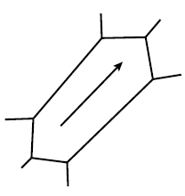
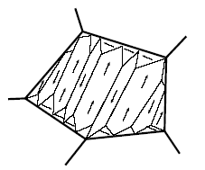
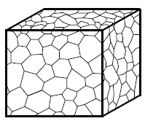
External function Multiscale model:
Magneto-elastic behavioural law of a ferromagnetic material:
Material parameters :
Elastic Coefficients
Magnetic Constants
Magneto-elastic Constants
Texture data (SEM measurement)
Τ
µ (H, Τ)
Mechanical stress [N/m²]
Magnetic permeability [H/m]
Domaine
Single-crystal (grain)
Polycrystal
[L. Bernard et al., 2011]
COMSOL CONFERENCE 2020 EUROPE

Slide 11

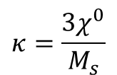
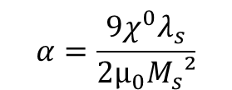



External function Analytical version of the Multiscale Model:
T_{xx}
H field :
$$H={\left(H_{x},H_{y},H_{z}\right)}_{xyz}={\left(\left\|H\right\|,0,0\right)}_{uvw}$$
x
H
Stress tensor :
$$T_{xyz}=T_{uvw}$$
u_{H}
θ
φ
y
$$α=\frac{9χ^{0}λ_{s}}{2µ_{0}M_{s}²}$$
$$κ=\frac{3χ^{0}}{M_{s}}$$
AMSM’s parameters:
v
w
T_{xx}
z
Magnetic permeability:
µ_{r}(0,T)=1+ $\frac{M_{s}κA_{u}}{A_{u}+A_{v}+A_{w}}$
$$i∈\left(u,v,w\right)$$
[Daniel, 2013]
COMSOL CONFERENCE 2020 EUROPE

Slide 12
Model definition
Magnetic field direction U_{H}
AMSM: Magnetic permeability µ(U_{H},T)
Stress tensor T
Implementation
EC sensor impedance Z(T)
COMSOL: Magnetic fields H and B
COMSOL CONFERENCE 2020 -EUROPE- October 2020

Slide 13
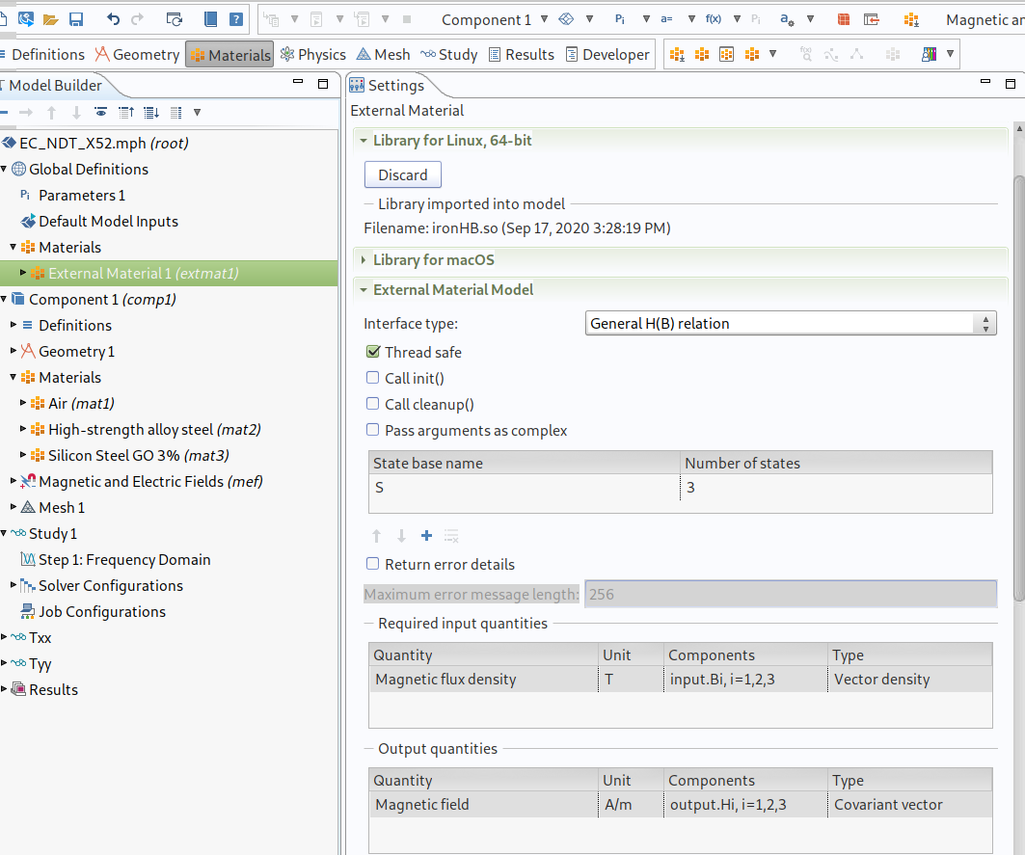
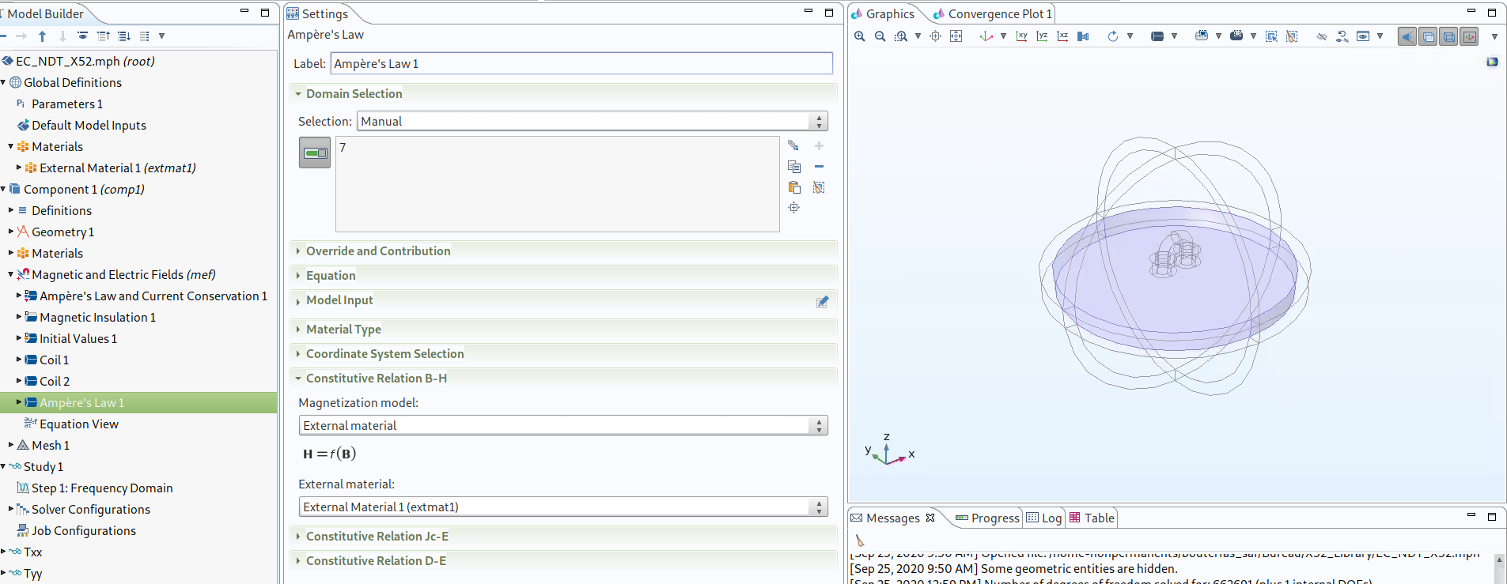
Finite Element Method: COMSOL Implementation of stress effect
External material:
Example ID: 32321
C code → .dll/.so
Hypothesis:
H & B field colinear in the plan (XY) of the material
COMSOL CONFERENCE 2020 EUROPE

Slide 14
Finite Element Method : Comsol Model algorithm:
Initial solution « µ(T) » : H
AMSM
µ(H,T)
External Function
B(T)
Direction of B(T)
NL Eq system (Newton Raphson)
Impedance signal
COMSOL CONFERENCE 2020 EUROPE

Slide 15
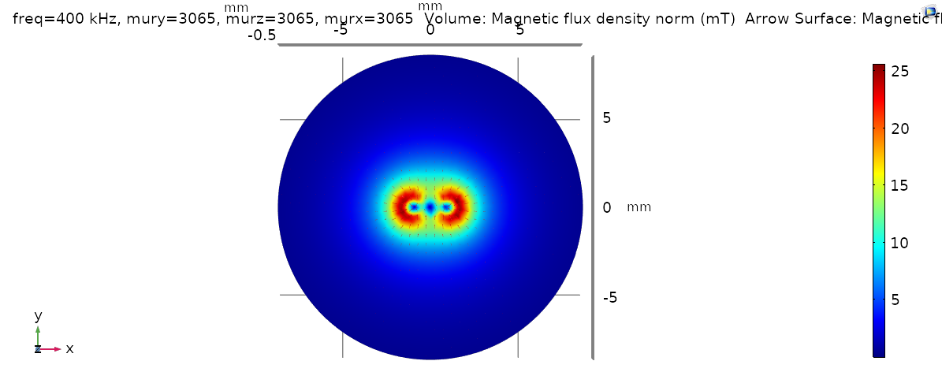
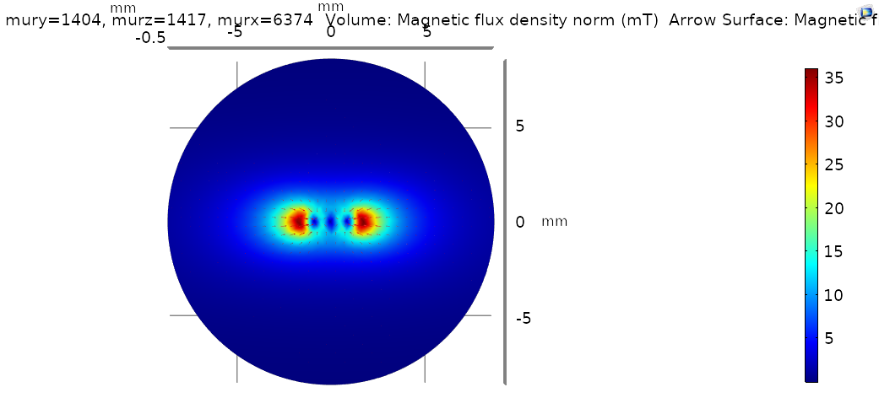
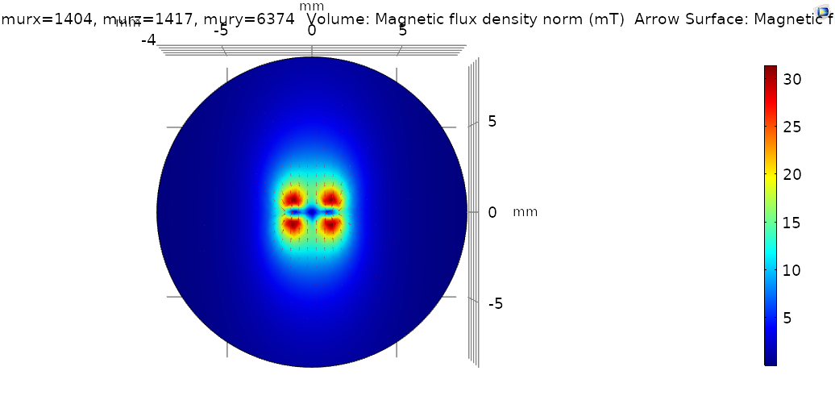
Results Magnetic flux density:
Without stress
Under stress: T_{xx}=300MPa
Under stress: T_{yy}=300MPa
COMSOL CONFERENCE 2020 EUROPE

Slide 16
Conclusion
Implementation of the stress effect on the magnetic properties using a multiscale approach
The model is yet to be improved
Laurent.santandrea@geeps.centralesupelec.fr
Safae.bouterfas@geeps.centralesupelec.fr
Laurent.daniel@geeps.centralesupelec.fr
Yann.le-bihan@geeps.centralesupelec.fr
COMSOL CONFERENCE 2020 EUROPE

