Slide 1



Modeling MEMS Gyroscopes with
COMSOL Multiphysics
James Ransley Veryst Engineering, Needham, MA, USA
Nagi Elabbasi Veryst Engineering, Needham, MA, USA
with thanks to Chien Liu, COMSOL, who created the corresponding COMSOL model library example and provided valuable feedback
10/07/2020
COMSOL is a registered trademark of COMSOL AB.

Slide 2
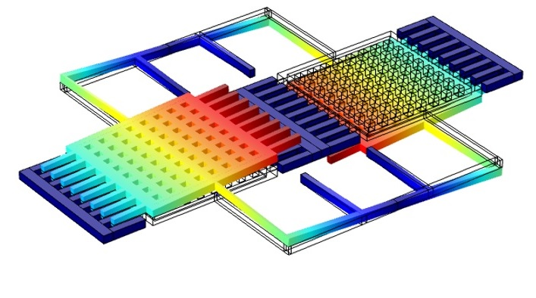
Outline
Introduction to Veryst
Challenges in MEMS Gyroscope Design & Simulation
Case Study: Draper Gyroscope
Equation Based Approach for Modeling Electrostatic Actuators
Capturing Manufacturing Defects
Other Error Sources
Conclusions

Slide 3

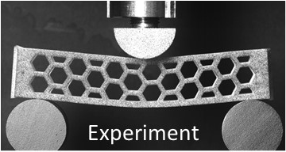
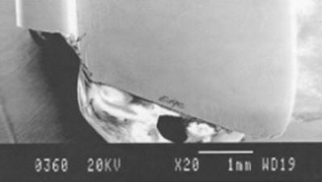
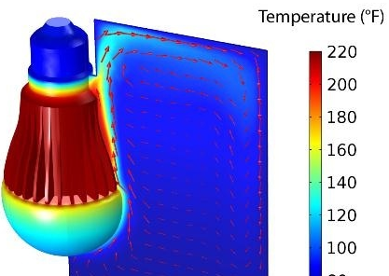
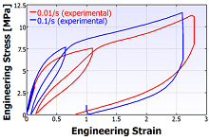
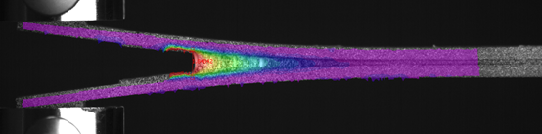
Introduction to Veryst
Introduction to Veryst
“Engineering Through the Fundamentals”
When the problem is difficult:
Multiple, nonlinear, simultaneous processes
Custom physics / special physical processes
Anisotropic, rate-or-temperature dependent, evolving materials
Impact and contact
Areas of Expertise:
Multiphysics
Polymer mechanics
Mechanical testing
Failure analysis
Microfluidics
Materials science
Adhesives
MEMS
Electromagnetics
Training classes

Slide 4
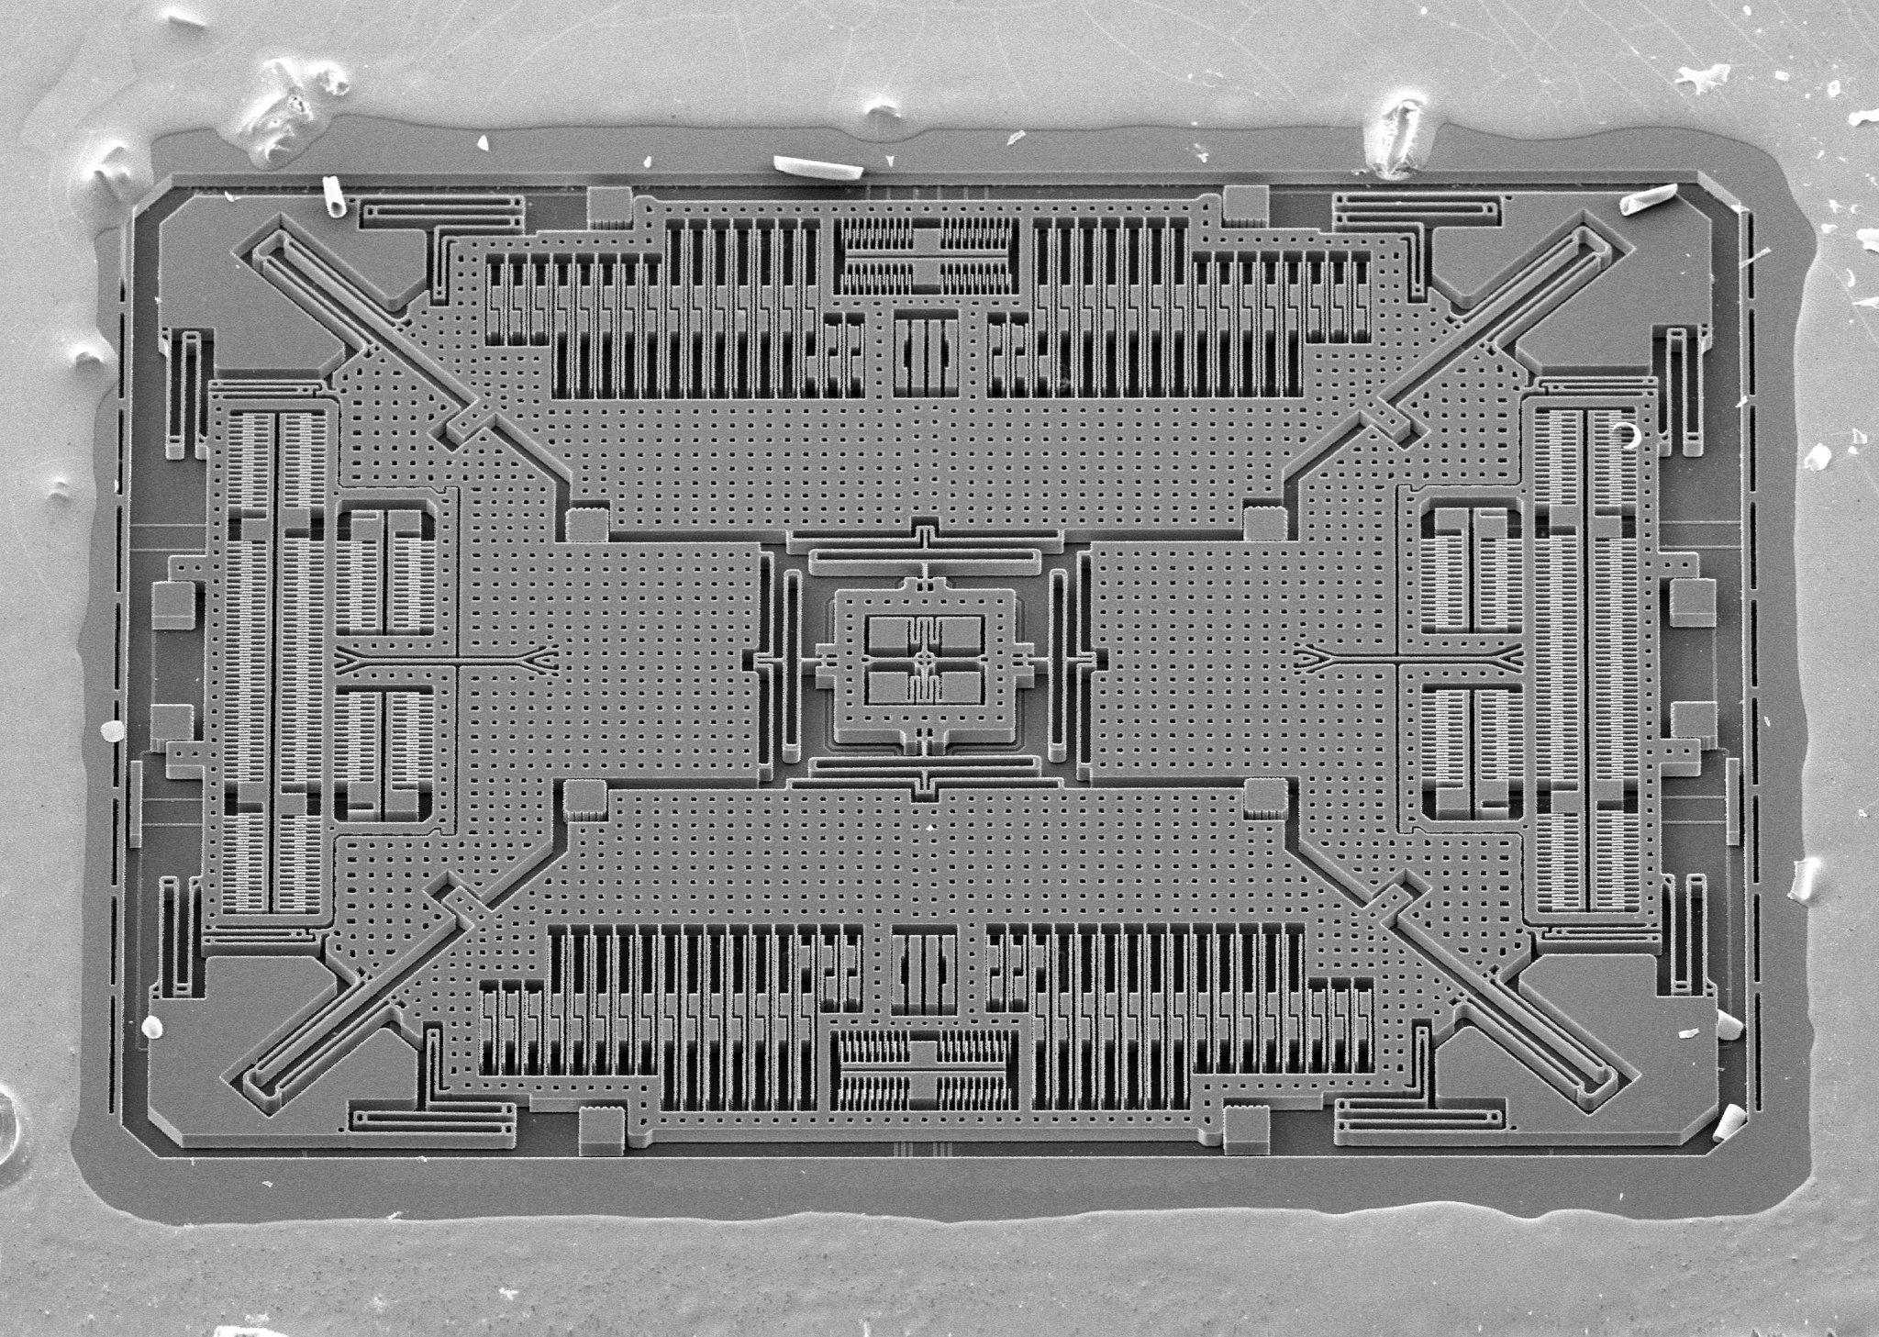
Challenges in MEMS Gyroscope Design & Simulation
Modern Gyroscopes have approximately 1000x variations in length scale – this can make modeling quite challenging
Comb drives are typically very small, and have many individual combs that are impractical to model explicitly using the electromechanics interface
Devices are differential, and typically highly optimized: very small changes in signal are important
Design for manufacture is of critical importance
SEM of an ST Microelectronics Gyroscope
Image from Adam McCombs, @nanographs, Twitter

Slide 5
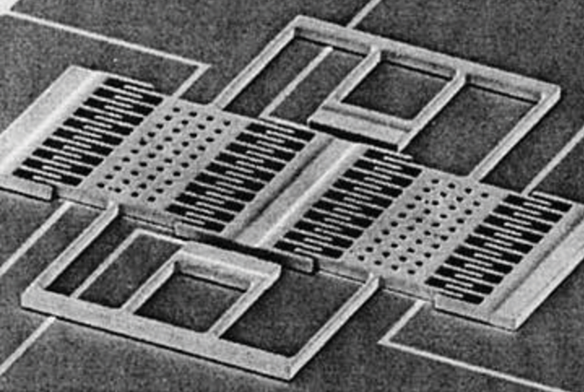
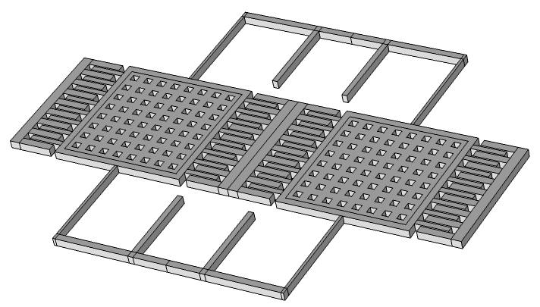
Case Study: Simple Tuning Fork Gyroscope
The figure on the right shows an SEM of a very early MEMS gyroscope, and below it a COMSOL model of a simple gyroscope use for the purposes of this case study.
This gyroscope is significantly simpler than a modern gyro, but serves as a useful case study to illustrate modeling techniques that can be applied on larger scales.
The design is a very simple, 1 axis gyroscope, that vibrates in plane
Coriolis forces induce an out of plane response – as illustrated on the next slide.
ω
Drive Mode
Sense Response

Slide 6
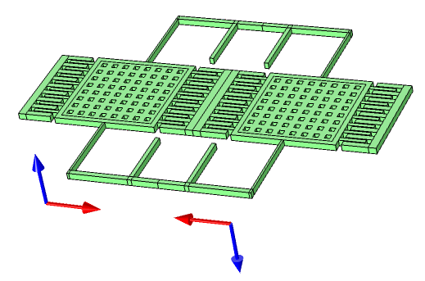
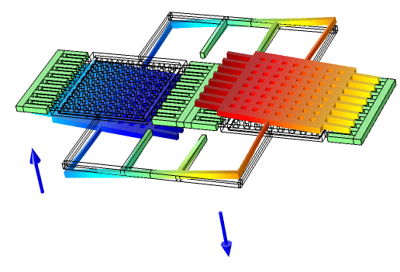




Drive and Sense Modes
The animations below visualize the gyroscope drive and sense modes and the Coriolis forces coupling the modes.
$$\dot{u}$$
$$Ω$$
$$\ddot{w}$$
$$F_{cor}∝−Ω×\dot{u}$$

Slide 7
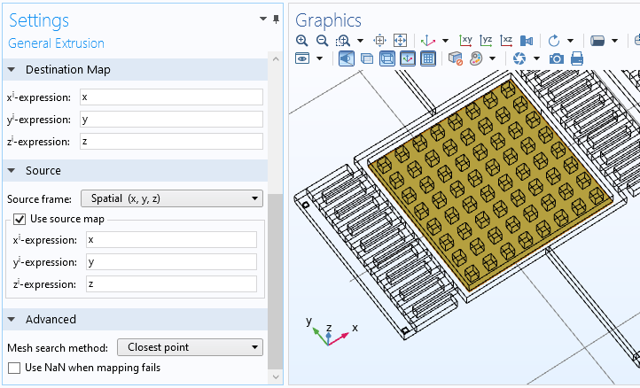
Equation Based Approach for Modeling Capacitive Actuators
The general extrusion operator with the “closest point” setting can be used to compute the distance between adjacent surfaces in COMSOL
The operator works in the spatial frame (accounts for movement), and is compatible with harmonic perturbations

Slide 8
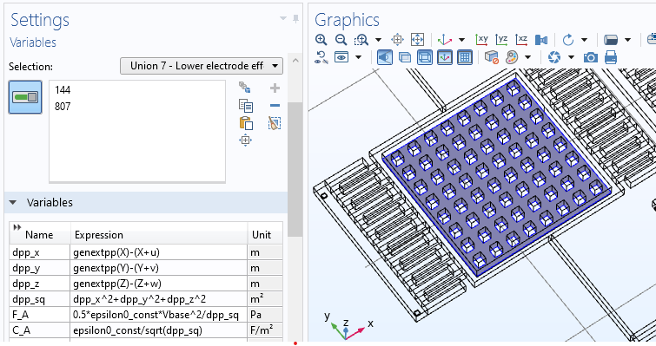

Equation Based Approach for Modeling Capacitive Actuators
The electrostatic forces are implemented as a non-linear function of the distance between the electrodes in the parallel plate electrodes and or comb drives
We use COMSOL’s perturbation machinery and the “pre-stressed” study types to linearize the problem in the frequency domain
$$F_{Az}=\frac{1}{2}\frac{∂C_{A}}{∂z}V^{2}=\frac{1}{2}\frac{ε_{0}V^{2}}{d^{2}}$$

Slide 9
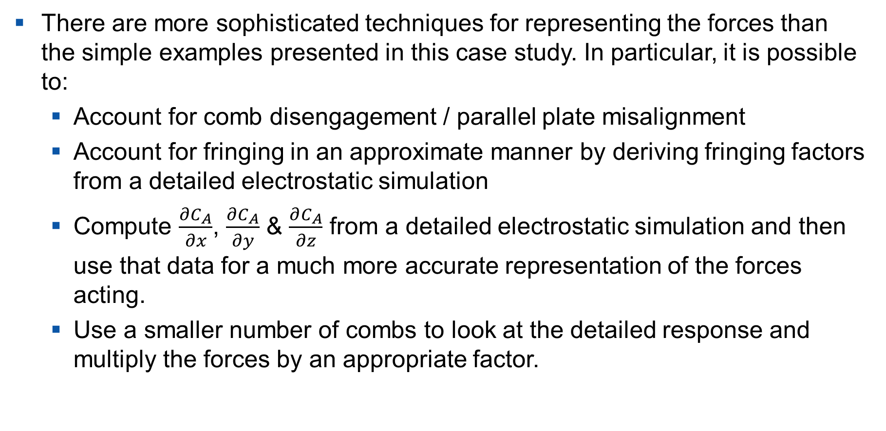
Equation Based Approach for Modeling Capacitive Actuators
There are more sophisticated techniques for representing the forces than the simple examples presented in this case study. In particular, it is possible to:
  Account for comb disengagement / parallel plate misalignment
  Account for fringing in an approximate manner by deriving fringing factors from a detailed electrostatic simulation
  Compute $\frac{∂C_{A}}{∂x}$, $\frac{∂C_{A}}{∂y}$ & $\frac{∂C_{A}}{∂z}$ from a detailed electrostatic simulation and then use that data for a much more accurate representation of the forces acting.
  Use a smaller number of combs to look at the detailed response and multiply the forces by an appropriate factor.

Slide 10
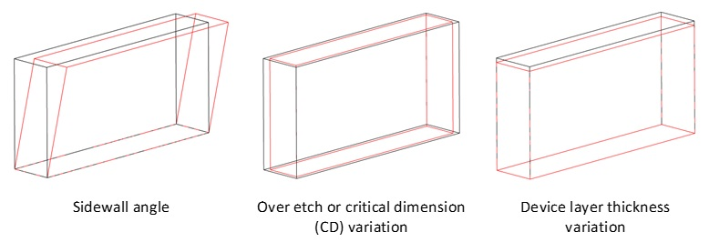
Accounting for Manufacturing Defects
MEMS device manufacturing variations (potentially with spatial variations) can be easily represented using COMSOL’s Deformed Geometry interface
The simulation can then be performed over design variations using the same mesh: enabling small differences in signals to be directly attributed to the change in the device geometry

Slide 11
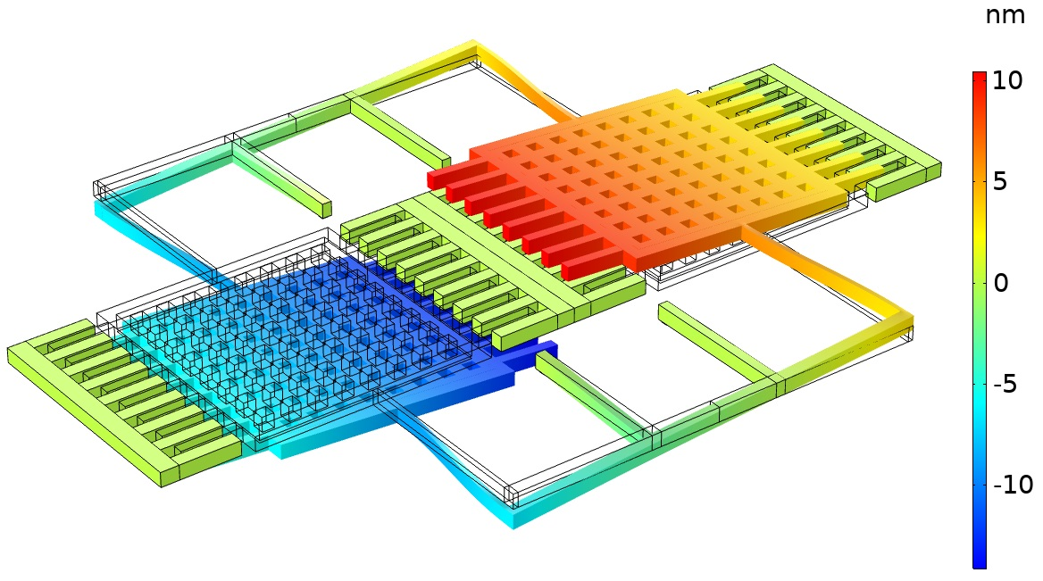
Typical Quadrature Error Induced by Sidewall
The figure on the right shows the magnitude of the out of plane motion that results from a 0.5° sidewall angle.
This is the quadrature signal, which is approximately 90° out of phase with the drive signal.
In this case the magnitude of the signal corresponds to 45,000 ° /s with a component at 90° to the drive signal of 3,900 ° /s.
This represents a constant offset which can be trimmed.
Harmonic vertical displacement magnitude due to a 0.5° sidewall angle

Slide 12
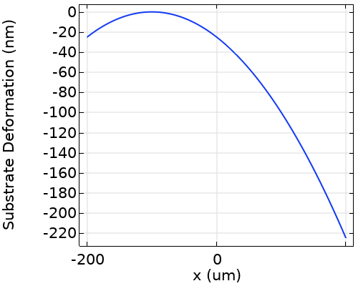
Accounting for Environmental Factors
The figure on the right shows the change in the real part of the AC displacement that occurred when the substrate is deformed cylindrically
For this simple example we consider the vertical deformation only of the anchors and the electrodes on the substrate
In a practice, such a deformation could be predicted from a package level simulation

Slide 13
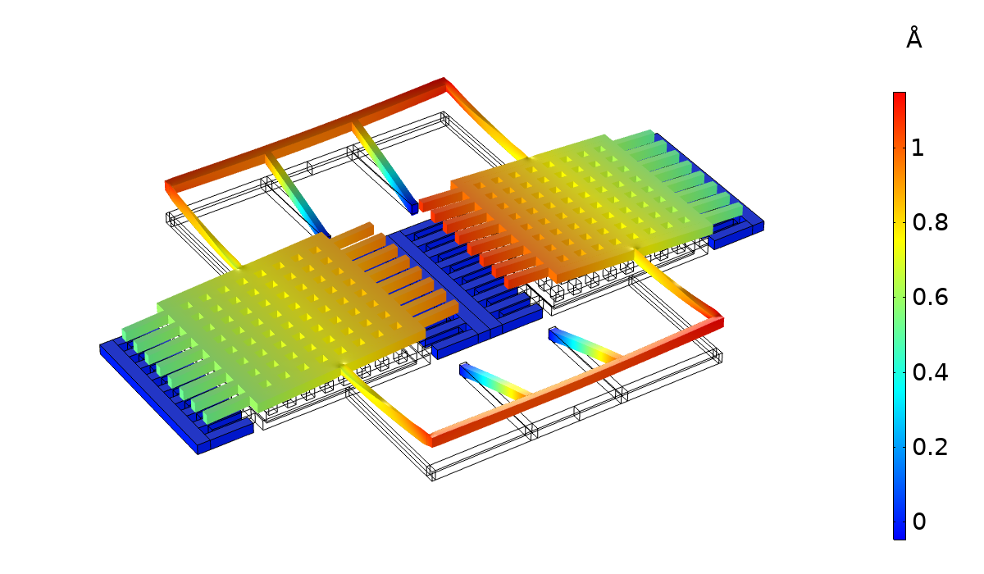

Accounting for Environmental Factors
The effect of the substrate deformation is a significant change in the measured rotation rate.
Such deformations can occur as a result of mechanical forces on the chip, or due to thermal stresses
They are difficult to calibrate for, because they typically depend on other properties of the system – such as the thermal and mechanical stresses the chip experiences during operation
$$x=0$$
Real part of harmonic vertical displacement due to substrate deformation. The relative displacement of the two proof masses is equivalent to 3.4°/s of rotation

Slide 14
Summary and Conclusions
In this simple case study, we showed various analyses of a MEMS gyroscope using COMSOL Multiphysics
COMSOL’s flexibility enables efficient & scalable implementation of electrostatic forces using equation-based modeling and accurate analysis of the changes induced by manufacturing defects or environmental disturbances
We illustrate some of the many design challenges facing designers in this field – accurate simulation is becoming increasingly important to improve modern designs
Note that we have previously automated the creation of gyroscope models to enable design verification
This example will be available in the COMSOL 5.6 MEMS Module

