Slide 1
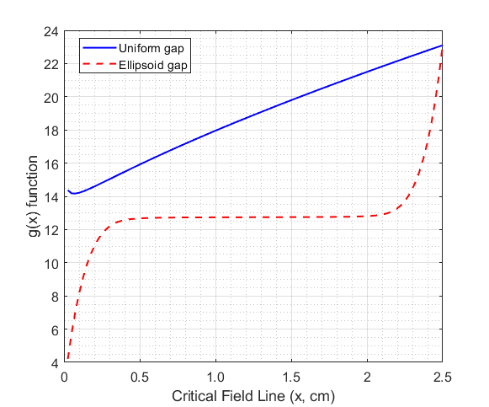
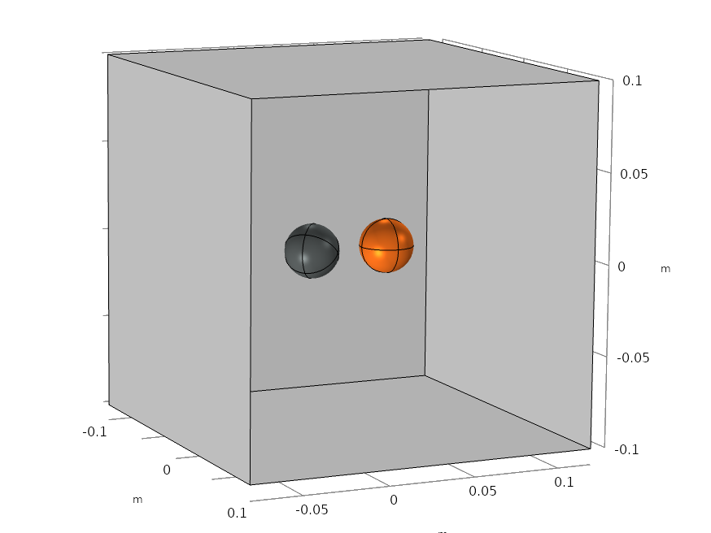
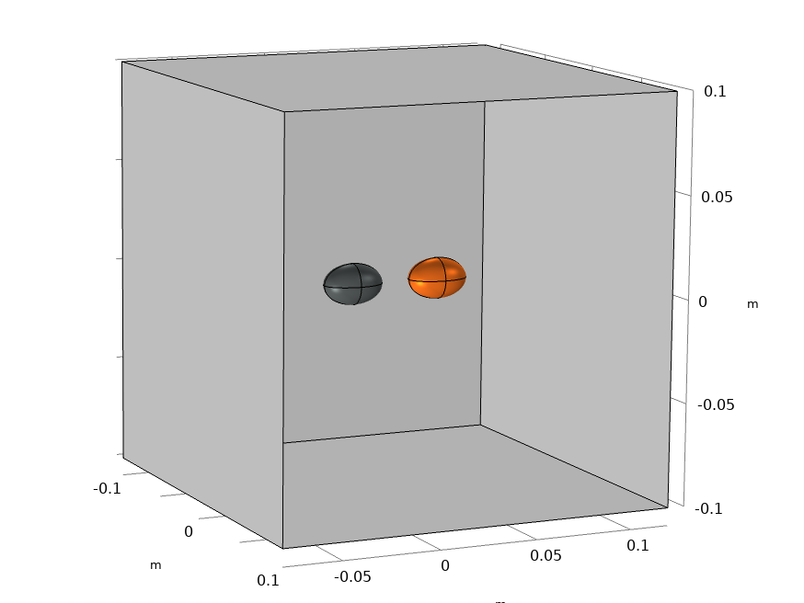
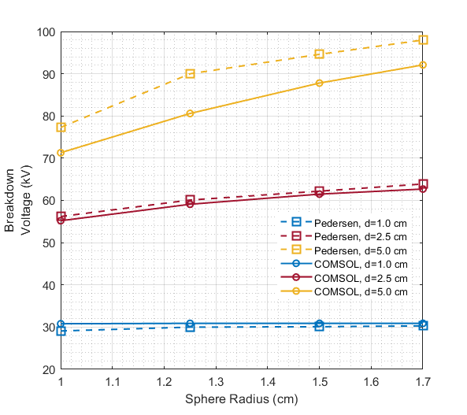
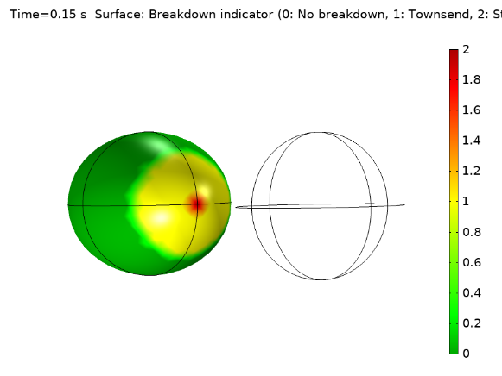
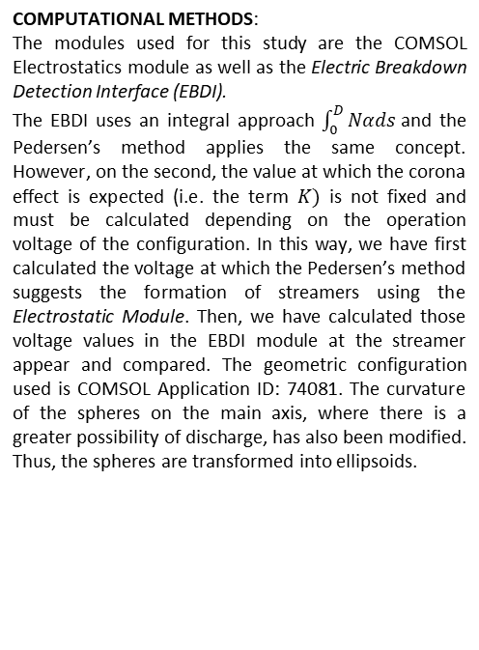
Corona Effect Prediction Methodologies
for Grounded Sphere-Sphere Configurations
M. De La Hoz¹, A. M. Larrea¹, A. Etxegarai¹, J. Mazon¹
1. Department of Electrical Engineering, University of the Basque Country UPV/EHU, Bilbao, Spain
INTRODUCTION:
This work compares the performance of the Electric Breakdown Detection Interface implemented in COMSOL 5.5 and Pedersen's method [1] implemented for the earthed sphere - sphere configuration. The effect of the selected corona effect prediction methodology is evaluated by modifying the curvature of the spheres.
Figure 4. Pedersen’s method with a=1.7 cm, d=2.5 cm and
Vapp = -49.8 kV
RESULTS: The results of the initial corona effect stress using the Pedersen’s method [1] and EBDI in different radius are shown in Fig 5. Table 1 indicates the corona inception voltages on ellipsoids with both methods.
Figure 1. Spheres and ellipses configuration. The orange element are
grounded and the grey element is the cathode
COMPUTATIONAL METHODS:
The modules used for this study are the COMSOL Electrostatics module as well as the Electric Breakdown Detection Interface (EBDI).
The EBDI uses an integral approach $\int_{0}^{D}{Nαds}$and the Pedersen’s method applies the same concept. However, on the second, the value at which the corona effect is expected (i.e. the term $K)$ is not fixed and must be calculated depending on the operation voltage ​​of the configuration. In this way, we have first calculated the voltage at which the Pedersen’s method suggests the formation of streamers using the Electrostatic Module. Then, we have calculated those voltage values ​​in the EBDI module at the streamer appear and compared. The geometric configuration used is COMSOL Application ID: 74081. The curvature of the spheres on the main axis, where there is a greater possibility of discharge, has also been modified. Thus, the spheres are transformed into ellipsoids.
Figure 5. Breakdown Voltage applying each method
(Pedersen’s and EBDI) on sphere-sphere earthed configuration
 | Semi-major axis (a)
Gap (d) | 1.25 cm | 1.50 cm | 1.70 cm
1.0 cm | -29.0/-31.5 | -28.6/-29.9 | -28.2/-30.3
2.5 cm | -53.6/-53.6 | -51.5/-51.7 | -50.0/-49.8
5.0 cm | -73.5/-68.8 | -70.0/-68.9 | -68.4/-69.3
Table 1. Inception voltage on ellipsoid – ellipsoid grounded configuration
in kV. Pedersen’s values in red (left) and EBDI in blue (right)
CONCLUSIONS: Both methods are complementary. The Pedersen's method allows estimating the voltage at which the corona effect can occur, and EBDI allows knowing what type of discharge mechanism is in operation (Townsend or Streamer). Both coincide in their predictive values ​​in slightly non-uniform electric field.
Figure 3. EBDI applied on ellipsoid with a= 1.7 cm and d=2.5 cm
at Vapp=-49.8 kV
REFERENCES:
A. Pedersen, “Calculation of Spark Breakdown or Corona Starting Voltages in Non-uniform Fields,” IEEE Trans. Power Appar. Syst., vol. PAS-86, no. 2, pp. 200–206, 1967.
Excerpt from the Proceedings of the 2020 COMSOL Conference

