Slide 1


Chemical Gradients, Carryover and Mixing in Fluidic Diagnostic Systems
Matthew J. Hancock, Ph.D. Andrew P. Spann, Ph.D. Andrew M. Fiore, Ph.D.
mhancock@veryst.com
Veryst Engineering, LLC
COMSOL is a registered trademark of COMSOL AB.
Notes:
This is Matthew Hancock from Veryst Engineering. Today I’ll talk about simulating oxygen transport and cellular uptake in a microphysiological system.

Slide 2
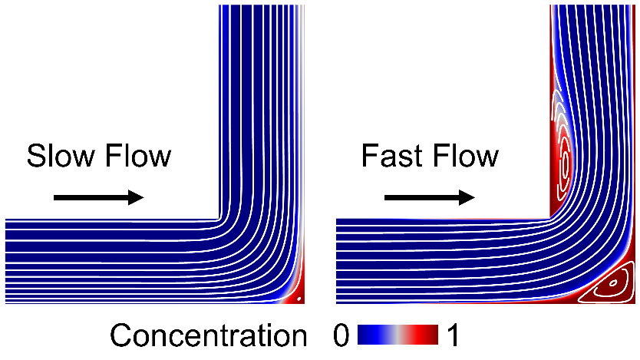
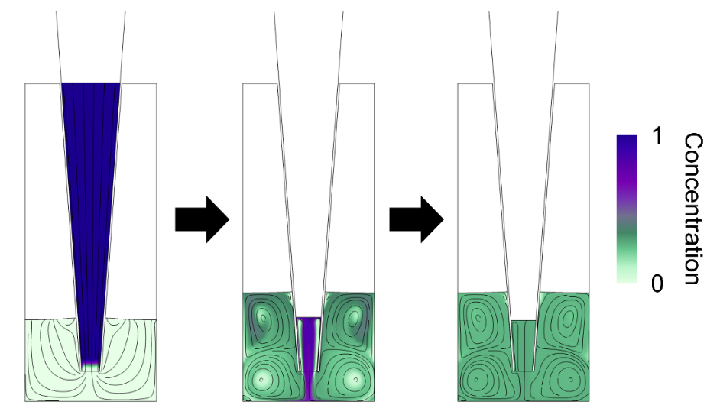
Simulating Fluidic Diagnostic Systems
Modeling fluidic diagnostic systems requires setting up a multiphysics system with the following components:
Physics of fluid flow
Chemical concentration gradients
Heat transfer, if applicable
Problems with interfaces/wetting/bubbles
We discuss three simulation examples relevant to fluidic diagnostic systems:
Chemical concentration gradients
Chemical carryover (cleaning between runs)
Mixing in a microwell
Carryover
Mixing

Slide 3
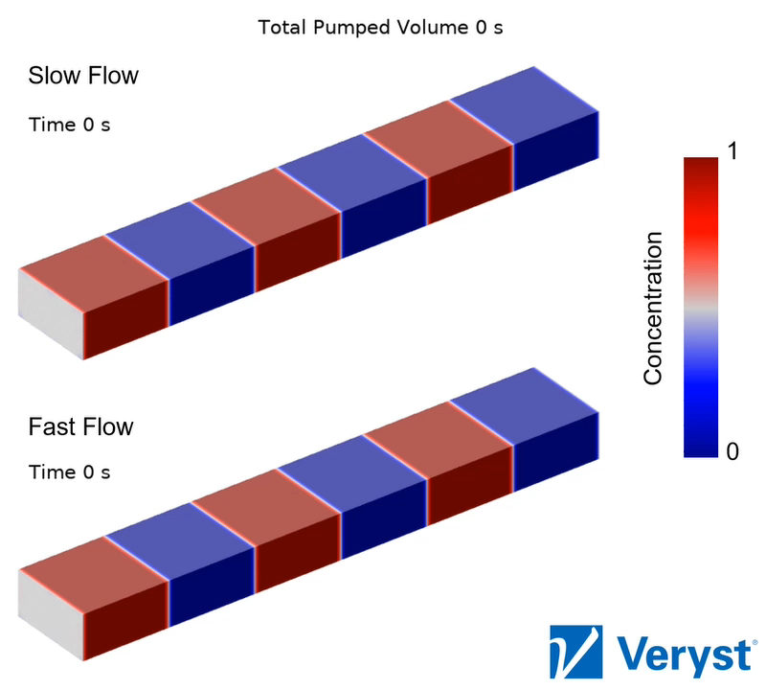
Concentration Gradients
Flowing successive segments of different solutions through a microchannel results in reagent dispersion and concentration gradients between solution segments.
Dispersion and gradient growth are characterized by the Peclet number which equals flow speed times channel height divided by molecular diffusivity. Gradient length increases with the Peclet number, and flow rate.
Simulations allow us to estimate the degree of dispersion and gradient generation and tune operating parameters (e.g. flow rate) to either mitigate or enhance the process.
More info: https://www.veryst.com/case-studies/concentration-gradients-microfluidic-devices

Slide 4
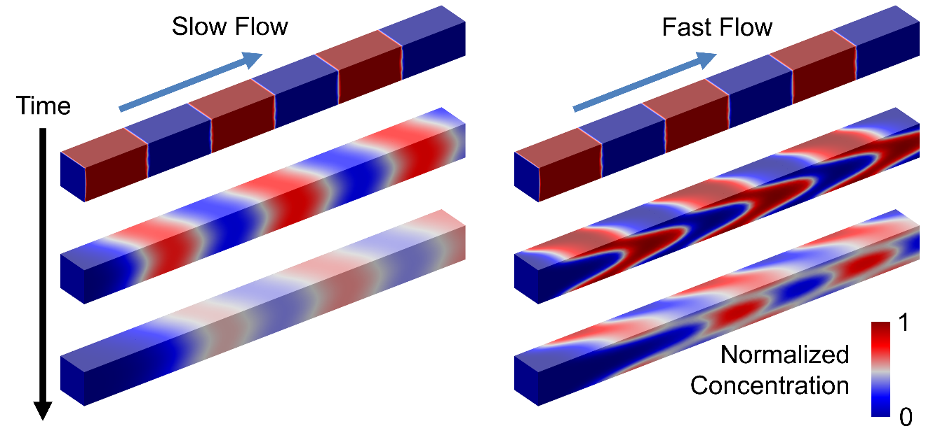
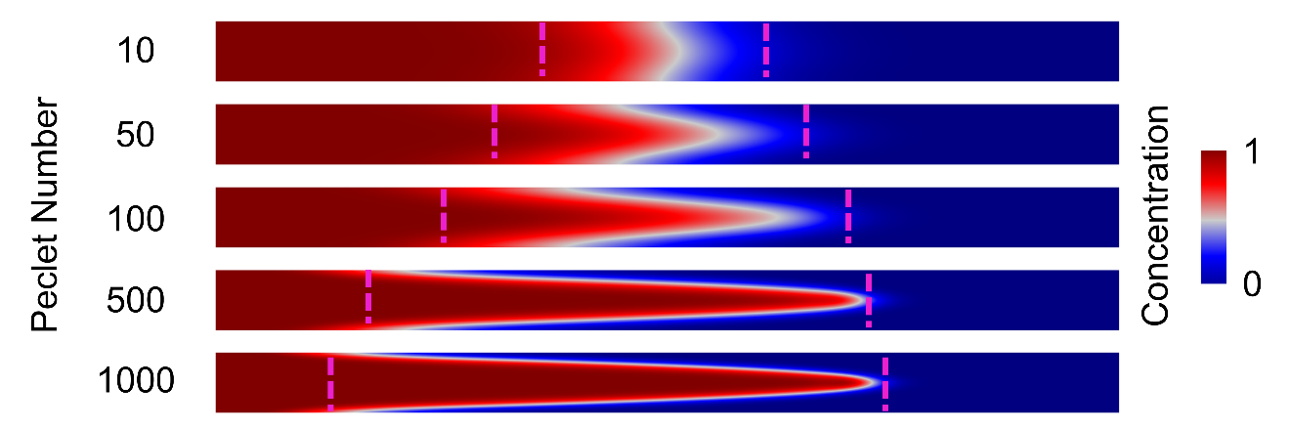
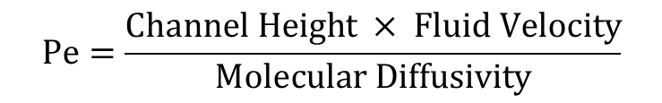
Concentration Profile in Response to Flow
Stretching of chemical concentration profiles shown in a vertical cross-section of a microchannel for different Peclet numbers.
Here, the Peclet number is modified by pumping the same fluid volume (50% of channel volume) at different speeds through the channel.
Dashed magenta lines indicate 5% and 95% vertically averaged concentrations delineating the concentration gradient.
$$\text{Pe}=\frac{\text{Channel} \text{Height} × \text{Fluid} \text{Velocity}}{\text{Molecular} \text{Diffusivity}}$$

Slide 5
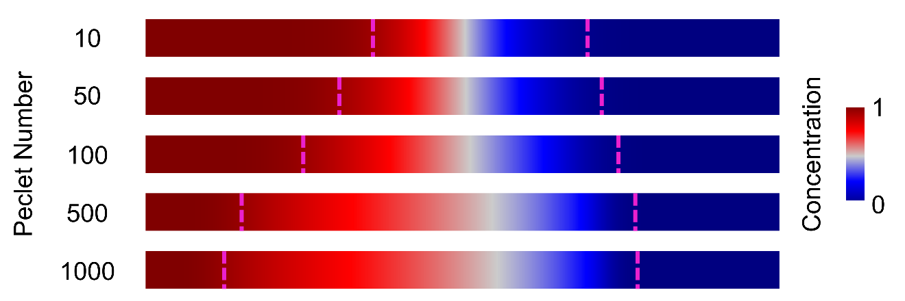
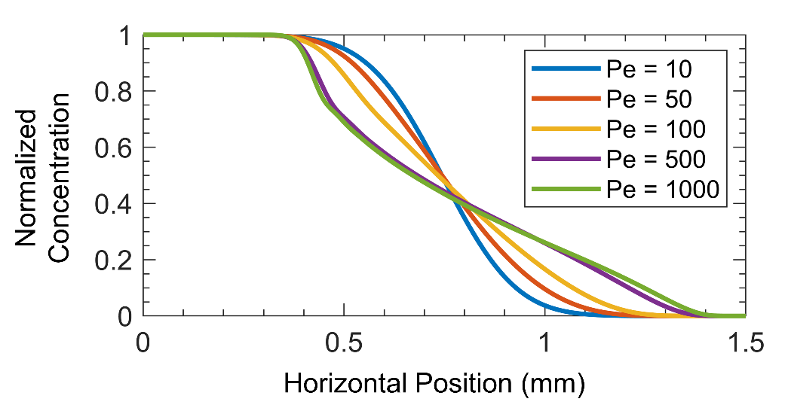
Stopping Flow and Allowing Vertical Concentration Equilibration
Concentration profiles shown here after molecular diffusion vertically equilibrates the concentration profiles.
Dashed magenta lines indicate 5% and 95% vertically averaged concentrations delineating the concentration gradient, whose length increases with increasing Peclet number.
Concentration profiles vs. horizontal position show how concentration gradient length increases with Peclet number.
$$\text{Pe}=\frac{\text{Channel} \text{Height} × \text{Fluid} \text{Velocity}}{\text{Molecular} \text{Diffusivity}}$$

Slide 6
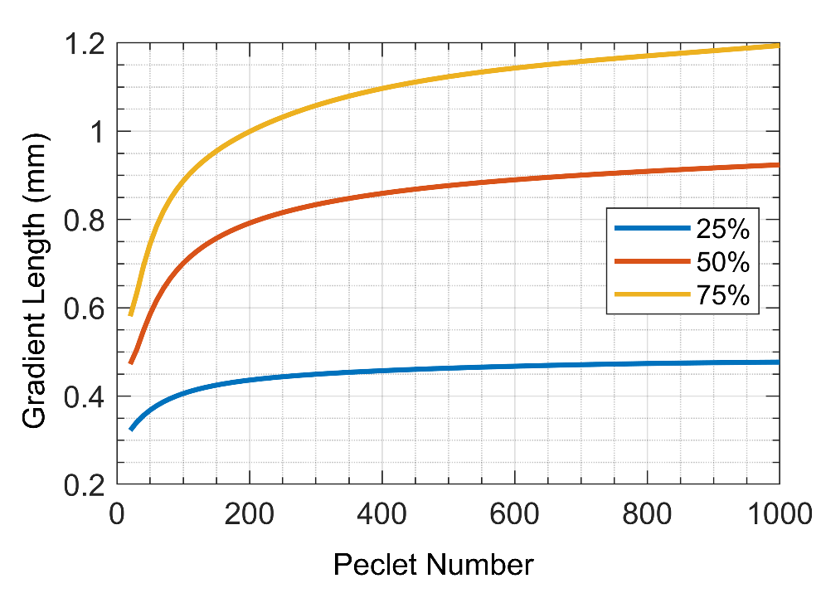
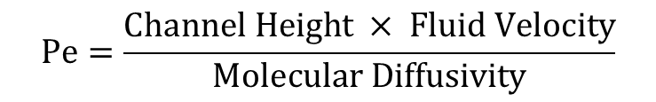
Concentration Gradient Length vs. Peclet Number
Flow speed is a useful lever to modify desired gradient length in microchannels.
Gradient length (distance between 5% and 95% concentrations) vs. Peclet number is plotted at right. Each curve corresponds to same fluid volume (as % of channel volume) pumped into the channel at different speeds.
Simulations allow us to estimate the degree of dispersion and gradient generation and to tune operating parameters (e.g. flow rate) to either mitigate or enhance this process.
% channel volume pumped into channel
$$\text{Pe}=\frac{\text{Channel} \text{Height} × \text{Fluid} \text{Velocity}}{\text{Molecular} \text{Diffusivity}}$$

Slide 7
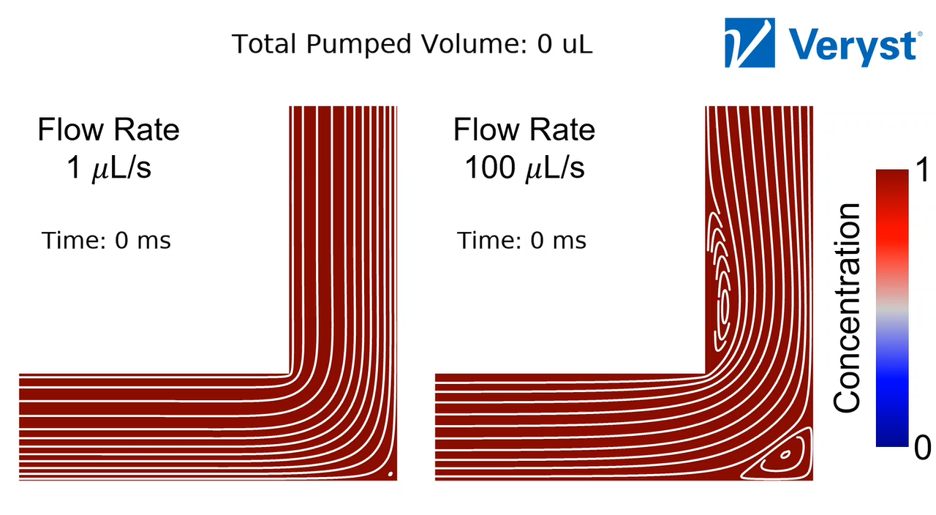
Chemical Carryover
When successive reagent solutions are pumped through a device, simulations can help optimize the wash cycle between solutions or runs.
In straight channels, chemical removal improves by increasing wash buffer volume and flow time.
In corners, recirculation zones develop and increase in size as the flow rate and Reynolds number increase.
Simulations allow us to optimize the wash strategy based on channel geometry and tradeoffs between operating time and wash buffer volume.
Carryover concentration relative to initial (color) and flow field streamlines (white) in a corner, for low and high wash buffer flow rates.
More info https://www.veryst.com/case-studies/chemical-carryover-microfluidic-devices

Slide 8
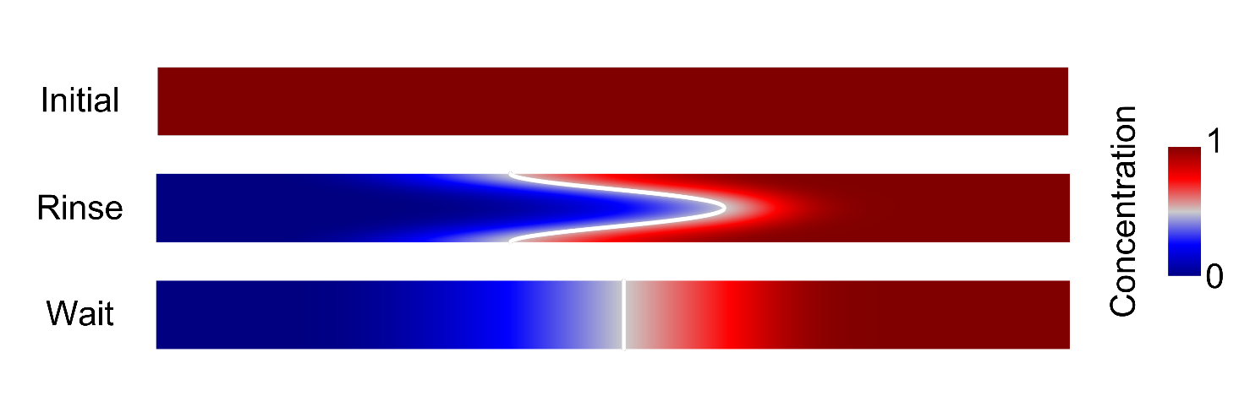
Chemical Carryover in a Straight Channel
To remove reagent (red) solution from a straight microchannel, wash buffer (blue) is introduced at the left inlet, flushing out reagent and creating a vertically and horizontally varying chemical concentration profile.
Vertical concentration gradients equilibrate after a few seconds of chemical diffusion.
Note: channel extends much farther than pictured (full length 7 cm, actual aspect ratio 700:1)
Flow
0.1 mm

Slide 9
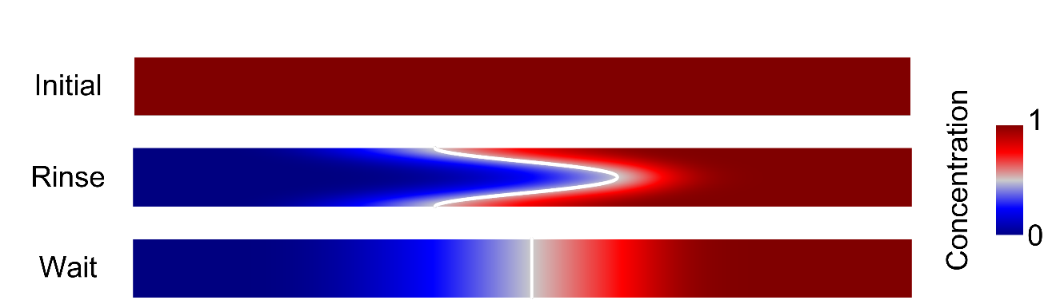
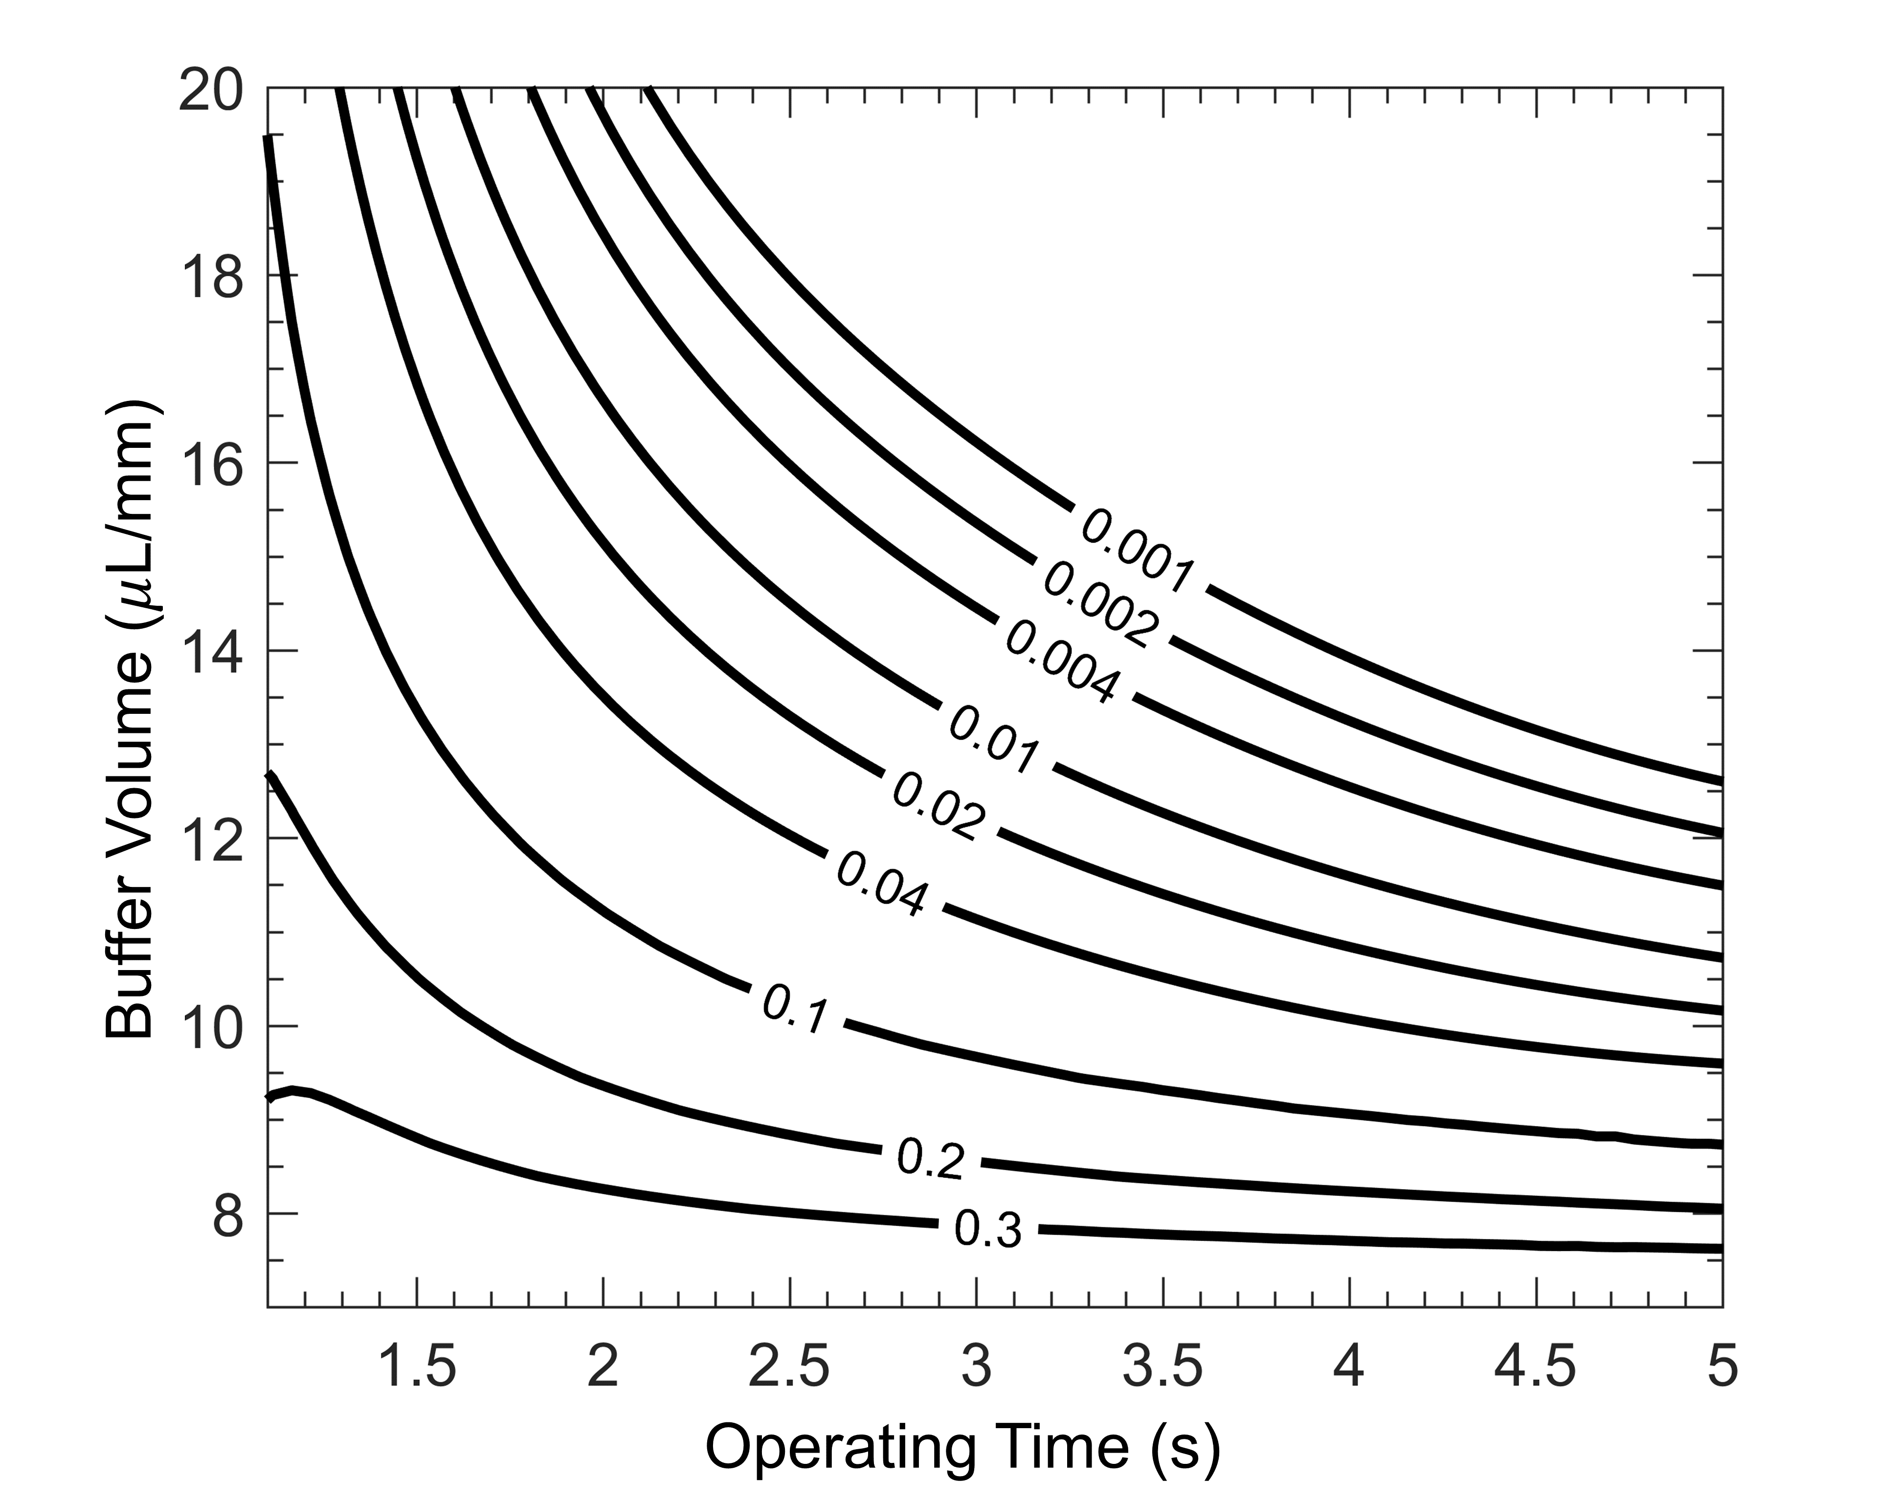
Tradeoffs in Clear Time and Buffer Volume
To remove more reagent (red), one can either pump more buffer (blue) through system or pump the same buffer volume at a slower rate to allow diffusion to smooth out the profile generated by the parabolic flow.
Tradeoff between wash buffer volume and operating time visualized by contour plot of maximum remaining reagent concentration relative to initial concentration.
Simulations and data visualization are helpful tools for tradeoff discussions and performance optimization.
Channel extends farther than pictured
Maximum remaining concentration
Use more buffer
Channel volume 7 μL per mm (into page)
Slower Flow

Slide 10
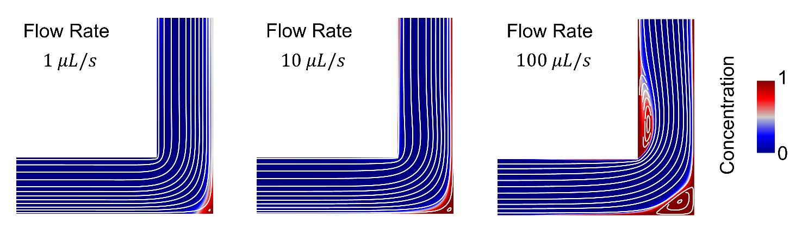
Carryover in a Corner
Leftover reagent concentration (i.e. carryover) relative to initial concentration (color) and flow field streamlines (white) for three different flow rates in a corner. In each case, the same buffer volume is pumped through the channel.
Recirculation zones develop in and near the corner, which can trap previous reagents. Said zones increase in size as the flow rate and Reynolds number increase.
0.1 mm
0.6 mm
Channel width 1 mm (into page), channel volume 0.06 μL per mm (into page)

Slide 11
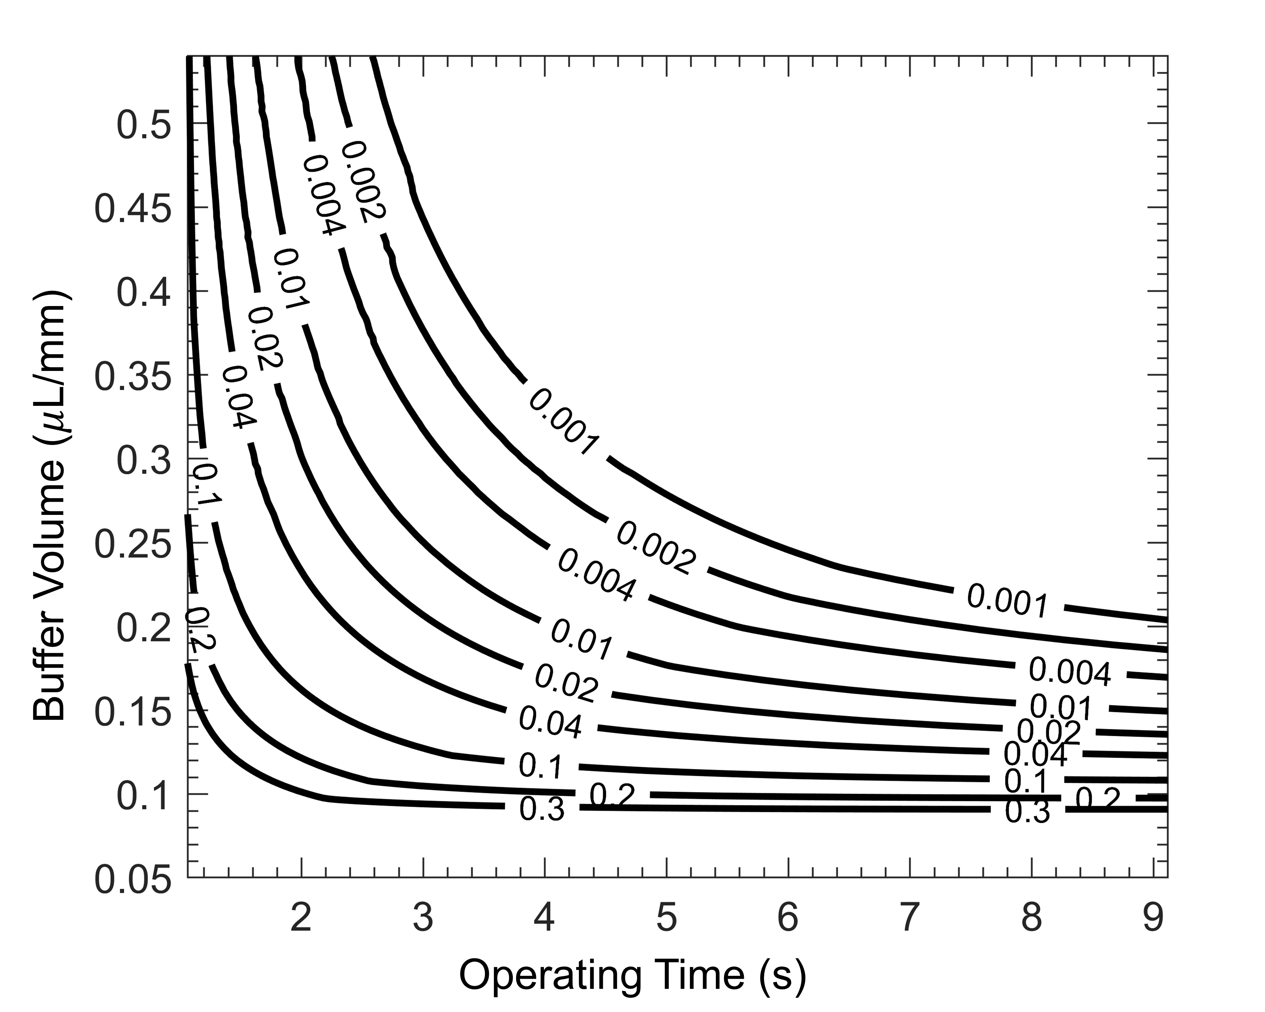
Tradeoffs for Carryover in a Corner
Similar to a straight channel, there is a tradeoff between wash buffer volume and operating time, visualized by the contour plot of maximum remaining reagent concentration. Recirculation in and near the corner modifies this tradeoff (quantitatively) compared to a straight channel.
Simulations allow us to optimize the wash strategy based on channel geometry and assess tradeoffs.
Maximum remaining concentration
Use more buffer
Slower Flow

Slide 12
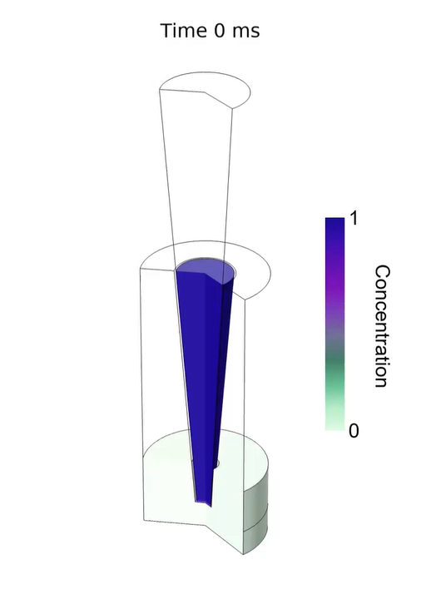
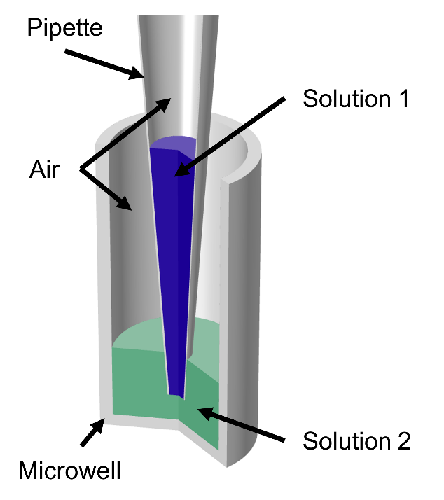
Mixing in a Microwell by Repetitive Pipetting
We study the mixing of two solutions by repeatedly moving fluid up and down in a pipette.
This is an advection-diffusion problem involving moving interfaces and chemical gradients.
A pipette containing 20 μL of a reagent is mixed into 60 μL of water in a microwell.
Animation: The first 1.5 seconds of mixing using a fast flow rate (200 μL/s) and large cycled volume (55 μL).
Concentrations are normalized by the initial concentration in the pipette.
https://www.veryst.com/case-studies/active-mixing-microwell-repetitive-pipetting

Slide 13
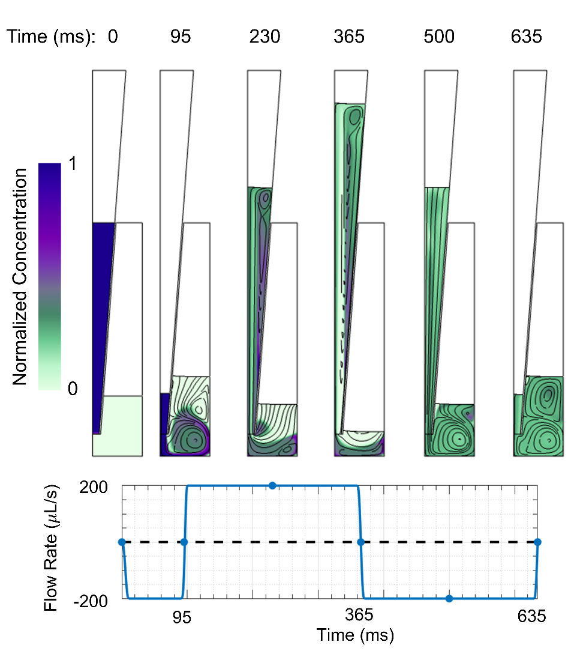
Snapshots of a Mixing Cycle
Reagent concentration (color) normalized by initial concentration and streamlines (black lines) at different times within the first mixing cycle for a mixing protocol with fast flow rate (200 µL/s) and large cycled volume (55 µL).
Flow rate profile is shown at bottom with time points corresponding to images above.
Pull Fluid
Push Fluid
https://www.veryst.com/case-studies/active-mixing-microwell-repetitive-pipetting
Initial Injection

Slide 14
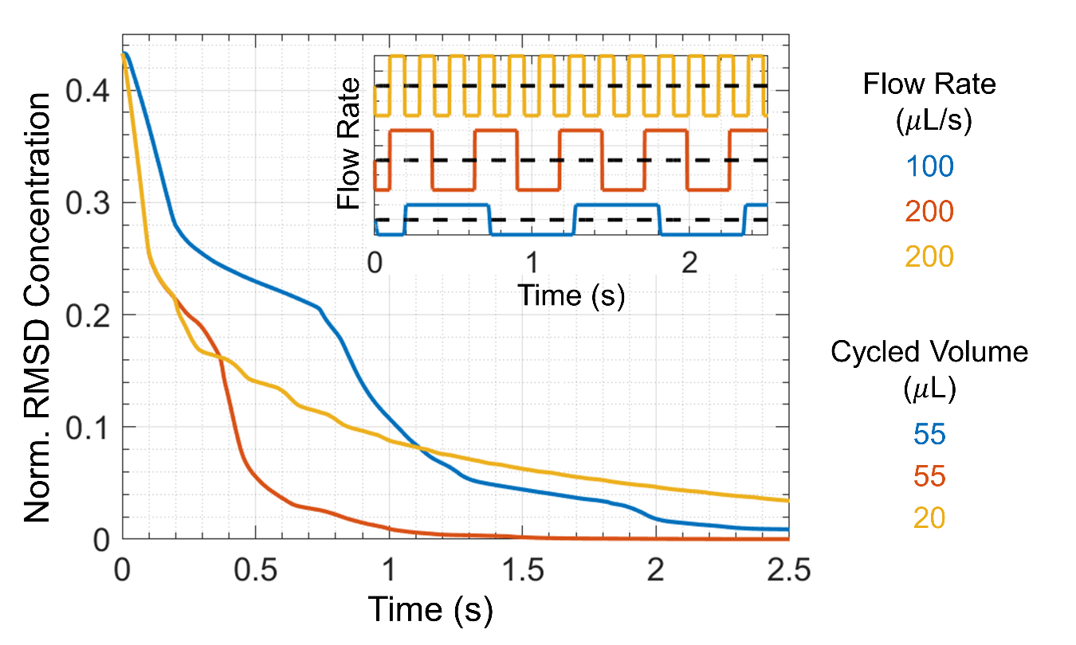
Effect of Flow Rate and Cycled Volume
Root-mean-square deviation (RMSD) of reagent concentration normalized by initial pipette concentration vs. time for multiple cycles of three mixing protocols.
The inset shows the flow rate profile associated with each RMSD curve.
Comparing the three mixing strategies:
Increasing flow velocity improves mixing for the same cycled volume.
Pulsing short, small-volume cycles is not an effective mixing strategy.
Long, slow cycles
Short, fast pulses
High volume and high speed
https://www.veryst.com/case-studies/active-mixing-microwell-repetitive-pipetting

Slide 15
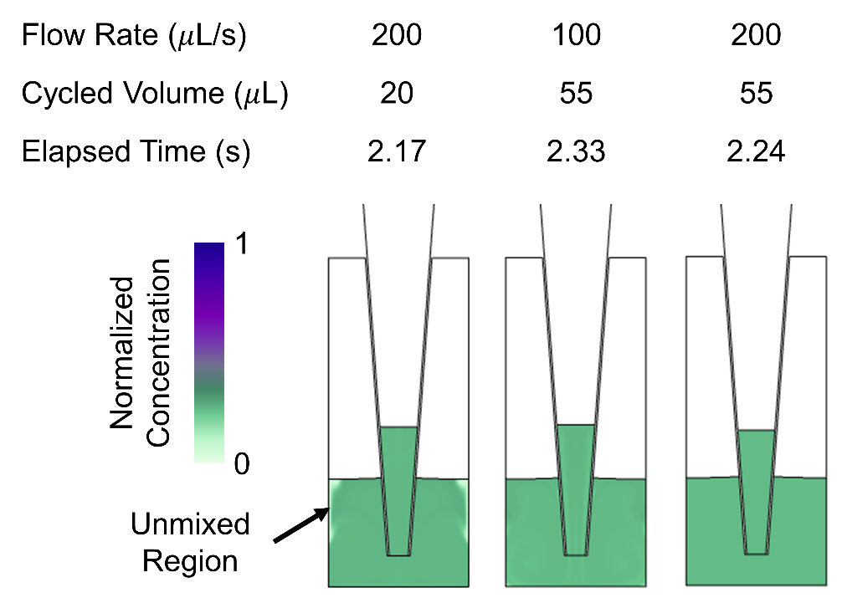

Effect of Flow Rate and Cycled Volume
To visualize the differences in mixing for different flow rates and cycled volumes, we show snapshots at right of reagent concentration normalized by initial pipette concentration after similar elapsed times.
Unmixed regions are noticeable in the leftmost snapshot and a jet-shaped distortion can be seen in the middle snapshot in the full resolution image.
RMSD concentration plot offers a more accurate comparison, showing the quantitative differences.
In general, outer edges and top surface of fluid in microwell are the least mixed.
https://www.veryst.com/case-studies/active-mixing-microwell-repetitive-pipetting

Slide 16
Conclusions
Simulations allow us to better understand, control, and optimize processes relevant to fluidic diagnostic systems.
Chemical concentration gradients: simulations estimate gradient growth and can tune operating parameters (e.g. flow rate) to either mitigate or enhance said process.
Chemical carryover: simulations allow us to optimize the wash strategy based on channel geometry and assess tradeoffs between wash buffer volume and operating time.
Mixing: COMSOL gracefully handles moving interface, laminar flow, and species transport, and shows that optimal mixing occurs when the largest volumes of fluid are moved with the highest velocity.
Carryover
Mixing

