Slide 1
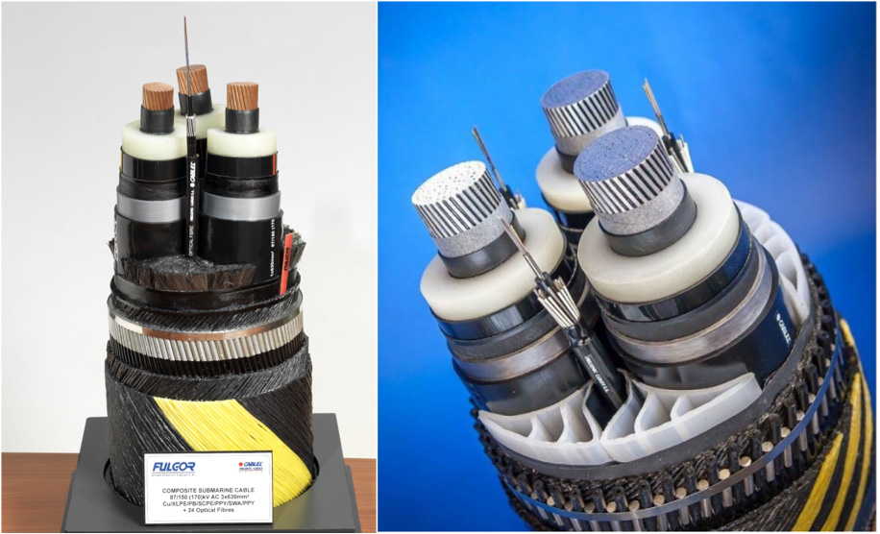
HELLENIC CABLES
Designing Subsea Cables for Offshore Wind Farms
Offshore wind (OFW) is a rapidly advancing source of power, with turbine networks being built further out to sea
  Subsea and underground cables connect these networks
  Cable designers have to ensure that designs will perform as intended in undersea conditions
Electric cables are complex devices to model
  However, recent computational advancements have made it possible to conduct high-fidelity cable analyses with finite element modeling
“Powering Offshore Wind Farms with Numerical Modeling of Subsea Cables”
Andreas Chrysochos and Dimitrios Chatzipetros, Hellenic Cables, Greece
Three-core submarine cables available from Hellenic Cables

Slide 2
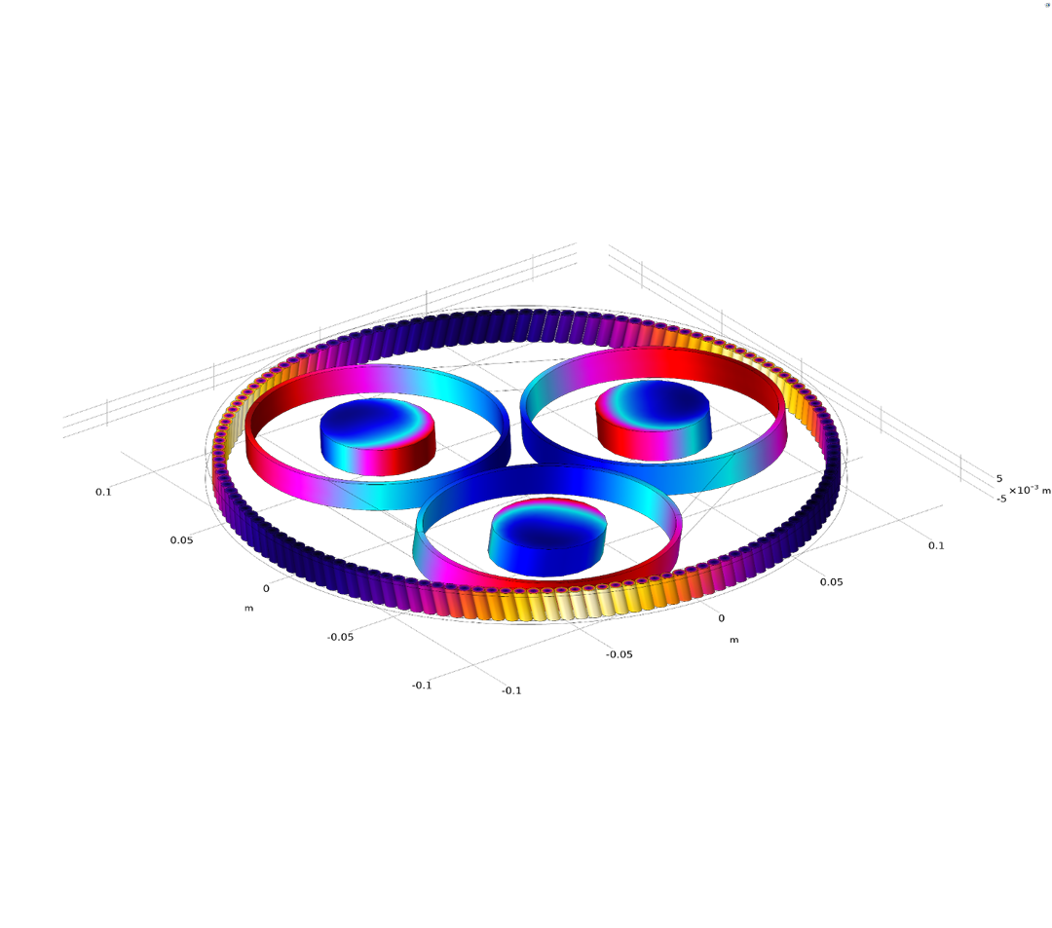
HELLENIC CABLES
Designing Subsea Cables for Offshore Wind Farms
The Hellenic Cables team turned to electromagnetics simulation to study different properties of a subsea cable:
  Electromagnetic interference
  Losses
  Thermal resistance of soil
  Grounding resistance
Validated results of numerical analysis against other techniques, experimental findings, and current standards
“Powering Offshore Wind Farms with Numerical Modeling of Subsea Cables”
Andreas Chrysochos and Dimitrios Chatzipetros, Hellenic Cables, Greece
A short-twisted cable model

